Slide 1

OSEP Disclaimer
2018 OSEP Project Directors’ Conference
DISCLAIMER:
The contents of this presentation were developed by the presenters for the 2018 Project Directors’ Conference. However, these contents do not necessarily represent the policy of the Department of Education, and you should not assume endorsement by the Federal Government.
(Authority: 20 U.S.C. 1221e-3 and 3474)

Slide 2
Equipping and Empowering Families for Leadership
Moderated by: Laura Weber
Presenters: Courtney Salzer, Stephanie Moss, Teresa Peña

Slide 3
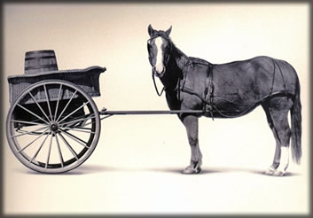
Engaging Families
Before we think about “how” to empower families, we must
consider “why” we should empower families.

Slide 4

Serving on Groups That Make Decisions: A Guide for Families
Opportunities to Get Involved
Types of Groups
Processes Groups Use
Tools Groups Use
Tips & Strategies for Groups
Understanding Data as Information
The Role of Families on Groups
Skills for Serving on Groups
Glossary of Common Terms
www.servingongroups.org

Slide 5
Serving on Groups Data (since 2013)
92% of training participants currently serving on a decision-making group
85% of training participants reported the training was effective at increasing their leadership skills
93% of training participants reported feeling ‘Very Confident’ or ‘Confident’ to participate productively in a decision-making group/s after taking the training

Slide 6

Leading By Convening: A Blueprint for Authentic Engagement
Authentic Engagement
Coalescing Around Issues
Ensuring Relevant Participation
Doing the Work Together
Brining It All Together
http://www.ideapartnership.org/building-connections/the-partnership-way.html
https://ncsi.wested.org/resources/leading-by-convening/

Slide 7
Courtney Salzer
Executive Director, WI FACETS
Director, Region 4 Parent Technical Assistance Center (PTAC)
csalzer@wifacets.org
1-414-374-4645

Slide 8

“Equipping and Empowering Families for Leadership”
The Exceptional Children’s Assistance Center
North Carolina’s PTI

Slide 9
PTI in our Outreach Program
One on one Assistance.
Workshops.
Parent Institutes.
  Special Education.
  Understanding and Resolving Disagreements with School.
Parents as Collaborative Leaders.
Capacity Building in Leadership Roles.
Technical Support to Local Parent Support Groups.
Connecting Parents with Local Community Leaders and Resources.

Slide 10

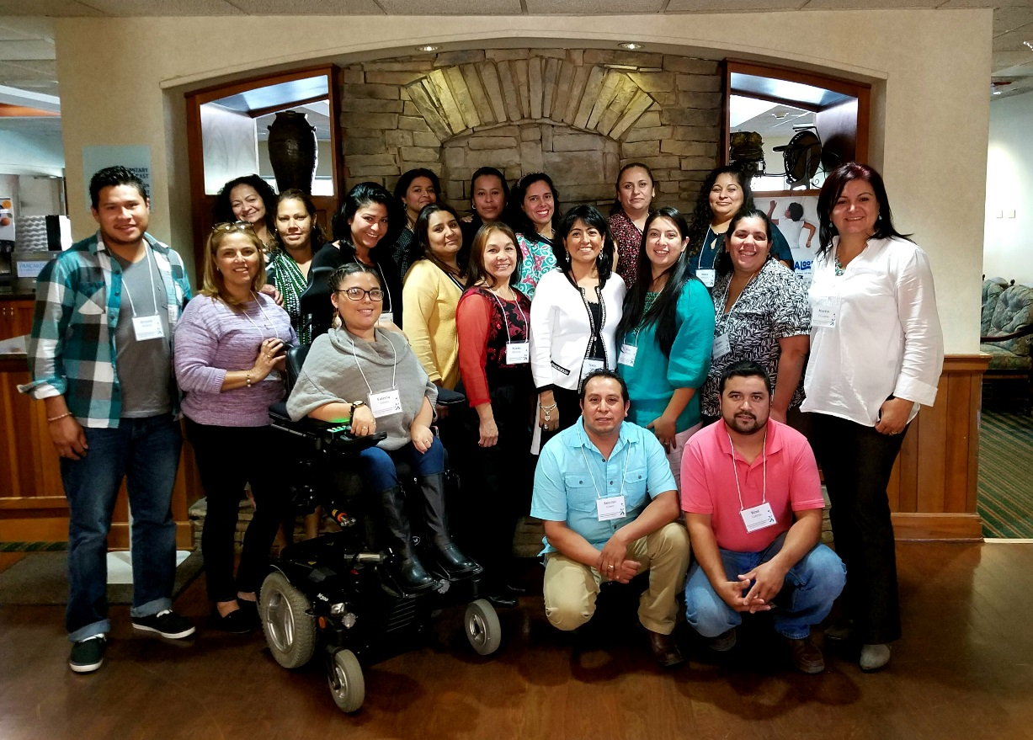
Parents as Collaborative Leaders

Slide 11
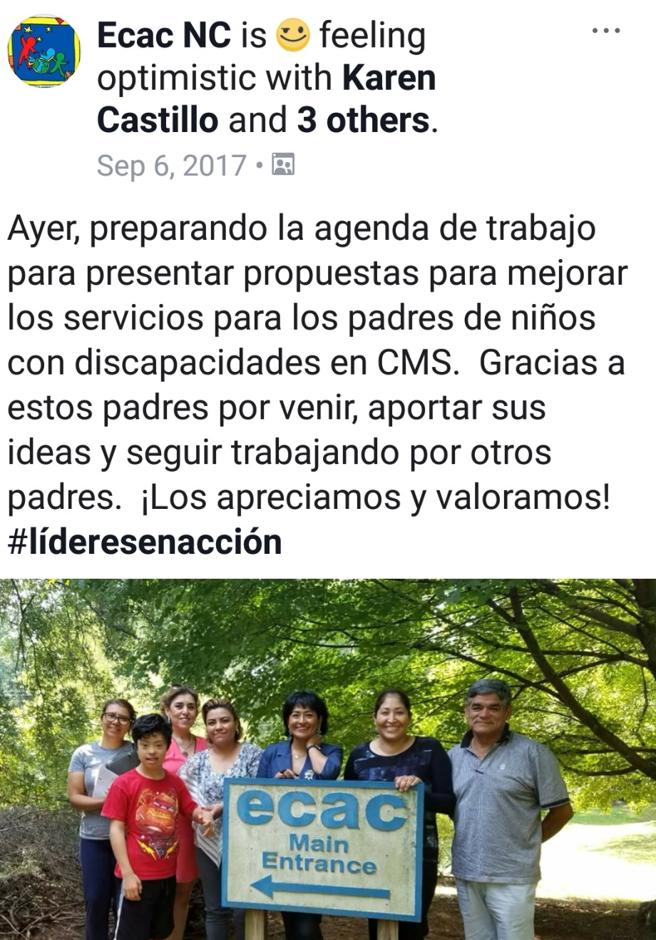
How ECAC support and Empower Parents Leaders?
Help start local parent support groups.
Connect leaders with local organizations.
Technical assistance.
Teach parents to effectively communicate in their leadership roles.
Keeps the leaders engage in conversations and topics that affect their communities.
Keep looking for new leaders to train and renew roles in local communities.

Slide 12
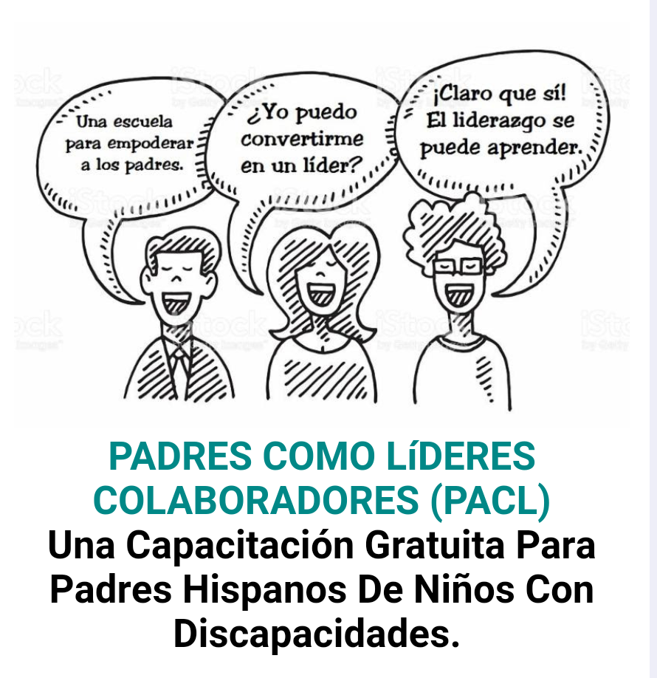
Barriers
Lack of understanding for “How the system works”
Language
Legal status or lack of documentation
Finances

Slide 13
Engaging Families of Young Children as Emerging Leaders

Slide 14
Family Leaders
Begin locally with their own child and family
With capacity-building and learning opportunities, can transform into advocacy on behalf of all young children with disabilities and their families

Slide 15
Families of Young Children
Need to process the fact that their child has a disability and what that means for their family
Need to learn about the disability movement and how that influences what is available for their child and family
Need to connect with other families of children with disabilities and adults with disabilities
Sustaining Family Involvement in Part C Policy and Services (Zero to Three, March 2011)

Slide 16
What Do Family Leaders Need?
Encouragement
Support
Training/Knowledge and Skill Development
Coaching
Mentoring
Follow-Up Support
Source: National Center for Deaf Blindness Family Leadership Project

Slide 17
Challenges? Or Strategies and Solutions?
  Personal: An opinion, quality, and/or situation that relates to a particular individual rather than to other people.
  Philosophical: An attitude, belief, or presupposition about a situation and/or relationship.
  Knowledge: Awareness or understanding of processes, strategies, technologies, and/or best practices.

Slide 18
Practical Tips & Strategies for Engaging Emerging Family Leaders
Schedule meetings, events at times of day that work for families
Pay for child care, transportation
Allow them to bring their children
Stipends for participation
Offer a variety of opportunities for participation (not just one way, one time, one format)
Coaching, mentoring, a “buddy”, family-to-family networking

Slide 19
Practical Tips & Strategies for Engaging Emerging Family Leaders (continued)
Orientation and preparation prior to meetings
ALWAYS provide information in the parent’s preferred language
Let them know how you will use their ideas, feedback, input
Bring in new families
High expectations for their children (no “horror” stories)

Slide 20
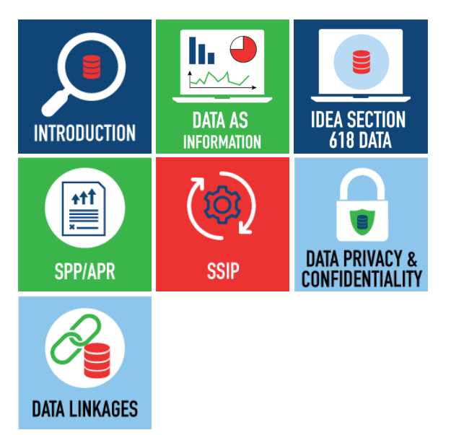

Online Toolkit:
Building Stakeholder Knowledge About Data
This toolkit provides stakeholders with an orientation to IDEA data and other data-related topics to help them meaningfully participate in conversations about important programmatic issues and decisions.
https://dasycenter.org/building-stakeholder-knowledge-toolkit/

Slide 21
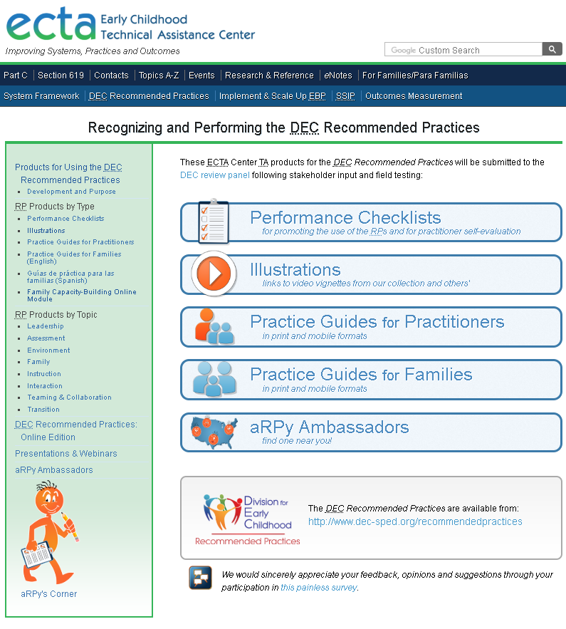
DEC Recommended
Practices
Find products to promote the use of the Recommended Practices at:
http://ectacenter.org/decrp/

Slide 22

DEC Recommended Practices (RPs)
Offer guidance to families and practitioners about the most effective ways to improve outcomes and promote the development of young children who have or are at risk for developmental delays or disabilities.
8 topic areas:
  Leadership
  Assessment
  Environment
  Family
  Instruction
  Interaction
  Teaming and Collaboration
  Transition
Source: DEC Recommended Practices

Slide 23
DEC RPs: Family Practices
On-going activities that: 1) promote the active participation of families in decision-making related to their children; 2) lead to the developmental of a service plan; or 3) support families in achieving the goals they hold for their children and the other family members.
Three themes:
  Family-centered practices
  Family capacity building practices
  Family and professional collaboration
F10. Practitioners inform families about leadership and advocacy skill-building opportunities and encourage those who are interested to participate.

Slide 24
Takeaways
Strive for authentic partnerships.
Identify programmatic activities in which families can participate and articulate a clear, intentional clear purpose for their involvement.
Use a variety of methods to Inform families of opportunities to become involved.
Close the loop about decisions.

Slide 25
OSEP Disclaimer
2018 OSEP Project Directors’ Conference
DISCLAIMER:
The contents of this presentation were developed by the presenters for the 2018 Project Directors’ Conference. However, these contents do not necessarily represent the policy of the Department of Education, and you should not assume endorsement by the Federal Government.
(Authority: 20 U.S.C. 1221e-3 and 3474)

