Slide 1
Doers Speak: SEAs Share Lessons from Using Implementation Science
Eric Kloos, Minnesota Department of Education
Amanda Waldroup, Kentucky Department of Education
Julia Hartwig, Wisconsin Department of Public Instruction
Wendy Sawtell, Colorado Department of Education
Jeff Diedrich, Michigan Department of Education

Slide 2
OSEP Disclaimer
2019 OSEP Leadership Conference
DISCLAIMER:
The contents of this presentation were developed by the presenters for the 2019 OSEP Leadership Conference. However, these contents do not necessarily represent the policy of the Department of Education, and you should not assume endorsement by the Federal Government.
(Authority: 20 U.S.C. 1221e-3 and 3474)

Slide 3
Session Objectives
Participants will learn about
engaging in the work from the SEA perspective,
data from across the system that SEAs used to identify catalysts and barriers to improvement, and
lessons learned.

Slide 4
SEA Overview
SEA | SISEP Partner since… | Stage of Implementation | Evidence Based Practice
Minnesota | 2008 | Multiple Evidence Based Practices in Multiple Stages | PBIS, Check and Connect, Pyramid Model, Person Centered Planning, Academic MTSS/TFI
Kentucky | 2014 | Initial Implementation | Mathematics—National Council of Teachers of Mathematics 8 Teaching Practices
Wisconsin | 2015 | Initial Implementation | SEA: Continuous Improvement RIT-DIT-BIT: Effective Instructional Practice
Michigan | March 2016 | Exploration-Installation- Initial Implementation | MTSS – Reading & Positive Behavior Intervention Supports
Colorado | August 2017 | Initial Implementation | SEA: Continuous Improvement District: Principal Supervisor Network -supporting school principals as instructional leaders

Slide 5
Linking Teams & Improvement Cycles
Usable Innovations
(Evidence-Based Practice)
Effective Implementation methods
(Stages and Drivers)
Enabling Contexts
(Linking Teams & Improvement Cycles)
Educationally Significant Outcomes
(Improved student outcomes)

Slide 6
MN: Linking Teams engaging in Improvement Cycles
Linking Teams as a supporting cascade (school to district to region to state)
Distributed leadership across teams helps moderate the impact of staff turnover (a regular and predictable occurrence)
Implementation Capacity is measured at each level to inform support of linked teams REPEATEDLY
Effective teams use relevant implementation data regularly so…
Get data in front of teams ASAP (different data at different stages)
Trust teams to make choices to improve and be nimble to coach and support gaps

Slide 7
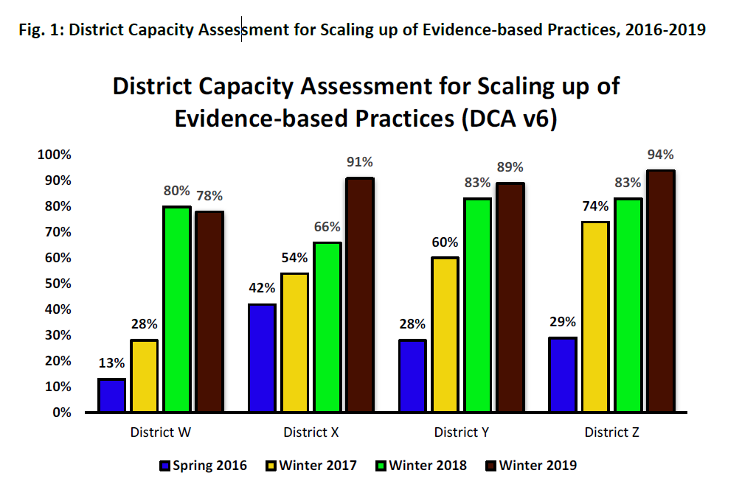
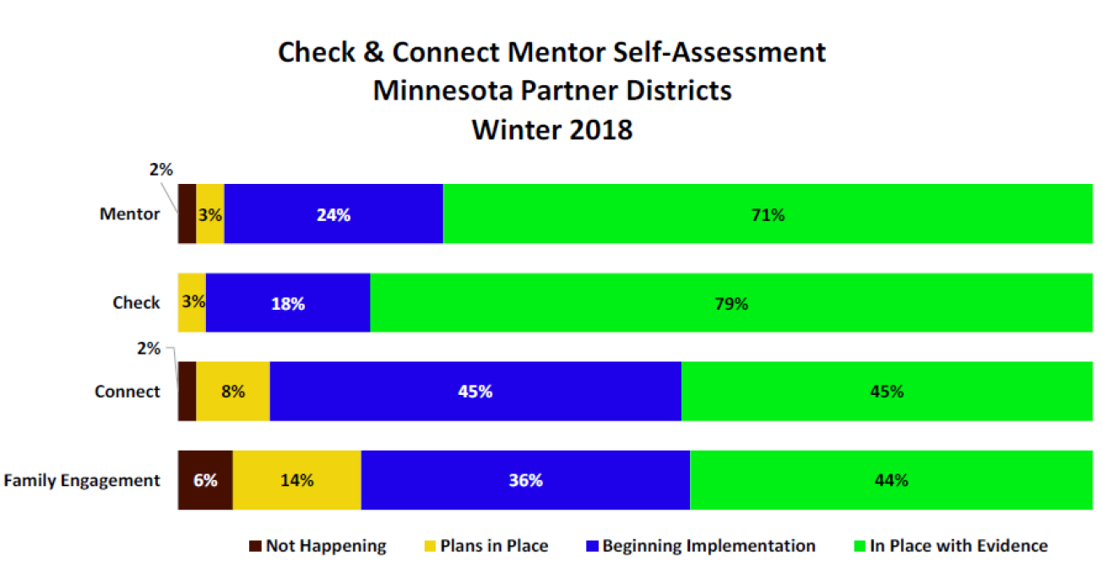
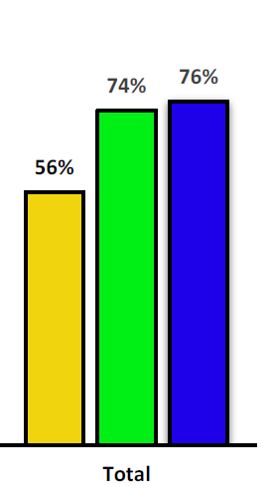
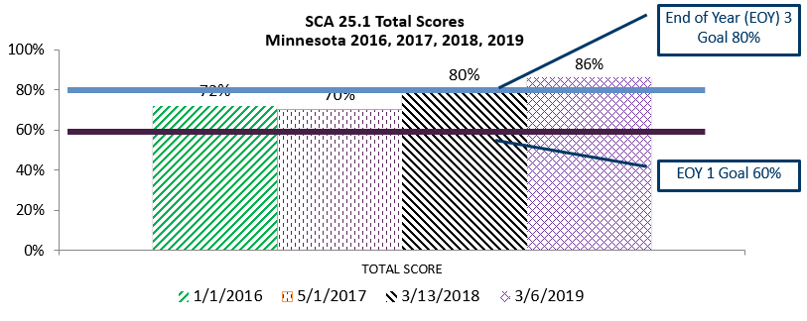
MN: Linked Implementation Teams with Data
School Implementation
Team
(Fidelity)
District
Implementation Team
(DCA)
Regional
Implementation Team
(RCA)
State
Implementation Team
(SCA)

Slide 8
Strategies to Sustain: Implementation Teams
A “data system” is NOT the same as a DSDS (Decision Support Data System)
TEAMS are the vehicle by which data is used and communicated to inform ongoing implementation therefore:
Get implementation data in front of teams ASAP and at regular intervals to make the next right step
Right info at right level (closest to where decision can be made- avoid micromanagement)
Right type of data at right time (e.g., by stage – exploration = needs assessment/hexagon, installation = training data, initial implementation = coaching data, full implementation = outcome data)
Coach teams through the shift – from viewing data generation as “grant compliance” to teams “valuing and anticipating” implementation data for progress feedback
When moving from Implementation to Scaling: Impact on teams
Manage role clarity on team- multiple hats – researcher, practitioner, purveyor
Anticipate shifting role of entire team

Slide 9
SEA
Data collected demonstrate an incongruence between Executive Leadership and the Leadership Team regarding the development of overall systemic infrastructure.
The Executive Leadership rates the MDE consistently higher across most domains of systemic infrastructure.
Overestimating progress can impede improvement efforts as the illusion of success is unlikely to produce action, thereby perpetuating a system which requires significant improvement.

Slide 10
Capacity Assessments
SEA
Change is occurring at a slower rate than anticipated
Leadership
56%
Infrastructure & Resources
50%
Communication & Engagement
72%
REGIONAL
Change is occurring at anticipated rate
Improvements noted in the Competency domain – Training and Fidelity, Data System for Decision-Making, and processes to support district implementation of EBPs
Challenges include Leadership and Systems Intervention
DISTRICT
Change is occurring at anticipated rate
Improvements noted in Data System for Decision-Making, Leadership, & Competency to Implement an EBP
Challenges largely focused around the process of Change

Slide 11
Using Data for Implementation
Usable Innovations
(Evidence-Based Practice)
Effective Implementation methods
(Stages and Drivers)
Enabling Contexts
(Linking Teams & Improvement Cycles)
Educationally Significant Outcomes
(Improved student outcomes)

Slide 12
Measuring the work and impact in Wisconsin

Slide 13
Responding to the data in Wisconsin
SEA
Expanding beyond the two teams that began the work
Need for state implementation structure
Region
Creating intentional integration of two regional entities
Need for clearly defined innovation
District and Building
Understanding and applying the Active Implementation Frameworks as a new way of work
Need for Decision Support Data System

Slide 14
Usable Innovations
Usable Innovations
(Evidence-Based Practice)
Effective Implementation methods
(Stages and Drivers)
Enabling Contexts
(Linking Teams & Improvement Cycles)
Educationally Significant Outcomes
(Improved student outcomes)

Slide 15
Innovation Selection Process
Instructional Practices and Academic Content (IPAC) Team
Mission: Provide support to the SSIP team and regional Educational Cooperatives by selecting and vetting educational initiatives that are likely to address the Gap in mathematics for struggling learners
Members with knowledge and expertise in mathematics
Kentucky Department of Education
Regional Education Cooperatives
KY Council of Administrators of Special Education
Higher Education
Committee for Mathematics Achievement
Kentucky Center for Mathematics
Kentucky Public Schools

Slide 16
Innovation Selection Process
IPAC Team’s Work:
Conduct a state initiative inventory
Evaluate each initiative for usability, measurement, and implementation with fidelity
Select 3-5 initiatives for menu
Create a Practice Profile on each initiative
Result:
A menu of evidence-based practices that will advise districts on initiatives that are usable and measurable and are likely to address the Gap in mathematics for struggling learners.

Slide 17
KY Mathematics Innovation Practice Profile

Slide 18
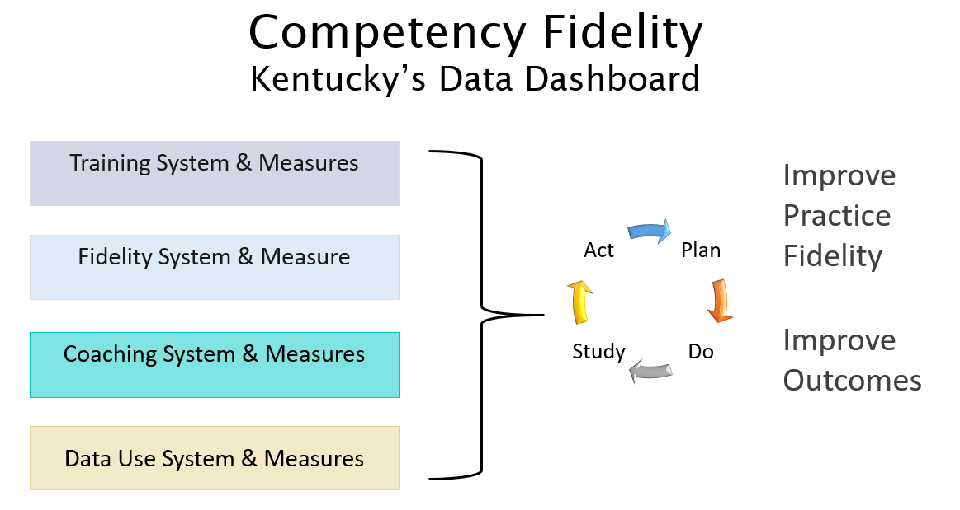
Innovation Selection Process
Challenges:
Math Menu
Lack of fidelity measure
Successes:
Common philosophy for mathematics that is teachable, learnable, doable, and measurable
State capacity to develop additional Practice Profiles and a math fidelity measure
Integration of Practice Profile components into training, coaching, fidelity, and data use measures

Slide 19
Menu of Supports for Low Performing Systems
State Management Team
EASI Team
Support Coordinator Team
Service Design Team
COORDINATED SET OF ACTIVITIES

Slide 20
Colorado Department of Education
EXPLORATION SUPPORTS
CDE OFFERED SERVICES
DISTRICT DESIGNED AND LED

Slide 21
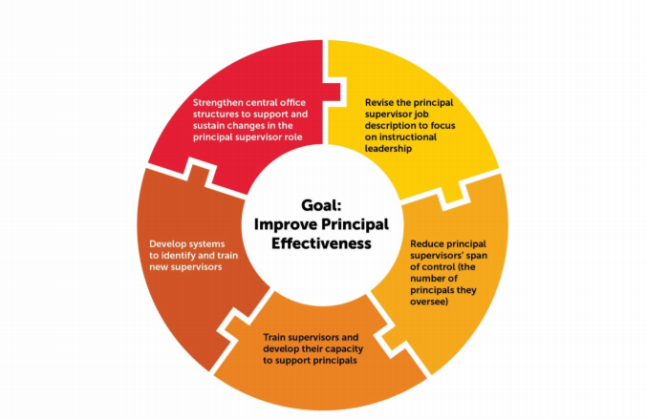
New Service Development
Principal Supervisor Initiative
Goldring, Ellen B., Jason A. Grissom, Mollie Rubin, Laura K. Rogers, Michael Neel, and Melissa A. Clark. “A New Role Emerges for Principal Supervisors: Evidence from Six Districts in the Principal Supervisor Initiative.” New York: Wallace Foundation, 2018.
Available at http://www.wallacefoundation.org/knowledge-center/Pages/A-New-Role-Emerges-for-PrincipalSupervisors.aspx.

Slide 22
Principal Supervisor Initiative
Strengthen central office structures to support and sustain changes in the principal supervisor role.
Revise the principal supervisor job description to focus on instructional leadership.
Reduce principal supervisors’ span of control (the number of principals they oversee).
Train supervisors and develop their capacity to support principals.
Develop systems to identify and train new supervisors.

Slide 23
Principal Supervisor Network
Supports focused at the District level
Supervisors of Principals working in Low Performing Schools
Those identified through State and/or Federal Accountability
Learning will be based on the CCSSO Model Principal Supervisor Professional Standards 2015.*
Pilot Project - Initial Implementation 2019-2020 school year
*Council of Chief State School Officers. (2015) Model Principal Supervisor Professional Standards 2015. Washington DC:CCSSO. Available at: https://ccsso.org/sites/default/files/2017-10/2015PrincipalSupervisorStandardsFinal1272015.pdf

Slide 24
Summary & Conclusions

Slide 25
Contact Information
Eric Kloos, Minnesota Department of Education
eric.kloos@state.mn.us
Amanda Waldroup, Kentucky Department of Education
amanda.waldroup@education.ky.gov
Julia Hartwig, Wisconsin Department of Public Instruction
julia.hartwig@dpi.wi.gov
Wendy Sawtell, Colorado Department of Education
sawtell_w@cde.state.co.us
Jeff Diedrich, Michigan Department of Education
jeff.diedrich@lakechain.org

Slide 26
OSEP Disclaimer
2019 OSEP Leadership Conference
DISCLAIMER:
The contents of this presentation were developed by the presenters for the 2019 OSEP Leadership Conference. However, these contents do not necessarily represent the policy of the Department of Education, and you should not assume endorsement by the Federal Government.
(Authority: 20 U.S.C. 1221e-3 and 3474)

