Slide 1

OSEP Disclaimer
2018 OSEP Project Directors’ Conference
DISCLAIMER:
The contents of this presentation were developed by the presenters for the 2018 Project Directors’ Conference. However, these contents do not necessarily represent the policy of the Department of Education, and you should not assume endorsement by the Federal Government.
(Authority: 20 U.S.C. 1221e-3 and 3474)

Slide 2






Competencies of Coaching
Competencies of Coaching:
Research and Resources
Session Facilitated by:
Dale Cusumano, Ph.D¹., Jennifer Pierce, Ph.D.,² and Caryn Ward, Ph.D.¹
¹ SISEP; ² AIR

Slide 3
Objectives
Gain knowledge about what effective coaching looks like
Identify what you want to learn more about and how to access resources
Become aware of a research-based model for coaching

Slide 4
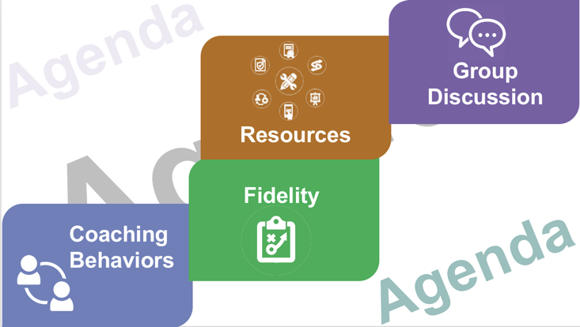
Agenda

Slide 5
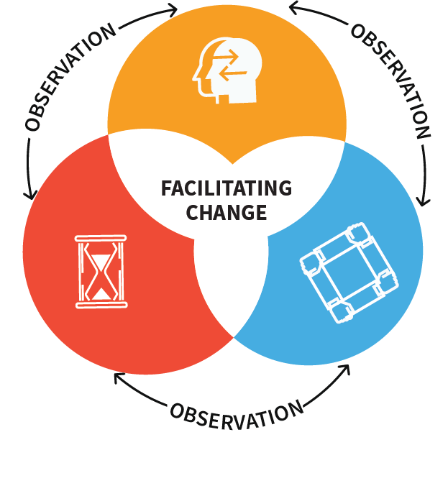







Coaching Process
DATA USE
Coaching Behaviors
Coaching Recipient Behaviors
Accurate Use of
Skills/Practices
Fluent Use of
Skills/Practices
Skills used with
fidelity leading to desired outcomes
Adaptation of Skills/
Practices to Context
PROMPTING
PERFORMANCE FEEDBACK
SCAFFOLDING SUPPORTS
Reminders
Cues
Reinforcing/Corrective Describe Behavior
Includes rationale
Linked to Goal
Modeling
Co-leading
Independent Practice
Fades over time
ENABLING COLLABORATIVE CONTEXT

Slide 6


Prompting
Timing
Prompting
Delivery
Cues

Slide 7


Performance Feedback
Provides
rationale
Data-based
Performance
Feedback
Glows or
Corrections
Linked
to goal
Describes
behavior

Slide 8

Scaffolding Supports
Scaffolding Supports

Slide 9
Coaching Process
DATA USE
Coaching Behaviors
Coaching Recipient Behaviors
Accurate Use of
Skills/Practices
Fluent Use of
Skills/Practices
Skills used with
fidelity leading to desired outcomes
Adaptation of Skills/
Practices to Context
PROMPTING
PERFORMANCE FEEDBACK
SCAFFOLDING SUPPORTS
Reminders
Cues
Reinforcing/Corrective Describe Behavior
Includes rationale
Linked to Goal
Modeling
Co-leading
Independent Practice
Fades over time
ENABLING COLLABORATIVE CONTEXT

Slide 10
Focusing on Coaching Recipient Behaviors
Coaching Recipient Behaviors
Accurate Use of
Skills/Practices
Fluent Use of
Skills/Practices
Skills used with
fidelity leading to desired outcomes
Adaptation of Skills/
Practices to Context

Slide 11
Goals for Coaching Recipient
Goals for Coaching Recipient
Adaptation of Skills/
Practices to Context
Fluent Use of
Skills/Practices
Accurate Use of
Skills/Practices

Slide 12
Focusing on Goals for Coaching Recipient Behaviors
Goals for Coaching Recipient
Adaptation of Skills/
Practices to Context
Fluent Use of
Skills/Practices
Accurate Use of
Skills/Practices

Slide 13
Focusing on Coaching Recipient Behavior aligned with fidelity of skill uses
Coaching Recipient Behaviors
Accurate Use of
Skills/Practices
Fluent Use of
Skills/Practices
Skills used with
fidelity leading to desired outcomes
Adaptation of Skills/
Practices to Context

Slide 14
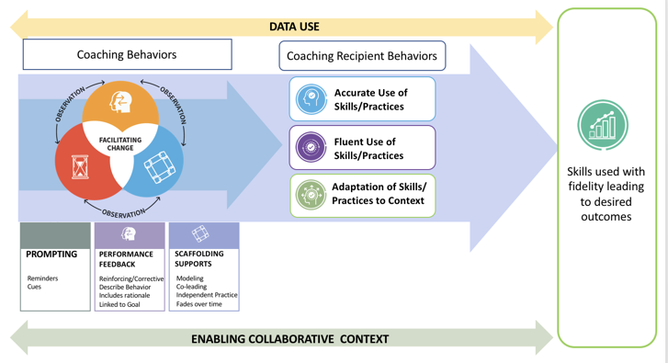
Coaching Process Big Picture Review

Slide 15
Cycle of Coaching

Slide 16




Up-close Look at First Steps in Coaching
Up-close Look at First Steps in Coaching
Review data
Determine need; identify goal for coaching
Develop Action Plan

Slide 17
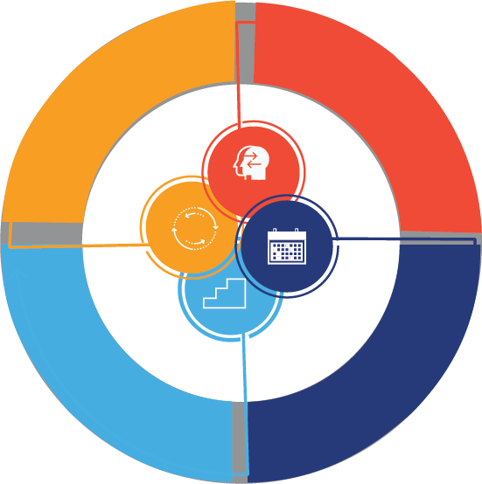
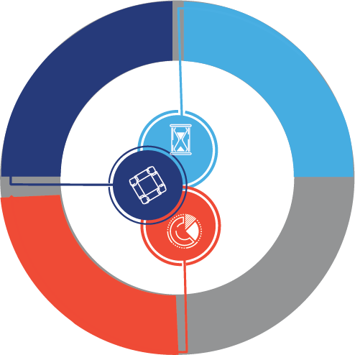
Cycles of Coaching

Slide 18







Cycles of Coaching Actions
Coach shares Performance Feedback
Relationship between cycles of coaching
Review data and goals from Action Plan
Deliver prompt if needed
Scaffold Skill Use
if needed
Practice with Feedback if needed
Collect data
Update Action Plan
if needed

Slide 19
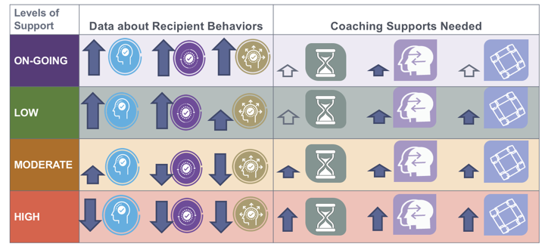
Putting it All Together: Using Data to Align Coaching Supports

Slide 20
Coaching Model Revisited

Slide 21

Fidelity
Agenda
Agenda
Fidelity
Agenda

Slide 22

How Do I Continuously Improve as a Coach?
  How can I collect, analyze, and use fidelity data to be more confident that the goals of coaching are attained?
Source: Pierce, 2018

Slide 23


Views on the Purpose of Measuring Fidelity
A productive view on fidelity:
A potentially problematic view on fidelity:
Supporting educators as they seek to continually develop their skills
Judging educators as “good” or “bad,” where data are used for formally evaluating professionals
Source: Pierce, 2018

Slide 24
Agenda
What is Fidelity and Why is it Important?
How Can We Use Fidelity Data?
Challenges and Opportunities: Considerations
Resources and opportunities for discussion
are embedded throughout the session.

Slide 25
Objectives: Participants Will…
Understand four aspects of fidelity and why it is important to collect and use data in these four areas.
Learn the process of measuring the fidelity of coaching.
Reflect on the information shared in the session and share insights with colleagues.

Slide 26
NCSI’s Modules on Coaching:
Module 1: Effective Practices for Coaches
  Module Link: http://airhsdlearning.airws.org/ncsi-effectivecoaching/11-15/story_flash.html
Module 2: Measuring the Fidelity of Coaching
Module forthcoming!
Source: Pierce, 2017

Slide 27
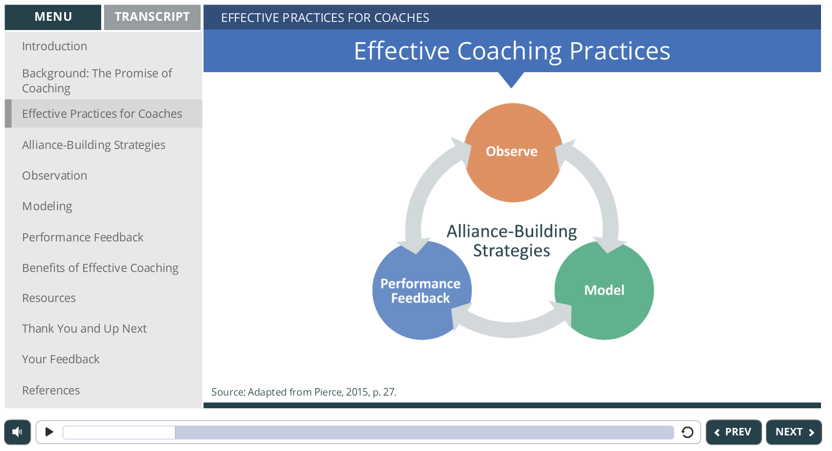
Module 1: Effective Practices for Coaches
Source: Pierce, 2017; Module Link: http://airhsdlearning.airws.org/ncsi-effectivecoaching/11-15/story_flash.html

Slide 28
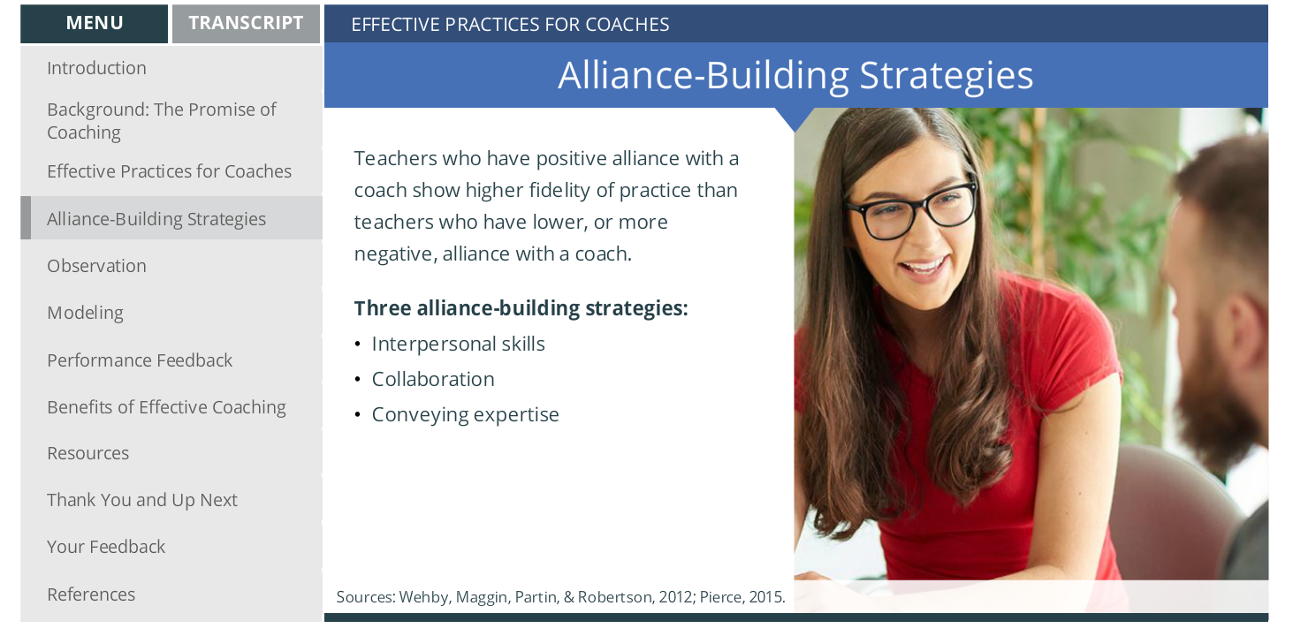
Alliance Building Strategies
Source: Pierce, 2017; Module Link: http://airhsdlearning.airws.org/ncsi-effectivecoaching/11-15/story_flash.html

Slide 29
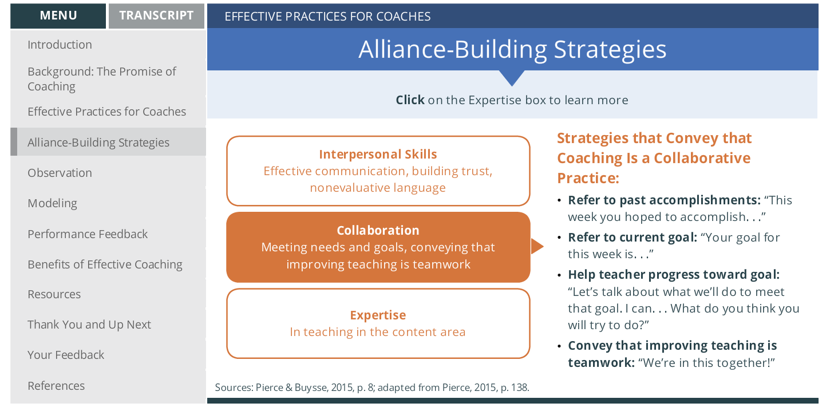
Alliance Building Strategies
Source: Pierce, 2017; Module Link: http://airhsdlearning.airws.org/ncsi-effectivecoaching/11-15/story_flash.html

Slide 30
What Is Fidelity?
“Fidelity of implementation is traditionally defined as the determination of how well an intervention is implemented in comparison with the original program design.” (O’Donnell, 2008, p. 33)
OR
The degree to which a program is used as it was designed to be used.
Source: Pierce, 2018; Pierce & Ferguson, 2015c, p. 1.

Slide 31
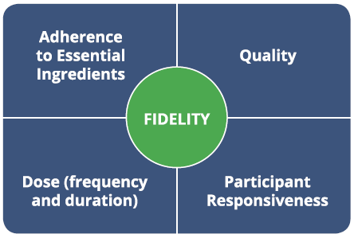
What Is Fidelity?
The presence of the most important “ingredients” of the innovation.
The degree to which the innovation is delivered according to ideal use.
The degree to which recipients are engaged with the innovation.
The amount of the innovation received by the participants.
Sources: Pierce, 2018; Pierce & Ferguson, 2015c, p. 1.

Slide 32
Why Is Fidelity of Coaching Important?
Evidence-based or research-based programs are most effective when they are used according to specific guidelines established by research studies.
For teachers to see the same effects with students “in the real world,” programs must be used in ways that are similar to how they were used in research settings.
If the four effective coaching practices are used as they were designed to be used, coaches can expect to see improved teaching and student learning.
Sources: Pierce, 2018; Pierce & Ferguson, 2015c; Dusenbury, Brannigan, Falco, & Hansen, 2003.

Slide 33
How Are Coaching Fidelity Data Used?
Coaches can use fidelity data to reflect on their practice and to continuously improve support for improved teaching and student learning.
Sources: Pierce, 2018; Pierce & Ferguson, 2015c; Dusenbury, Brannigan, Falco, & Hansen, 2003.

Slide 34
How Are Coaching Fidelity Data Used?
Fidelity data help coaches answer several questions, including these:
  Did coaching contain the four effective coaching practices?
  To what degree did use of the four effective practices align with research recommendations?
  How are teachers and students responding to coaching?
  How can coaching continue to develop?
Sources: Pierce, 2018; Pierce & Ferguson, 2015c; Dusenbury, Brannigan, Falco, & Hansen, 2003.

Slide 35
Tools for Measuring the Fidelity of Coaching
Effective Coaching of Teachers: Fidelity Tool Worksheet
  https://docs.google.com/viewerng/viewer?url=https://ncsi-library.wested.org/system/resources/documents/000/000/058/original/NCSI_Coaching-Fidelity-Tool_Worksheet-508_1_.pdf?1490127910
Effective Coaching of Teachers: Fidelity Tool Rubric
  https://docs.google.com/viewerng/viewer?url=https://ncsi-library.wested.org/system/resources/documents/000/000/059/original/NCSI_Coaching-Fidelity-Tool_Rubric-508_1_.pdf?1490204815
Effective Coaching of Teachers: Sample Completed Fidelity Tool Worksheet
  https://docs.google.com/viewerng/viewer?url=https://ncsi-library.wested.org/system/resources/documents/000/000/189/original/NCSI_Coaching-Fidelity-Tool_Worksheet_completed-sample-508_(2).pdf?1497294973
Module forthcoming!

Slide 36
Getting Ready: The Materials
Effective Coaching of Teachers: Fidelity Tool Worksheet
  Blank worksheet used to record fidelity data
  Describes who is involved in the process
  Provides step-by-step instructions for collecting fidelity data
Effective Coaching of Teachers: Fidelity Tool Rubric
  Contains scoring procedures
  Used to complete the blank worksheet
Sources: Pierce, 2018; Pierce & Ferguson, 2015a, b, and c

Slide 37


Getting Ready: The Roles
Lenore-Claudio’s coach
Claudio- Teacher (Recipient of Coaching)
Source: Pierce, 2018

Slide 38

Getting Ready: The Roles
Vivian—observer to the teacher-coach sessions
The observer is responsible for:
  Scoring Lenore’s use of four effective coaching practices as she coaches Claudio
  Sharing data with Lenore
  Helping Lenore reflect on current coaching practice and how to improve in future sessions
Source: Pierce, 2018

Slide 39
Getting Ready: The Process
2. The observer watches the coaching session, using the rubric to score the coach’s use of effective coaching practices.
3. The observer meets with the coach to discuss fidelity data and identify next steps for continuous improvement.
1. The observer meets with the coach prior to the coaching session with the teacher to identify the goals of the coaching session.
Coaching Session
with the Teacher
Source: Pierce, 2018

Slide 40
Getting Ready: The Process
Source: Pierce, 2018

Slide 41
Check Your Understanding: Sample Schedule
Monday: Vivian’s preobservation meeting with Lenore.
Tuesday: Lenore’s preobservation meeting with Claudio. Vivian observes this meeting.
Wednesday: Lenore’s observation in Claudio’s classroom. Vivian observes Lenore as Lenore coaches Claudio.
Thursday: Lenore’s postobservation meeting with Claudio. Vivian observes Lenore’s meeting with Claudio.
Friday: Vivian’s postobservation meeting with Lenore.
Source: Pierce, 2018

Slide 42
Four Aspects of Fidelity
Scoring: Check the box. Did the coach observe, model, provide performance feedback, and use alliance strategies? (3-4 pts total, depending on use of modeling)
Source: Pierce, 2018; Pierce & Ferguson, 2015c, p. 1.

Slide 43
Four Aspects of Fidelity
Scoring: Check the box.
(16-18 points, depending on use of modeling)
Source: Pierce, 2018; Pierce & Ferguson, 2015c, p. 1.

Slide 44
Scoring: Quality (Examples)
High-quality observations:
  The coach observes the teacher and the students to better understand the impact of teacher practice on student learning.
High-quality performance feedback:
  Specific
  Positive
  Timely
  Corrective, if warranted
  Contains a student rationale
Source: Pierce, 2018; Pierce & Ferguson, 2015c, p. 1.

Slide 45
Four Aspects of Fidelity
Scoring: Scale of 1-3
(9-12 points, depending on use of modeling)
Source: Pierce, 2018; Pierce & Ferguson, 2015c, p. 1.

Slide 46
Scoring Dose (Examples)
Observation:
  1 = The observation of the teacher is too brief and occurs too infrequently for the coach to understand how that teacher works with students.
  3 =The observation of the teacher occurs on a regular basis so as to sufficiently understand teacher practice.
Performance Feedback:
  1 = Less than 25% of feedback to the teacher is positive.
  3 = 80% of performance feedback to the teacher is positive.
Source: Pierce, 2018; Pierce & Ferguson, 2015c, p. 1.

Slide 47
Four Aspects of Fidelity
Scoring: Scale of 1-3
(9-12 points, depending on use of modeling)
Source: Pierce, 2018; Pierce & Ferguson, 2015c, p. 1.

Slide 48
Scoring Responsiveness
Observation:
  1 = Coach observes the teacher during a time not selected by the teacher and when the teacher is not using the practice of interest.
  3 = Coach observes the teacher during the agreed-upon time and the teacher uses the practice of interest.
Source: Pierce, 2018; Pierce & Ferguson, 2015c, p. 1.

Slide 49

Potential Pros for Using Fidelity Data
Creates a designated time for a coach to:
  Reflect on fidelity data with another person in a supportive way.
  Identify the necessary next steps to improve the coaching of teachers.
Source: Pierce, 2018

Slide 50
Potential Cons and Supporting Feasibility
This is not necessarily a simple and fast process!
Data can be misused if the purpose is not set by leaders.
To enhance feasibility:
  Work with stakeholders to establish your system’s process and purpose for measuring/using fidelity data.
  Communicate the process and purpose to stakeholders and provide opportunities for stakeholders to provide on-going feedback about measuring coaching fidelity.
  Embrace technology! Consider recording coaching sessions conducted with teachers, including any pre/post observation debriefs.
Source: Pierce, 2018

Slide 51
Check Your Understanding
Item 1, True or False:
  Fidelity data are used to support improved coaching, not to formally evaluate coaching as “good” or “bad.”
Item 2, True or False:
  Adherence means that coaching consists of the “essential ingredients,” or most powerful practices.
Item 3, True or False:
  Adherence is the most important aspect of fidelity.
Source: Pierce, 2018

Slide 52
References
Dusenbury, L., Brannigan, R., Falco, M., & Hansen, W. B. (2003). A review of research on fidelity of implementation: Implications for drug abuse prevention in school settings. Health Education Research, 18(2), 237–256.
Pierce, J. D. (2015). Teacher-coach alliance as a critical component of coaching: Effects of feedback and analysis on teacher practice (Doctoral dissertation).
Pierce, J.D. (2017). Effective coaching practices (Online Module). Retrieved from http://airhsdlearning.airws.org/ncsi-effectivecoaching/11-15/story_flash.html.
Pierce, J.D. (2018). Measuring the fidelity of coaching (Online Module in Preparation).
Pierce, J. D., & Buysse, V. (2015). Effective coaching: Improving teacher practice and learner outcomes (Brief and Infographic). Retrieved from https://ncsi.wested.org/resources/tools-publications/
Pierce, J. D., & Ferguson, A. (2105a). Effective coaching of teachers: Completed sample of the fidelity tool worksheet. Retrieved from https://docs.google.com/viewerng/viewer?url=https://ncsi-library.wested.org/system/resources/documents/000/000/189/original/NCSI_Coaching-Fidelity-Tool_Worksheet_completed-sample-508_(2).pdf?1497294973

Slide 53
References
Pierce, J. D., & Ferguson, A. (2105b). Effective coaching of teachers: Fidelity tool rubric. Retrieved from https://docs.google.com/viewerng/viewer?url=https://ncsi-library.wested.org/system/resources/documents/000/000/059/original/NCSI_Coaching-Fidelity-Tool_Rubric-508_1_.pdf?1490204815
Pierce, J. D., & Ferguson, A. (2015c). Effective coaching of teachers: Fidelity tool worksheet. Retrieved from https://docs.google.com/viewerng/viewer?url=https://ncsi-library.wested.org/system/resources/documents/000/000/058/original/NCSI_Coaching-Fidelity-Tool_Worksheet-508_1_.pdf?1490127910
Pierce, J. D., & Ferguson, A. (2105d). Implementation guide for effective coaching of teachers. Retrieved from https://docs.google.com/viewerng/viewer?url=https://ncsi-library.wested.org/system/resources/documents/000/000/060/original/NCSI_Teacher_Coaching_Implementation_Guide-508_1_.pdf?1490204994

Slide 54

Resources
Agenda
Agenda
Resources
Agenda

Slide 55
Effective Coaching Practices: Resources
Effective Practices for Coaches (Module)
  http://airhsdlearning.airws.org/ncsi-effectivecoaching/11-15/story_flash.html
Effective Coaching: Improving Teacher Practice and Outcomes for All Learners (Brief)
  https://docs.google.com/viewerng/viewer?url=https://ncsi-library.wested.org/system/resources/documents/000/000/057/original/NCSI_Effective-Coaching-Brief-508_1_.pdf?1490127749
Effective Coaching Practices: Coaching to Improve Teacher Practice and Learner Outcomes (Infographic)
  https://docs.google.com/viewerng/viewer?url=https://ncsi-library.wested.org/system/resources/documents/000/000/188/original/NCSI_Coaching_Infographic5.pdf?1497294857
Source: Pierce, 2018; Pierce & Ferguson, 2015c, p. 1.

Slide 56
Fidelity of Coaching: Resources
Module forthcoming!
Effective Coaching of Teachers: Fidelity Tool Worksheet
  https://docs.google.com/viewerng/viewer?url=https://ncsi-library.wested.org/system/resources/documents/000/000/058/original/NCSI_Coaching-Fidelity-Tool_Worksheet-508_1_.pdf?1490127910
Effective Coaching of Teachers: Fidelity Tool Rubric
  https://docs.google.com/viewerng/viewer?url=https://ncsi-library.wested.org/system/resources/documents/000/000/059/original/NCSI_Coaching-Fidelity-Tool_Rubric-508_1_.pdf?1490204815
Effective Coaching of Teachers: Completed Sample of the Fidelity Tool Worksheet
  https://docs.google.com/viewerng/viewer?url=https://ncsi-library.wested.org/system/resources/documents/000/000/189/original/NCSI_Coaching-Fidelity-Tool_Worksheet_completed-sample-508_(2).pdf?1497294973

Slide 57
Implementation Guide for Coaching: Resources
Implementation Guide for Effective Coaching of Teachers
  https://docs.google.com/viewerng/viewer?url=https://ncsi-library.wested.org/system/resources/documents/000/000/060/original/NCSI_Teacher_Coaching_Implementation_Guide-508_1_.pdf?1490204994

Slide 58
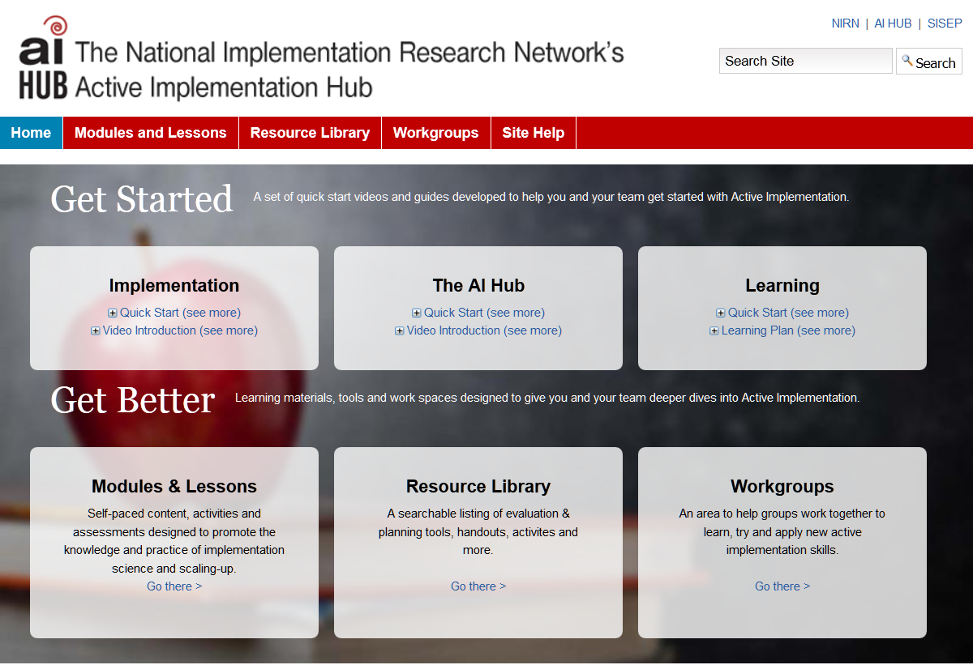
Ai Hub
http://implementation.fpg.unc.edu/

Slide 59
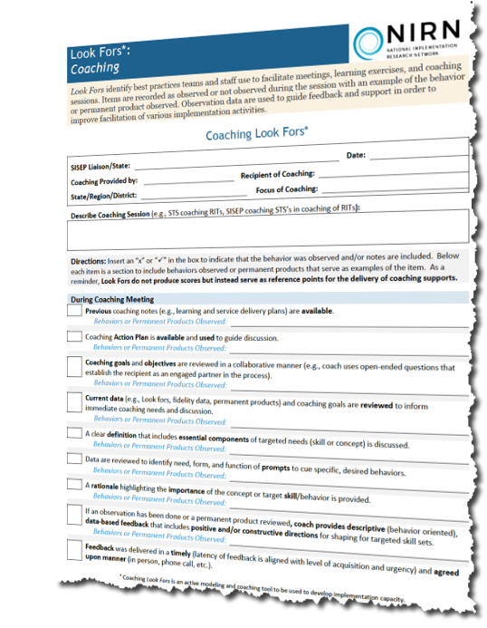
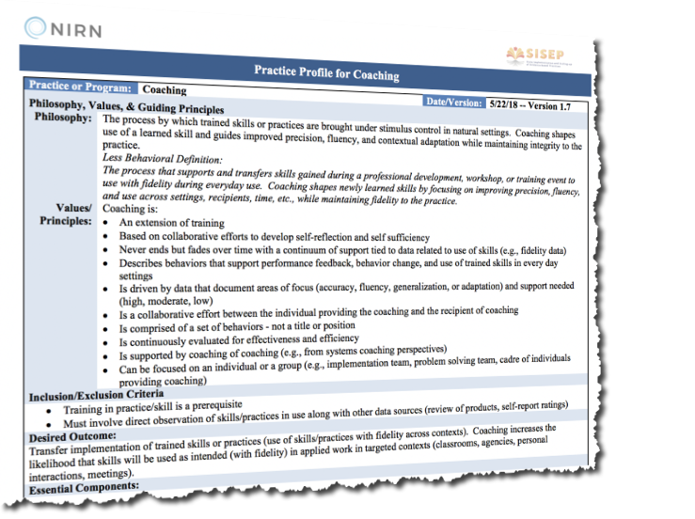
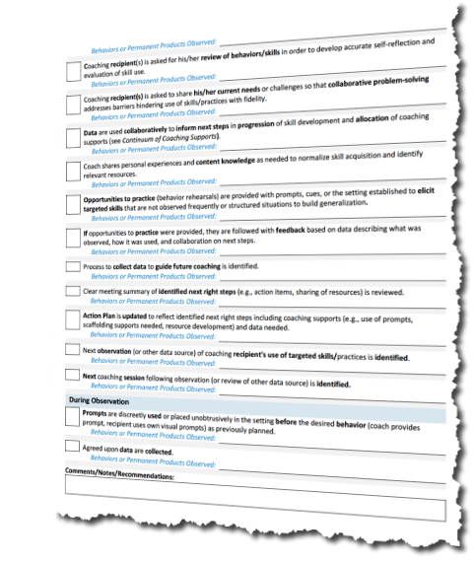
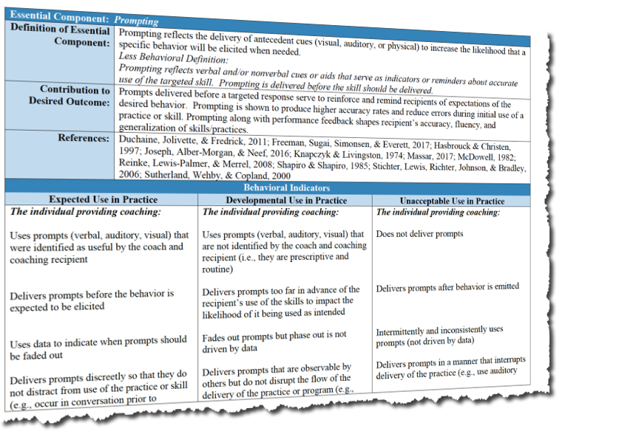
More Resources

Slide 60

Group Discussion
Agenda
Agenda
Group Discussion
Agenda
Group Discussion

Slide 61
Discussion
What additional supports do you see as being needed when establishing a system of coaching in an education setting?
How can your system come to consensus on a research-based definition of coaching and ensure that this definition shapes and supports the goals of coaching?
How can your system measure the fidelity of coaching? How might your system ensure that fidelity data are used to support coaches rather than to formally evaluate coaches?

Slide 62
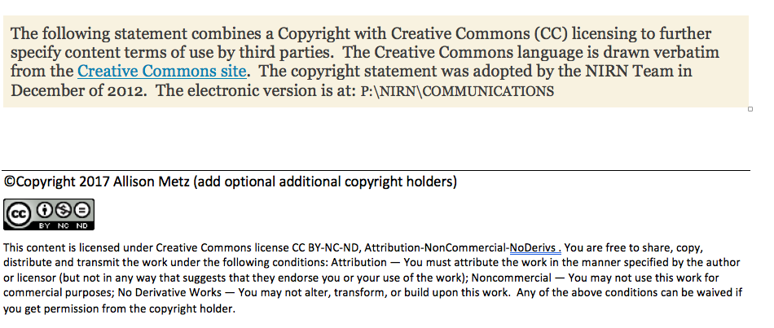
Copyright Statement

Slide 63
Measuring the Fidelity of Coaching
Jennifer D. Pierce, Ph.D.

Slide 64
OSEP Disclaimer
2018 OSEP Project Directors’ Conference
DISCLAIMER:
The contents of this presentation were developed by the presenters for the 2018 Project Directors’ Conference. However, these contents do not necessarily represent the policy of the Department of Education, and you should not assume endorsement by the Federal Government.
(Authority: 20 U.S.C. 1221e-3 and 3474)

