Slide 1
New SPP/APR System
An explanation and demonstration

Slide 2
Agenda
Why Are We Changing?
Justification
Overview
Project Status
Demonstration
Next Steps

Slide 3
Why Are We Changing?
Two main reasons
Cybersecurity
Costs

Slide 4
Justification
The APR tool being built under the EDFacts Technical Support Systems (ETSS) II contract is adaptable to the requirements for the IDEA APRs
Both ED and the states benefit from using a single, standardized reporting data collection system for APRs
A standardized reporting tool will allow grantees who know one system to seamlessly transition to the other reporting system
A single APR system:
Reduces the number of APR systems which aligns with OCIO goals related to decreasing the number of individual systems
Standardizes the secure movement of data

Slide 5
Overview
The EDFacts APR tool has the following adaptable functionality
Content – The indicators or questions are specific to the APR
Workflow – The movement of the APR (a) between the states and ED and (b) within ED during the review process is specific to the APR
Source data – In addition to states responding to indicators and questions through the APR interface, data can be loaded into the APR
Business rules – Each APR has a set of business rules
Output – Each APR can have different reports for the state submitters and for the program office
The EDFacts APR tool is being built using Appian

Slide 6
Project Status
Pilot is in development for the Consolidated State Performance Report (CSPR)
Currently in requirements gathering stage for IDEA APRs
Part B and Part C Templates (Collection Tool) will be available by October 1, 2019

Slide 7
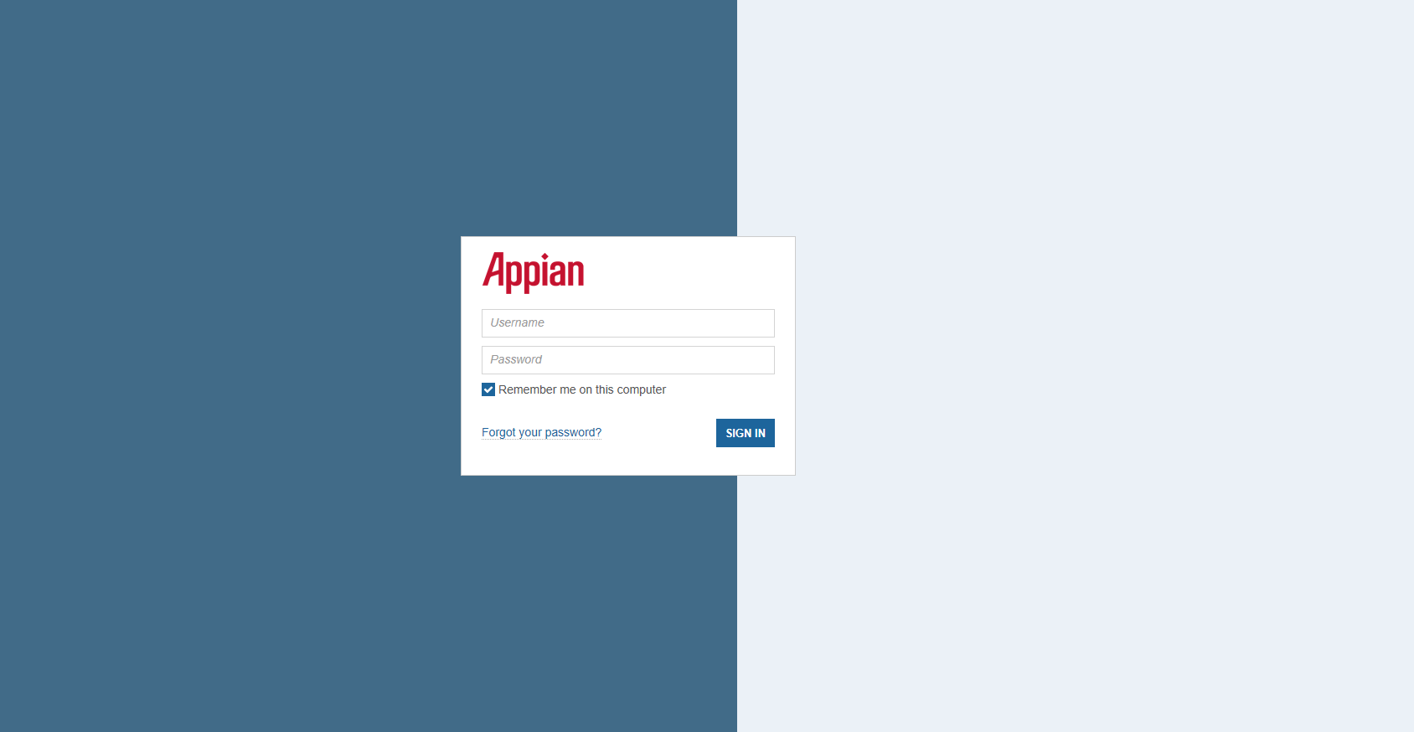
Login Page

Slide 8
EDFacts Portal

Slide 9
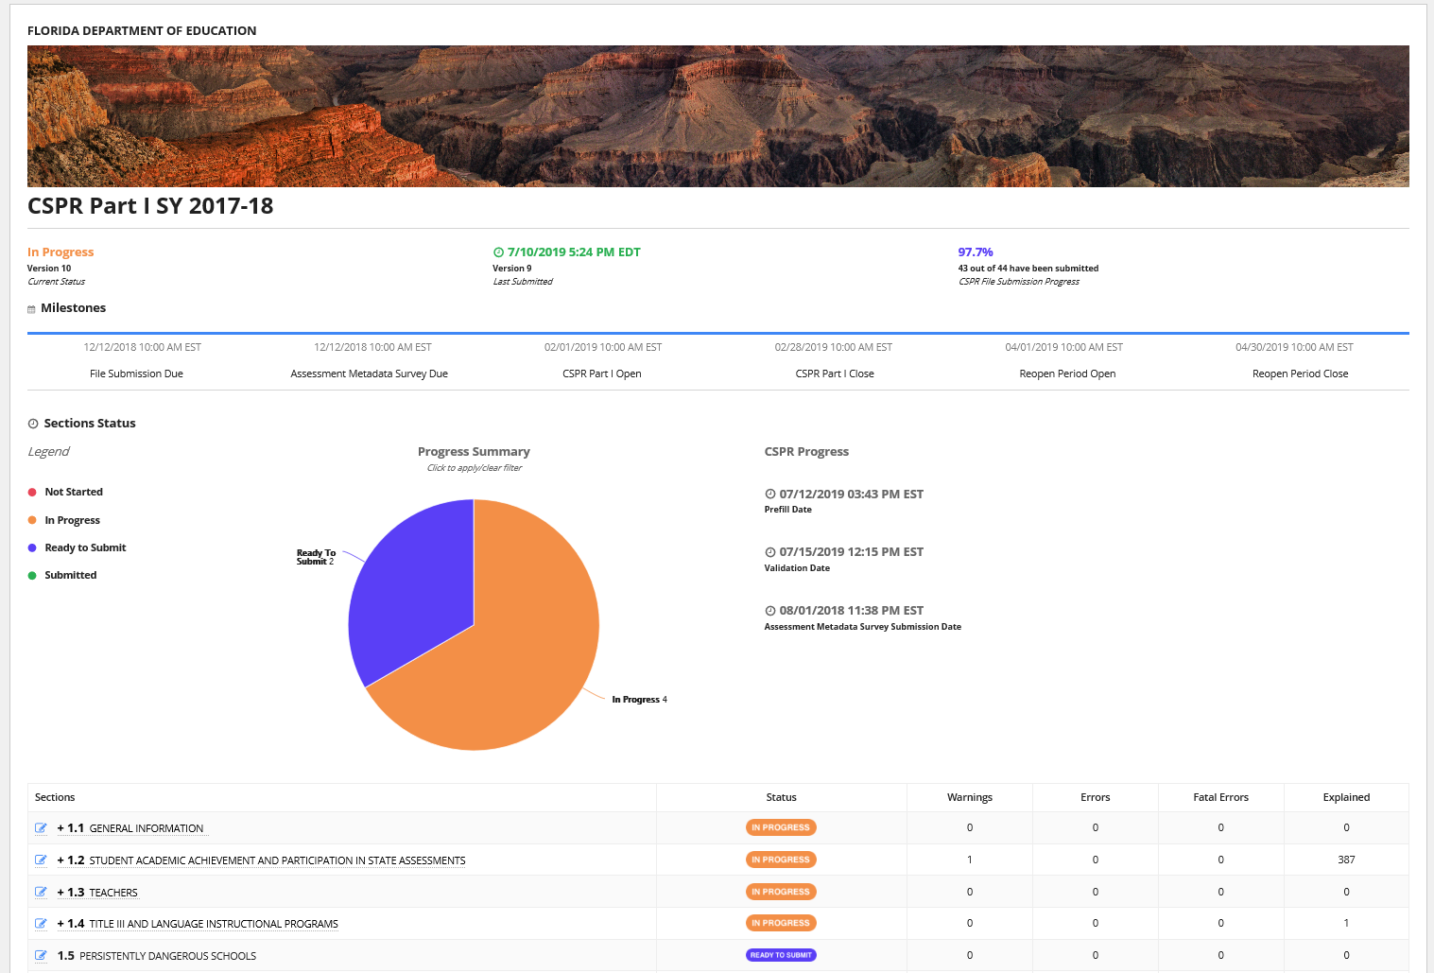
State Dashboard

Slide 10
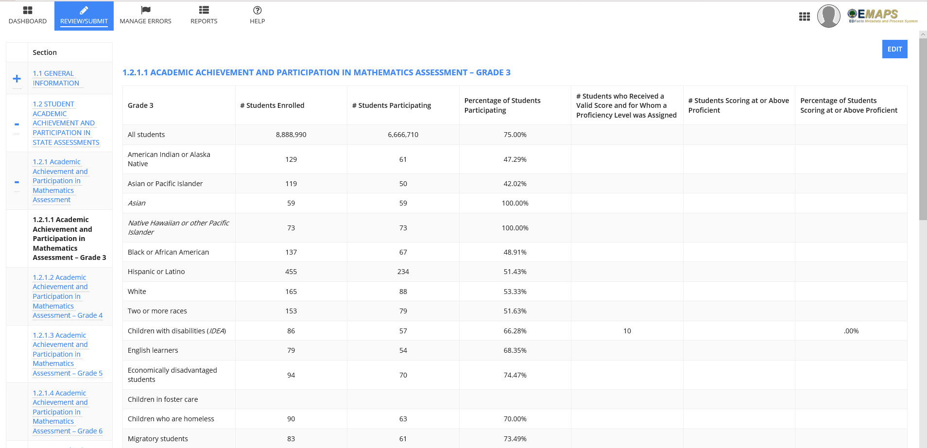
Review/Submit – Prefilled Data

Slide 11
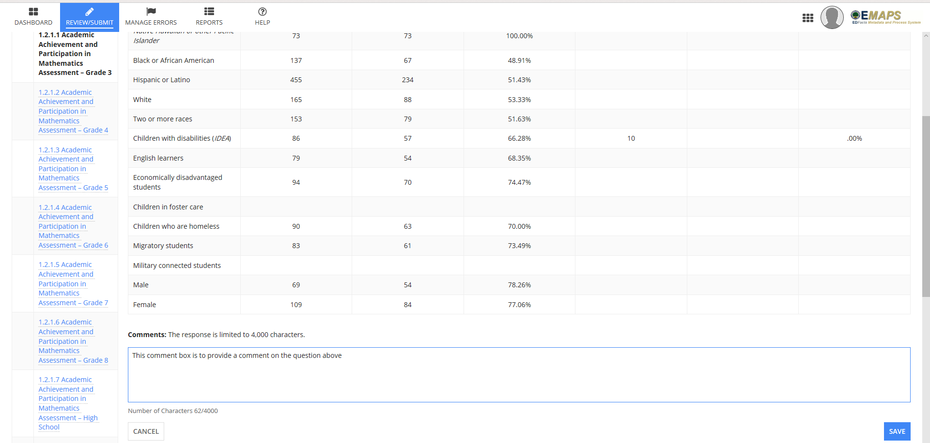
Review/Submit – Enter Comments

Slide 12
Review/Submit – Dropdown Selections

Slide 13
Review/Submit – Invalid Data Type

Slide 14
Unsaved Changes

Slide 15
Mark Indicator “Ready to Submit”

Slide 16
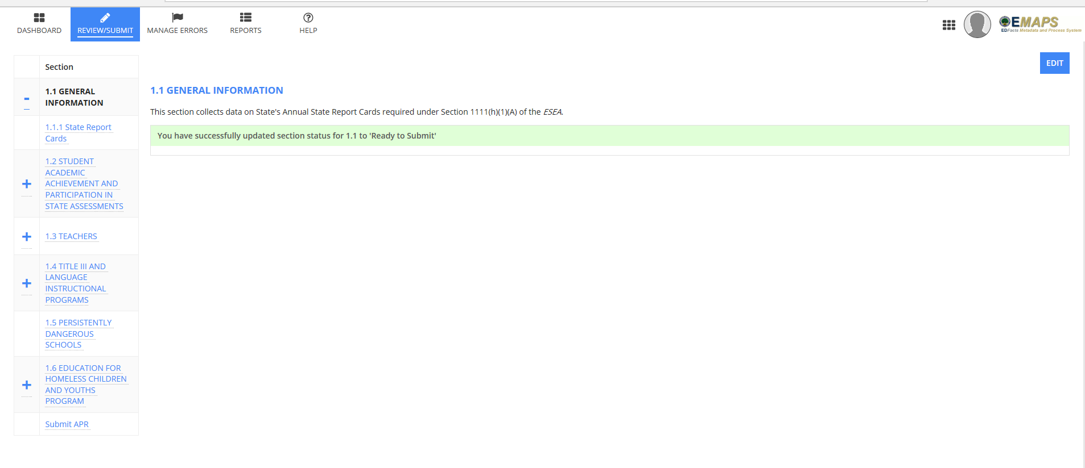
Section in “Ready to Submit” Status

Slide 17
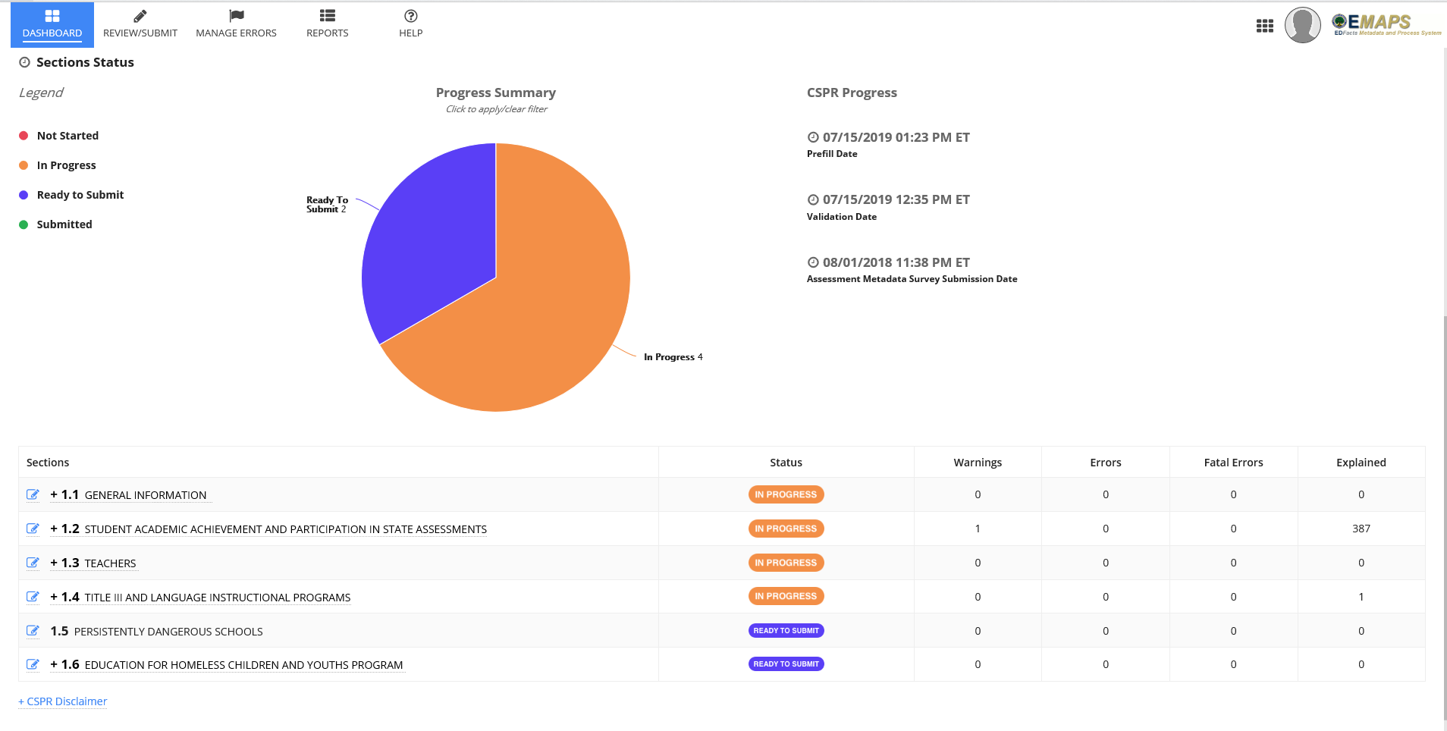
Indicators Status “Ready to Submit”

Slide 18
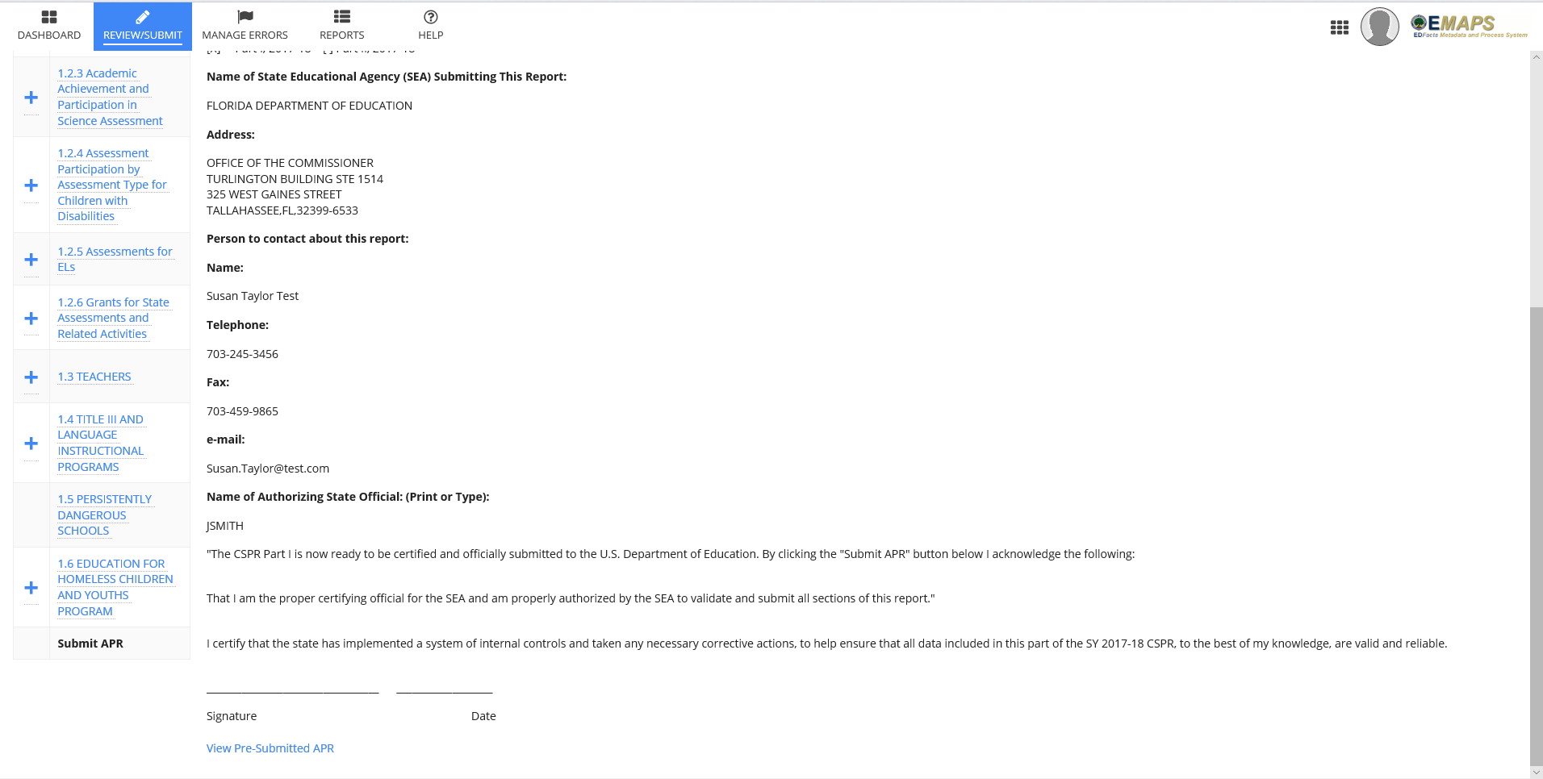
Submit (Certify) APR

Slide 19
Reports

Slide 20
Help Tab

Slide 21
Indicator (Example) – Instructions Page

Slide 22
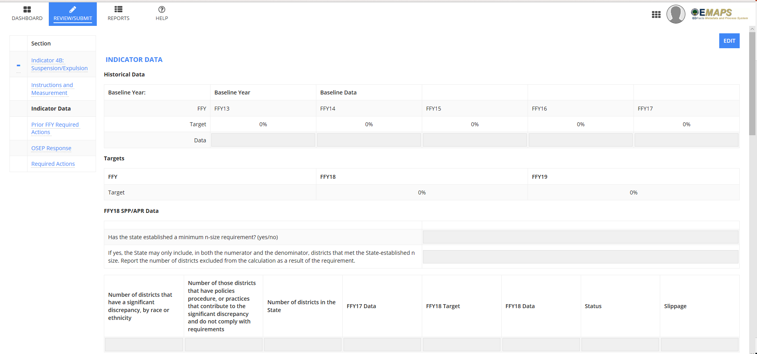
Indicator (Example) – Data Page

Slide 23
Indicator (Example) – Data Page (cont’d)

Slide 24
Indicator (Example) – Prior FFY Required Actions

Slide 25
APR Submitted Document (Example)

Slide 26
Next Steps
Initial reactions
We’ll be looking for your participation during requirements gathering to provide input on operational workflows and be involved in the functionality demos being planned throughout the effort
Stay tuned for communications from ED!

Slide 27
OSEP Disclaimer
2019 OSEP Leadership Conference
DISCLAIMER:
The contents of this presentation were developed by the presenters for the 2019 OSEP Leadership Conference. However, these contents do not necessarily represent the policy of the Department of Education, and you should not assume endorsement by the Federal Government.
(Authority: 20 U.S.C. 1221e-3 and 3474)

