Slide 1
OSEP Symposium: Conveying Our Stories - Displaying our Data

Slide 2
Planning for Effective Communication and Engagement

Slide 3
Slide 3
https://www.youtube.com/watch?v=Dzjgm7RIZIY&t=5s&list=PLOEcbgBUbdMfZdXoE0Y3po6QlDQ5XZvT7&index=5

Slide 4
Effectively Communicating the Results of Your Project – A New Resource
Jill Lammert, Westat
October 10, 2017
The Center to Improve Project Performance was funded with Federal funds from the U.S. Department of Education, Office of Special Education Programs, under contract number ED-OSE-13-C-0049. The project officer was Dr. Patricia Gonzalez. The content of this presentation does not necessarily reflect the views or policies of the U.S. Department of Education nor does mention of trade names, commercial products, or organizations imply endorsement by the U.S. government.

Slide 5
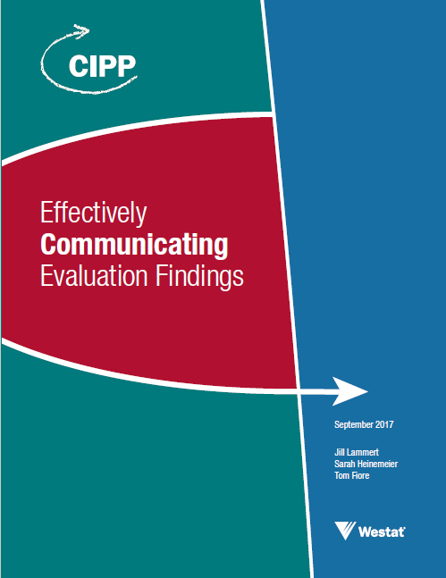
Product Overview
Understanding evaluation data and their function in communicating project success
Developing an effective communication plan
Communicating about evaluation data with current project managers and staff
Communicating with project funders and benefactors
Communicating with current and potential project participants and potential replicators
Communication challenges, ethics, and tools

Slide 6
Understanding Evaluation Data and Their Function in Communicating Project Success
Communicating about evaluation findings can…
Ensure high-quality services are provided
Promote demand for project services
Ensure accountability for current project investments
Share important information with project stakeholders and the field
A comprehensive evaluation is an integral part of an effective communication strategy
Comprehensive evaluation that answers questions for key stakeholders
High quality evaluation data
Effective communication strategies
Effective communication

Slide 7
Linking Evaluation Data to Communication Strategies
What information from the evaluation do you want to share with your audiences and how will you communicate it?
Will the evaluation data you are collecting answer the questions that your audiences will have?
What are the pros and cons of providing (or not providing) a specific piece of information to an audience?
Evaluation Plan
Communication Plan

Slide 8
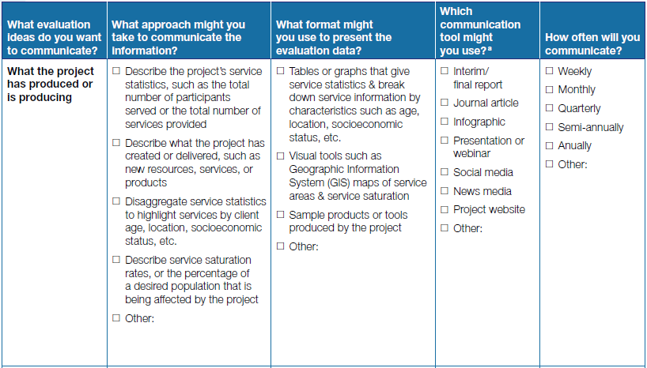
Table 1: Strategy Sheet for Developing a Communication Plan Focused On Communicating Specific Evaluation Information

Slide 9
Developing an Effective Communication Plan
Who are the project’s audiences, and what are their needs for project evaluation data?
Audiences directly connected to the project
Project managers and staff
Funders and benefactors
Participants, potential participants, and potential replicators
Audiences indirectly connected to the project
Public and the media
Professional colleagues
Policymakers

Slide 10
Three Important Questions to Answer for Each Audience
What does the audience need to know?
How will the audience use the information?
What is the best way to communicate information?
Factors that you may want to consider include:
What types of data are most convincing to each audience?
How much data are needed for each audience?
When is the best timing for project communications?
What specific communication tool is best?
What are the cost considerations?

Slide 11
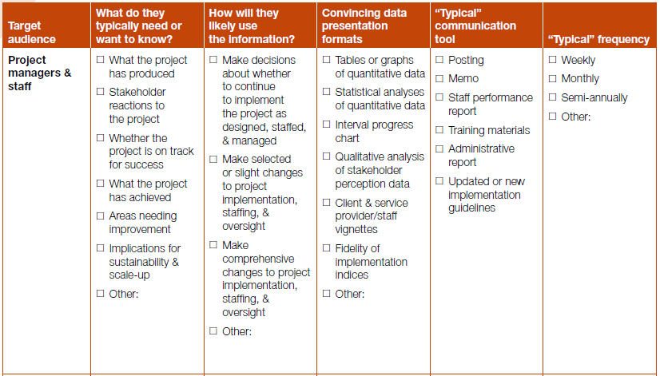
Table 3: Strategy Sheet for Tailoring Communications to Target Audiences

Slide 12
Communicating About Evaluation Data with Current Project Managers and Staff
What project elements are working well?
What project elements need attention and support?
What project elements can or should continue?
What project elements can or should be modified, scaled back, or eliminated?

Slide 13
Figure 2: Example of Using Evaluation Data to Inform Internal Communications
WHAT DO THE DATA SHOW?
MESSAGE TO STAFF BASED ON DATA

Slide 14
How Context Affects Communications with Current Project Managers and Staff
Internal and external expectations regarding project services and outcomes
Adequacy of financial support for project implementation
Social support for project services

Slide 15
Communicating with Project Funders and Benefactors
What does the project do?
Who does the project serve?
Is the project successful (or can/will it be)?
What does the project cost?
What are the opportunities to enhance or expand the project’s success?

Slide 16
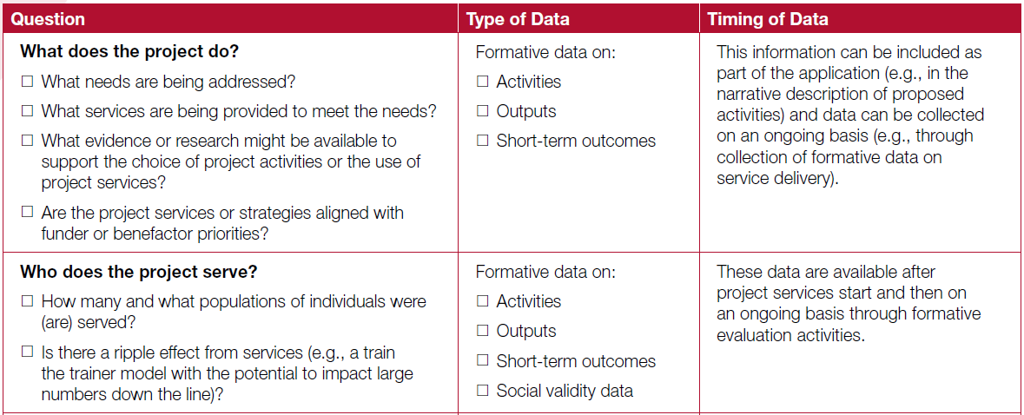
Table 5: Questions that Funders and Benefactors Often Want or Need to Have Answered

Slide 17
Important Considerations When Communicating with Funders
Establish a plan for regular communications early to create a constructive working relationship
Don’t wait to communicate with funders when there are data that suggest the project has encountered challenges
There may be constraints or limitations on activities that might be considered advocacy or lobbying
Funders typically invest in projects to help them accomplish specific goals
Context is important

Slide 18
Communicating with Current and Potential Project Participants
Communicate with project participants to…
Convey how important they are to the project
Ensure they have the data they need to effectively participate
Empower participants to become advocates
They can: recruit more participants, advocate for community support, solicit additional resources
When communicating with project participants…
Use the participant’s primary language, provide oral and written communication, consider social media
Consider context, including…
Ease of access to participation and availability of similar services
Project’s social desirability
Returns on investment for participants

Slide 19
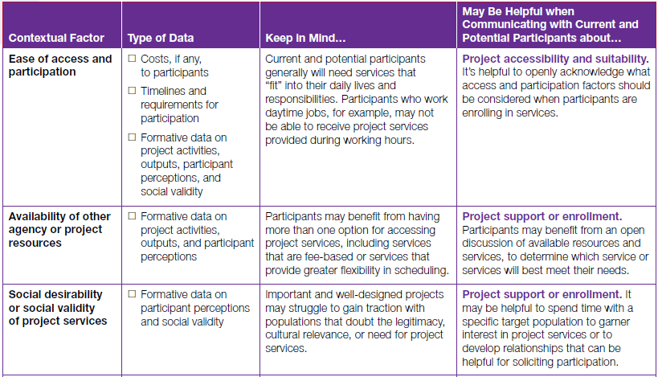
Table 7: Contextual Information to Inform Communications with Current and Potential Participants

Slide 20
Communicating with Potential Replicators
What is the best information to communicate to potential replicators?
Knowing how and when to start
Lessons learned and strategies to improve implementation
General and specific project barriers and supports
Estimated costs
Important contextual factors and evaluation data that may help to inform decisions around these factors

Slide 21
Communication Challenges, Ethics, and Tools
Challenges to clearly and effectively communicating evaluation data
Project and evaluation limitations
Contradictory findings
“Negative” findings or implementation problems
Ethical considerations to keep in mind
Evaluators cannot promise to deliver positive findings

Slide 22
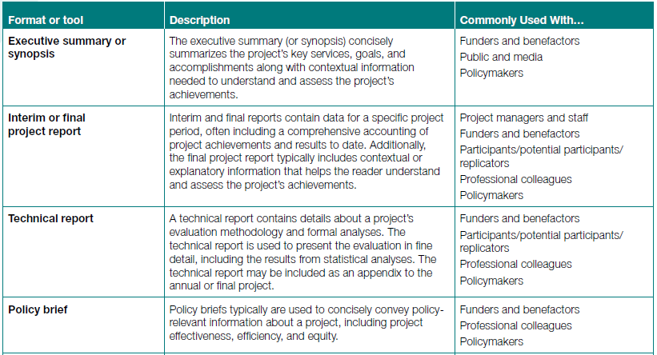
Table 9: Common Tools for Communicating Evaluation Findings

Slide 23
Closing Thoughts
It is important to develop your communication plan in advance, ideally alongside your evaluation plan
Different audiences have different needs for evaluation findings; target communication strategies and tools accordingly
Communicating evaluation findings purposefully and effectively can benefit the project and the field

Slide 24
Contact Us!
CIPP@Westat.com
1-888-843-4101

Slide 25
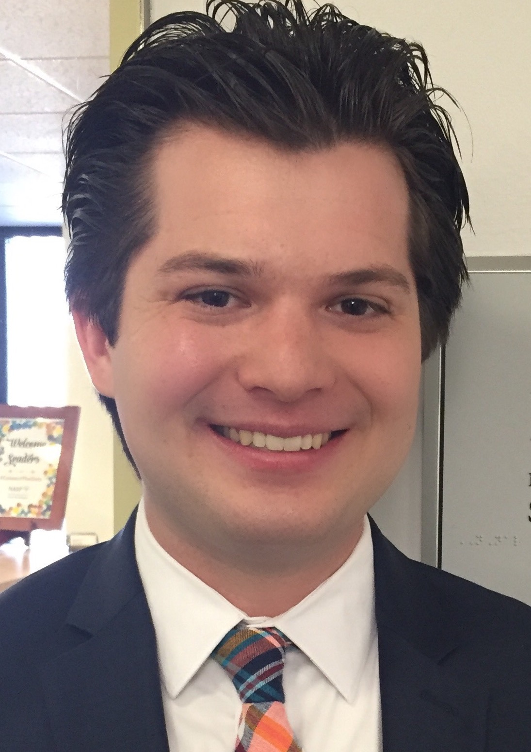
Transforming Information Effectively
Clement Coulston
Manager, Communications & Public Relations National Association of School Psychologists
clement@clementcoulston.com
@clementc26

Slide 26
Communication
Curate Awareness
Enrich Perspectives
Create Connections
Open Opportunities

Slide 27
We have the stories. How can we…
Aggregate them to communicate a comprehensive picture?
Leverage them to communicate systemic impact?

Slide 28
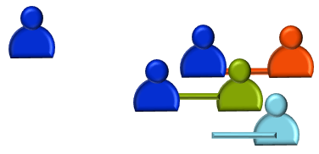
Visuals to Bring Life to Content
Meet people ‘where they are’ on the issue.
Bring people together to build support for addressing the issue.

Slide 29
Ideating, Crafting, and Disseminating Infographics

Slide 30
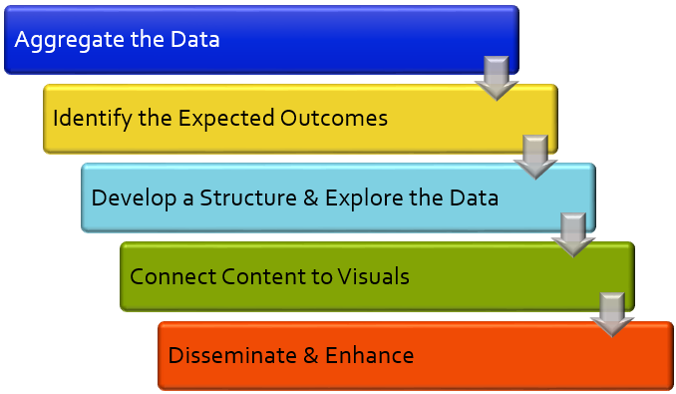
Slide 30

Slide 31
Step 1: Aggregate the Data

Slide 32
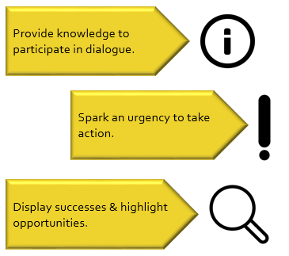
Step 2: Identify the Expected Outcomes
What is the purpose of the infographic?

Slide 33
Step 3: Develop a Structure & Explore the Data
An Introduction Statement (The Why)
Highlights, & Priorities (The What)
Implications, & Actions (The Now)

Slide 34
Step 4: Connect Content to Visuals
Content: Assign team members different tasks to accomplish the goal.
Content: Update the documents to reflect the new timeline.
Search Terms: People, & name badge
Search Terms: Refresh, new, & recycle

Slide 35
Step 5: Disseminate & Enhance
Determine how to best disseminate the infographic and what to include with it.
As stakeholders engage with the material, be mindful to what resonates & surprises.

Slide 36
Three Lessons to Meaningfully Engage Stakeholders

Slide 37
Slide 37
https://www.youtube.com/watch?v=6vJ3uMxEuyI&index=6&list=PLOEcbgBUbdMfZdXoE0Y3po6QlDQ5XZvT7

Slide 38
Making Data Meaningful through Data Visualization
October 10, 2017

Slide 39
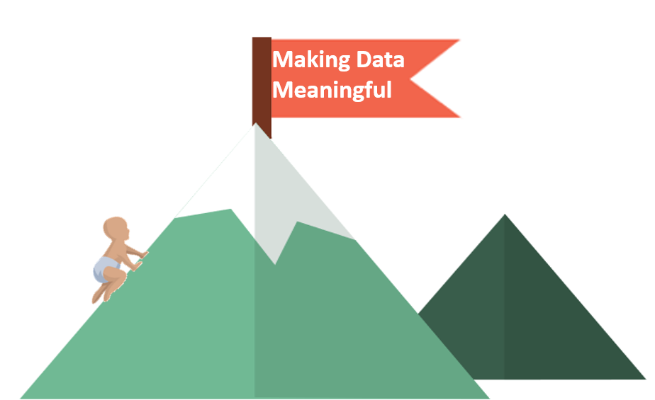
Slide 2
The Challenge

Slide 40
The Challenge
Presenting data or complex information…
in an efficient and meaningful way
that is…
appropriate for your audience.

Slide 41
Making Data Meaningful
Audience
Purpose
Message

Slide 42
Audience
Who are they? What is their role?
What is their most pressing concern that your data can answer?
Why does this issue matter to them?
Do they have a particular point of view?

Slide 43
Purpose
Why are you sharing the information?
Why is this information important to the audience?
Why do you want this information to be important to them?

Slide 44
Message
What is your point?
What is the audience’s key takeaway, decision-point, or action?

Slide 45
Let’s Look at a Child Outcomes Example
All states annually report data on the outcomes children 0-5 achieve in Early Intervention and Early Childhood Special Education.
Data are reported on three functional outcomes
Positive social emotional skills
Acquisition and use of knowledge and skills
Taking actions to meet needs
Outcomes are measured using two summary statements
Percent of children who make greater than expected growth between entry and exit from the program
Percent of children who exit functioning at age expectations

Slide 46
Child Outcomes Data
 | A. Social Skills |  | B. Acquisition and Use |  | C. Meet Needs
 | Social Skills 1 | Social Skills 2 | Social Skills 1 | Social Skills 2 | Social Skills 1 | Social Skills 2
 | 2012
Part C | 71.9 | 62 | 79 | 53.3 | 78.3 | 60.5
Part B 619 | 82.3 | 39.1 | 81.3 | 37.6 | 81.3 | 53.6
 | 2013
Part C | 73.13 | 62.59 | 78.8 | 53.79 | 78.94 | 61.12
Part B 619 | 82.34 | 35.08 | 82.52 | 34.24 | 81.81 | 52.05
 | 2014
Part C | 70.74 | 58.75 | 76.88 | 51.92 | 77.14 | 57.42
Part B 619 | 84.8 | 36.71 | 83.17 | 35.05 | 84.07 | 54.46

Slide 47
Child Outcomes Data
 | A. Social Skills |  | B. Acquisition and Use |  | C. Meet Needs
 | Social Skills 1 | Social Skills 2 | Social Skills 1 | Social Skills 2 | Social Skills 1 | Social Skills 2
 | 2012
Part C | 71.9 | 62 | 79 | 53.3 | 78.3 | 60.5
Part B 619 | 82.3 | 39.1 | 81.3 | 37.6 | 81.3 | 53.6
 | 2013
Part C | 73.13 | 62.59 | 78.8 | 53.79 | 78.94 | 61.12
Part B 619 | 82.34 | 35.08 | 82.52 | 34.24 | 81.81 | 52.05
 | 2014
Part C | 70.74 | 58.75 | 76.88 | 51.92 | 77.14 | 57.42
Part B 619 | 84.8 | 36.71 | 83.17 | 35.05 | 84.07 | 54.46

Slide 48
Example of when charting is not an effective tool

Slide 49
Part C Positive Social Emotional Outcomes, SS1 & SS2

Slide 50
An Example of A Simple, yet Effective Presentation of Data

Slide 51
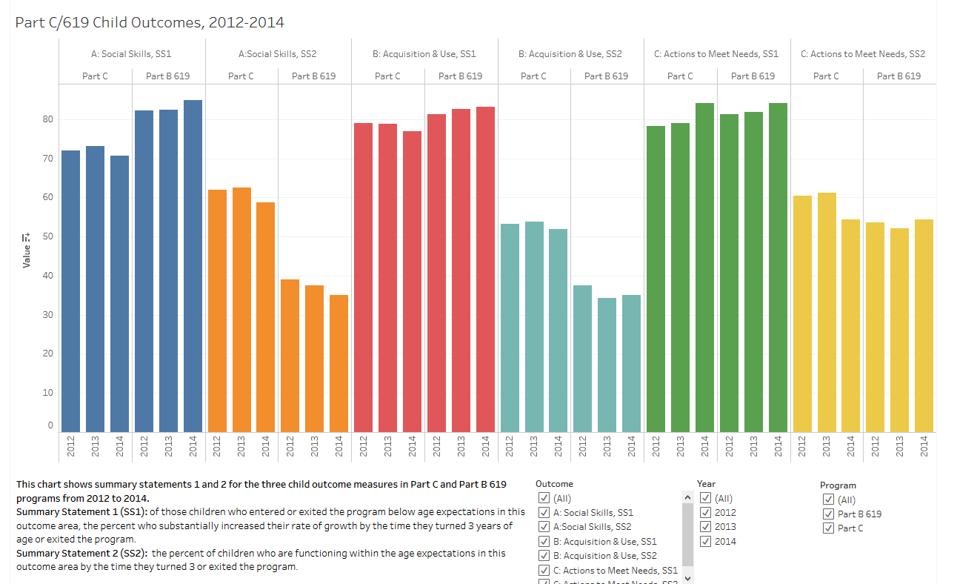
An Example of a Chart Made Using Tableau
https://public.tableau.com/profile/kerry.belodoff#!/vizhome/Test2_448/Dashboard2

Slide 52
DaSy-NCSI Data Visualization Toolkit
http://dasycenter.org/data-visualization-toolkit/

Slide 53
Slide 16
The contents of this presentation were developed under a grant from the U.S. Department of Education, # H373Z120002. However, those contents do not necessarily represent the policy of the U.S. Department of Education, and you should not assume endorsement by the Federal Government. Project Officers, Meredith Miceli and Richelle Davis.

Slide 54
Communicating with Legislators

Slide 55
Slide 2
Jane West Ph.D.
Education Policy Consultant
janewestdc@gmail.com
@janewestdc
October 10, 2017

Slide 56
Slide 3

Slide 57
Your Goals in Meeting with Legislators
Build a relationship so you become a “go to” resource; this is your “first date” of what you hope will be long term
Demonstrate how what the legislator (or the body she serves in) is doing makes a difference (or could make a difference) to her constituents
Provide answers to questions

Slide 58
What do Legislators Want to Know?
Did I (or the body I serve in) have any role in supporting funds or policy for your work?
What problem of public significance (that is or should be on my radar screen) are you addressing?
What is the impact/outcome of your project/grant?
What would the impact be if your project/grant was eliminated? What would the unmet need be?

Slide 59
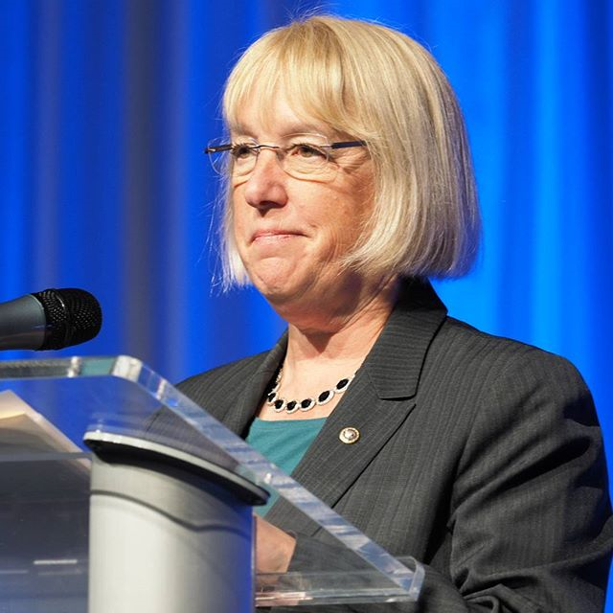
Know Who You are Meeting With
What is their track record on your issue/related issues?
What role do they play in the body where they serve (e.g. Chair of Education Committee?) What authority do they have?
What are their priorities related to your priority in meeting with them? Intersection?
Check their website/twitter/facebook

Slide 60
REMEMBER
You, as a constituent and citizen, are the EMPLOYER of the elected representative – local, state, federal level
By voting “you hire them and you fire them”
However – you are there on behalf of your project so stick to that
Every legislator wants to be informed about what is going on with their constituents
You do not have to agree with them. You can disagree without being disagreeable!

Slide 61
Your Role
A constituent
An expert
A knowledgeable resource with information/expertise and access to important networks
An educator – educate them!
An advocate for students with disabilities and those who serve and support them

Slide 62
Developing “Leave Behinds”
One to two pages! No more
Infographs are great!
Get to the POINT!
Nothing (or VERY LITTLE) on methodology
Highlight IMPACT
Include your contact information

Slide 63
HECSE Template

Slide 64
Slide 11
Notes:
http://www.cec.sped.org/~/media/Files/Policy/Personnel%20Prep/state%20profiles/Kansas.pdf

Slide 65
CEC/HECSE Example Cont.Slide 12

Slide 66
A Good Meeting
Short
Purpose “I am here to share with you the critical impact that funding to support employment for high school students with disabilities has made in your district.”
Combine data and a powerful story
Ask them about their priorities and how you might support them
Be ready to answer “What can I do for you?” THE ASK

Slide 67
Follow Up
Always get emails, contact info for staffers, and leave your card
Follow up with thank yous
Provide any information (IN SHORT FORM) they were interested in or requested
Every couple of months check in with a short email with good news
Invite them to teach your class or visit your program
Attend town halls
Go back at least every year

Slide 68
Advocates not Lobbyists
An advocate informs, educates, provides information and resources
A lobbyist often is paid to ask for funding or legislation etc.
Check with others to confirm your activities to ensure you are inside the guidelines; every state has different rules; public vs. private etc.
Federal funds cannot be used to support lobbying

Slide 69
TWITTER
Most legislators have twitter accounts; do you?
Tweet about your projects regularly! Good practice shortening your message!
Follow your legislators on twitter; tag them when you are reporting results
@janewestdc See you there!

Slide 70
That’s All Folks!

Slide 71
Social Media: New Low-Cost Tools for Effective Outreach

Slide 72
Slide 72
https://www.youtube.com/watch?v=Y_z8AQetv80&index=7&list=PLOEcbgBUbdMfZdXoE0Y3po6QlDQ5XZvT7

Slide 73
Conveying Our Stories – Displaying Our Data: Reflections

Slide 74
Slide 74
Conveying Our Stories - Displaying Our Data
Questions, Actions, and Resources
Effectively sharing and communicating outcomes to meet the information needs of different audiences is often challenging. These are key questions, actions, and resources shared during today’s presentation.
Questions to Ask
Actions to Take
Resources to Review
How are you learning about your audience and why are you sharing this information with them?
Develop an effective, comprehensive communication plan.
DaSy-NCSI Data Visualization Toolkit
How are you translating complex information in ways that resonate and activate?
Never stop engaging with your stakeholders. Learn from and with them.
CIPP TA Product: Effectively Communicating Evaluation Findings
What “leave behinds” are you providing and what follow-up will you pursue?
Utilize social media outlets to meet stakeholders where they are. “Was this page helpful?”
OSEP IDEAs That Work website

Slide 75
Slide 75
Conveying Our Stories - Displaying Our Data
Key Themes
Effectively sharing and communicating outcomes to meet the information needs of different audiences is often challenging. Follow these best practices and tips for more impactful and effective communication efforts!
Set Priority
Maximize and Utilize Talent
Know Your Audience
Review Lessons Learned
Identify the Purpose
Continuously Evaluate & Enhance

Slide 76
Slide 76
Conveying Our Stories - Displaying Our Data Quick Notables
“Communicating evaluation findings purposefully and effectively can benefit the project and the field.”
Convene stakeholders to continuously check for assumptions, identify what is missed, and opportunities for collaboration.
Develop relationships with key stakeholders to recognized as the “go-to” person/group.
Maps, interactive displays, infographics, animation, charts, and data tables are all strategies to visually present data.
“Before change can happen, people need to understand the key issues, become motivated to take action, and recognize how they can make a difference."

Slide 77
Slide 77
Conveying Our Stories - Displaying Our Data Reflection
“Ah-ha!” Moments
2 tweets per items…
Challenges
Surprises
Connections

Slide 78
Questions & Answers

