Slide 1


Slide 2

OVERVIEW
Equity in IDEA
Significant Disproportionality

Slide 3
FLEXIBILITY
Notes:
The Equity in IDEA regulations provide a uniform, national method for analyzing significant disproportionality, BUT one size cannot fit all

Slide 4
Flexibility in Methodology
States set risk ratio thresholds
Categories of Analysis: 14
Widely differing conditions
Notes:
States can’t all use the same risk ratio thresholds.
There are 14 categories of analysis for significant disproportionality, and the risk ratio threshold for one need not be the same as the threshold for another (e.g. identification of African-American children with emotional disturbance and placement of Hispanic children with disabilities in a regular classroom for less than 40% of the day.
Localities can have widely divergent conditions: demographics, poverty, special school districts, etc.

Slide 5
Flexibility in Methodology
States set minimum cell sizes and n-sizes
Small populations
Volatility
Notes:
There is no such thing as a perfect methodology. Every one has limits. Risk ratios can produce volatile results with small populations. States can set minimum cell sizes and n-sizes so they don’t have to measure LEAs for significant disproportionality when a population is too small to produce meaningful results. A finding of significant disproportionality won’t, for example, be the result of one or two families moving in or out of a district.

Slide 6
Flexibility in Methodology
States may make determinations only after multiple years
Optional
Up to three years
“Multiple years of data”
Notes:
Analysis for significant disproportionality required annually, but determination may be made after looking at LEA performance over prior one, two, or three years, i.e. only find significant disproportionality if risk ratio exceeds risk ratio threshold for three consecutive, immediately prior years. Addresses both volatility and realistic time required for systematic change.

Slide 7
Flexibility in Methodology
Reasonable progress
Optional
Above risk ratio threshold but…
Lowering risk ratio for the two prior consecutive years
Details determined by State
Notes:
No determination of significant disproportionality if risk ratio, though above the risk ratio threshold, decreases. Reasonable progress must be defined by State. Given the time it takes to make systematic change, why interrupt something that is working?

Slide 8
Flexibility in Timing
General compliance date: 7-1-18
Include children 3 – 5 in significant disproportionality analysis by: 7-1-20
Notes:
Must have standard methodology in place and begin using by July 1, 2018. Children 3-5 need not be included in significant disproportionality analysis until: July 1, 2020. Early implementation at the option of the State.

Slide 9
REASONABLENESS
Notes:
Underlies all flexibilities in the standard methodology.

Slide 10
Reasonableness
Guides all State determinations:
Risk ratio thresholds
Cell sizes and n-sizes
Reasonable progress
Notes:
Another kind of flexibility, in a sense. Reasonableness in all of the circumstances – taking into consideration all relevant facts and characteristics, such as racial and ethnic composition, enrollment demographics, conditions correlated with disability, etc.

Slide 11
Reasonableness
Presumptively reasonable:
Minimum cell sizes <= 10
Minimum n-sizes <= 30

Slide 12
Comprehensive CEIS

Slide 13
Comprehensive CEIS
Expanded. May be provided to:
Children with Disabilities
Children ages 3 – 5
Whereas “voluntary” CEIS may not.
Notes:
As opposed to voluntary CEIS, which may not be provided to children with disabilities or children ages 3 – 5.

Slide 14
Comprehensive CEIS
Must be targeted to address the factors contributing to significant disproportionality
Notes:
E.g. lack of access to instruction or diagnostic screening; economic, cultural, linguistic barriers to appropriate identification and placement; inappropriate use of disciplinary removals; differences in achievement; etc.

Slide 15

Examining Success Gaps to Identify Factors That Contribute to Significant Disproportionality
OSEP Symposia Series
Significant Disproportionality: Why This Topic is Important to All of Us February 8, 2017
Nancy O’Hara
Tom Munk
Julie Bollmer

Slide 16
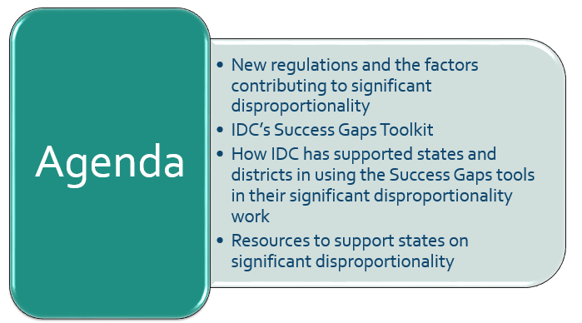
Examining Success Gaps to Identify Factors That Contribute to Significant Disproportionality

Slide 17
Identifying the Factors Contributing to Significant Disproportionality
34 CFR §300.646(d)(1)(ii)
When the state determines that significant disproportionality is occurring in a local education agency (LEA), that LEA “must identify and address the factors contributing to the significant disproportionality.”

Slide 18
Some Factors That May Contribute to Significant Disproportionality
“a lack of access to scientifically based instruction;
economic, cultural, or linguistic barriers to appropriate identification or placement in particular educational settings;
inappropriate use of disciplinary removals;
lack of access to appropriate diagnostic screenings;
differences in academic achievement levels; and
policies, practices, or procedures that contribute to the significant disproportionality.”
34 CFR §300.646(d)(1)(ii)

Slide 19
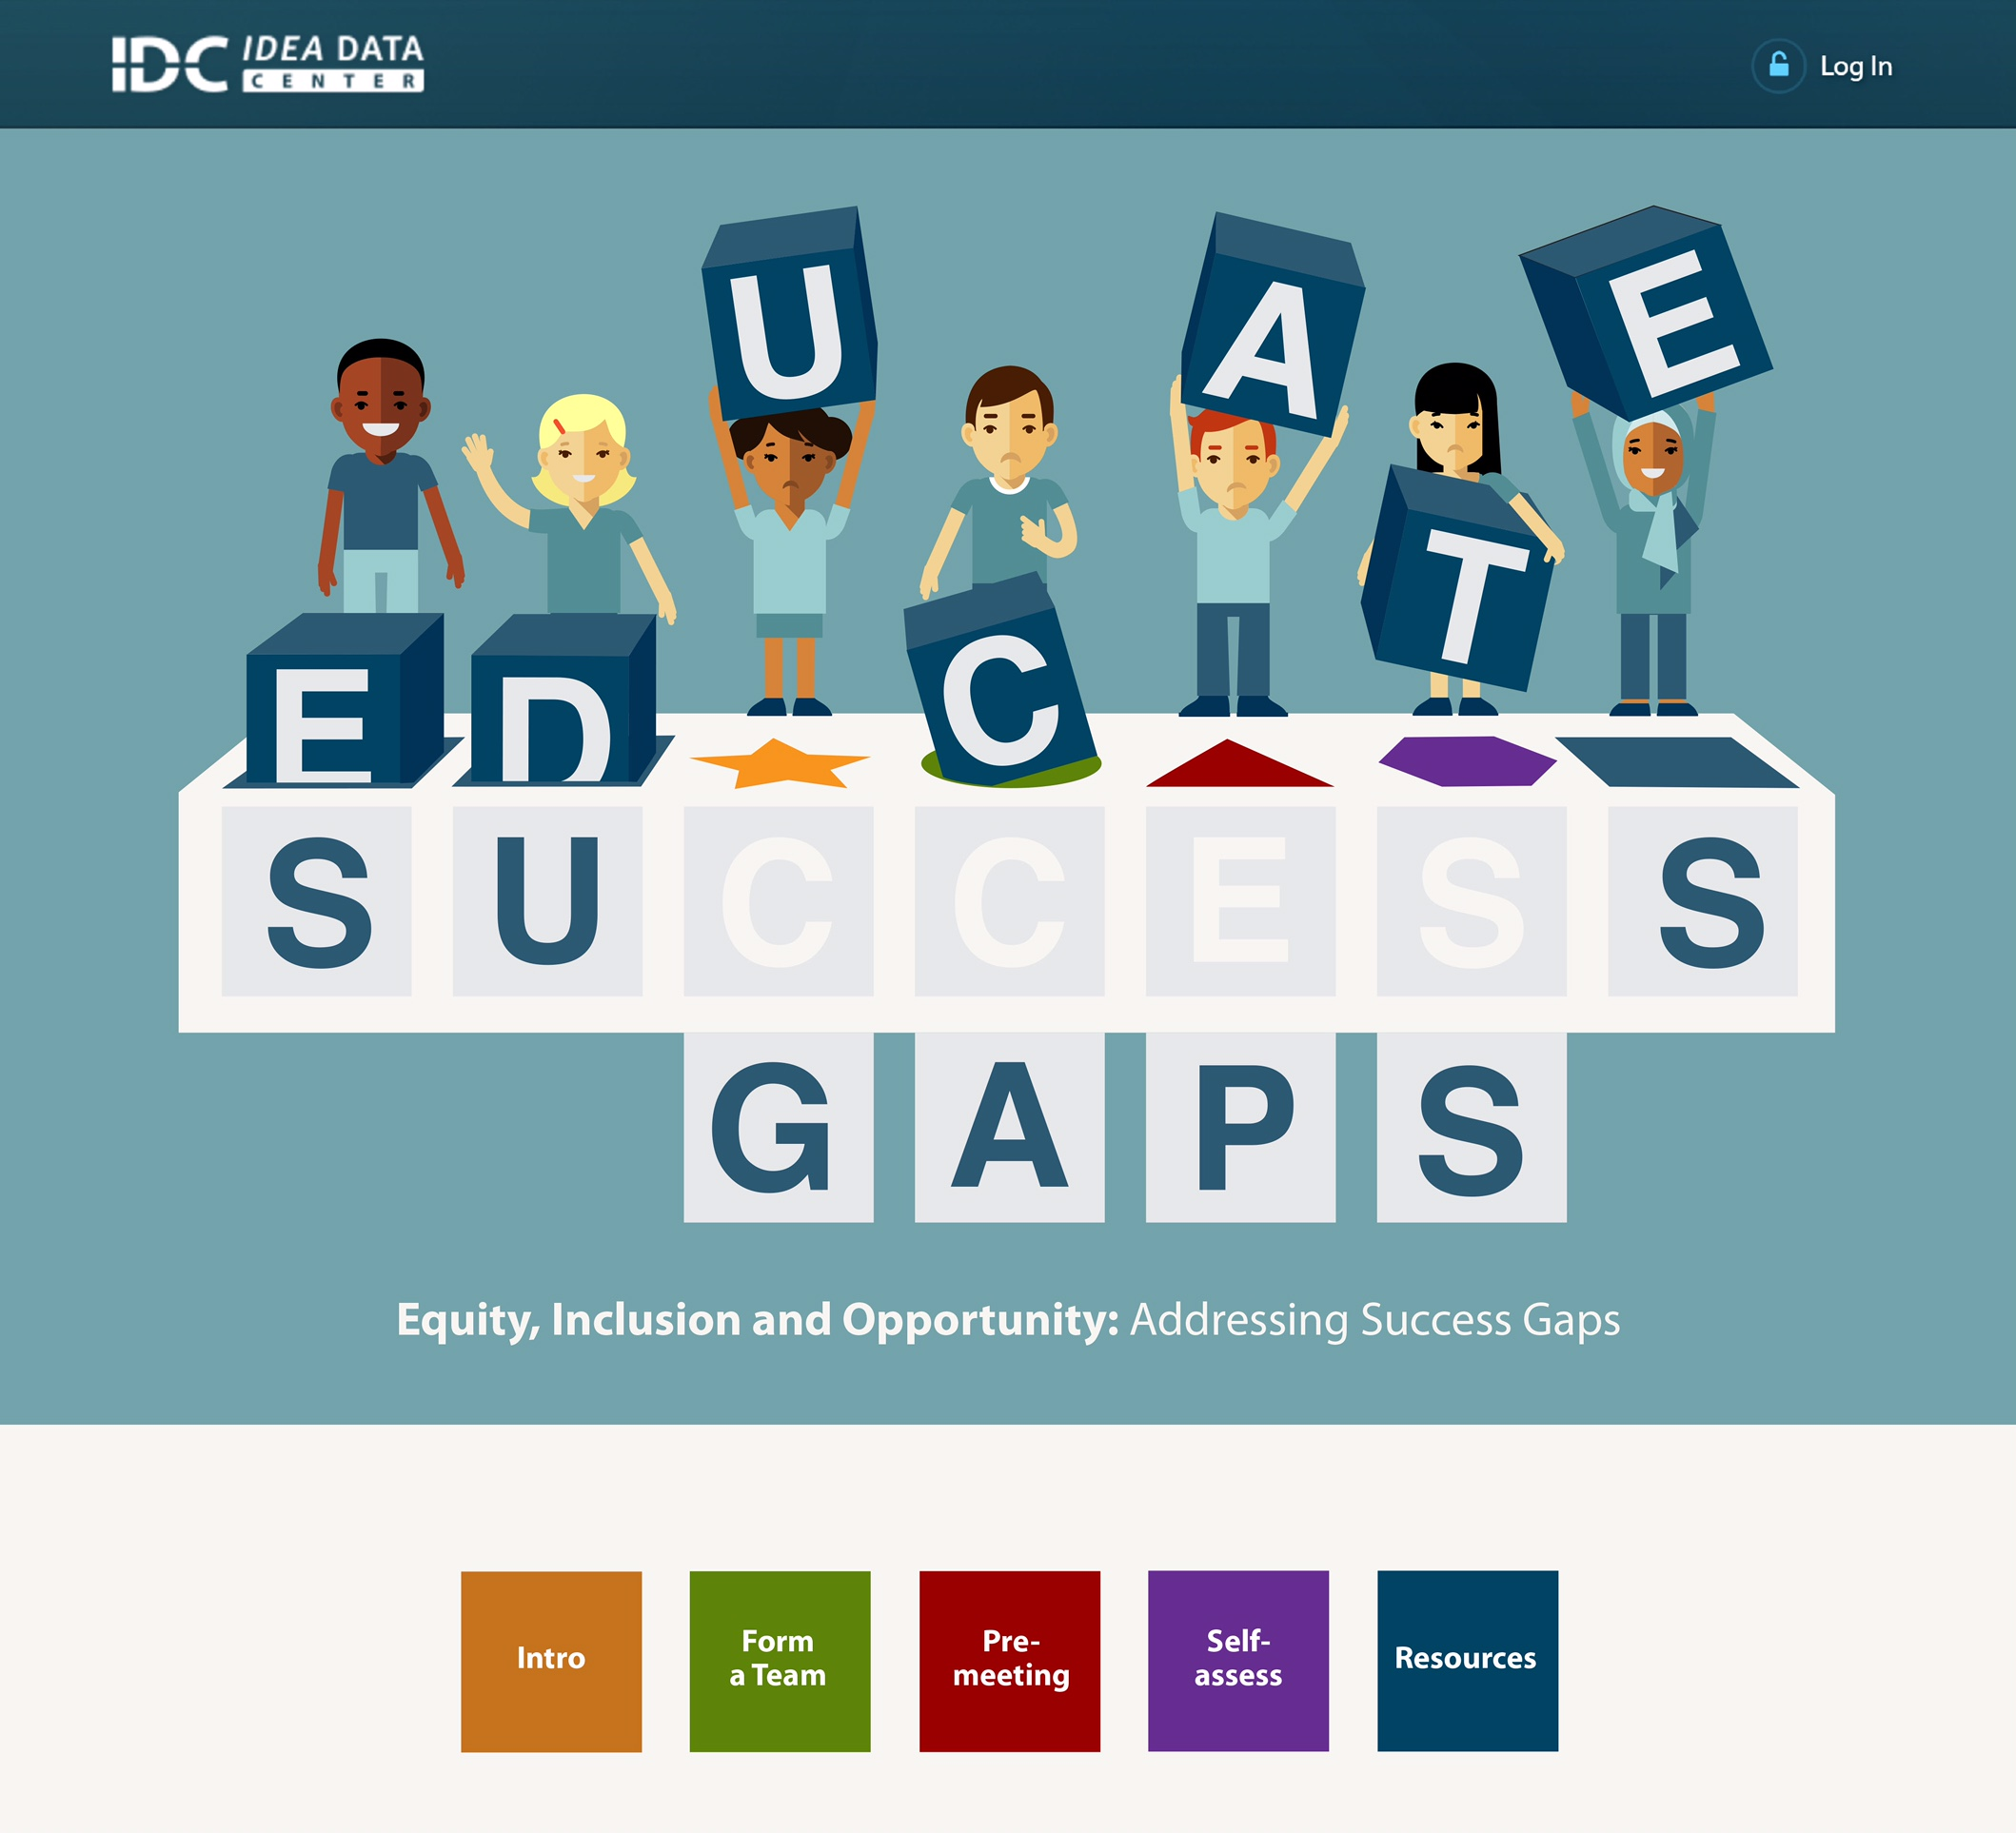
How Do We Identify the Factors?
IDC Toolkits
Notes:
https://toolkits.ideadata.org/

Slide 20
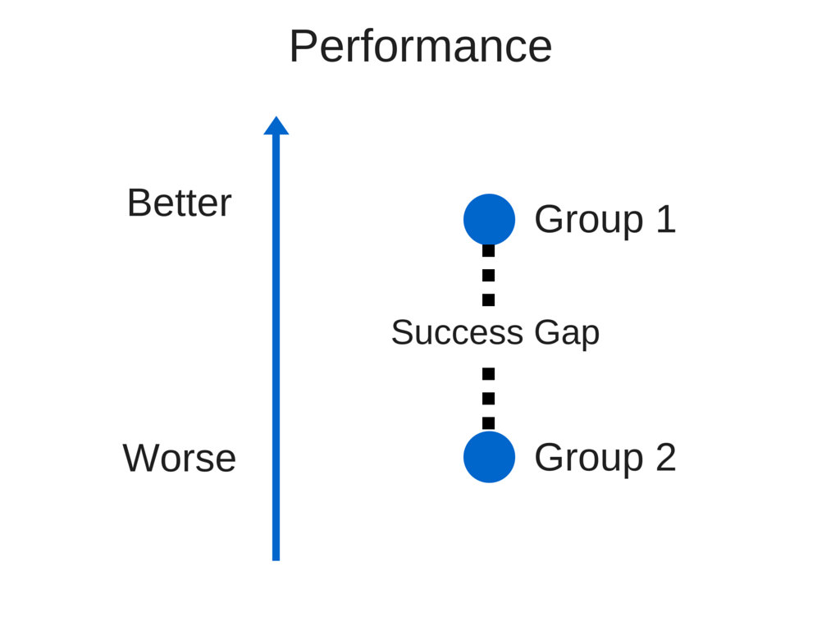
What Is a Success Gap?

Slide 21
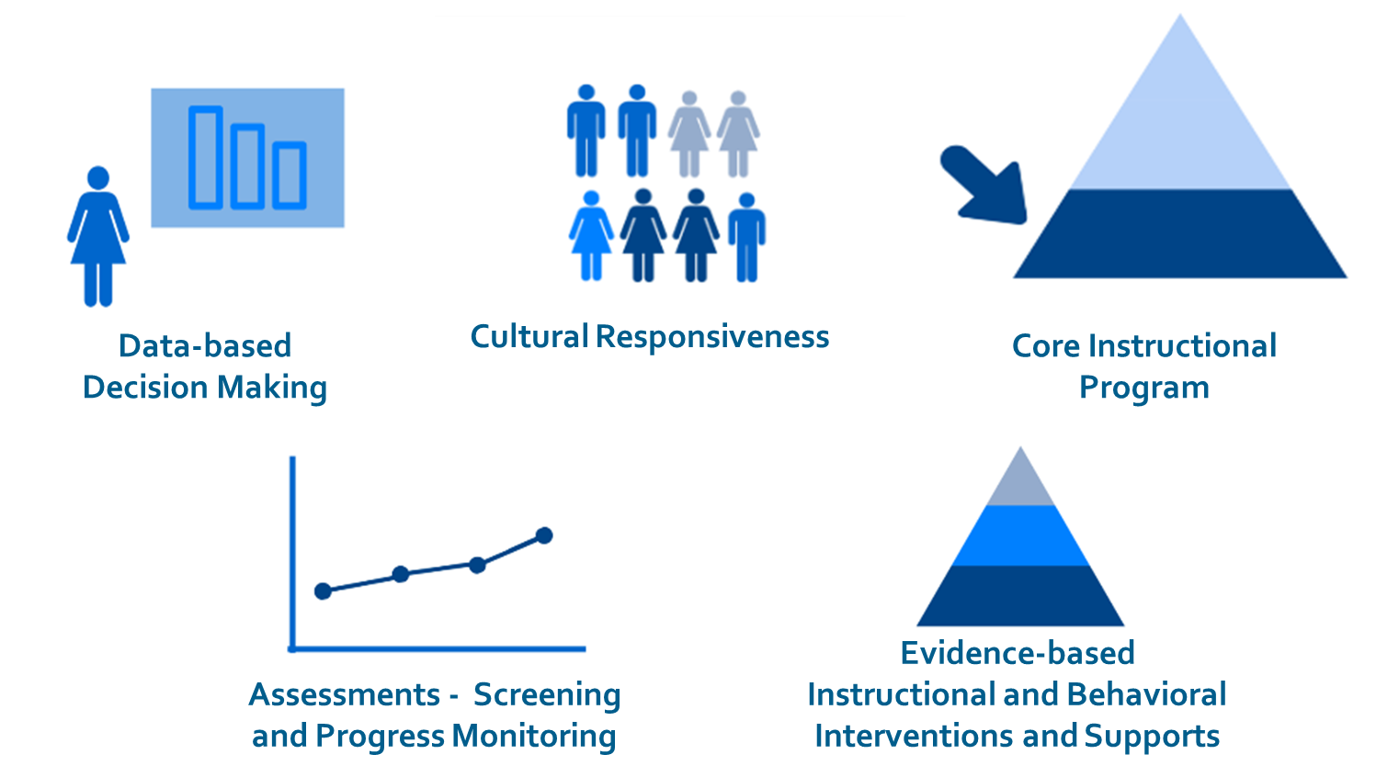
Equity, Inclusion, and Opportunity Can Lessen Success Gaps Between Groups of Students

Slide 22
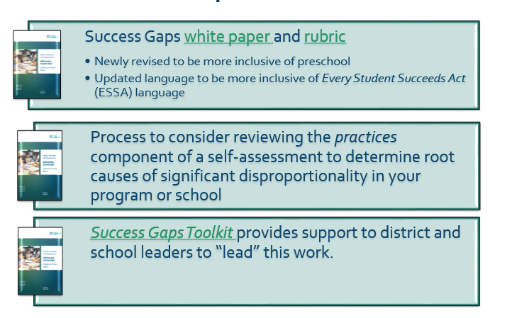
Success Gaps Toolkit

Slide 23

How to Use the Toolkit to Identify the Factors –
It Is a Process!
Form a local stakeholder team to focus on the significant disproportionality:
  Identify the target group and topic area of your key success gap – your area(s) of significant disproportionality.
  Include on your team:
    family members representative of the group that is disproportionate;
    general and special ed staff who work with the target group;
    general and special ed staff who work with students who are succeeding; and
    community members who may work with the disproportionate group.

Slide 24

How to Use the Toolkit to Identify the Factors –
It Is a Process! (cont.)
Determine the root cause(s) of the success gap by using the rubric for group discussion and decision making:
  Plan to commit time to this process over multiple meetings
  Disaggregate data to keep digging into the problem
  Document the evidence for your decisions/ratings on the rubric
Develop a plan of action to address the factors identified

Slide 25

IDC Toolkits
Notes:
https://toolkits.ideadata.org/

Slide 26
How Have States Used IDC’s Success Gaps Materials To Address Disproportionality?
Success Gaps materials are designed to be used at the district or school level.
States have used these materials to have districts/schools take a deeper look at the root causes of their significant disproportionality
  as part of a self-assessment process along with the reviews of policies and procedures; and
  as a process for identifying root cause prior to developing an improvement plan.

Slide 27
IDC Can Help Build State Capacity
Work with states working on various forms of disproportionality, for example
  All areas of significant disproportionality, including
    Suspension and expulsion of Black or African American students with disabilities
    Overidentification of White students in the Other Health Impairments category
    Overidentification of Hispanic/Latino students in the Specific Learning Disabilities category

Slide 28
IDC Can Help Build State Capacity (cont.)
Often start with state capacity building
  Preparing state staff to know and understand the materials
    Deeper understanding of significant disproportionality
    Become familiar and experienced with the materials in order to facilitate use of Success Gaps at the district or school level
  Partnering with state staff to plan and facilitate “forums” for significant disproportionality in their state

Slide 29
IDC Can Help Build District or School Capacity
Capacity building at the district or school level
  Districts/schools bring teams to a multi-day forum to use the Success Gaps materials to identify root causes and start to develop a plan
  Team members continue the work when they return to the district or school with a more complete team
  States may select a few districts for more in-depth work in partnership with IDC:
    Districts with long-standing significant disproportionality
    Districts that are not yet identified, but approaching the threshold

Slide 30
Resources for Significant Disproportionality from ED
The New Regulations
Fact sheet: Equity in IDEA
OSEP Memo 08-09. Coordinated Early Intervening Services (CEIS) Guidance

Slide 31
IDC Resources for Determining Significant Disproportionality
  Methods for Assessing Racial/Ethnic Disproportionality in Special Education: A Technical Assistance Guide (Revised) (more revisions coming to align with new regulations) (IDC)
  Spreadsheet Application for Calculating Disproportionality Measures and User’s Guide (revisions coming to align with new regulations) (IDC)
IDC Resource for Identifying Factors That May Contribute to Significant Disproportionality
  Success Gaps Toolkit (IDC)

Slide 32
Additional Related Resources
CEIS Resources Step-by-Step (CIFR)
Quick Reference Guide on CEIS (IDC & CIFR)
MOE Reduction Eligibility Decision Tree and Worksheet (IDC)
Navigating CEIS White Paper and FAQ (IDC)
IDEA Data Training Modules – Module 3 May Data Submission (IDC)
618 Data Pre-submission Edit Check Tool - Part B MOE and CEIS (CIFR & IDC)
EMAPS User Guide: IDEA Part B MOE Reduction and CEIS

Slide 33

For More Information
Visit the IDC website
http://ideadata.org/
Follow us on Twitter
https://twitter.com/ideadatacenter
Follow us on LinkedIn
http://www.linkedin.com/company/idea-data-center

Slide 34




The contents of this presentation were developed under a grant
from the U.S. Department of Education, #H373Y130002. However, the contents do not necessarily represent the policy of the Department of Education, and you should not assume endorsement by the Federal Government.
Project Officers: Richelle Davis and Meredith Miceli

Slide 35
How SEAs and LEAs Can Take a Lead on Significant Disproportionality 2.0
Edward Fergus, Ph.D.
Assistant Professor
Educational Leadership and Policy

Slide 36
Policy Context and Research Question
The 2004 reauthorization of IDEA required state education agencies (SEA) to identify districts found with “significant disproportionality” to set aside up to 15% of Part B funds for coordinated early intervening services (CEIS).
The policy to practice question is, how are school districts translating the guidance on CEIS funds utilization into strategies for remedying racial/ethnic disproportionality?
This paper focuses on secondary data collected of districts cited for significant disproportionality in 2011 to 2013 by an SEA.

Slide 37
Data
Sample of 12 districts cited for significant disproportionality in various areas.
Sample districts received special targeted technical assistance in the form of a grant and an external consultant.
Districts required to participate in a 4-part process involving a self-review, root cause analysis, identification of remedy areas, and implementation of remedies

Slide 38
District Racial/Ethnic Student enrollment composition 2011-12
 | Percent White | Percent Black | Percent Latino | Percent Asian | Percent FRLP | Sig. Dis. Citation
District 1 | 30% | 12% | 15% | 30% | 35% | Black students, ED
District 2 | 20% | 19% | 55% | 1% | 60% | Black students, ED
District 3 | 10% | 9% | 78% | 1% | 84% | Black students
District 4 | <1% | 17% | 79% | <1% | 81% | Black students, ED
District 5 | 8% | 3% | 48% | 30% | 41% | White students, ED
District 6 | 20% | 3% | 66% | 4% | 81% | White students

Slide 39
District Racial/Ethnic Student enrollment composition 2011-12
 | Percent White | Percent Black | Percent Latino | Percent Asian | Percent FRLP | Sig. Dis. Citation
District 7 | 32% | 4% | 49% | 6% | 50% | Black students
District 8 | 41% | 5% | 37% | 7% | 38% | Black students
District 9 | 23% | 11% | 46% | 8% | 59% | Black students, ED
District 10 | 12% | 11% | 25% | 39% | 61% | Black students, ED
District 11 | 11% | 21% | 50% | 11% | 64% | Black students, ED
District 12 | 26% | 1% | 65% | 5% | 64% | Black students

Slide 40
findings

Slide 41
Overview of professional development and intervention activities
District | RTI | PBIS/MTSS | Equity Consultant/CRE training | Data Consultant/ system | Specific Interventions | Equity goals
District 1 | X | X | X | X | X
District 2 |  |  | X | X | X
District 3 | X | X |  | X
District 4 | X | X | X
District 5 | X | X |  |  | X
District 6 |  | X | X |  | X
District 7 |  | X | X | X |  | X
District 8 | X | X | X | X
District 9 | X | X | X
District 10 | X | X | X | X | X
District 11 | X | X |  | X | X
District 12 |  | X | X | X |  | X

Slide 42
Findings 1: LEAs are following policy provisions
Apparent across the sample districts is the overwhelming utilization of CEIS funds to support professional development and intervention support on RTI, PBIS/MTSS, Data consultant/system, and CRE consultant/training.
For example, the RTI activities included:
  convenings to develop an RTI framework;
  the development of student support teams and related forms;
  differentiated training of general education teachers;
  training on Solution Tree RTI resources;
  literacy training for special education and general education teachers; and
  training on pre-referral interventions (e.g., PRIM manual).

Slide 43
Finding 1: LEAs are following policy provisions
The PBIS/MTSS activities similarly focused on training teachers on new systems and on specific interventions such as PEACE Builders. In two districts PBIS/MTSS activities involved trainings on crisis prevention, and legal requirements of suspension.
The utilization of consultants for culturally responsive education (CRE) and data systems or analysis appeared often.
Concern: The utilization of external consultants, particularly on CRE topics is the tendency of these activities to appear in these CEIS plans as “one time” activities without development of institutionalized equity goals. On the other hand, the data analysis or systems consultancy suggests the potential of certain analysis capacities becoming institutionalized practice.

Slide 44
Finding 1: LEAs are following policy provisions
Though the CEIS plans may only provide a window into how districts are interpreting the guidance provided by SEA on fund expenditures regarding disproportionality, they do begin to give some indication as to whether this initial form of plan could yield direct and/or indirect effect on disproportionality. A concern of these CEIS plans is the absence of information regarding professional development or intervention quality and/or fidelity monitoring.

Slide 45
Finding 2: Limited districts with language on equity in CEIS plans
Though the identification of patterns of racial/ethnic disproportionality in special education may direct school districts to consider race-based issues in their policies, practices and procedures it has not directed districts to consider adopting equity guided goals.
Despite the low incidence of equity goals or activity identified as part of the CEIS plans, the districts in which explicit language on equity goals appeared suggest a district commitment to addressing racial/ethnic disproportionality as a systemic issue versus compartmentalized to singular policies, practices or procedures.

Slide 46
Sample school board adopted policy
“The District values students’ individuality and culture and recognizes that disparities in academic achievement, socio-emotional adjustment and behavior between student subgroups have complex roots. The causes of this resulting disproportionality are complex and cross many social systems. The District is committed to examining the root causes of disproportionality and to take action to eradicate these disparities. By addressing the root causes, the District will ensure that factors such as race, ethnicity, gender and socio-economic status are not predictors of which students will be suspended or expelled, referred for special education services or over or under identified for a variety of services and programs such as the gifted and talented program and the Advanced Placement (AP) Program”

Slide 47
Discussion
One of the important preliminary findings in this paper is the overwhelming pattern of districts identifying professional development on “research-based” interventions and/or supports for the population in the citation. These interventions primarily focused on literacy and behavioral supports.
Finally, there was a small proportion of districts identifying activities in which equity and/or proportional examination was included as a policy tool.
This last finding raises questions as to whether CEIS funded activities will lead to substantive reductions in racial/ethnic disproportionality.

Slide 48
Implications
Need for additional data collection on CEIS plans and implementation – greater attention is needed on quality.
The lingering question then is, should there be further guidance on the process of examination that SEA provides LEA in examining disproportionality in order to ensure CEIS funds focus on bias-based issues of the racial/ethnic disproportionality citation?
This micro-level examination of LEAs in one state suggest that SEAs may need to closely to determine whether the CEIS fund activities are compartmentalizing the problem or making system-wide reforms.

Slide 49
recommendation: alignment of Comprehensive CEIS Plans and Root Cause Approach

Slide 50
Root Cause Processes
SEAs are already conducting root causes as component of significant disproportionality identification.
Numerous tools available for conducting root cause analyses on disproportionality:
  Disproportionality book
  Technical Assistance Center on Disproportionality
  IDC IDEA Data Center
  AIR
Notes:
https://us.corwin.com/en-us/nam/book/solving-disproportionality-and-achieving-equity
http://steinhardt.nyu.edu/metrocenter/center/technical_assistance/program/disproportionality/resources/publications
https://ideadata.org/resource-library/57ae50ea140ba0532a8b459e/
https://safesupportivelearning.ed.gov/addressing-root-causes-disparities-school-discipline

Slide 51
Comprehensive CEIS Plans
SEAs are already requiring school districts to develop comprehensive CEIS Plans closely connected to root cause analysis.
  California
  SEAs should also consider infusing into the outline of these comprehensive CEIS plans the framework from the National Implementation Research Network.
Notes:
California: http://www.cde.ca.gov/sp/se/qa/disproguidance112011.asp
NIRN: http://nirn.fpg.unc.edu

Slide 52


Slide 53
ADD PHIL STRAIN VIDEO HERE

Slide 54

Equity in School Discipline: Enhancing Commitment through Teacher Training

Slide 55
ADD KENT MCINTOSH VIDEO HERE

Slide 56
Building an Equity Lens into Instructional Improvement Practice: Santa Cruz City School District
Edward Fergus, Ph.D.
Assistant Professor
Educational Leadership and Policy
@eddiearcia

Slide 57
Santa Cruz City School District
Identified by California Department of Education as Significantly Disproportionate for Black/African American students in 2012-13 SY
Conducted root cause analysis and identified various causes including instructional quality, absence of culturally responsive approach in educational practice and policy, and inconsistent effect of intervention strategies.

Slide 58
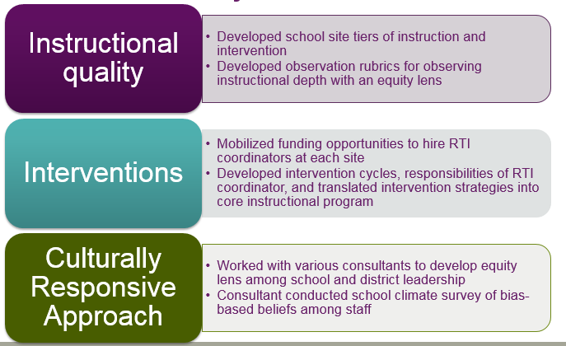
2013- Present CEIS Activities connected to root cause analysis

Slide 59
Sample observation tools developed by SCCS leaders with an equity lens

Slide 60
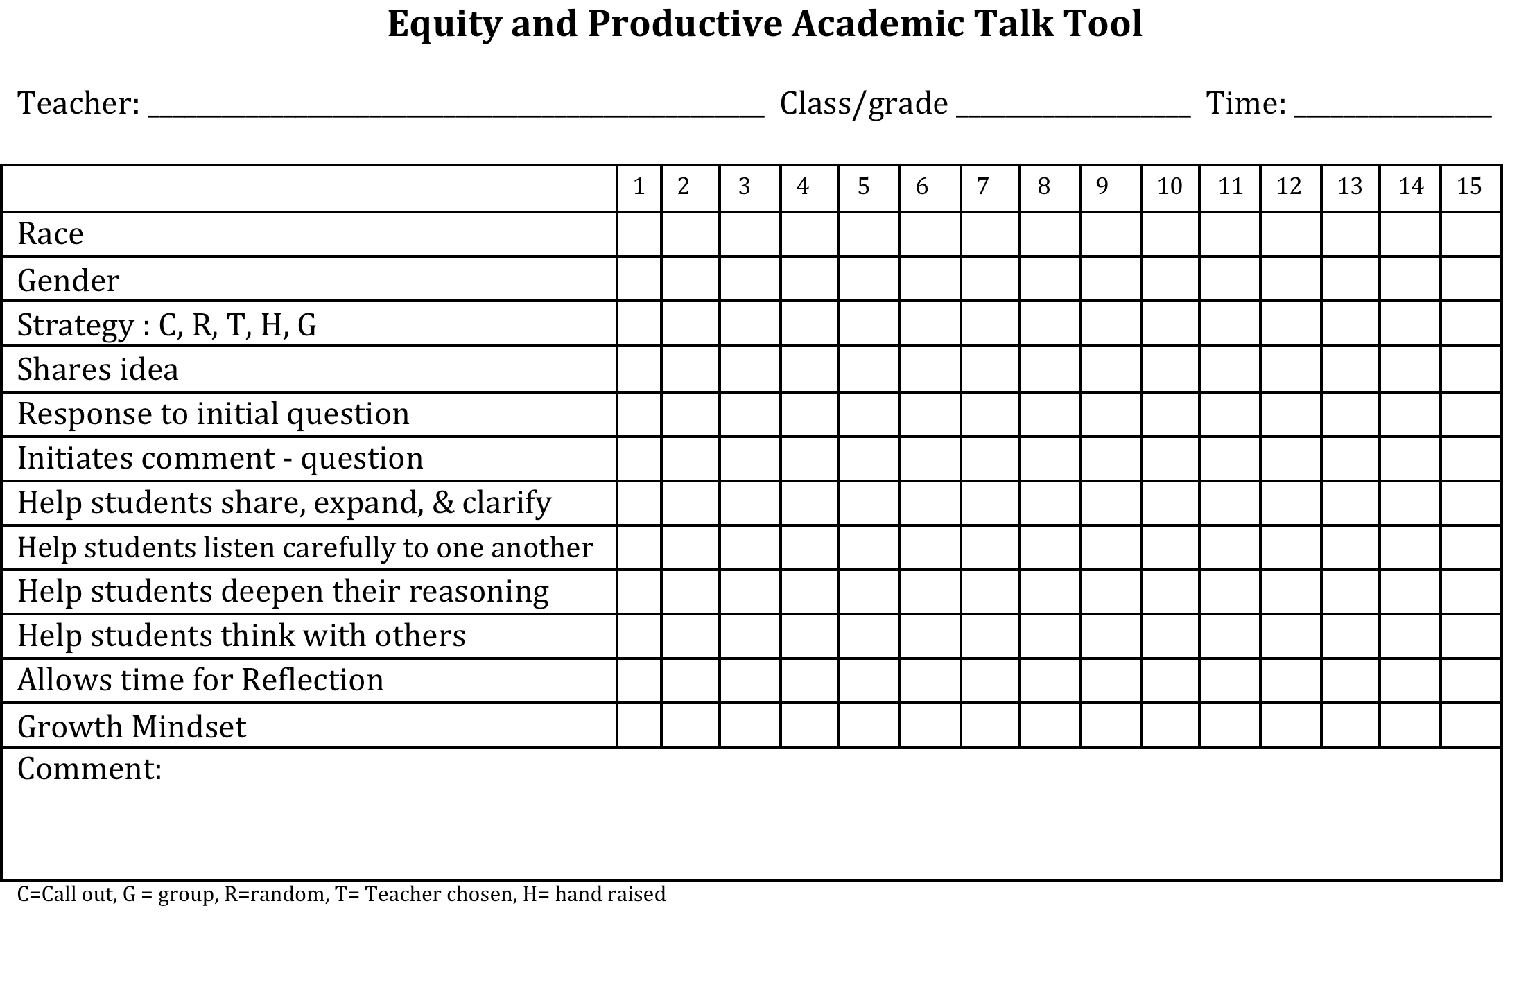

Slide 61
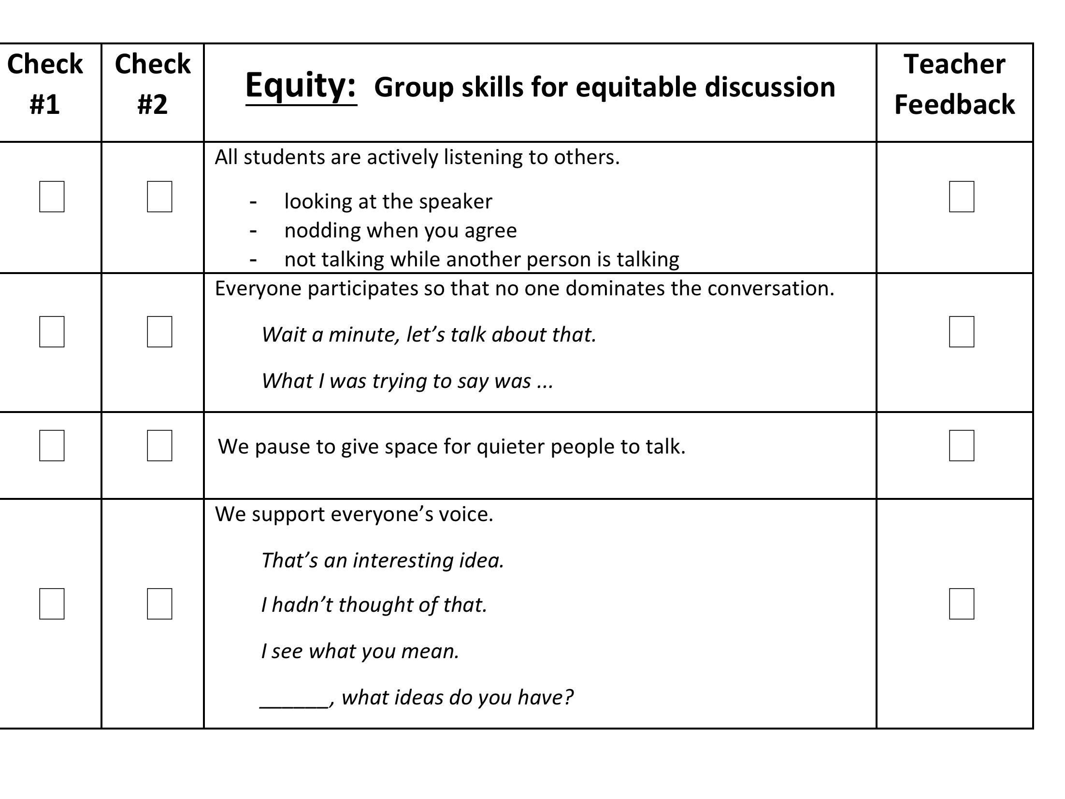
Collaborative Work Rubric:

Slide 62

QUESTIONS
&
ANSWERS

