Slide 1
Notes:
The Council of Chief State School Officers (CCSSO) is a nationwide, nonpartisan, and nonprofit membership organization.
CCSSO serves the chief state school officer and their departments of education in states and territories and has a total of 57 members.
With the adoption and implementation of the Common Core and other college- and career-ready standards, the bar has been raised for students to achieve at higher levels.
As a result, the bar has also been raised for teachers, principals, and those who prepare them for those roles.
We as leaders in education have a responsibility to help students learn.
By asking students to do more, we’ve made a promise to help them leave high school college- and career-ready
There should be multiple ways to enter the education profession and all providers should be held to high standards.
This report is the first in a series of reports that will focus on different components of the developmental continuum for teachers and leaders.
This report was written by chiefs, for chiefs.
We were assisted by NGA and NASBE and an expert advisory group of various stakeholders.
Chiefs will partner with the profession to align and leverage national accreditation and state program approval processes to ensure development of quality educators

Slide 2
Learner-Ready Teachers
More specifically, learner-ready teachers have deep knowledge of their content and how to teach it;
they understand the differing needs of their students, hold them to high expectations, and personalize learning to ensure each learner is challenged;
they care about, motivate, and actively engage students in learning; they collect, interpret and use student assessment data to monitor progress and adjust instruction;
they systematically reflect, continuously improve, and collaboratively problem solve; and
they demonstrate leadership and shared responsibility for the learning of all students.
On day one of their careers, teachers should be able to model and develop in students the knowledge and skills they need to succeed today including the ability to think critically and creatively, to apply content to solving real world problems, to be literate across the curriculum, to collaborate and work in teams, and to take ownership of their own continuous learning.

Slide 3
School-Ready Principals
With other stakeholders, they craft the school’s vision, mission, and strategic goals to focus on and support high levels of learning for all students and high expectations for all members of the school community.
To help transform schools, they lead others in using performance outcomes and other data to strategically align people, time, funding, and school processes to continually improve student achievement and growth and to nurture and sustain a positive climate and safe school environment for all stakeholders.
They work with others to develop, implement and refine processes to select, induct, support, evaluate, and retain quality personnel to serve in instructional and support roles.
They nurture and support professional growth in others and appropriately share leadership responsibilities.
Recognizing that schools are an integral part of the community, they lead and support outreach to students’ families and the wider community to respond to community needs and interests and to integrate community resources into the school.
On day one on the job, principals should be able to blend their energy, knowledge, and professional skills to transform school learning environments in ways that ensure all students will graduate college and career ready.

Slide 4
State Levers for Change
Licensure
Program Approval
Data Collection, Analysis, and Reporting
four recommendations
four recommendations
two recommendations

Slide 5
Licensure
Revise licensure standards to support the teaching and leading of more demanding content aligned to college- and career-readiness (CCR)
Work together to influence the development of innovative licensure performance assessments that are aligned to CCR and include multiple measures of educators’ ability to perform, including evidence of student achievement and growth.
Create multi-tiered licensure systems aligned to a coherent developmental continuum that reflects new performance expectations for educators and their implementation in the learning environment and to assessments that are linked to evidence of student achievement and growth.
Work toward true licensure reciprocity across states
Notes:
States will revise and enforce their licensure standards for teachers and principals to support the teaching and leading of more demanding content aligned to college- and career-readiness and critical thinking skills to a diverse range of students.
States will work together to influence the development of innovative licensure performance assessments that are aligned to the revised licensure standards and include multiple measures of educators’ ability to perform, including the potential to impact student achievement and growth.
States will create multi-tiered licensure systems aligned to a coherent developmental continuum that reflects new performance expectations for educators and their implementation in the learning environment and to assessments that are linked to evidence of student achievement and growth.
States will reform current state licensure systems so they are more efficient, have true reciprocity across states, and so that their credentialing structures support effective teaching and leading toward student college- and career-readiness.

Slide 6
Program Approval
Will hold preparation programs accountable by exercising the state’s authority to determine which programs should operate and establishing a clear and fair performance rating system to guide continuous improvement.
Adopt and implement rigorous program approval standards including around highly selective admissions and exit criteria and high quality clinical practice
Require alignment of content standards to PK-12 student standards for all areas in which candidates seek licensure.
Provide feedback, data, support, and resources to preparation programs to assist them with continuous improvement.
Notes:
States will hold preparation programs accountable by exercising the state’s authority to determine which programs should operate and recommend candidates for licensure in the state, including establishing a clear and fair performance rating system to guide continuous improvement. States will act to close programs that continually receive the lowest rating and will provide incentives for programs whose ratings indicate exemplary performance.
Adopt and implement rigorous program approval standards to assure that educator preparation programs recruit candidates based on supply and demand data, have highly selective admissions and exit criteria including mastery of content, provide high quality clinical practice throughout a candidate’s preparation that includes experiences with the responsibilities of a school year from beginning to end, and that produces quality candidates who are capable of positively impacting student achievement.
States will require alignment of content standards to PK-12 student standards for all areas in which candidates seek licensure.
States will provide feedback, data, support, and resources to preparation programs to assist them with continuous improvement and to act on any program approval or national accreditation recommendations.

Slide 7
Data Collection, Analysis, and Reporting
Develop and support state-level governance structures to guide confidential and secure data collection, analysis, and reporting of PK-20 data and how it informs educator preparation programs, including
the need for unique educator identifiers,
the mobility of data across state lines,
links to non-traditional preparation providers, and
the sharing of candidate data among organizations and across states.
Use data collection, analysis and reporting of multiple measures for continuous improvement and accountability of preparation programs.
Notes:
States will develop and support state-level governance structures to guide confidential and secure data collection, analysis, and reporting of PK-20 data and how it informs educator preparation programs, hiring practices, and professional learning. Using stakeholder input, states will address and take appropriate action, individually and collectively, on the need for unique educator identifiers, the mobility of data across state lines, links to non-traditional preparation providers, and the sharing of candidate data among organizations and across states.
States will use data collection, analysis and reporting of multiple measures for continuous improvement and accountability of preparation programs.

Slide 8
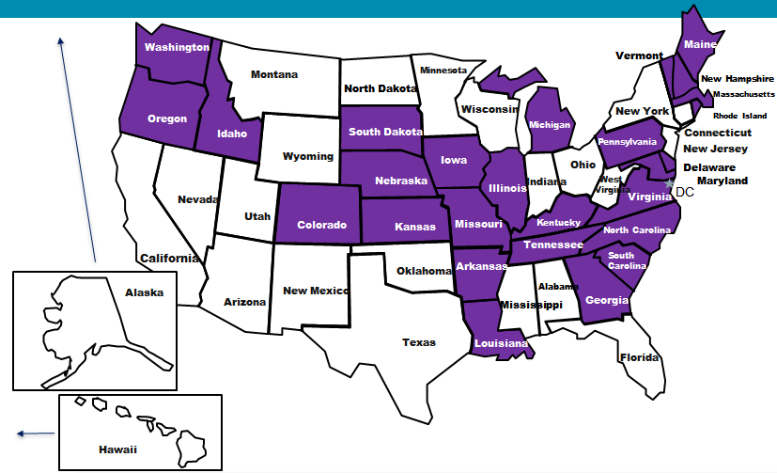
27 States Supporting the Recommendations
Maine
Virginia
Notes:
NEXT STEPS
CCSSO in collaboration with NASBE and NGA will provide a pilot for 8-10 states to implement the recommendations.
CCSSO will provide chiefs with communications and advocacy support at the state and national level.
CCSSO will also identify and share lessons learned across states in the following areas:
Implementation of existing pre-service performance assessments including edTPA, PACT, California TPA, and others regarding their potential use in making licensure decisions.
Identification of necessary standard data elements, determine the appropriate policies (especially with respect to privacy and security), and understand the technology needs in order to implement candidate record exchange allowing all candidates and practicing teachers access to their own Education Data Passport.

Slide 9
Next Steps: Launching a Network of States Ready for Implementation
Applications for states to participate in a pilot to implement the recommendations in the task force were sent to state chiefs on May 8
Completed applications are due on June 28
Selection of pilots will be announced in mid-July
First state convening will be August 27-29, Portland Oregon

Slide 10
How CCSSO will Support the Pilot State Network
CCSSO will assist states in
conducting a self-assessment and setting clear expectations for the outcomes of the work that will be agreed upon through a memorandum of agreement
building consensus within and across preparation faculty and PK-12 educators on what a beginning teacher and principal should know and be able to do
developing robust stakeholder involvement strategies

Slide 11
How CCSSO will Support the Pilot State Network
CCSSO will work with pilot states collectively and individually to:
redesign program approval policies
redesign licensure systems
create new data systems
to support transformation of educator preparation and entry systems.

Slide 12
How CCSSO will Support the Pilot State Network
CCSSO will also
provide technical assistance to pilot states on strategies for implementing their state policies (e.g., guidelines, rules, regulations, statutes, etc.) for licensure, program approval, and data collection, analysis, and reporting
advocate for and solicit input from pilot states to inform the reauthorization of the Higher Education Act and the ESEA, along with the Title II regulations for both the Higher Education Act and ESEA to support transformation of educator preparation and entry systems.

Slide 13
Contact Information
Taskforce Report is available online at:
www.ccsso.org
Search “Our Responsibility, Our Promise”
Kathleen Paliokas, Director, InTASC, CCSSO
kathleenp@ccsso.org

