Slide 1
State Advisory Panel (SAP) and
State Interagency Coordinating Council (SICC)
2017-18 Webinar Series
May 15, 2018
The Center for IDEA Early Childhood Data Systems presents
Building Stakeholder Knowledge About Data
Recording Transcripts

Slide 2
Welcome!
Thanks for joining today. We will begin very soon.
To prevent background noise from interfering with the call, your line is muted on entry.
During the presentation you will have an opportunity to ask questions and make comments at any time, by using the chat.
You will receive a short evaluation survey after the webinar. Please take a few minutes to give us your input.

Slide 3
Discussion Questions
  In what ways does your state engage its SAP/SICC in using data for decision-making/advising? Please describe the specific types of data use activities in which representatives/stakeholders engage.
  What is going well with how your SAP/SICC is using data? What is not going so well?
  In what ways do you think your SAP/SICC representatives could benefit from using the toolkit?

Slide 4
Agenda
Welcome from OSEP
  Ruth Ryder
Introduction of topic and presenters
Siobhan Colgan
Introduction to DaSy Building Stakeholder Knowledge About Data Toolkit
  Betsy Ayankoya & Amy Nicholas
Closing Comments and Announcements
  Stephanie Moss

Slide 5

Building Stakeholder Knowledge About Data
Betsy Ayankoya & Amy Nicholas
SAP/SICC Network
May 15, 2018
In collaboration with the

Slide 6
The Role of Stakeholders in Data Conversations
Stakeholders of various types serve as key advisors on activities and decision-making around IDEA program lead agency responsibilities.
Many stakeholders, however, do not have the needed knowledge about those data and other data-related initiatives/topics to participate fully and meaningfully in conversations.

Slide 7
Data-Related Knowledge for IDEA Stakeholders
The responsibilities of IDEA systems-level stakeholders
may include partnering with the state’s lead agency in:
Developing program policies and procedures (e.g., legislative/regulatory policies);
Collaborating with influential groups and government officials to achieve full participation, coordination, and cooperation of all appropriate private and public agencies; and
Monitoring the implementation of the statewide system of services and addressing program quality issues.

Slide 8
Data-Related Knowledge for IDEA Stakeholders (cont.)
Effectively fulfilling these responsibilities requires
stakeholders to have knowledge about a variety of data-related topics, such as:
How data are used as information for decision-making
Federal and state data collection and reporting requirements for IDEA programs
Data privacy and confidentiality considerations
The ways and reasons why IDEA programs are linking data with data from other programs

Slide 9
DaSy Family Data Institutes (2015/16)
Designed to support states with strengthening family engagement in conversations about Part C/619 state-level programmatic data by:
Providing family leaders with an orientation to data and data topics commonly involved in systems-level discussions and decision-making.
Helping family leaders ask good questions about data.
Planning for opportunities for family leaders to participate in data-related activities.

Slide 10
Participating States
Year 1, 18 states: AK, CT, GA, HI, LA, MA, MI, MN, MT, NE, NM, NV, NY, OR, PA, TX, UT, WI
Year 2, 11 states: CO, IL, KS, MD, NC, ND, NH, RI, SD, VA, VT
About 45 participants each year
State teams ranged in size from 2 to 5 participants

Slide 11
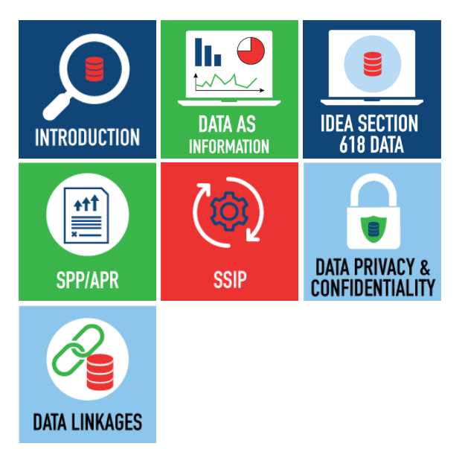
Online Toolkit: Building Stakeholder Knowledge About Data
This toolkit provides stakeholders with an orientation to IDEA data and other data-related topics to help them meaningfully participate in conversations about important programmatic issues and decisions.

Slide 12
What is included in the toolkit?
Information, activities, and other resources to increase stakeholders’ knowledge and understanding of:
Data as Information
IDEA Section 618 Data
The State Performance Plan/Annual Performance Report (SPP/APR)
The State Systemic Improvement Plan (SSIP)
Data Privacy and Confidentiality
Cross-Program/Agency Data Linkages

Slide 13
What information is provided about each topic?
Brief overview of the topic
Key points about the topic that stakeholders need know
A content presentation providing more in-depth information about the topic
Suggestions for how stakeholders can take what they learned about the topic and apply it to their state’s context
Supplemental resources on the topic

Slide 14
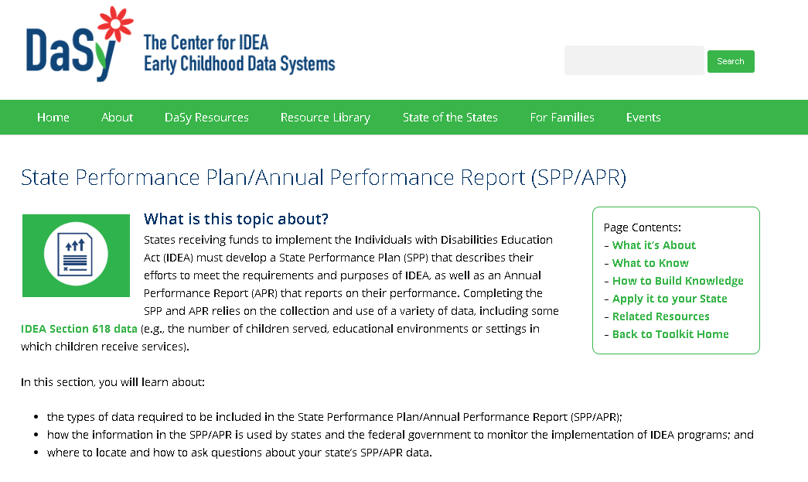
Let’s Take a Look Inside the Toolkit!

Slide 15
Discussion Questions
  In what ways does your state engage its SAP/SICC in using data for decision-making/advising? Please describe the specific types of data use activities in which representatives/stakeholders engage.
  What is going well with how your SAP/SICC is using data? What is not going so well?
  In what ways do you think your SAP/SICC representatives could benefit from using the toolkit?

Slide 16
Contact Information
Betsy Ayankoya
  (919) 962-7313
  betsy.ayankoya@unc.edu
Amy Nicholas
  (919) 962-3457
  amy.nicholas@unc.edu

Slide 17
Visit the SAP-SICC website
OSEP Collaboration Space SAP/SICC
Check out the State Resources at
OSEP Collaboration Space SAP/SICC Resources
For example, specific to our webinar topic today
DaSy Center Resources for Families

Slide 18

We want to hear from you!
Resources you are willing to share on the SAP-SICC website
Questions, comments, feedback
Topics for future webinars
info@stateadvisorypanel.org

Slide 19
Accessing information after this webinar
Information from SAPs and SICCs as well as archived webinars with PowerPoint presentations are available at:
OSEP Collaboration Space SAP/SICC

Slide 20
Please tell us how we are doing
Each registered participant will get a short evaluation immediately following this webinar. Please take a few minutes to share your insights.
SAP SICC Webinar Survey
Thanks you for your participation today!

