Slide 1
State Advisory Panel (SAP) and State Interagency Coordinating Council (SICC)
2020-2021 Webinar Series
January 28, 2021
Authentic Stakeholder Engagement
- - - - - - - - - - - - - - - - - - - - - - - - - - - - - - - - - - - - - - - - - - - - - - - - - - - - - - - - - - - - - -
SAP & SICC
Notes:
Registration Link: https://wested.zoom.us/meeting/register/tJErfuusqTwoG90NIXwIHiGKon7jgRC0wRZd

Slide 2
Welcome!
Welcome – We are so happy that you have joined us today.
Today we will be discussing stakeholder engagement on you Advisory Panel or Interagency Coordinating Council.
*Captioning services are provided through the ZOOM platform. Please locate access to this service at the bottom right of your screen.
- - - - - - - - - - - - - - - - - - - - - - - - - - - - - - - - - - - - - - - - - - - - - - - - - - - - - - - - - - - - - -
SAP & SICC
Notes:
(AL)
Welcome to our webinar today. In this webinar we want to share with you strategies for engaging stakeholders on your Advisory panel or Interagency Coordinating Council. This PPT and the script that we will be using will be posted to our website following this presentation.
If you are in need of captioning services, you may access this at the bottom right of your screen.
First, let us introduce and identify who will be leading this webinar today.
Today our presenters consist of:
Anne Louise (NCSI)
Christine Pilgrim (OSEP)
Angela Mcquire and Amy Peterson (NCSI)
Christine Germeyer (VA State Special Education Advisory Council)
Today’s webinar topic was chosen from direct input received through gathered SAP and SICC identified needs at the OSEP Leadership conference and the EC conference ECTA.

Slide 3
Have any additional activities?
Quick Poll
Who is Joining Us Today?
- - - - - - - - - - - - - - - - - - - - - - - - - - - - - - - - - - - - - - - - - - - - - - - - - - - - - - - - - - - - - -
SAP & SICC
Notes:
(AL)
Who is joining us today?
Review audience - welcome
SET UP POLL
SAP Member
SICC Member
National TA Center
OSEP
PTI Staff
CPRC Staff
Other (identify?)

Slide 4
Agenda
Recent SPP/APR Revisions Regarding Parent Engagement
Strategies for Virtual Meetings
Strategies for Discussions and Decision-making
Strategies for Engaging non-English Speakers
Resources for Stakeholder Engagement
Notes:
(AL) [up to this point should be 5 mins]
Today’s session is to provide you with a variety of strategies for authentic engagement of the stakeholders throughout your state and more focused, within your SAP or ICC through in-person and virtual engagement.
READ SLIDE
Now let me turn this over to Christine Pilgrim from the Office of Special Education, Monitoring and State Improvement Planning Division.

Slide 5
Stakeholder Engagement in IDEA
IDEA Expectations- formats, functions & representation
Role of State Interagency Coordinating Councils and State Advisory Panels
Parent emphasis throughout IDEA
Notes:
(MSIP) [YOU HAVE 10-13 MINUTES FOR YOUR SECTION}
Thank you, Anne Louise.
1. IDEA expects stakeholder engagement in many facets of the educational system to meet the needs of students with disabilities, performing many types of functions with different levels of engagement including to advise, develop, recommend, implement.... In many different types of forums.
Students-IEP meetings
States-public reporting on state websites of reports and data such as expected in the State Performance Plan/Annual Performance Report,
Committees- State Systemic Improvement Plan in the development and implementation of the SIMR, targets, activities and evaluation.
Resources- Parent Training Information Centers, Community Resource Centers
2. Stakeholders also are diverse in their representation: One state describes it this way... * Stakeholders and tribal nations include: district and school educators and staff, students, parents and families (particularly, parents and families of students most directly impacted), community members which may include culturally specific community-based organizations, “the state’s” federally recognized tribes, school board members, early learning providers, and other community partners.
3. As you are all aware, SAP and SICC are designed purposefully to engage stakeholders to advise (as is the case with SAP) and advise/assist (as with SICC) the work of the SEA and LA, respectively.
4. Throughout IDEA you will note a strong parent participation emphasis as noted in the types of engagement just identified, IEP meetings, resource centers specific to meet parent needs, participation on committees.

Slide 6
Stakeholder Engagement: State Performance Plan/Annual Performance Report
States are expected to report the “mechanisms for soliciting broad stakeholder input on the State’s targets in the SPP/APR and any subsequent revisions that the State has made to those targets, and the development and implementation of Indicator B17 and C11, the State’s Systemic Improvement Plan (SSIP).” (FFY 2020 SPP/APR package)
Notes:
(MSIP)
Since the inception of the SPP/APR Stakeholder Involvement in 2014, states have been expected to report the mechanisms for soliciting broad stakeholder input on the State’s targets in the SPP/APR and any subsequent revisions that the State has made to those targets, and the development and implementation of Indicator B17/C11 , the State’s Systemic Improvement Plan (SSIP).
USDOE, OSEP, 2020- Measurement Table

Slide 7
Stakeholder Engagement: State Performance Plan and Annual Performance Report
Beginning February 2022, states will be including:
The number of parent members and a description of how the parent members of the State Interagency Coordinating Council/State Advisory Panel, parent center staff, parents from local and Statewide advocacy and advisory committees, and individual parents were engaged in target setting.
Description of the activities conducted to increase the capacity of diverse groups of parents to support the development of implementation of activities designed to improve outcomes for infants, toddlers and children with disabilities and their families;
The mechanisms and timelines for soliciting public input for target setting, analyzing data, developing improvement strategies, and evaluating progress;
The mechanisms and timelines for making the results of the target setting, data analysis, development of the improvement strategies, and evaluation available to the public;…
Notes:
(MSIP)
Beginning with the February 1, 2022 submission of the SPP/APR, additional reporting requirements have been added in an effort to further support parent and stakeholder engagement.
Specifically, READ THE SLIDE
OMB 1820-0624 and 1820-0578

Slide 8
Family Outcomes: Demographic Categories
Revision: When reporting the extent to which the demographics of infants and toddlers for whom families responded to surveys are representative of the demographics of infants, toddlers, and families enrolled in the Part C program, States must include:
Race and ethnicity in their analysis (beginning with FFY 2022 submission due Feb, 2024).
At least one of the following demographics: socioeconomic status, parents or guardians whose primary language is other than English and who have limited English proficiency, maternal education, geographic location, and/or another category approved through the stakeholder input process.
States are encouraged to work in collaboration with their OSEP-funded parent centers in collecting data.
Notes:
(MSIP)
Breaking down Part B and C because there are two different dates these changes are effective.
Race/ethnicity must be included in a state’s analysis with the 2024 submission. In addition, at least one other demographic category from the list provided. Within the list want to draw your attention to the option to include a demographic category approved through your stakeholder input process.
A foundational principle of the IDEA is to enhance the capacity of all parents to meaningfully participate in decision making regarding their infants and toddlers with disabilities. Research and experience have demonstrated that decisions regarding infants and toddlers with disabilities can be made more effective by strengthening the role and responsibility of parents and ensuring that families of infants and toddlers with disabilities have meaningful opportunities to participate in the education of their infants and toddlers at school and at home.
READ THE SLIDE

Slide 9
Parent Involvement & Post-School Outcomes: Demographic Categories
Current: Include the State’s analysis of the extent to which the demographics of the parents responding are representative of the demographics of children receiving special education services/youth who are no longer in secondary school and had IEPs in effect at the time they left school. States should consider categories such as race and ethnicity, age of the child, and geographic location in the State.
Revision: When reporting the extent to which the demographics of the children for whom parents responded to surveys are representative of the demographics of children receiving special education services/youth who are no longer in secondary school and had IEPs in effect at the time they left school, States must include:
Race and ethnicity in their analysis (beginning with FFY 2021 submission due Feb, 2023).
At least one of the following demographics: age of student (B8), disability category, gender, geographic location, and/or another category approved through the stakeholder input process.
States are encouraged to work in collaboration with their OSEP-funded parent centers in collecting data.
Notes:
(MSIP) [UP TO THE END OF THIS SLIDE SHOULD BE 5 + 13 MINUTES=18 minutes]
A foundational principle of the IDEA is to enhance the capacity of all parents to meaningfully participate in educational decision making regarding their children with disabilities. Research and experience have demonstrated that the education of children with disabilities can be made more effective by strengthening the role and responsibility of parents and ensuring that families of children with disabilities have meaningful opportunities to participate in the education of their children at school and at home. States collect parent involvement data as a means of improving services and results for children with disabilities, as well as to know if the State is supporting parents in meeting this goal. High quality data is necessary for States to make decisions about their program regarding parent involvement, including programmatic improvements.
READ THE SLIDE
Let me turn this back to Anne Louise to learn about your awareness of these changes.
NOTES:I Indicator 8: When reporting the extent to which the demographics of the children for whom parents responded are representative of the demographics of children receiving special education services, States must include race and ethnicity in their analysis. In addition, the State’s analysis must also include at least one of the following demographics: age of the student, disability category, gender, geographic location, and/or another demographic category approved through the stakeholder input process.
States are encouraged to work in collaboration with their OSEP-funded parent centers in collecting data.
Indicator 14: When reporting the extent to which the demographics of respondents are representative of the demographics of youth who are no longer in secondary school and had IEPs in effect at the time they left school, States must include race and ethnicity in its analysis. In addition, the State’s analysis must include at least one of the following demographics: disability category, gender, geographic location, and/or another demographic category approved through the stakeholder input process.

Slide 10
POLL: Did you know? CHAT: Actions you will be taking as a result?
What actions might you take knowing this information?
Use the Chat Box to share your ideas.
Notes:
(Anne Louise)
Thank you, Christine.
So we recognize that you may not be aware of these new changes. How many of you were aware of these new requirements of states? [Tanner will put up the poll]
[Comment on the poll results]
In the Chat box, share what actions have you begun to take or might you take within your states knowing this information. Let’s brainstorm some ideas in the chat. [allow time for people to think and put items in the chat...read/acknowledge a few of the ideas as they are posted]

Slide 11
Strategies for Virtual Meetings Amy Peterson, NCSI, ampeterson@air.org Angela Mcguire, NCSI, amcguir@wested.org
Participating in Virtual Stakeholder Meetings
Participant Checklist for Virtual Meetings
Planning for Effective Facilitation of Virtual Meetings
Planning to Support Participant Access and Engagement for Virtual Meetings
Notes:
(AL) {THIS PRESENTATION SHOULD BEGIN AT 20 MINUTES}
I’d like to now introduce Amy Peterson and Angela Mcquire, co-chairs of the NCSI-Stakeholder and Family Engagement (SaFE) Capacity building team. They will share with us several tools that NCSI has prepared that can be useful with stakeholder groups in virtual meeting settings to help ensure efficient and effective engagement of participants.

Slide 12
Problems Come Bundled
Virtual stakeholder meetings pose both technical and adaptive challenges for facilitators and participants.
Few problems have just a technical side or just an adaptive side. Often, as Heifetz shares, “problems come bundled.”
Notes:
(NCSI) [YOU HAVE 10-13 MINUTES FOR YOUR SECTION]
Thank you, Anne Louise.

Slide 13
Technical vs. Adaptive
Technical Solutions
Rule/Tool
Experts​
Manuals​
Tools​
Protocols​
Adaptive Solutions​
Re-School/Retool
Communication​
Understanding​
Agreement​
Willingness to make personal change
Notes:
NCSI

Slide 14
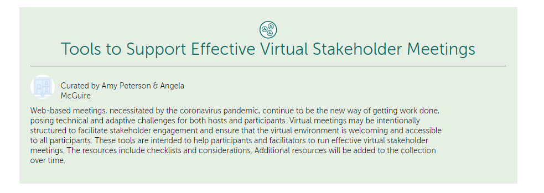
Collection of Tools to Support Virtual Stakeholder Engagement
https://ncsi-library.wested.org/collections/178
Notes:
NCSI

Slide 15
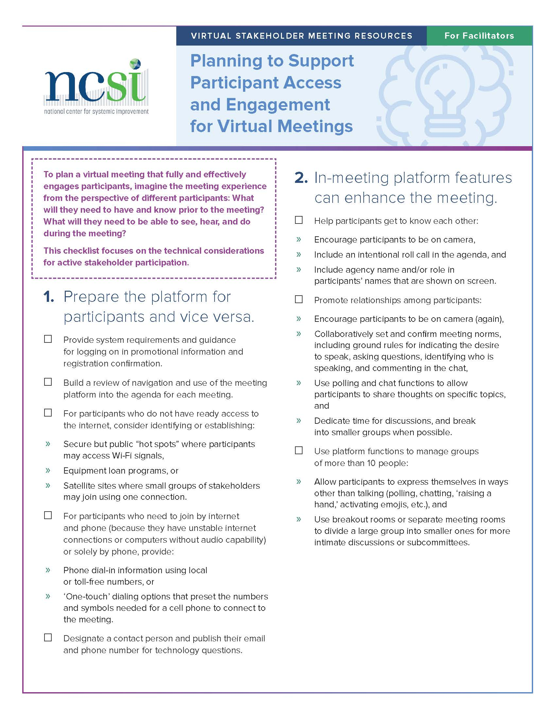
Tools to Support Facilitators
Planning to Support Participant Access and Engagement for Virtual Meetings
Planning for Effective Facilitation of Virtual Meetings
Notes:
ANGELA
Let’s start with you, the presumed hosts and facilitators. These resources highlight things that you can do ahead of or during a meeting to set yourselves up for success… or at least for fewer technical problems. So what is the difference between the two resources? I’m going to use an analogy that most of you will be familiar with and some of you may be dealing with this week: preparing for a Thanksgiving gathering:
Planning for Effective Facilitation addresses what you need to do to successfully execute your menu, or your agenda. Do you have all the ingredients you need for the meal? When and how will each item be prepared? Do you have all the equipment that you need? Will your sister in law’s sweet potatoes need to be in the oven at the same time as the turkey? For mashed potatoes, are you going to use a hand masher, your stand mixer, or go full on Thomas Keller and use a food mill?
This resources addresses the timing, tools, settings, and procedures that you need to think about to execute your agenda.
Planning to Support Participant Access and Engagement is a little different. Thinking about your Thanksgiving dinner, you adjust your plans to address the number of participants, any food allergies or special diets that need to be accommodated, participants who want to contribute to the meal by preparing a family favorite dish. Then there are the lefties who will be sitting at the table… and thinking about seating… maybe don’t seat your husband next to your sister in law’s boyfriend, because… bad. How about setting kids up for success at the kid’s table?
This resource addresses the timing, tools, settings, and procedures that you need to think about so that your participants may effectively contribute to your stakeholder goals.
But it’s not all on you! Stakeholders have responsibility in their own effectiveness as virtual meeting participants…

Slide 16
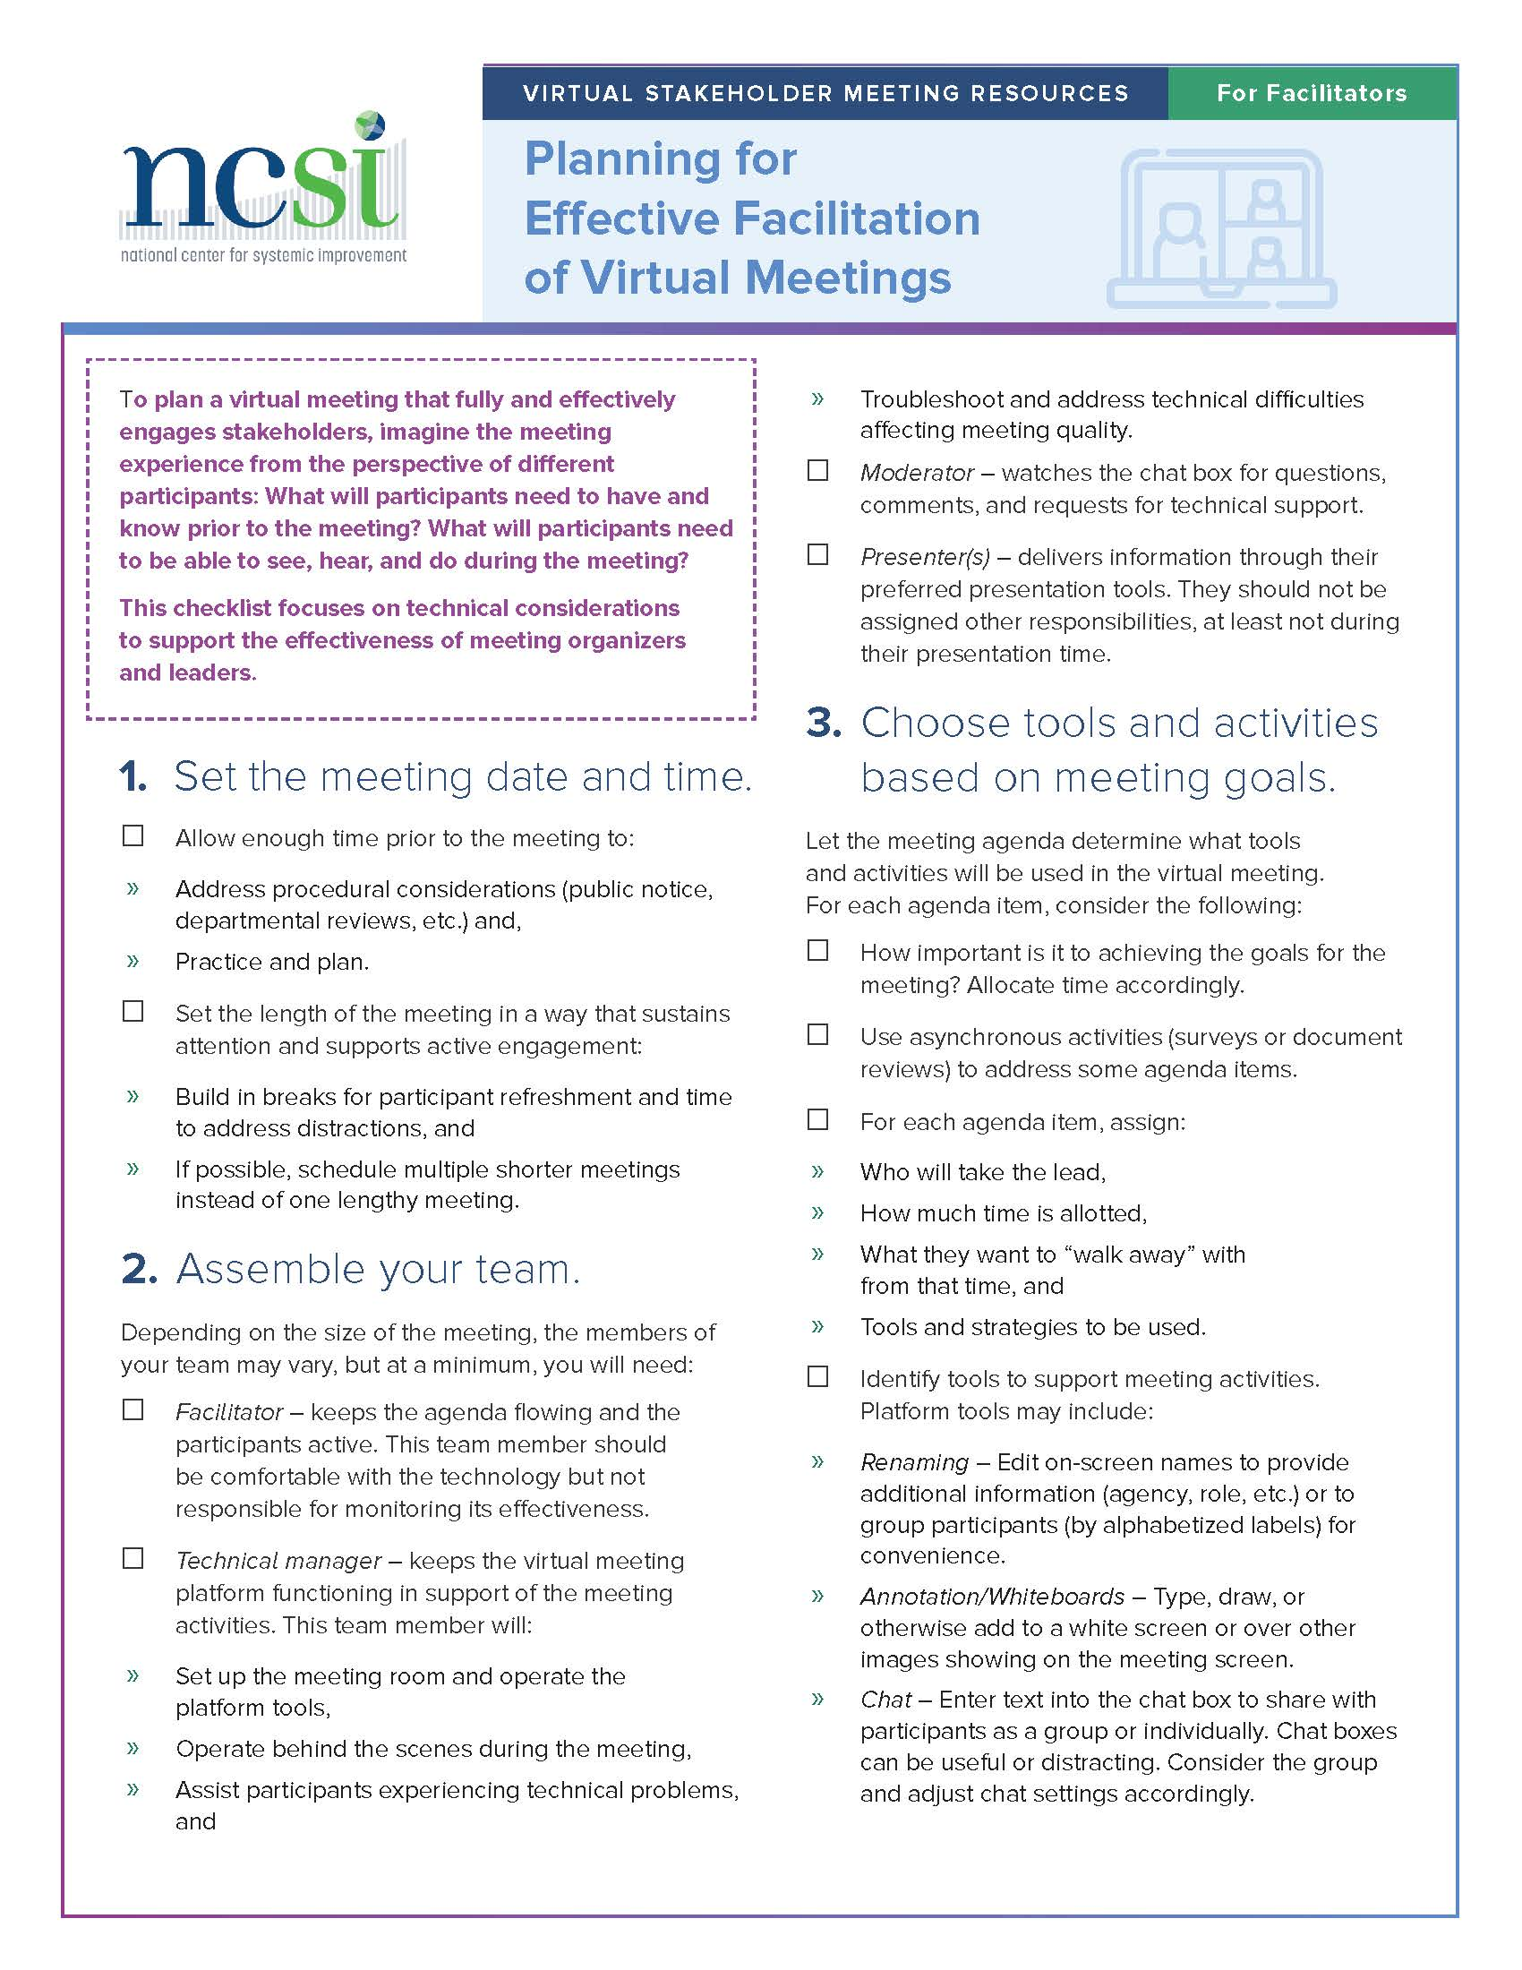
Planning for Effective Facilitation of Virtual Meetings
Set meeting date and time
Assemble your team
Choose tools and activities based on meeting goals
Practice makes perfect
Read your reviews

Slide 17
Planning to Support Participant Access and Engagement for Virtual Meetings
Prepare the platform
Platform features
Accessibility
Notes:
NCSI

Slide 18
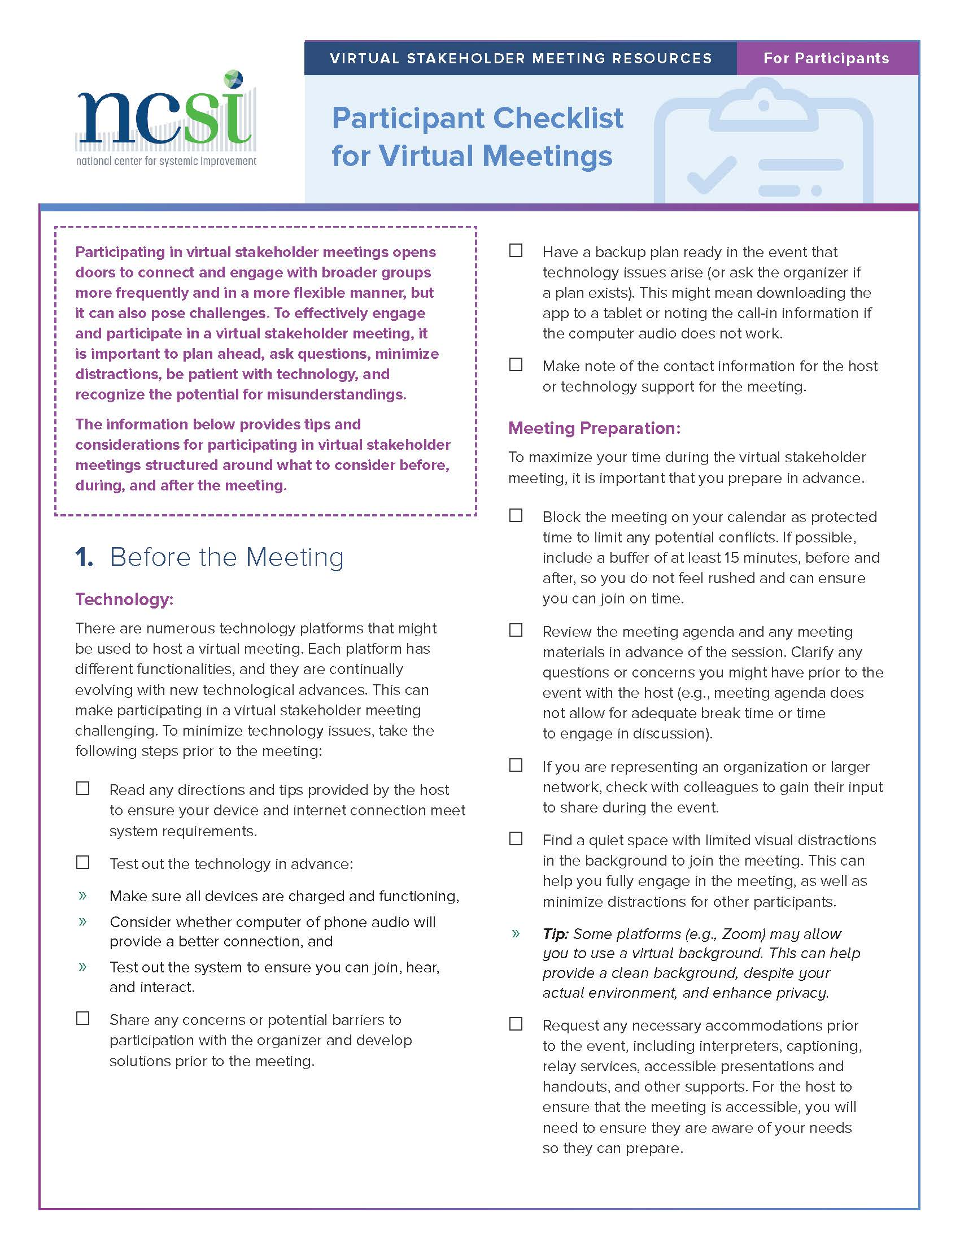
Tools to Support Participants
Participating in Virtual Stakeholder Meetings: Five Considerations
Participant Checklist for Virtual Meetings
Notes:
NCSI

Slide 19
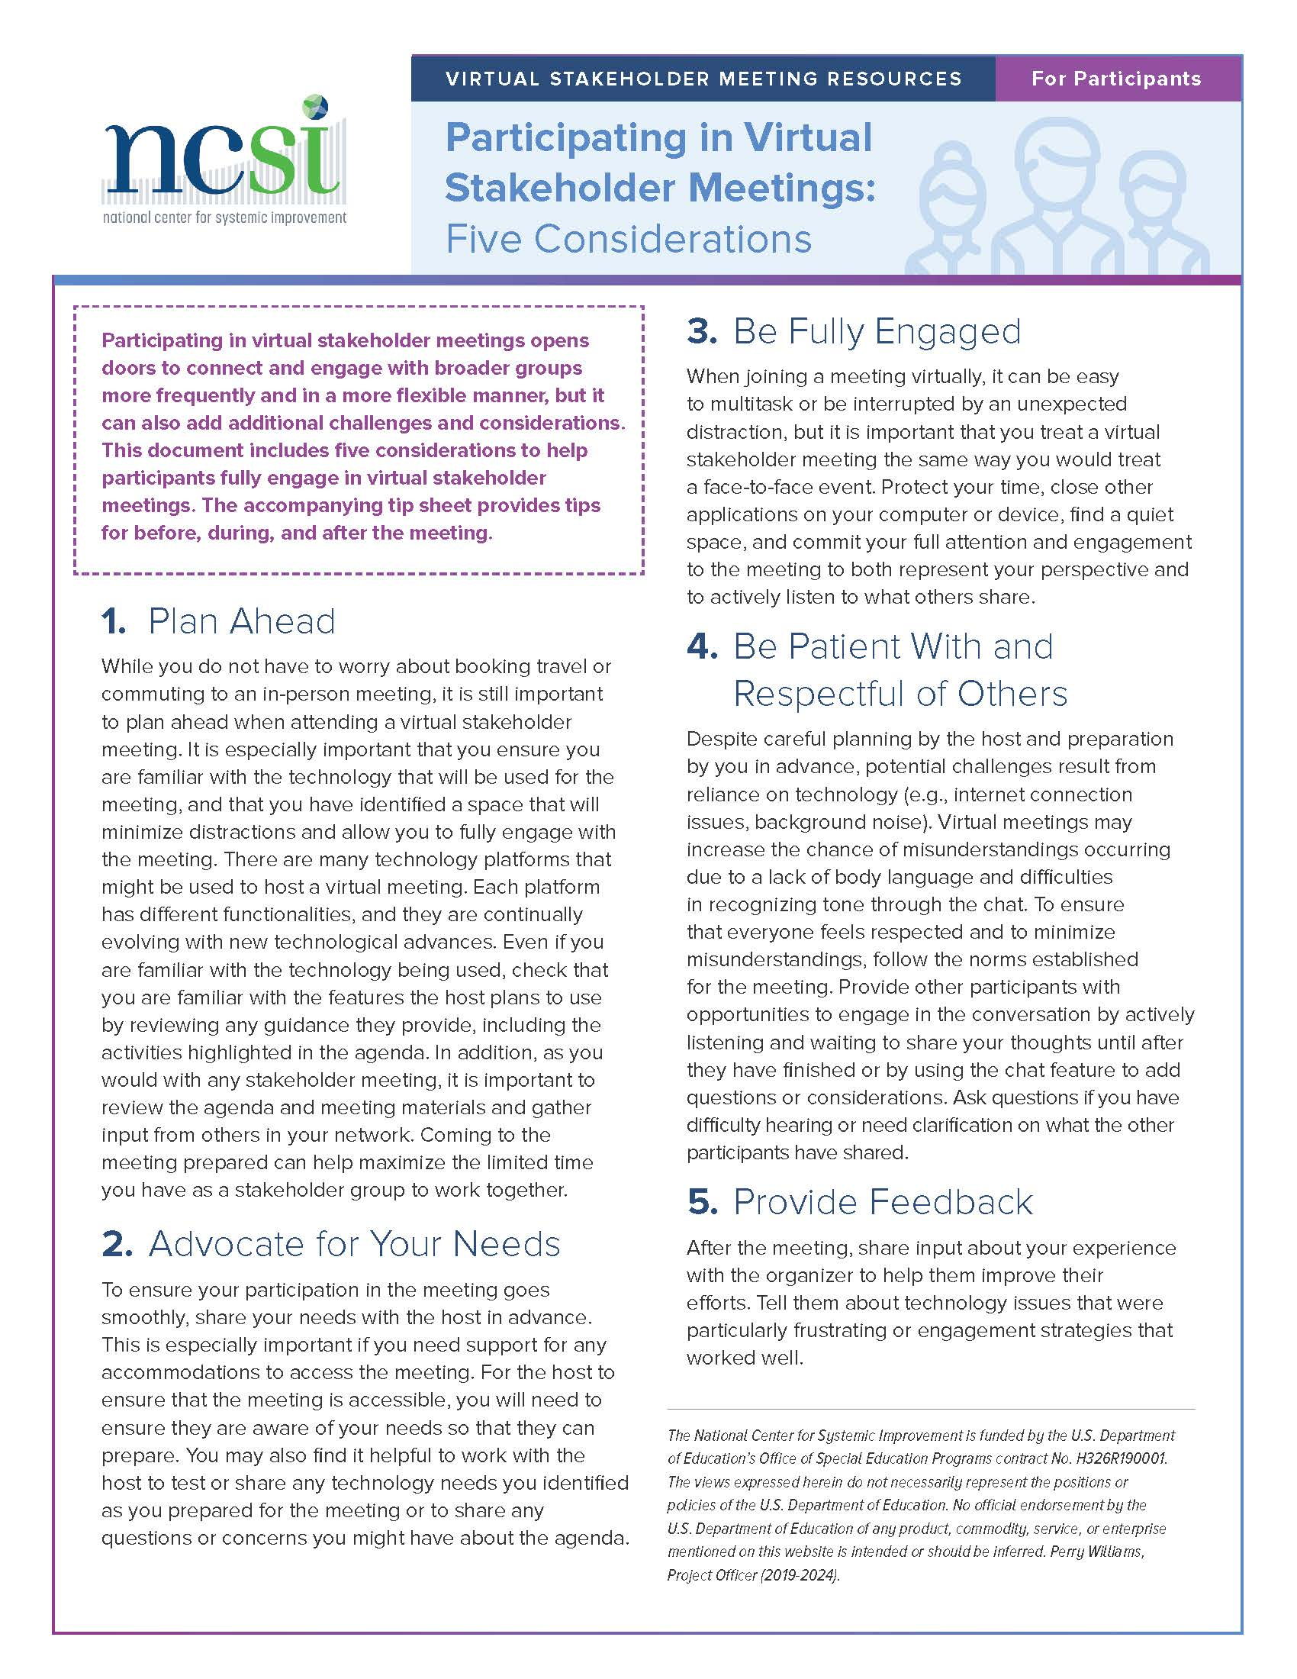
Participating in Virtual Stakeholder Meetings: Five Considerations
Plan ahead
Advocate for your needs
Be fully engaged
Be patient with and respectful of others
Provide feedback
Notes:
NCSI

Slide 20
Participant Checklist for Virtual Meetings
Before the meeting
Technology
Meeting Preparation
During the meeting
Technology
Meeting Participation
After the meeting
Notes:
NCSI

Slide 21
Thank you!
Notes:
(NCSI)
[LEAVE TIME FOR QUESTION]
Thank you for having us. I’ll turn this back to you, Anne Louise.
(Anne Louise)
Thank you for these terrific resources. At this time, let me turn the meeting over to Christine Germeyer, the chairperson of the VA State Special Education Advisory Council, who will talk with us about engaging non-English speaking stakeholders in the SAP and SICC work, Christine.

Slide 22
Engaging Non-English Speakers
Soliciting Membership
Members’ participation during meetings
Gathering input
Public Comment Participation
Notes:
(Christine G.) [YOU HAVE 5 MINUTES FOR THIS SECTION, WHEN YOU BEGIN IT SHOULD BE AT 31 MINUTES]
Thank you, Anne Louise.
There are several areas you will want to be thinking about when looking to explicitly address the engagement of non-English speakers in the work of the SAP or SICC. In each of these activities which an SAP or an SICC engages, be thinking about Non-English speakers. These activities include: 1) when soliciting new members for your council or panel; 2) as you gather input from a broader stakeholder base within your state; 3) throughout the course of your meeting agenda; and 4) during each of your meeting’s public comment sessions.

Slide 23
Engaging Non-English Speakers (cont)
Interpretation Available
Technology Accessible
Supportive Services Budgeted
Cultural Diversity Represented
Notes:
(Christine G. )
It's extremely important to provide professional training to group members in terms of diversity so all biases can be erased in order to provide the foundations of Non-English speakers' engagement.
The foundations for engaging Non-English speakers include:
Interpretation as a rule, not as a requirement.- Many times interpretation is only available upon request. Instead, it should be listed on every flyer as a rule in order to create a feeling of welcome.
Diversity services must be a part of the budget, so all these strategies can be implemented effectively and families can be heard and understood effectively.
Technology must be enabled for families to be active participants full time, not only for certain events. Involvement and engagement are a part of the educational process, and so, to be engaged and empowered to participate, families must have access to information at all times to all information available to other parents.
Cultural component. It's not only about language but the cultural aspect. Representation matters and diversity must be an active component of every one of these opportunities to drive families to participate as they feel represented.

Slide 24
Any ideas that you have used?
Notes:
(Christine G.)
We would like to open the phone lines and allow you a chance to share with others on the call ideas that you have used to engage non-English speakers in your SAP and SICCs.
[Christine to contact several people to speak up at this point to serve as catalysts for others to share]
Teri Petit from MI
Liz or Suzanne from VA PETAC
Back to you, Anne Louise!

Slide 25
Facilitation Strategies and Use
Different learning styles
Learning new information
Creating shared meaning
Bringing more voices
Notes:
(AL) [THIS SECTION IS 10-13 MINUTES. YOU SHOULD BE STARTING AT 36 MINS]
Next we wanted to offer some facilitation strategies that can be used for in person and virtual meetings in order to have authentic stakeholder engagement. We don’t have time to demonstrate all of these, but if you google them you will find descriptions. You will find that you often will use several of these strategies together in order to best engage your group.
These strategies serve several purposes: You want your strategies to acknowledge
Different learning styles of participants so people feel that they are involved and contributing- for example, some of us are introverts and need think time before we talk. Each of these allow for this... Any strategy that allows personal reflection prior to talking... This should be built into whatever strategy you might use.
People are learning new information so they can better be prepared for other types of engagement (Mining the Wisdom, Jigsaw, Paired Share, Data Carousel)
Creating shared meaning so more likely to get to consensus or greater majority approval of topics because people know what other people are thinking (dot voting, gallery walk, round robin)
Bringing more voices into the work, discussion, agenda iteam, the room, etc.

Slide 26
Facilitation Strategies and Use
Paired Share (1, 2)
Round Robin (1, 3, 4)
Dot Voting (1, 3)
Jigsaw (1, 2, 4)
3-2-1/TQE (1)
Mining the Wisdom (1, 2)
Quiet grouping (1, 3, 4)
Wait time (1)
Personal Reflection (1)
Data Carousel (1, 2, 3)
Brainstorming (1, 3)
Gallery Walk (1, 3, 4)
Notes:
(AL)
Next we wanted to offer some facilitation strategies that can be used for in person and virtual meetings in order to have authentic stakeholder engagement. We don’t have time to demonstrate all of these, but if you google them you will find descriptions. You will find that you often you will want to use several of these strategies together in order to best engage your group.
The numbers after the items here on the slide, are linked back to the prior slide. So for example, a great strategy for a SAP or SICC to use is the jigsaw when examining a state document for which the state wants feedback. This addresses 1) acknowledging learning style differences and 2) provides a means to learn new information efficiently and more thoroughly and 4) brings more voices to the work. For a Jigsaw, you divide your council or panel into several groups. Each group is assigned a portion of the document to read to become very proficient on that section. Each person takes time to read and study their section. The section is then discussed as a small group by summarizing and identifying the key points within their section. NEXT, one person from each group congregates with one person from each of the other groups. This new team includes one person that is knowledgeable on each section of the report. This team then has each person share their portion of the report with others at the table so that everyone learns about all parts of the report. In this way you can see that it allows people quiet reflection/reading time as they prepare their section of the report, as well as discussion group time which respects their learning style. This also offers a much more efficient and thorough way for people to learn information.
Notes: ------------------------------
These strategies serve several purposes:
Acknowledges different learning styles of participants so people feel that they are involved and contributing- for example, some of us are introverts and need think time before we talk. Each of these allow for this... Any strategy that allows personal reflection prior to talking... This should be built into whatever strategy you might use.
People are learning new information so they can better be prepared for other types of engagement (Mining the Wisdom, Jigsaw, Paired Share, Data Carousel)
Creates shared meaning so more likely to get to consensus or greater majority approval of topics because people know what other people are thinking (dot voting, gallery walk, round robin)
Bring more voices into the room.

Slide 27
Getting More Voices in the Discussion
Wait Time
Personal Reflection
Paired Share
Round Robin
Quiet Grouping
Data Carousel
Dot Voting
Gallery Walk
Notes:
(AL)
In most SAPs and SICCs, you want to ensure that all voices are heard. These strategies specifically will do that by coupling these strategies together.
Recognize that people engage differently.
people who think before speaking need time for reflection- so use the strategies on the left-of wait time, personal reflection then couple it with paired share or round robin
People who do not want to be called out, are more reserved or timid or less confident- consider using those techniques that won’t put people on the spot in front of the larger group… paired share, dot voting, quiet grouping, data carousel, gallery walk work well for these types of situations.

Slide 28
Virtual Tools
Padlet (Padlet.com)
JamBoard (jamboard.google.com)
Pol Everywhere (polleverywhere.com)
Mentimeter (mentimeter.com)
Break out rooms
Annotation
Y/N thumbs up
Chat box
Polling features
Notes:
(AL)
As most if not all of our meetings are virtual, we wanted to share a couple strategies specific to virtual platforms so that you can engage with your folks in interactive ways.
Most of you probably have become familiar with those items on the right side of the slide, as you all are working from ZOOM or Teams or Google Hangout, etc.
So we wanted to share some of the free services that your group may be interested in using to help support engagement among your councils and panels membership. On the left side are a variety of tools for your group to consider to make for a more interactive council or panel meeting.
Padlet: This allows you to post notes on a common page ( such as Brainstorming on a topic, identifying project or ideas. Can be used to identify questions people may have. Gather work from a committee. Use it for an Exit Ticket, Collaborative notetaking. Event planning.
JamBoard: brainstorming -- gathering ideas, sorting them by color, organizing them on different frames, moving them together, drawing lines to connect important ideas, etc. Give members a brainstorming space -- and, if it fits, let them collaborate, too!
Write and draw with the included stylus.
Search Google and insert images or webpages.
Sketch a box, star, cat, or dragon. Image recognition technology converts your sketch into a polished image.
Share your jams with collaborators.
Pol Everywhere: voting or polling from your phone
Mentimeter: voting or polling and provides colorful visual displays of your data results
Let us demonstrate one of these... Padlet:
Directions:
On the Padlet are several of the strategies that were just shared. We provided an example of how that strategy has been used or could be used in your meetings. Indicate how you have used one of these strategies or could use one of these strategies for your panel or council meeting. Type your idea/experience into the appropriate column.
Perhaps you want to add another column with a different strategy.
If you have no ideas/experiences to share, or when you are done with that, indicate with a vote that you like that idea, or have used that idea in your meetings.
There are no right or wrong answers. This is just a chance for you to experience how PADLET works and could work for your group.
Round Robin-Identifying unmet needs within the state from each member’s experiences since the last meeting.
Brainstorming-Identifying what to include in a new member orientation session.
Paired Share-Getting to know each other at the first meeting of the year.
Jigsaw- Reviewing the SPP/APR indicator report prior to submission.
Quiet Grouping- Regrouping a brainstormed list of meeting norms to get to a manageable number.
Now, I’ll turn it back to Christine to close out today’s session.

Slide 29
Resources for Engagement
Leading By Convening- virtual modules; handbook; activity sheets; performance rubrics
https://ncsi.wested.org/resources/leading-by-convening/
Serving on Groups- virtual modules; Spanish/English handbook
www.servingongroups.org
NCSI: Tools for Virtual Meetings- quick references of checklists, tips, strategies, and considerations; webinars
https://ncsi-library.wested.org/collections/178
Notes:
(Christine G.) [YOU HAVE 9 MINS FOR THE REMAINDER OF THE SLIDES. YOU SHOULD BE STARTING AT 49 MINS]
Thank you, Anne Louise
Here are several resources some of which were discussed today that will be helpful to assisting your State Advisory Panel or State Interagency Coordinating Council, engage its membership and other stakeholders throughout the state in order to efficiently and effectively conduct its business.

Slide 30
Take Aways from this Session
Continue/increase parent engagement in SPP/APR work and begin to record the specific information that needs to be reported about parent engagement in SPP/APR work.
Incorporate facilitation and virtual strategies in meetings in order to make participants comfortable to engage; learn new information for shared meaning and to increase consensus; increase greater numbers of members having a voice at meetings.
Intentionally utilize techniques that are appropriate and supportive for engaging non-English speakers in SAP & SICC membership and offering their perspectives at/for meetings
Notes:
(Christine G.)
Here are the key takeaways from today’s session…[read the slide or red/bolded portions]

Slide 31
Let’s Hear from YOU: What Have you Tried?
Notes:
(Christine G. ) [Use this slide only if there is 5 or more minutes left, if not, skip it and move on as there are several more slides to wrap up with]
What has worked, what hasn’t worked, what have you tried when trying to engage more stakeholders and their voices into your work?

Slide 32
What are your needs?
Are there any needs your SAP or SICC have at this time that we might be able to assist with?
Please unmute, indicate in the chat, or contact us at: info@stateadvisorypanel.org
- - - - - - - - - - - - - - - - - - - - - - - - - - - - - - - - - - - - - - - - - - - - - - - - - - - - - - - - - - - - - -
SAP & SICC
Notes:
(Christine G. ) Before we wrap up today, we are interested in hearing if there are any other needs that we might be able to assist you with...
Please place your thoughts in the chat box, or at anytime contact us by email.

Slide 33
Upcoming Events
Registration forthcoming for the Spring 2021 SAP & SICC Webinar:
“Best Practices in SAP and SICC Work”
Anticipate a March 2021 edition of the SAP & SICC Newsletter
Watch for updates on the SAP & SICC website Home Page for CURRENT AND UPCOMING EVENTS
- - - - - - - - - - - - - - - - - - - - - - - - - - - - - - - - - - - - - - - - - - - - - - - - - - - - - - - - - - - - - -
SAP & SICC
Notes:
(Christine G.) READ THE SLIDE

Slide 34
Supports for SAPs & SICCs
SAP & SICC Support
Contact SAP_SICC at:
info@stateavdisorypanel.org
Website Content
Visit the SAP_SICC website:
https://collab.osepideasthatwork.org/SAP-SICC
Website
Newsletter
Flyer
Webinar Series
Linkage to TA Center for Individualized Support
News
Calendar
Files: Archives
Contacts: States
FAQs
State Resources
- - - - - - - - - - - - - - - - - - - - - - - - - - - - - - - - - - - - - - - - - - - - - - - - - - - - - - - - - - - - - -
SAP & SICC
Notes:
(Christine)
We would like to remind you that there are a variety of supports available to state advisory panels and interagency coordinating councils through this national workgroup.
First, you may contact our group using the info@stateadvisorypanel.org email with any questions or requests for information OR you may visit our SAP/SICC website located at: https://collab.osepideasthatwork.org/SAP-SICC.
THE LINK WILL BE PLACED IN THE CHAT BOX

Slide 35
Evaluation
Before you leave, one more virtual tool... Please provide one word that describes your experience with today’s presentation using a Word Cloud... go to the link in the chat box and type in one word or hyphenated-words about today’s experience with us!
- - - - - - - - - - - - - - - - - - - - - - - - - - - - - - - - - - - - - - - - - - - - - - - - - - - - - - - - - - - - - -
SAP & SICC
Notes:
(Christine G.)
[Tanner can put ling and directions it in the chat box and bring up the screen to show the word cloud]

Slide 36
Evaluation
If you registered for this webinar, you will get an email with a link to the evaluation. Please help us to serve you better by completing the evaluation.
You can access the evaluation now, using the link in the chat box.
- - - - - - - - - - - - - - - - - - - - - - - - - - - - - - - - - - - - - - - - - - - - - - - - - - - - - - - - - - - - - -
SAP & SICC
Notes:
(Christine G.)
Please help us help you. We appreciate hearing from you through the evaluation or by email.
We appreciate you taking the time now using the link in the chat box for the evaluation. Just copy and paste it in your web browser. Thank you!
[Tanner insert link into chat box]

Slide 37
Thank You!
Thank you for your active engagement and ongoing support!
- - - - - - - - - - - - - - - - - - - - - - - - - - - - - - - - - - - - - - - - - - - - - - - - - - - - - - - - - - - - - -
SAP & SICC
Notes:
(Christine G.)

