Slide 1
State Advisory Panel State Interagency Coordinating Council
Capacity Building Webinar
January 31, 2019
Notes:
Total time -Slides 1 through 6
5 minutes

Slide 2
The Webinar Series: Our Purpose
Bring SAPs and SICCs into dialogue about their role
Surface challenges
Share successful approaches
Interact regularly
Provide a repository of recommended resources
Notes:
Each year several projects work together to create a webinar series aimed at helping state advisory groups to interact and learn from and with each other.

Slide 3
Survey to SAP/SICC Members
268 Responses
Shared challenges
Identified needs
Access to information
Preferred ways to interact
Notes:
In November, the workgroup conducted a survey to advisory groups

Slide 4
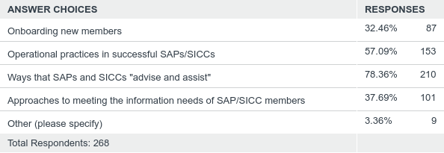
Identified Needs
Notes:
We listened to your response...

Slide 5
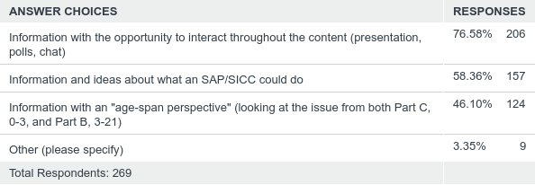
Preferred Ways to Interact

Slide 6
Responding to Your Input: Today’s Webinar
Panels from State Advisories
WA – Part B
NV- Part C
OR – Communication across Part B and C
Roles on Panels
State Agency Lead
New Advisory Member
Experienced Advisory member
Notes:
We acted on what you told us...

Slide 7
Question from the Field: There is often a need to build the background knowledge of incoming members and yet the meetings are generally scheduled for review and two-way communication regarding the state plan implementation and/or proposed policy. How do states handle this?
To new advisory members:
From the perspective of a new advisory member, how did you get your needs met?
To the perspective of the experienced advisory member and state agency lead:
How has your advisory dealt with this need over time?
What has worked best in helping new members to move into their role while participating in content and policy discussions?
Notes:
Total time on this slide – 10 minutes
Stephanie will read the description at the top of the slide as an overview. She will direct the first question to new advisory members from each team. Comments should be about one minute . Be aware of time...but we want you to make you point.
When we have finished the new member comments she will ask the stae leads and experienced members to comment. Again...limit comments to one minute. Thanks!
Workgroup: Check for comments in CHAT.

Slide 8
Question from the Field: There is an ongoing need to engage families, especially families from diverse groups and those with unique needs. What are the best practices in outreaching to families and engaging parent leaders from diverse communities?
To the teams:
How do you undertake the challenge to engage diverse families?
How do you know when you are being successful?
Notes:
Total time on this slide – 10 minutes
Stephanie will read the description at the top of the slide as an overview. She will direct question to the teams. Comments should be about one minute . Be aware of time...but we want you to make you point.
When we have finished the new member comments she will ask the stae leads and experienced members to comment. Again...limit comments to one minute. Thanks!
Workgroup: Check for comments in CHAT.
Check the CHAT

Slide 9
Question from the Field: To extend the reach of an advisory group, members must act as the ‘conduit’ to a wider group of stakeholders. How can an advisory support members in reaching out to their stakeholder group?
To the teams:
How are members expected to take information out to their stakeholder?
How can members enable their stakeholders to work with the state agency and the advisory?
Notes:
Total time on this slide – 10 minutes
Stephanie will read the description at the top of the slide as an overview. She will direct the first question to the teams. Comments should be about one minute . Be aware of time...but we want you to make you point.
When we have finished the new member comments she will ask the stae leads and experienced members to comment. Again...limit comments to one minute. Thanks!
Workgroup: Check for comments in CHAT.

Slide 10
Question from the Field: It is sometimes difficult for advisory members to hold a broader picture while holding the perspective of their own stakeholder group. How can we develop advisory members as system thinkers who can consider issues more globally while they represent the views of their stakeholders?
To the state leads and experienced advisory members:
To what extent has this issue been addressed in your advisory group?
What strategies have been successful over time?
To help members build a view of the system, how do you build connections between your SICC and your SAP?
To new members:
To what extent have you experienced this challenge.
What has helped you to understand the dual roles?
Notes:
Total time on this slide – 10 minutes
Stephanie will read the description at the top of the slide as an overview. She will direct the first question to the state leads and experienced members from each team. Comments should be about one minute . Be aware of time...but we want you to make you point.
When we have finished the new member comments she will ask the stae leads and experienced members to comment. Again...limit comments to one minute. Thanks!
Workgroup: Check for comments in CHAT.

Slide 11
Poll
I would participate in a voluntary ’meet up’ call or webinar to continue discussing identified areas of need.
Yes
No
Notes:
Tanner will prepare a Poll with this content and will display it.
After the poll closes , Stephanie will review the responses. And make a statement about the potential for more frequent and informal chats among SAP/SICC members between the quarterly webinars.

Slide 12
Poll
Check all that apply:
I would like to participate in a follow-up discussion across state advisories around:
Onboarding new members
Practices in outreaching to families
Reaching networks through SAP and SICC members
Thinking broadly while holding your own perspective
Thinking across the SICC and SAP perspectives
Notes:
Tanner will prepare a Poll with this content and will display it.
After the poll closes , Stephanie will review the responses...and make a statement about the potential content for more frequent and informal chats among SAP/SICC members between the quarterly webinars.

Slide 13
Accessing and Submitting Resources
Visit the SAP/SICC website: https://collab.osepideasthatwork.org/SAP-SICC
Resources available on demand
Archived Webinars
Resources submitted by State Advisories
Submit resources for the website
Send a link to your resources to: info@stateadvisorypanel.org

Slide 14
Continuing to Respond to Your Input
From the Survey:
“Possibly include an opportunity for additional follow up after strategies are presented”.
“Include case study examples to demonstrate applied strategies”.

Slide 15
Next Webinar
State example of state agency and advisory group acting together .
State and member participants
Transferable ideas for collaboration
Notes:
We are continuing to listen to you...we are panning to host a state and its advisory that are trying to define and implement meaningful participation; Advise and Assist!

Slide 16
Evaluation
If you registered for this webinar , you will get a email with a link to the evaluation
You can access the evaluation now at: https://www.surveymonkey.com/r/SAPSICC_1-31-19
Notes:
Leave the link to the eval on the screen to reach those that may be participating with others but have not registered ... and those that may not follow-up.
Do follow-up with a survey.

Slide 17
Thank you for your active engagement
and ongoing support!

