Slide 1
State Advisory Panel (SAP) and State Interagency Coordinating Council (SICC)
2019-2020 Webinar Series
April 30, 2020
Supports for SAPs and SICCs
The Role of SAPs and SICCs during COVID-19
- - - - - - - - - - - - - - - - - - - - - - - - - - - - - - - - - - - - - - - - - - - - - - - - - - - - - - - - - - - - - -
SAP & SICC

Slide 2
Welcome!
Webinar Purpose
Supports for SAPs & SICCs
COVID-19 Resources for SAPs & SICCs
Introduction of the Workgroup
Purpose of the SAP & SICC Workgroup
- - - - - - - - - - - - - - - - - - - - - - - - - - - - - - - - - - - - - - - - - - - - - - - - - - - - - - - - - - - - - -
SAP & SICC
Notes:
Welcome to our webinar today. Over the next hour we want to share with you an array of supports for SAPs and SICCs that will assist you in your work.
Let us begin share our purpose if you are new to SAPs or SICCs or to the work of this national group and introduce you to the people that are on the workgroup that are here to assist you.

Slide 3
SAPs and SICCs…
Advise and assist the state education agency/state lead agency in the performance of their responsibilities as outlined in IDEA to address the needs of infants, toddlers, children, and youth with disabilities.
All IDEA Part C state lead agencies (serving infants and toddlers birth to three) are required to have a State Interagency Coordinating Council (SICC).
All IDEA Part B state education agencies (serving children ages 3-21) are required to have a State Advisory Panel (SAP).
- - - - - - - - - - - - - - - - - - - - - - - - - - - - - - - - - - - - - - - - - - - - - - - - - - - - - - - - - - - - - -
SAP & SICC
Notes:
As you are aware, the IDEA requires that state lead agencies for early intervention programs serving infants and toddlers, as well as state education agencies serving school-aged children operate a group of specific stakeholder representatives to advise and assist the state education agency/state lead agency in the performance of their responsibilities as outlined in IDEA to address the needs of infants, toddlers, children and youth with disabilities.

Slide 4
Our Purpose
A national workgroup assists in planning and facilitating national professional learning and capacity building activities to support states in organizing, orienting, and providing learning opportunities for SICCs and SAPs across the country.
Interagency collaboration
Leadership
Engagement with families and other stakeholders
Emerging issues
- - - - - - - - - - - - - - - - - - - - - - - - - - - - - - - - - - - - - - - - - - - - - - - - - - - - - - - - - - - - - -
SAP & SICC
Notes:
And to assist these Panels and councils, a national workgroup was created to ...[READ SLIDE}
Today’s webinar will introduce you to the types of activities this workgroup offers.

Slide 5
Members of the Workgroup
Lead: Anne Louise Thompson, NCSI
Ali Conners, NY DOE
Barb Martorana, NY SAP
Brenda Lamkin, WV PTI
Carmen Sanchez, OSEP
Daniel Dinnell, NV SICC
Jodi Webb, ND PTI
John Copenhaver or Norm Ames, TAESE
Katherine Bradley-Black, NCSI
Luz Hernandez, CPRC
Pakethia Harris, NCSI
Perry Williams, OSEP
Sherry Franklin, ECTA
Siobhan Colgan, ECTA
Stephanie Moss, PTAC
Coordination: Brenda Smith, TAESE
- - - - - - - - - - - - - - - - - - - - - - - - - - - - - - - - - - - - - - - - - - - - - - - - - - - - - - - - - - - - - -
SAP & SICC
Notes:
The workgroup consists of interested staff from the Office of Special Education Programs (OSEP), Parent Training and Information Centers, OSEP-funded Technical Assistance Centers, and state staff currently involved in their states’ SICC or SAP.
Here is this year’s workgroup and we are grateful not only to OSEP and several of the national centers, but we want to especially thank the state staff and panel or council members from NY and NV for their participation.

Slide 6
Supports for SAPs & SICCs
SAP & SICC Support
Contact SAP_SICC at:
info@stateavdisorypanel.org
Website Content
Visit the SAP_SICC website:
https://collab.osepideasthatwork.org/SAP-SICC
Website
Newsletter
Flyer
Webinar Series
Linkage to TA Center for Individualized Support
News
Calendar
Files: Archives
Contacts: States
FAQs
State Resources
- - - - - - - - - - - - - - - - - - - - - - - - - - - - - - - - - - - - - - - - - - - - - - - - - - - - - - - - - - - - - -
SAP & SICC
Notes:
There are a variety of supports available to state advisory panels and interagency coordinating councils through this national workgroup. We just want to share some of our resources that you see listed here and explain how to access them.
First, you may contact our group using the info@stateadvisorypanel.org email OR
Secondly, visit the SAP/SICC website: https://collab.osepideasthatwork.org/SAP-SICC.
As you can see we have many supports to assist you in your states with this work.
Let us share the website with you so you can see how to locate these many resources

Slide 7
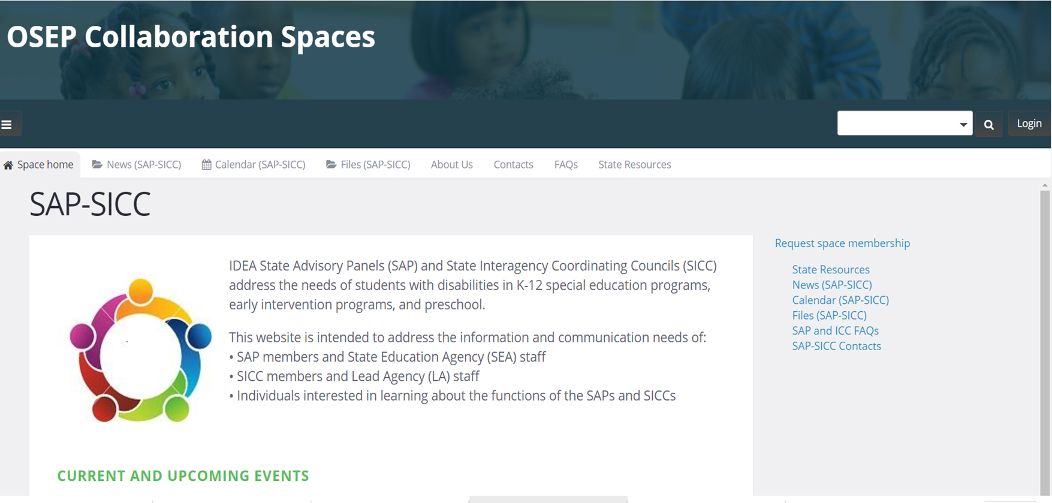
SAP & SICC Website
- - - - - - - - - - - - - - - - - - - - - - - - - - - - - - - - - - - - - - - - - - - - - - - - - - - - - - - - - - - - - -
SAP & SICC
Notes:
The website has a landing page or home page which looks like this. Let us take you to the webpage now, real time.
Here you will see the top tool bar which has several tabs for you to access.
NEWS; Calendar of Events (see the webinar, other events with TA centers); Files-archives; About Us: Contacts: FAQs: and State Resources
1. The landing page we provide you with Current and Upcoming Events of interest
2. In the NEWS: section you will find our newsletter, flyers, recent resources we are making available
3. Calendar: keeps you abreast of events of interest across the country and with our workgroup
4. Files: All of our archived webinars that have been hosted throughout the years on a variety of topics, information from states, and OSEP
About Us: a bit of who we are and our role to support you
Contacts: Here we host the names and links to all of the ICCs and SAPs chairs and state contacts. We are constantly working to update this so if you are on this page and see a need to revise your state’s information, please let us know. The ICC information is linked to the ECTA website, so the information when changed on the ECTA webpage will automatically revise this page as well.
FAQs: This section offers a variety of questions that SAPs and SICCs may have about their work. These are some of the most common questions for the work of SAPs and SICCS based on IDEA regulations and how groups of this purpose operate.
And lastly is the State Resources page. Here is a host of resources by topic with examples from a variety of state to provide you with examples of the types of work that you encounter as a SAP or SICC.

Slide 8
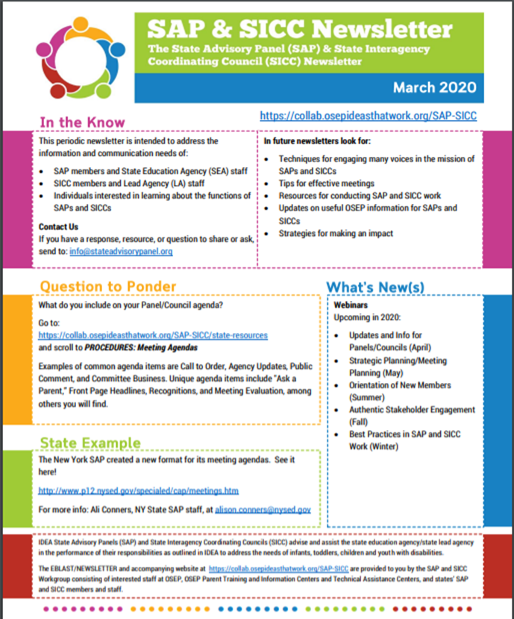
Newsletter & Flyer
The premiere edition (March 2020) of the SAP & SICC Newsletter along with a one-page flyer explaining the National SAP-SICC Workgroup has been posted to the News page of the SAP-SICC website.
Quarterly Releases: March, June, September, December
Contents: State examples, Q & A, Upcoming events, links to resources
- - - - - - - - - - - - - - - - - - - - - - - - - - - - - - - - - - - - - - - - - - - - - - - - - - - - - - - - - - - - - -
SAP & SICC
Notes:
Now let us share a bit more deeply some of these resources that you can find on our website.
Our Newsletter was premiered this spring in MARCH and is found on our NEWS page. The newsletter is intended to provide you a quick set of resources on a quarterly basis. We have sections in the newsletter with state Q and A, so if you have a question to ask, please let us know. If you see a question and have other responses, let us know that as well. We would like to feature what different states are doing through this newsletter so we welcome your ideas.

Slide 9
Webinar Series 2019 - 2020
The National SAP-SICC Workgroup is pleased to announce the 2019-2020 SAP-SICC Webinar Series! Detailed information about each potential topical webinar and how to participate will be posted closer to the dates below.
Updates and Information for Panels/Councils
Strategic Planning/Meeting Planning
Orientation of New Members
Authentic Stakeholder Engagement
Best Practices in SAP and SICC Work
- - - - - - - - - - - - - - - - - - - - - - - - - - - - - - - - - - - - - - - - - - - - - - - - - - - - - - - - - - - - - -
SAP & SICC
Notes:
Another support we offer to you is the Webinar Series. We mentioned that in the Files on the state website, we have archived several years of webinars, that you may access at anytime. Our webinar series for 2020 starts today as this is our first in a series that we’d like to host across this coming year.
Over the past two years, this group has conducted sessions to gather your input on topics of interest and help to you. ECTA at OSEP Leadership conference and the EC conference has gathered your interests and needs as well. This fall we perused your websites and looked at the types of agenda items that you address throughout the year. Through these means of needs sensing, we are proposing the following topics for this year:
[read the topics from slide]

Slide 10
What would you like? Please Share.
Proposed Topics for 2020 Webinar Series:
Updates and Information for Panels/Councils
Strategic Planning/Meeting Planning
Orientation of New Members
Authentic Stakeholder Engagement
Best Practices in SAP and SICC Work
Comments about the proposed topics?
Other topics to consider?
- - - - - - - - - - - - - - - - - - - - - - - - - - - - - - - - - - - - - - - - - - - - - - - - - - - - - - - - - - - - - -
SAP & SICC
Notes:
We are interested in hearing from you. What do you think of these topics? What would you like to see covered in each of these topics?
Please let us know in the chat box of the types of information you would want us to cover?

Slide 11
What would you like? Please Share.
Visit the SAP/SICC website: https://collab.osepideasthatwork.org/SAP-SICC
Resources available on demand
Archived webinars
Resources submitted by Panels and Councils
Contact us at: info@stateadvisorypanel.org
Questions for the workgroup for the Newsletter
Revisions to your state’s information
- - - - - - - - - - - - - - - - - - - - - - - - - - - - - - - - - - - - - - - - - - - - - - - - - - - - - - - - - - - - - -
SAP & SICC
Notes:
You may visit our website at anytime. Visit frequently, as we are changing it routinely.
If you have any questions or want to correct any information about your state, please be in touch. Given the support of OSEP and the many federal TA centers that are represented on this workgroup, if we can’t respond to your questions, we will pass them along anonymously or with your permission share your state and name, to others within our TA Center network to help with a response.

Slide 12
COVID-19 Resources for SAPs & SICCs
National Resources
State Specific Resources
SAP Resources
SICC Resources
- - - - - - - - - - - - - - - - - - - - - - - - - - - - - - - - - - - - - - - - - - - - - - - - - - - - - - - - - - - - - -
SAP & SICC
Notes:
We’d now like to switch to sharing information about COVID-19 resources that are for SAPs and SICCs, both national and state specific.

Slide 13
COVID-19 Resources for SAPs and SICCs
COVID-19 National Resources
The Office of Special Education and Rehabilitative Services designated the following technical assistance centers as resource hubs for information on issues related to COVID-19 (coronavirus):
Early Childhood Technical Assistance Center (ECTA) for early childhood: https://ectacenter.org/topics/disaster/coronavirus.asp
National Center on Systemic Improvement (NCSI) for K-12: https://ncsi.wested.org/
Information tailored to families and family-serving organizations can be found at the Center for Parent Information and Resources (CPIR): https://www.parentcenterhub.org/coronavirus-resources/
- - - - - - - - - - - - - - - - - - - - - - - - - - - - - - - - - - - - - - - - - - - - - - - - - - - - - - - - - - - - - -
SAP & SICC
Notes:
There are three centers that can serve as national hubs of information for you during this time.
ECTA is the OCR and OSERS hub for early childhood
NCSI is the hub for school aged students
Center for Parent information and Resources is the hub for information specific to families and family serving organizations
At these locations you will find links to federal policy documents, Q & As from federal offices, as well as webinars that have been hosted. There are resources for state and lead agencies that will be valuable to state level work as well as resources to assist LEAs and providers.

Slide 14
COVID-19 Resources for SAPs and SICCs
SAP Resource Example
Washington-Special Education Advisory Council (SEAC)
This document was prepared and released by the WA SEAC to provide leadership to the field during the outbreak of COVID-19:
Special Education Advisory Council (SEAC) Statement on Novel Coronavirus (COVID-19)
- - - - - - - - - - - - - - - - - - - - - - - - - - - - - - - - - - - - - - - - - - - - - - - - - - - - - - - - - - - - - -
SAP & SICC
Notes:
We want to offer an example of what one state has done specific to the SAPs and SICCs. Your colleagues in Washington state shared some of what they are doing.
The Special Education Advisory Council in Washington prepared a document that we have placed on the landing page of our website, that was offered to provide leadership to the field.
In their letter they shared information such as:
Length of school closure
Equity issues for online learning
Possible partners during this time
Words of support and encouragement
Statements of nondiscrimination of COVID-19 and how to report harassment of students in protected class status
Links to national and state resources

Slide 15
COVID-19 Resources for SAPs & SICCs
SICC Resource Example
Washington-Interagency Coordinating Council
Part C has just recently suspended face to face early intervention services and in the process of consulting with the Executive Committee of the ICC. Below is an excerpt of the guidance sent out to the field from the Early Support for Infants and Toddlers (ESIT) State Leadership Team:
Stakeholder Engagement: We will be calling on the State Interagency Coordinating Council (SICC) Executive Committee and other key stakeholder groups to assist us with effectively implementing the required adjustments in services and identifying additional challenges that will need to be addressed.
- - - - - - - - - - - - - - - - - - - - - - - - - - - - - - - - - - - - - - - - - - - - - - - - - - - - - - - - - - - - - -
SAP & SICC
Notes:
Washington’s Early Support for Infants and Toddlers State leadership team provided a memo to the field in which they mentioned their interest in reaching out to the Washington Interagency Coordinating Council and other stakeholders to assist with the implementation of adjustments and identifying other challenges that will need to be addressed.
These are two examples of how states are incorporating SAP and ICC in the work.

Slide 16
COVID-19 Resources for SAPs and SICCs
Other State Examples:
What is happening in your state?
- - - - - - - - - - - - - - - - - - - - - - - - - - - - - - - - - - - - - - - - - - - - - - - - - - - - - - - - - - - - - -
SAP & SICC
Notes:
We would like to hear what might be happening in your state with this. Please unmute your lines or put our information in the chat box to share ideas with others.

Slide 17
What are your needs?
Are there any needs your SAP or SICC have at this time that we might be able to assist with?
Please unmute, indicate in the chat, or contact us at: info@stateadvisorypanel.org
- - - - - - - - - - - - - - - - - - - - - - - - - - - - - - - - - - - - - - - - - - - - - - - - - - - - - - - - - - - - - -
SAP & SICC
Notes:
Before we wrap up today, we are interested in hearing if there are any other needs than what you have already offered earlier in this webinar, that we might be able to assist you with...
Please unmute your lines to talk, or share your thoughts in the chat box, or at anytime contact us by email.

Slide 18
Upcoming Events
Registration for the June 2020 SAP & SICC Webinar:
“Strategic Planning/Meeting Planning”
Anticipate a June edition of the SAP & SICC Newsletter
Save the Date: SICC Annual Meeting- August 10, 2020
Watch for updates on the SAP & SICC website for CURRENT AND UPCOMING EVENTS
- - - - - - - - - - - - - - - - - - - - - - - - - - - - - - - - - - - - - - - - - - - - - - - - - - - - - - - - - - - - - -
SAP & SICC
Notes:
A couple of items for you to remember before we close that are upcoming...
SICC Annual meeting will most likely be virtual but will occur on this date. More information is forthcoming.

Slide 19
Accessing Information After This Webinar
Information from SAPs and SICCS, archived webinars (including PowerPoint presentations, recording and captioning) are all available by going to https://collab.osepideasthatwork.org/SAP-SICC
- - - - - - - - - - - - - - - - - - - - - - - - - - - - - - - - - - - - - - - - - - - - - - - - - - - - - - - - - - - - - -
SAP & SICC
Notes:
This webinar PPT and recording will be archived on the website. Please look for that if you would like to review this material.

Slide 20
Evaluation
If you registered for this webinar, you will get an email with a link to the evaluation.
You can access the evaluation now, using the link in the chat box at:
SICC-SAP Webinar Evaluation
(
(https://unc.az1.qualtrics.com/jfe/form/SV_eRKYqDqEKoC2OKF)
- - - - - - - - - - - - - - - - - - - - - - - - - - - - - - - - - - - - - - - - - - - - - - - - - - - - - - - - - - - - - -
SAP & SICC
Notes:
Please help us help you. We appreciate hearing from you through the evaluation or by email.
We appreciate you taking the time now using the link in the chat box for the evaluation. Just copy and paste it in your web browser. Thank you!

Slide 21
Thank You!
Thank you for your active engagement and ongoing support!
- - - - - - - - - - - - - - - - - - - - - - - - - - - - - - - - - - - - - - - - - - - - - - - - - - - - - - - - - - - - - -
SAP & SICC

