Slide 1
State Advisory Panel (SAP) and
State Interagency Coordinating Council (SICC)
2018-19 Webinar Series
May 2, 2019
Learning Together in Hawaii:
Increasing Active Engagement through
the Special Education Advisory Council (SEAC)
Recording

Slide 2
Welcome!
Thanks for joining today. We will begin very soon.
To prevent background noise from interfering with the call, your line is muted on entry.
During the presentation you will have an opportunity to ask questions and make comments at any time, by using the chat.
You will receive a short evaluation survey after the webinar. Please take a few minutes to give us your input.

Slide 3
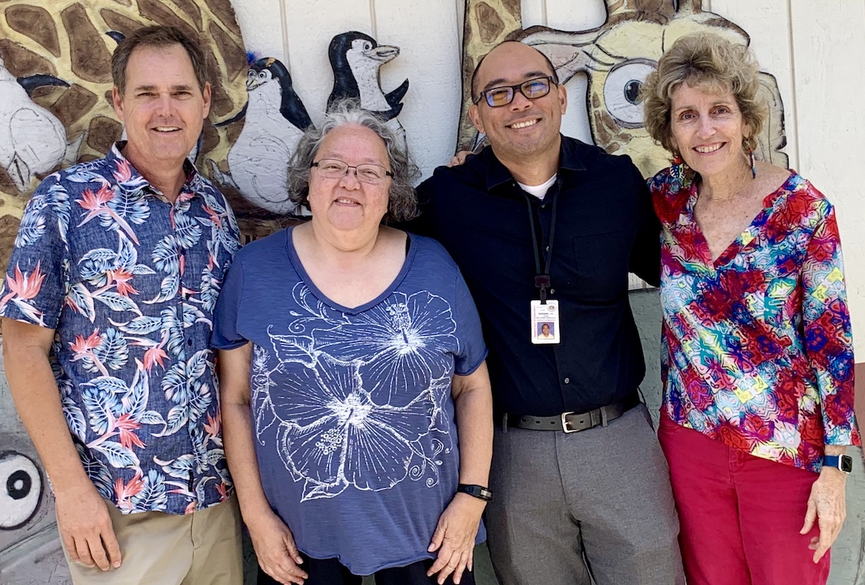
Hawaii’s Team Members
Steven Vannatta, Community Children’s Council Office (HIDOE)
Martha Guinan, SEAC Chair
Drew Saranillio, Monitoring and Compliance Office (HIDOE)
Susan Rocco, Staff to SEAC

Slide 4

Hawaii is Different: No LEAs
OTHER STATES
State Educational Agency (SEA)
LEA/
District 1
LEA/
District 2
LEA/
District 6
State Educational Agency
HAWAII
LEA/
District 3
LEA/
District 5
LEA/
District 4

Slide 5
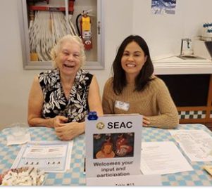
SEAC is Also Somewhat Unique
Having Superintendent-appointed members
Fairly large Council to accommodate all island districts and key agencies as Hawaii has no ‘feeder’ SEACs
Meetings 10 times/year support relationship, retention and focus
Less turnover in members (our longest serving member joined in 1977!)
Early adoption of Leading by Convening has strengthened relationships with key HIDOE leadership
Ivalee Sinclair, 91 years young and a lifelong advocate for students with disabilities, sits with Debbie Cheeseman, a special education teacher who has served for two decades

Slide 6
Poll 1: Tell us about your SAP or SICC
Check all that apply:
Advise the state agency
Diverse membership
Set terms
Active members
Work as ally with the state agency
Have projects led by the SAP/SICC
Conduit to your networks
Other….

Slide 7
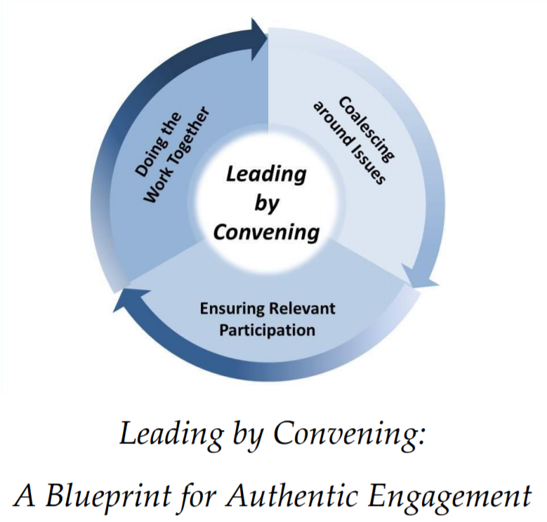

Slide 8

Infographics as a Tool for Creating Shared Products with HIDOE
Introduced by Joanne Cashman, Cesar D’Agord (NCSI) and Dr. Christina Tydeman (HIDOE) as a way to enhance the Leading by Convening process.
MARCH
2018
Members self-selected one of 4 work groups:
Inclusive education and Na Hopena A‘o
What is meant by Significant Disproportionality?
Understanding Hawaii’s disproportionality data
Hawaii’s State Systemic Improvement Plan.
APRIL
2018
Significant Disproportionality work groups combined into one and a new work group—Obtaining school-based medical services--was formed around input from the public.
MAY
2018
A group Venngage account was set up and infographic design principles (from DaSy) were shared, and time was set aside in each monthly meeting for work group meetings.
AUG-DEC 2018

Slide 9
Infographic Vetting Process
JAN
2019
Version 1
Version 2
Adapted from the DaSy Toolkit

Slide 10
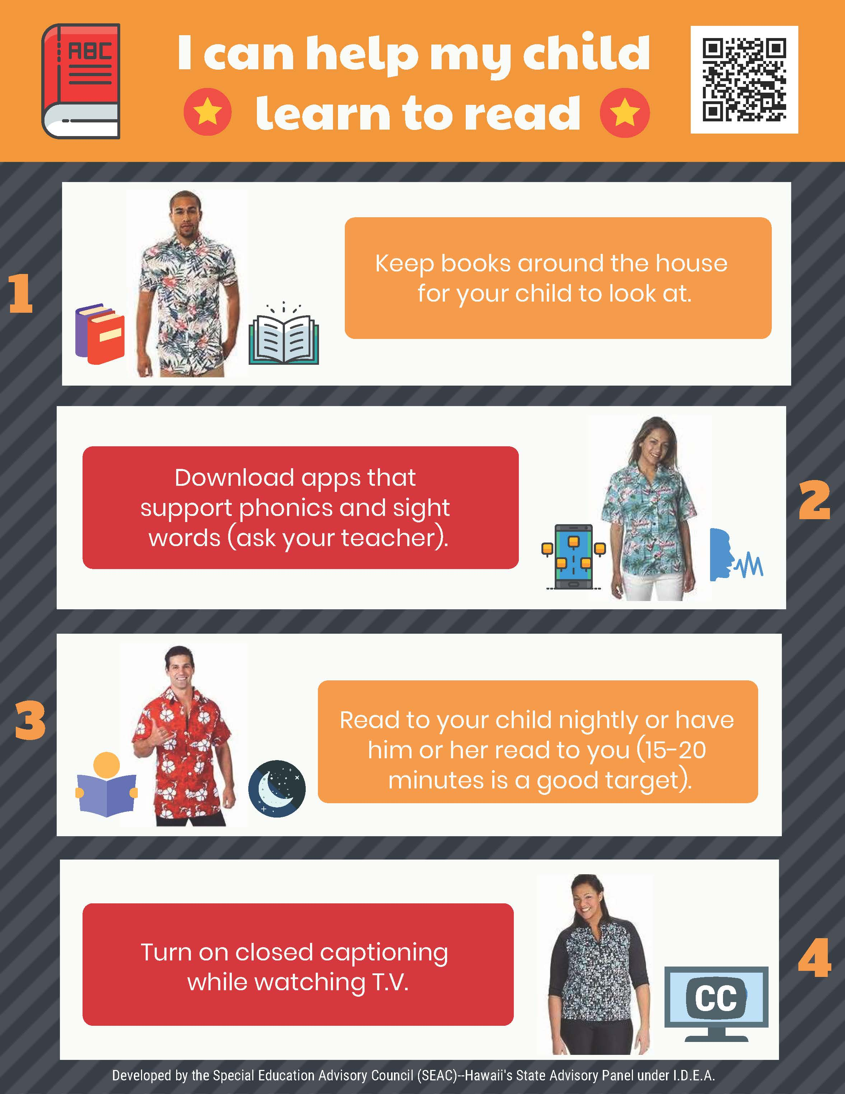
SSIP Infographic: Encouraging parent/school partnership around reading
QR Code that links to website
Local parents
Additional option of having child read to parent
Version 1
Version 2

Slide 11
Other Uses of SEAC Infographics
To explain the OSEP monitoring process and recent site visit to stakeholders
To report on recent SEAC activities

Slide 12
Poll 2: To what extent could your SAP/SICC benefit from co-creating infographics with the state agency?
Check one:
Not at all
Benefit somewhat
Benefit a lot

Slide 13
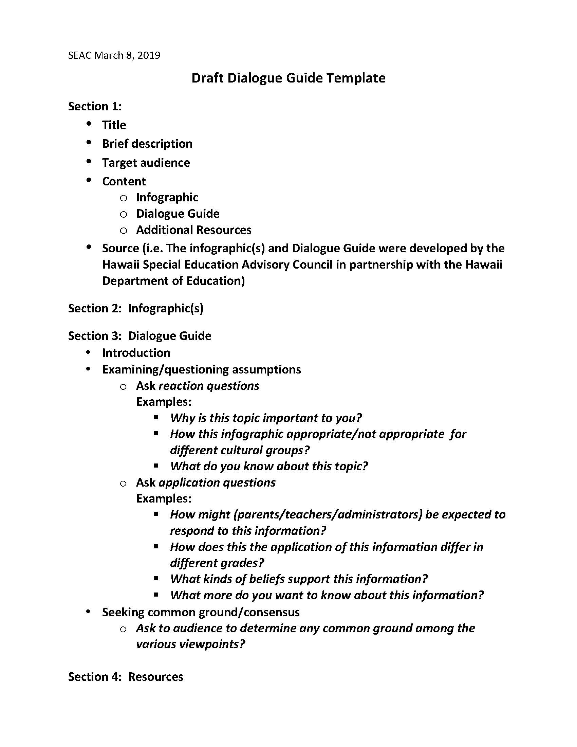
Next Steps: Creation of Dialogue Guides and Community Outreach
A Dialogue Guide forces the group to identify target audience(s).
Dialogue examines assumptions and seeks common ground.
Reaction questions help audience members see the issue from many perspectives.
Application questions encourage continued involvement and shared action.
https://sites.ed.gov/idea/files/facilitator.pdf

Slide 14
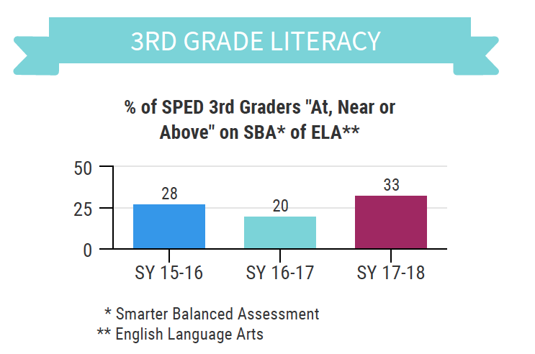
How a Dialogue Guide could enhance the reading infographic:
A 2nd infographic could offer statistics re: reading performance among young children with disabilities
The data infographic could be customized for presentations to specific audiences and locales
Resources like links to apps and adult literacy programs could be added
Community feedback would help shape future efforts and activities

Slide 15
Poll 3: To what extent could your SAP/SICC benefit from co-creating dialogue guides with the state agency?
Check one:
Not at all
Benefit somewhat
Benefit a lot

Slide 16
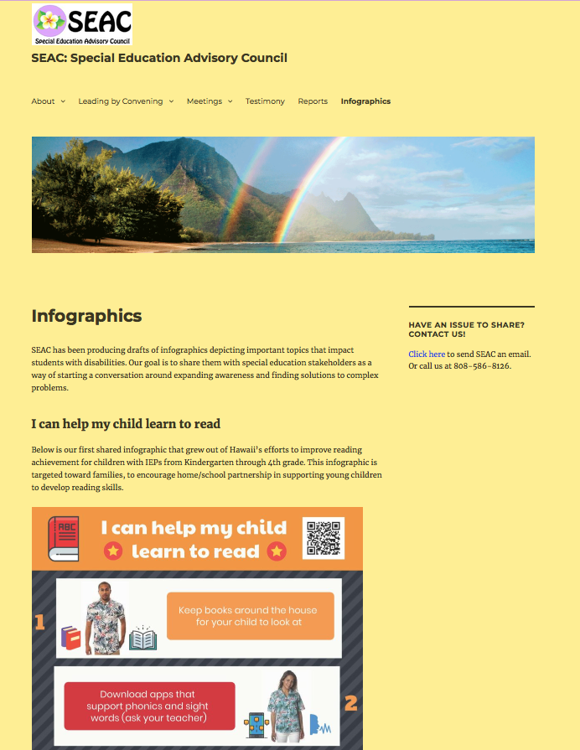
Questions & Contact Information
Visit our SEAC website to learn more about our infographics initiative:
http://seac-hawaii.org
Return from time to time to see what we have added!

Slide 17
Visit the SAP-SICC website
OSEP Collaboration Space SAP/SICC
Check out the State Resources at
OSEP Collaboration Space SAP/SICC Resources

Slide 18

We want to hear from you!
Resources you are willing to share on the SAP-SICC website
Questions, comments, feedback
Topics for future webinars
info@stateadvisorypanel.org

Slide 19
Accessing information after this webinar
Information from SAPs and SICCs as well as archived webinars with PowerPoint presentations are available at:
OSEP Collaboration Space SAP/SICC

Slide 20
Please tell us how we are doing
Each registered participant will get a short evaluation immediately following this webinar. Please take a few minutes to share your insights.
SAP SICC Webinar Survey
Thanks you for your participation today!

