Slide 1
State Advisory Panel (SAP) and State Interagency Coordinating Council (SICC)
2019-2020 Webinar Series
June 30, 2020
Meeting Planning
Strategic Planning
- - - - - - - - - - - - - - - - - - - - - - - - - - - - - - - - - - - - - - - - - - - - - - - - - - - - - - - - - - - - - -
SAP & SICC
Notes:
Slides 1-3 Anne Louise
Slides 4-14 Ali
Slides 15-24 Jodi
Slides 25&26 Sherry or Stephanie
Slides 27-31 Anne Louise

Slide 2
Welcome!
Welcome – We are so happy that you have joined us today.
Today we will be doing an overview of requirements and recommendations related to SAP and SICC meeting and strategic planning.
*If you are in need of captioning services, please login by using the link found in the chat box: https://www.captionedtext.com/client/event.aspx?EventID=4471698&Customer...
- - - - - - - - - - - - - - - - - - - - - - - - - - - - - - - - - - - - - - - - - - - - - - - - - - - - - - - - - - - - - -
SAP & SICC
Notes:
Welcome to our webinar today. In this webinar we want to share with you an overview of requirements and recommendations for planning of your SAP and SICC meetings as well as for requirements and recommendations for strategic planning with your groups.
If you are in need of captioning services, please log in by using the link found in the chat box.
First, let us introduce and identify who will be leading this webinar today.
Today our presenters consist of:
Anne Louise (National Center for Systemic Improvement)
Jodi Webb (Executive Director with ND’s Parent Training and Information Center)
Ali Conners (Supervisor, Special Education Policy Unit of the NY Department of Education, Office of Special Education)
Sherry Franklin (Early Childhood Technical Assistance Center)
Stephanie Moss (Chief Operating Office, Parent to Parent, Georgia)
Today’s webinar topic was chosen from direct input received through gathered SAP and SICC identified needs at the OSEP Leadership conference and the EC conference ECTA.
ADD TO CHAT
At the start time of the event, if you are in need of captioning services, please login by using the link found in the chat box: https://www.captionedtext.com/client/event.aspx?EventID=4471698&Customer...

Slide 3
Welcome!
Quick Poll
Who is Joining Us Today?
- - - - - - - - - - - - - - - - - - - - - - - - - - - - - - - - - - - - - - - - - - - - - - - - - - - - - - - - - - - - - -
SAP & SICC
Notes:
Who is joining us today?
Review audience - welcome
SET UP POLL
SAP Member
SICC Member
National TA Center
OSEP
PTI Staff
CPRC Staff
Other (identify?)

Slide 4
Purpose of State Advisory Panels
The Individuals with Disabilities Education Act (IDEA) requires that each State establish and maintain an advisory panel for the purpose of advising the State special education staff regarding the education of eligible children with disabilities. (34 CFR §300.167)
- - - - - - - - - - - - - - - - - - - - - - - - - - - - - - - - - - - - - - - - - - - - - - - - - - - - - - - - - - - - - -
SAP & SICC
Notes:
ALI:
Diving into todays webinar, we will begin by looking at federal guidance on SAP and SICC meetings and then look into strategic planning and annual meetings.
When we look through meeting requirements and recommendations we will focus around 5 main areas:
Purpose
Function
Procedures
Activities
Recommended Activities
Let’s start with State Advisory Panels, and then we will move into State Interagency Coordinating Councils, Identifying similarities and differences between the two.
WHAT IS THE PURPOSE OF THE STATE SPECIAL EDUCATION ADVISORY PANEL (SAP)?
The Individuals with Disabilities Education Act (IDEA) requires that each State establish and maintain an advisory panel for the purpose of advising the State special education staff regarding the education of eligible children with disabilities.
WHERE IS THE SAP DESCRIBED IN LEGISLATION?
Authority for State Advisory Panels (SAPs) from IDEA legislation: Sec. 612(a)(21) "The State has established and maintains an advisory panel for the purpose of providing policy guidance with respect to special education and related services for children with disabilities in the State."

Slide 5
Purpose of State Interagency Coordinating Councils
The Individuals with Disabilities Education Act (IDEA) requires that each State establish and maintain an interagency council for the purpose of advising and assisting the State lead agency staff regarding early intervention for eligible children with disabilities. (CFR 34 §303.604)
- - - - - - - - - - - - - - - - - - - - - - - - - - - - - - - - - - - - - - - - - - - - - - - - - - - - - - - - - - - - - -
SAP & SICC
Notes:
ALI:
Thank You Ali!
Now let’s look into the purpose of SICCs. Although there are similarities between the two there are some notable differences.
WHAT IS THE PURPOSE OF THE STATE INTERAGENCY COORDINATING COUNCIL (SICC)?
The Individuals with Disabilities Education Act (IDEA) requires that each State establish and maintain an interagency council for the purpose of advising and assisting the State lead agency staff regarding early intervention for eligible children with disabilities.
WHERE IS THE ICC DESCRIBED IN LEGISLATION?
Authority for State Interagency Coordinating Council (SICCs) from IDEA legislation: 20 USC 1441(f) "The council shall … advise and assist the lead agency … in the performance of the responsibilities … particularly the identification of the sources of fiscal and other support for services for early intervention programs, assignment of financial responsibility to the appropriate agency, and the promotion of the interagency agreements."

Slide 6
Functions of State Advisory Panels
Advise the State of unmet needs in the education of children with disabilities.
Comment publicly on any rules or regulations proposed by the State regarding the education of children with disabilities.
Provide advice to the State staff in developing evaluations and reporting on data to the Secretary of Education.
Advise the State in developing corrective action plans to address findings identified in Federal monitoring.
Advise the State in developing and implementing policies relating to the coordination of services for children with disabilities.
Review all final due process officer findings and decisions.
(CFR 34 §300.164)
- - - - - - - - - - - - - - - - - - - - - - - - - - - - - - - - - - - - - - - - - - - - - - - - - - - - - - - - - - - - - -
SAP & SICC
Notes:
ALI:
The Functions of a State Advisory Panel are to:
Advise the State of unmet needs in the education of children with disabilities.
Comment publicly on any rules or regulations proposed by the State regarding the education of children with disabilities.
Provide advice to the State staff in developing evaluations and reporting on data to the Secretary of Education.
Advise the State in developing corrective action plans to address findings identified in Federal monitoring.
Advise the State in developing and implementing policies relating to the coordination of services for children with disabilities.
Review all final due process officer findings and decisions.
IDEA regulation
CFR.300.164- states that SAPs “Waiver of requirement regarding supplementing and not supplanting with Part B funds.”
CFR 300.164 (c)(4) says “Evidence that the State, in determining that FAPE is currently available to all eligible children with disabilities in the State, has consulted with the State Advisory Panel under 300.167.”

Slide 7
Functions of State Interagency Coordinating Councils
Advise and Assist the Lead Agency
Duties
identification of the sources of fiscal and other support for services for early intervention programs, assignment of financial responsibility to the appropriate agency, and the promotion of the interagency agreements;
preparation of applications and amendments
regarding the transition of toddlers with disabilities to preschool and other appropriate services; and
prepare and submit an annual report to the Governor and to the Secretary on the status of early intervention programs for infants and toddlers with disabilities and their families operated within the State.
(CFR 34 §303.604)
- - - - - - - - - - - - - - - - - - - - - - - - - - - - - - - - - - - - - - - - - - - - - - - - - - - - - - - - - - - - - -
SAP & SICC
Notes:
ALI:
The Functions of a State Interagency Coordinating Council are to advise and assist the lead agency;
Duties:
identification of the sources of fiscal and other support for services for early intervention programs, assignment of financial responsibility to the appropriate agency, and the promotion of the interagency agreements;
preparation of applications and amendments
regarding the transition of toddlers with disabilities to preschool and other appropriate services; and
prepare and submit an annual report to the Governor and to the Secretary on the status of early intervention programs for infants and toddlers with disabilities and their families operated within the State.

Slide 8
Functions of State Interagency Coordinating Councils
Authorized activity:
The council may advise and assist the lead agency and the State educational agency
regarding the provision of appropriate services for children from birth through age 5
appropriate agencies in the State with respect to the integration of services for infants and toddlers with disabilities and at-risk infants and toddlers and their families, regardless of whether at-risk infants and toddlers are eligible for early intervention services in the State.
(CFR 34 §303.604)
- - - - - - - - - - - - - - - - - - - - - - - - - - - - - - - - - - - - - - - - - - - - - - - - - - - - - - - - - - - - - -
SAP & SICC
Notes:
ALI:
Other possible Functions a State Interagency Coordinating Council may advise and assist the lead agency;
Authorized activity:
The council may advise and assist the lead agency and the State educational agency
regarding the provision of appropriate services for children from birth through age 5
appropriate agencies in the State with respect to the integration of services for infants and toddlers with disabilities and at-risk infants and toddlers and their families, regardless of whether at-risk infants and toddlers are eligible for early intervention services in the State.

Slide 9
SAPs follow specific procedures
Hold adequate amount of meetings to conduct business.
Agendas must be publicly announced prior to meetings.
Meetings must be open to the public.
Interpreters and other necessary services must be provided.
Official minutes must be kept on all panel meetings.
Refer to your state’s Open Meeting Law Requirements
- - - - - - - - - - - - - - - - - - - - - - - - - - - - - - - - - - - - - - - - - - - - - - - - - - - - - - - - - - - - - -
SAP & SICC
Notes:
ALI:
Federal regulations do not designate a specific number of meetings to be conducted annually by the State Advisory Panel.
The panel should hold adequate meetings to conduct its business.
The following elements could be included in the panel procedures:
The advisory panel should submit an annual report of panel activities and suggestions to the State Education Agency each year. This report must be made available to the public. Official minutes must be kept on all panel meetings.
All advisory panel meetings must be open to the public, and agenda items must be publicly announced prior to the meeting.
Interpreters and other necessary services must be provided at the panel meetings for panel members or participants.
The advisory panel members serve without compensation, but the State must reimburse the members for reasonable and necessary expenses for attending meetings and performing duties.
SAPs need to also understand and follow their State Open Meeting Laws/requirements to ensure the are in compliance. - These include information on requires public posting of Agendas, Meeting Minutes, and having meetings open to the public and offering Public Comment Opportunities at each meeting.

Slide 10
SICCs follow specific procedures
Hold at minimum quarterly meetings.
Agendas must be publicly announced prior to meetings.
Meetings must be open to the public, to the extent appropriate.
Management Authority.
Subject to the approval of the Governor, the council may prepare and approve a budget using funds under this part to conduct hearings and forums, to reimburse members of the council, to pay compensation to a member of the council when performing official council business, to hire staff, and to obtain the services of such professional, technical, and clerical personnel as may be necessary to carry out its functions under this part.
Official minutes must be kept on all panel meetings.
Refer to your state’s Open Meeting Law Requirements
- - - - - - - - - - - - - - - - - - - - - - - - - - - - - - - - - - - - - - - - - - - - - - - - - - - - - - - - - - - - - -
SAP & SICC
Notes:
ALI:
The council shall meet, at a minimum, on a quarterly basis, and in such places as the council determines necessary.
The meetings shall be publicly announced, and, to the extent appropriate, open and accessible to the general public.
Management Authority.--Subject to the approval of the Governor, the council may prepare and approve a budget using funds under this part to conduct hearings and forums, to reimburse members of the council for reasonable and necessary expenses for attending council meetings and performing council duties (including child care for parent representatives), to pay compensation to a member of the council if the member is not employed or must forfeit wages from other employment when performing official council business, to hire staff, and to obtain the services of such professional, technical, and clerical personnel as may be necessary to carry out its functions under this part.
SICCs need to also understand and follow their State Open Meeting Laws/requirements to ensure the are in compliance. - These include information on requires public posting of Agendas, Meeting Minutes, and having meetings open to the public and offering Public Comment Opportunities at each meeting.

Slide 11
Reviewing a Resource Sample
- - - - - - - - - - - - - - - - - - - - - - - - - - - - - - - - - - - - - - - - - - - - - - - - - - - - - - - - - - - - - -
SAP & SICC
Notes:
ALI:
So what are some basic activities that occur at SAP and SICC meetings?
Let’s take a look at a January 2020 SICC agenda from the District of Columbia
https://osse.dc.gov/sites/default/files/dc/sites/osse/publication/attachments/ICC%20Meeting%20Agenda_Jan.%2016%2C%202020.pdf
You can see their agenda included:
Call to Order
Approval of minutes
Meeting Business
Interagency Coordinating Council (review council business)
Review actions from last meeting and retreat
Membership status
Approve Fiscal year
Agency Updates
Quarterly data reports
Annual Performance Report
IV. Council Business
Committee Structure
Priorities
Meeting location finalization
V. Public Comment
VI. Adjourn
As mentioned above other activities that could be included in the agenda are:
Introductions
Approval of Agenda
Announcements
Overview of packet materials
Report on continuous improvement and focused monitoring activities
Report on Level of Determination
Meeting summary and future agenda items
Samples of meeting agendas can be found on the SAP and SICC website located under state resources.
In the chat link we have included the District of Columbia’s SICC Meeting Agenda as a sample for you to view, as well as the link of where to find other Part B and Part C Samples.
Post link to resource in Chat room.
https://osse.dc.gov/sites/default/files/dc/sites/osse/publication/attachments/ICC%20Meeting%20Agenda_Jan.%2016%2C%202020.pdf
Link to all Reports Part B and C: https://collab.osepideasthatwork.org/SAP-SICC/state-resources

Slide 12
SAP and SICC Basic Meeting Activities
Introductions
Approval of Agenda and previous Meeting Minutes
Announcements
Old/new business
Overview of packet materials
Report from State director/Part C Coordinator
Report on continuous improvement and focused monitoring activities
Report on State Performance Plan and Annual Performance Report
Report on Level of Determination
Public comments
Group or sub-committee reports
Action items
Meeting summary and future agenda items
Establishment of next meeting
- - - - - - - - - - - - - - - - - - - - - - - - - - - - - - - - - - - - - - - - - - - - - - - - - - - - - - - - - - - - - -
SAP & SICC
Notes:
ALI:
In addition to the activities identified in the District of Columbia’s SICC agenda, other activities that could be included in the agenda are:
Introductions
Approval of Agenda
Announcements
Overview of packet materials
Report from the Director or Coordinator
Report on continuous improvement and focused monitoring activities
Report on Level of Determination
Meeting summary and future agenda items
Samples of meeting agendas can be found on the SAP and SICC website located under state resources-procedures-meeting agendas.
https://collab.osepideasthatwork.org/SAP-SICC/state-resources
Several other items, in addition or more specifically than what the District of Columbia had included, are highlighted here in boldtype, such as
Welcome and introductions
Approval of agenda and minutes
Announcements
Old/new business
Overview of packet materials
Report from State director or staff
Report on continuous improvement and focused monitoring activities
Report on State Performance Plan and Annual Performance Report
Report on Level of Determination
Public comments
Group or sub-committee reports
Action items
Meeting summary and future agenda items
Establishment of next meeting

Slide 13
Recommended SAP and SICC Activities
Developing by-laws and operating procedures
Establishing annual priorities
Providing an orientation and annual planning meeting
Developing an annual report
Ongoing and annual review of committee achievements
Involvement with the State APR and SPP
Knowledge and understanding of the State’s Level of Determination
- - - - - - - - - - - - - - - - - - - - - - - - - - - - - - - - - - - - - - - - - - - - - - - - - - - - - - - - - - - - - -
SAP & SICC
Notes:
ALI:
Some other recommended activities that may occur throughout the year that we would suggest from our experiences include:
Developing by-laws and operating procedures
Establishing annual priorities
Providing an orientation and annual planning meeting
Developing an annual report
Ongoing and annual review of committee achievements
Involvement with the State APR and SPP
Knowledge and understanding of the State’s Level of Determination

Slide 14
NY Perspective
Meeting Minute Notes…
How should they look?
What needs to be tracked?
How do we share?
- - - - - - - - - - - - - - - - - - - - - - - - - - - - - - - - - - - - - - - - - - - - - - - - - - - - - - - - - - - - - -
SAP & SICC
Notes:
Ali Connors from the New York State Advisory Panel will offer some perspective on Meeting Notes and how to make them more efficient.

Slide 15
Strategic Planning
Sets aside time to promote collaboration among members
Provide an opportunity for council members to review the existing by-laws
Appoint new Members to panel/council
Provide an orientation for any new members
Strategic Planning
- identify priorities and develop or revise a plan of action
- - - - - - - - - - - - - - - - - - - - - - - - - - - - - - - - - - - - - - - - - - - - - - - - - - - - - - - - - - - - - -
SAP & SICC
Notes:
Slides 15-24 Jodi
Let’s now talk about Strategic Planning
Each year set aside a time to meet as a group to plan the events for the upcoming year.
This can be a time for member changes as well as a time to train new members to the panel or council.
These meetings provide an opportunity for members to review the existing by-laws and provide an orientation for any new members.
It sets aside a specified time to promote collaboration among the council members as they identify priorities and develop or revise a yearly strategic plan of action

Slide 16
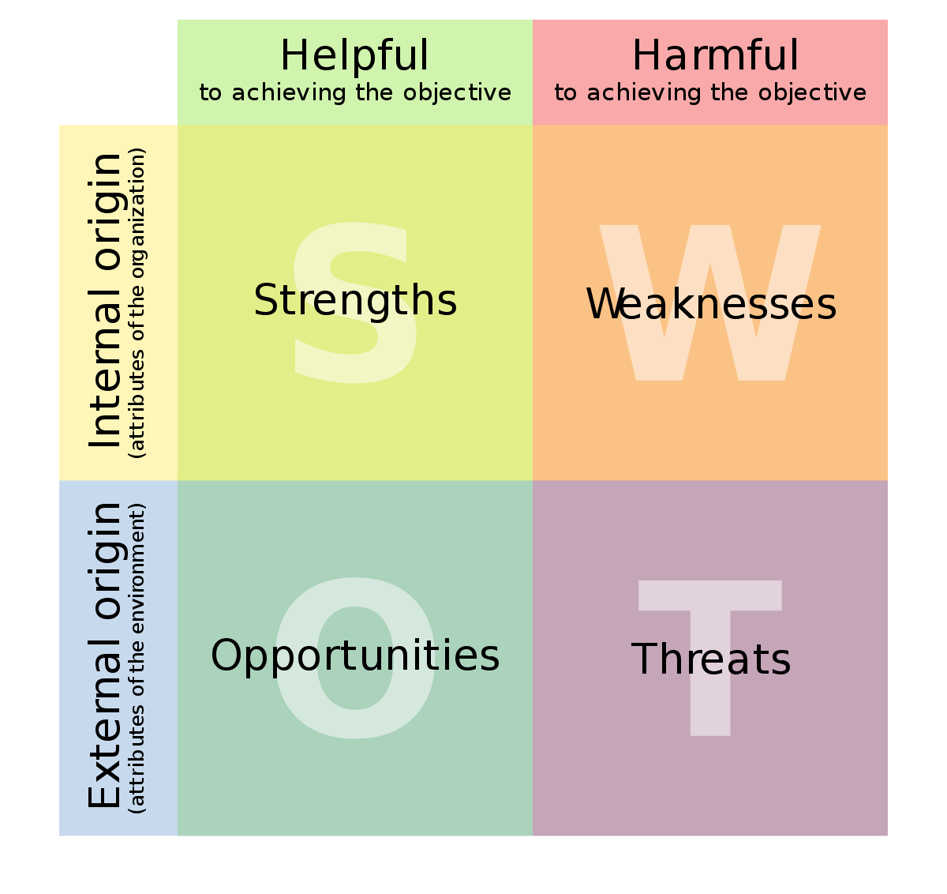
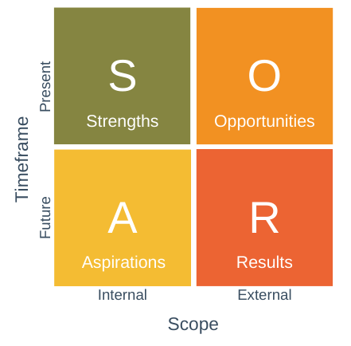
SWOT and SOAR Analysis
- - - - - - - - - - - - - - - - - - - - - - - - - - - - - - - - - - - - - - - - - - - - - - - - - - - - - - - - - - - - - -
SAP & SICC
Notes:
JODI:
When looking at efficient ways to plan forward movement, agencies tend two use two different methods; The SWOT analysis or The SOAR analysis
Both have internal and external influence
These tools help groups of individuals to dive into what is or is not working, what is new and could potentially influence movement and also to identify red flags of possible change or need of change.

Slide 17
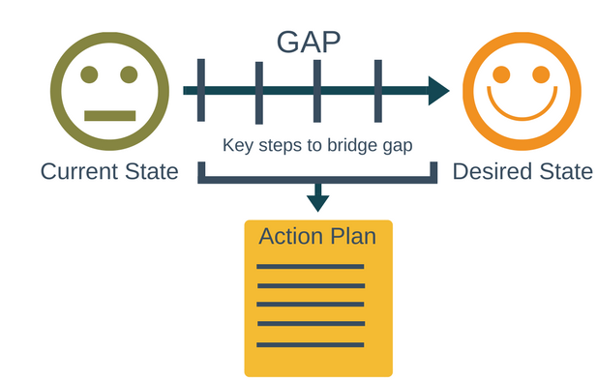
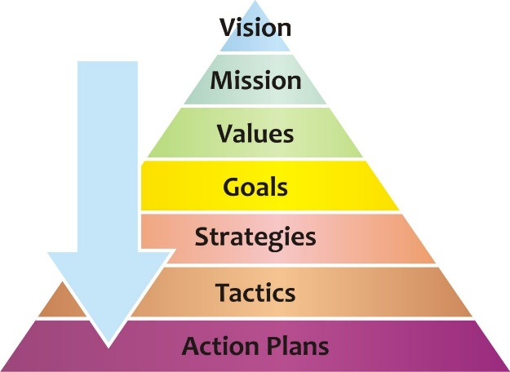
Other Planning Tools
Pyramid
Gap Analysis
- - - - - - - - - - - - - - - - - - - - - - - - - - - - - - - - - - - - - - - - - - - - - - - - - - - - - - - - - - - - - -
SAP & SICC
Notes:
JODI:
There are also other analysis methods and planning tools to use such as:
The pyramid analysis method and the Gap analysis method.

Slide 18
Planning Tools?
Quick Poll
What planning tools do you use?
- - - - - - - - - - - - - - - - - - - - - - - - - - - - - - - - - - - - - - - - - - - - - - - - - - - - - - - - - - - - - -
SAP & SICC
Notes:
JODI: What planning tool do you currently use when strategic planning?
Review responses
SET UP POLL
SWOT
SOAR
Pyramid
Gap
Excel Spreadsheet
Not sure
Nothing at this time
Other (Identify?)

Slide 19
Creating Goals
Specific
Measurable
Achievable
Realistic
Timely
Who will complete the task?
- - - - - - - - - - - - - - - - - - - - - - - - - - - - - - - - - - - - - - - - - - - - - - - - - - - - - - - - - - - - - -
SAP & SICC
Notes:
JODI: Creating SMART goals is a great way to lay out a plan of action.
SMART goals focus on five main areas; Specific, Measureable, Achievable, Realistic (or Responsible) and Timely.

Slide 20
Reviewing a Resource Sample
- - - - - - - - - - - - - - - - - - - - - - - - - - - - - - - - - - - - - - - - - - - - - - - - - - - - - - - - - - - - - -
SAP & SICC
Notes:
JODI: Looking through a sample Strategic Plan from IDAHO SICC, you can see their plan included;
Goals
Outcomes
Foundations – which include
Guiding Principles
Standards
System Components
Strategies of Action
And identified categories of focus such as;
Health
Social and emotional
Early Education and Care
Family Resources and Tools
Systems
Other items that could be included in the strategic plan are:
creating short, medium and long term goals
Overview of all services being conducted to ensure there isn’t duplication
Stakeholder representation – identifying if you have included professionals, parents, OSEP funded and other parent agencies, lead state agencies
Sample strategic plans can also be found on the SAP and SICC website.
A link to IDAHO’s Part C strategic plan has been placed in the chat box for you to view, as well as the link of where to find other Part B and Part C Samples.
POST IN CHAT BOX
https://healthandwelfare.idaho.gov/Portals/0/Children/InfantToddlerProgram/EICC/Scanned%20SPlan%20for%20Website%209_2014.pdf
Link to all Reports Part B and C: https://collab.osepideasthatwork.org/SAP-SICC/state-resources

Slide 21
Purpose of SAPs Annual Report
Outlines advice to the State on the priority areas that were addressed by the panel during the year.
Serves to apprise State officials and the public of the activities conducted by the panel during the year.
Delineates areas of need within the State that are viewed as priorities.
Serves to provide advice to the State regarding the development of policy and procedures needed to support the education of children with disabilities.
- - - - - - - - - - - - - - - - - - - - - - - - - - - - - - - - - - - - - - - - - - - - - - - - - - - - - - - - - - - - - -
SAP & SICC
Notes:
JODI: Annual Reports are required of both the State Advisory Group and the State Interagency Council.
Again, although there are similarities between the two there are some differences…
The purpose of the SAP annual report is to;
Outline advice to the State on the priority areas that were addressed by the panel during the year.
Serves to apprise State officials and the public of the activities conducted by the panel during the year.
Delineates areas of need within a the State that are viewed as priorities.
Serves to provide advice to the State regarding the development of policy procedures needed to support the education of children with disabilities.
*The advisory panel should submit an annual report to the State Education Agency. Some states are responsible for reporting to other entities as well within their state such as the Commissioner of Education, State Board of Education, Legislature or Governor. It is recommended that you check your state’s requirements for this.

Slide 22
Purpose of SICCs Annual Report
Reports the status of early intervention programs for infants and toddlers with disabilities and their families operated within the State.
Educate stakeholders about the status of early intervention programs in a state.
Provides information to the State on the areas that were addressed by the council during the year.
Serves to provide advice to the State regarding the development and sustainability of an infrastructure needed to support early intervention services.
*An ICC may choose to use the Lead Agency’s SPP/APR as their annual report.
- - - - - - - - - - - - - - - - - - - - - - - - - - - - - - - - - - - - - - - - - - - - - - - - - - - - - - - - - - - - - -
SAP & SICC
Notes:
JODI: The purpose of the SICC annual report is to;
Report the status of early intervention programs for infants and toddlers with disabilities and their families operated within the State.
Educate stakeholders about the status of early intervention programs in a state.
Provide information to the State on the areas that were addressed by the council during the year.
Serve to provide advice to the State regarding the development and sustainability of an infrastructure needed to support early intervention services.
An ICC may choose to use the Lead Agency’s SPP/APR as their annual report.
*The ICC is required to prepare and submit an annual report to the Governor and to the federal Secretary of Education. Some states are responsible for reporting to other entities as well within their state such as the Commissioner of Education, State Board of Education, Legislature or Governor. It is recommended that you check your state’s requirements for this.

Slide 23
Reviewing a Resource Sample
- - - - - - - - - - - - - - - - - - - - - - - - - - - - - - - - - - - - - - - - - - - - - - - - - - - - - - - - - - - - - -
SAP & SICC
Notes:
JODI: Looking through a sample Annual Report from FLORIDA’s SICC, you can see their plan included;
Program Overviews
Stakeholder relationships
Letter from the Chair
Funding Allocation and expenditure Report
Child participation breakdown
Family stories (SICC requirement only)
A listing of appointed members
Identified Service Areas
As mentioned above, other items that could be included in the Annual Report are:
Annual priorities and goals
Advice regarding the SPP, APR, and Level of Determination
Advice and recommendation on priority issues
Meeting agendas and minutes
Future issues
Resource section
Sample Annual Reports can also be found on the SAP and SICC website.
A link to FLORIDA’s Part C Annual Report has been placed in the chat box for you to view, as well as the link of where to find other Part B and Part C Samples.
POST IN CHAT BOX
http://www.floridaicc.com/docs/ficcit-annual-report-2013-2014.pdf
Link to all Reports Part B and C: https://collab.osepideasthatwork.org/SAP-SICC/state-resources

Slide 24
Key Items in an Annual Report
Preface
Cover letter
Table of contents
Message from the chair
Membership
Annual priorities and goals
Advice regarding the SPP, APR, and Level of Determination
Advice and recommendation on priority issues
Key activities
Meeting agendas and minutes
Future issues
Resource section
The report should be concise, user friendly, and advisory in nature
*SICC – Family Stories
- - - - - - - - - - - - - - - - - - - - - - - - - - - - - - - - - - - - - - - - - - - - - - - - - - - - - - - - - - - - - -
SAP & SICC
Notes:
JODI: In addition to what was mentioned in FL’s SICC Annual Report, other items that could be included in the Annual Report are those highlighted in boldface text:
Annual priorities and goals
Advice regarding the SPP, APR, and Level of Determination
Advice and recommendation on priority issues
Meeting agendas and minutes
Future issues
Resource section
In addition SICC’s should include Family stories
The Annual report should be concise, user friendly, and advisory in nature.
Sample Annual Reports can also be found on the SAP and SICC website.
A link to FLORIDA’s Part C Annual Report has been placed in the chat box for you to view, as well as the link of where to find other Part B and Part C Samples.
POST IN CHAT BOX
http://www.floridaicc.com/docs/ficcit-annual-report-2013-2014.pdf
Link to all Reports Part B and C: https://collab.osepideasthatwork.org/SAP-SICC/state-resources
Key items found in Annual Reports would be;
Preface
Cover letter
Table of contents
Message from the chair
Membership
Annual priorities and goals
Advice regarding the SPP, APR, and Level of Determination
Advice and recommendation on priority issues
Key activities
Meeting agendas and minutes
Future issues
Resource section

Slide 25
Have any additional activities?
Breakout Rooms
Are there other activities that you do within your state panels or councils?
- - - - - - - - - - - - - - - - - - - - - - - - - - - - - - - - - - - - - - - - - - - - - - - - - - - - - - - - - - - - - -
SAP & SICC
Notes:
Slides 25&26 Sherry or Stephanie
We will break off in rooms for 15-20 minutes to discuss within designated groups (SAP and SICC).
Are there other activities that your state focuses on that was not mentioned?
SAP – Anne Louise, Luz, Sherry
SICC – Stephanie, Pakethia, Carmen

Slide 26
Breakout Room Results
Debriefing
Let’s take a moment to share as a group
- - - - - - - - - - - - - - - - - - - - - - - - - - - - - - - - - - - - - - - - - - - - - - - - - - - - - - - - - - - - - -
SAP & SICC
Notes:
SHERRY and STEPHANIE:
Let’s take a moment to debrief from out breakout rooms and to share as a group.

Slide 27
What are your needs?
Are there any needs your SAP or SICC have at this time that we might be able to assist with?
Please unmute, indicate in the chat, or contact us at: info@stateadvisorypanel.org
- - - - - - - - - - - - - - - - - - - - - - - - - - - - - - - - - - - - - - - - - - - - - - - - - - - - - - - - - - - - - -
SAP & SICC
Notes:
Slides 27-31 Anne Louise
Before we wrap up today, we are interested in hearing if there are any other needs that we might be able to assist you with...
Please unmute your lines to talk, or share your thoughts in the chat box, or at anytime contact us by email.

Slide 28
Upcoming Events
Registration forthcoming for the Fall 2020 SAP & SICC Webinar:
“Orientation of New Members”
Anticipate a September edition of the SAP & SICC Newsletter
Watch for updates on the SAP & SICC website Home Page for CURRENT AND UPCOMING EVENTS
- - - - - - - - - - - - - - - - - - - - - - - - - - - - - - - - - - - - - - - - - - - - - - - - - - - - - - - - - - - - - -
SAP & SICC
Notes:
Slides 27-31 Anne Louise

Slide 29
Supports for SAPs & SICCs
SAP & SICC Support
Contact SAP_SICC at:
info@stateavdisorypanel.org
Website Content
Visit the SAP_SICC website:
https://collab.osepideasthatwork.org/SAP-SICC
Website
Newsletter
Flyer
Webinar Series
Linkage to TA Center for Individualized Support
News
Calendar
Files: Archives
Contacts: States
FAQs
State Resources
- - - - - - - - - - - - - - - - - - - - - - - - - - - - - - - - - - - - - - - - - - - - - - - - - - - - - - - - - - - - - -
SAP & SICC
Notes:
Slides 27-31 Anne Louise
We would like to remind you that there are a variety of supports available to state advisory panels and interagency coordinating councils through this national workgroup.
First, you may contact our group using the info@stateadvisorypanel.org email with any questions or requests for information OR you may visit our SAP/SICC website located at: https://collab.osepideasthatwork.org/SAP-SICC.
THE LINK WILL BE PLACED IN THE CHAT BOX

Slide 30
Evaluation
Here is the link for the evaluation for the webinar: https://unc.az1.qualtrics.com/jfe/form/SV_6YvCzGqhTodCCqx
Here is the link for the evaluation for the webinar: https://unc.az1.qualtrics.com/jfe/form/SV_6YvCzGqhTodCCqx
If you registered for this webinar, you will get an email with a link to the evaluation.
You can access the evaluation now, using the link in the chat box at:
https://unc.az1.qualtrics.com/jfe/form/SV_6YvCzGqhTodCCqx
- - - - - - - - - - - - - - - - - - - - - - - - - - - - - - - - - - - - - - - - - - - - - - - - - - - - - - - - - - - - - -
SAP & SICC
Notes:
Slides 27-31 Anne Louise
Please help us help you. We appreciate hearing from you through the evaluation or by email.
We appreciate you taking the time now using the link in the chat box for the evaluation. Just copy and paste it in your web browser. Thank you!

Slide 31
Thank You!
Thank you for your active engagement and ongoing support!
- - - - - - - - - - - - - - - - - - - - - - - - - - - - - - - - - - - - - - - - - - - - - - - - - - - - - - - - - - - - - -
SAP & SICC
Notes:
Slides 27-31 Anne Louise

