Slide 1
State Advisory Panel (SAP) and State Interagency Coordinating Council (SICC)
2022 Webinar Series
November 16, 2022
Establishing Effective Panels:
SAP & SICC Bylaws
- - - - - - - - - - - - - - - - - - - - - - - - - - - - - - - - - - - - - - - - - - - - - - - - - - - - - - - - - - - - - -
SAP & SICC

Slide 2
Welcome!
Welcome – We are so happy that you have joined us today.
Today we will be discussing establishing effective Panel and ICC bylaws and operating procedures.
*Captioning services are provided through the ZOOM platform. Please locate access to this service at the bottom right of your screen.
- - - - - - - - - - - - - - - - - - - - - - - - - - - - - - - - - - - - - - - - - - - - - - - - - - - - - - - - - - - - - -
SAP & SICC
Notes:
Welcome to our November webinar. Thank you for joining us today as we discuss establishing effective Panel and ICC bylaws and operating procedures. This powerpoint and the script that we will be using will be posted to our website following this presentation.
If you are in need of captioning services, you may access this at the bottom right of your screen.

Slide 3
Our Purpose
A national workgroup assists in planning and facilitating national professional learning and capacity building activities to support states in organizing, orienting, and providing learning opportunities for SICCs and SAPs across the country.
Interagency collaboration
Leadership
Engagement with families and other stakeholders
Emerging issues
- - - - - - - - - - - - - - - - - - - - - - - - - - - - - - - - - - - - - - - - - - - - - - - - - - - - - - - - - - - - - -
SAP & SICC
Notes:
Today’s session is brought to you by the National Workgroup for SAP/SICC. I’m_____________ one of the members of this committee that will be facilitating today’s session, along with ____________, _______________, and ________________.
To assist State Advisory Panels and State Interagency Coordinating Councils, a national workgroup was created by the Office of Special Education Programs (OSEP) to ...[ assist in…READ TOP OF SLIDE} The group provides information on {FINISH READING THE SLIDE].

Slide 4
Members of the Workgroup
John Copenhaver or Norm Ames TAESE
Katherine Bradley-Black, NCSI
Luz Hernandez, CPRC
Pakethia Harris, NCSI
Pam Weir, DE SAP (staff)
Perry Williams, OSEP
Stephanie Moss, PTAC/ECTA
Ali Conners, NY DOE
Anne Louise Thompson, NCSI
Carmen Sanchez, OSEP
Christine Germeyer, VA SAP
Eliana Tardio Hurta, NCSI
Jennifer Lussier, CT PTI and SAP
Jodi Webb, ND PTI
- - - - - - - - - - - - - - - - - - - - - - - - - - - - - - - - - - - - - - - - - - - - - - - - - - - - - - - - - - - - - -
SAP & SICC
Notes:
The workgroup consists of interested staff from the Office of Special Education Programs (OSEP), Parent Training and Information Centers, OSEP-funded Technical Assistance Centers, and state staff currently involved in their states’ SICC or SAP either as a board member or a state staff member.
Here is this year’s workgroup and we are grateful not only to OSEP and several of the national centers, but we want to especially thank the state staff and panel or council members from CT, DE, NY, NV, and VA for their participation.

Slide 5
Who is Joining Us Today?
- - - - - - - - - - - - - - - - - - - - - - - - - - - - - - - - - - - - - - - - - - - - - - - - - - - - - - - - - - - - - -
SAP & SICC
Notes:
Before we jump into our topic today, we want you to learn who is participating with you from around the country. Please take the poll and then we would love to have you put the state that you represent or your work location in the chat box.
Review audience - welcome
Tanner, please SET UP POLL and Launch Poll
SAP Member
SAP SEA staff
SICC Member
SICC LA staff
National TA Center staff
OSEP staff
PTI Staff
CPRC Staff
Other (identify?)

Slide 6
Learning Objectives
Participants in the webinar will
Increase awareness of the importance of bylaws for SAPs and SICCs.
Build understanding of the purpose and function of by-laws.
Increase capacity to participate in and conduct effective SAP and SICC meetings.
- - - - - - - - - - - - - - - - - - - - - - - - - - - - - - - - - - - - - - - - - - - - - - - - - - - - - - - - - - - - - -
SAP & SICC
Notes:
We hope that by the end of this webinar you will have increased awareness of the importance of bylaws for SAPs and SICCs, have and understanding of the purpose and function of by-laws, and have an increased capacity to participate in and conduct effective SAP and SICC meetings. Now I am going to turn it over to John Copenhaver, from TAESE, to start our discussion on bylaws.

Slide 7
Purpose for the Bylaws
Bylaws set the ground rules for the day-to-day operation of the Panel/ICC.
Bylaws are the most important document for the Panel/ICC
They provide direction and consistency for the way the Panel/ICC is organized and mode of operation.
The bylaws set a standard on how Panel/ICC meetings should operate.
Notes:
Bylaws are critical to the operation of Panels and ICCs, providing direction and consistency for how the panel or ICC is organize, as well as how meetings are conducted. Over the years, there will be changes in membership and state directors. The bylaws serve as an anchor to ensure that the panel or ICC continues to operate under consistent standards, regardless of membership changes.
Tanner, Please LAUNCH POLL:
If you are an Advisory Panel or ICC member, are you familiar with the bylaws of your group?
Yes____ No _____.

Slide 8
Relationship of Bylaws With Other Meeting Operations
State Opening Meeting Requirements
Family Educational Rights and Privacy Act (FERPA)
Consensus building
Robert’s Rules of Order
Notes:
The bylaws work in conjunction with other important meeting operations such as state open meeting requirements, the Family Educational Rights and Privacy Act, Consensus Building and Robert’s Rules of Order. For example, during a meeting members should refrain from using personally identifiable information that would violate FERPA. Specific student names and educator names should not be used in this public meeting. Instead, issues should be shared and discussed on a more general, systemic level.

Slide 9
Open Meeting Requirements
All States have their own Open Meeting Requirements that explain how public meetings will be conducted so they are fair and consistent from one government meeting to another.
The Panel/ICC bylaws and meetings should be consistent with the State Open Meeting requirements.
Notes:
Panels and ICCs should abide by their state’s open meeting requirements. Each state has their own set of requirements for how public meetings will be conducted so they are fair and consistent from one government meeting to another. The state board of education will be following open same open meeting requirements that a Panel or ICC will be following. Panel and ICC members can look to their state board of education as models for agendas, procedures and practices.

Slide 10
Why Do We Need Open Meeting Requirements?
Protect and inform the public
Maintain integrity of government
Build trust between the government and citizens
Establish consistent procedures for all public meetings

Slide 11
State Open Meeting Requirements
Adhere to the State Open Meeting requirements. All Advisory Panel/ICC meetings and agenda items must be announced far enough in advance of the meetings to afford interested parties a reasonable opportunity to attend. All meetings must be open to the public.
Notes:
Tanner, please Launch Poll:
Has your SAP or SICC provided you training on your state’s open meeting requirements?
Yes____ or No______

Slide 12
Part C – Possible Content of ICC Bylaws
Purpose and Authority
Mission of the Council
Values of the Council
Duties of the Council
Membership
Term of office
Meeting Participation
Vacancies
Resignation
Orientation
Executive Committee and other Committees
Executive Committee
Committees and work groups

Slide 13
Part C – Possible Content of ICC Bylaws
Roles of Part C Coordinator
Procedures and Requirements for Meetings of the Council
Schedule
Quorum
Chairperson
Vice-Chairperson
Voting
Public Comments
Conflict of Interest
Expenses
Public Participation
Placing Items on the Agenda
Minutes
Annual Report
Bylaws Amendment Process

Slide 14
Part B- Possible Content of Advisory Panel Bylaws
Purpose and Authority (34 CFR §300.167)
Authorizing Legislation
Name of Council
Advisory Council Responsibility
Advisory Council Functions (34 CFR §300.169)

Slide 15
Part B- Possible Content of Advisory Panel Bylaws
Council Membership (34 CFR §300.168)
Nominations and Appointments
Council Membership (34 CFR §300.168)
Stakeholders
Tenure of Members
Reappointment Procedures
Expectations of Members
Member Orientation and Priority Setting

Slide 16
Part B- Possible Content of Advisory Panel Bylaws
Advisory Council Officers
Committee Work
Meetings
Number of Meetings
Quorum
Public Comments
Public Comments Procedures

Slide 17
Part B- Possible Content of Advisory Panel Bylaws (con’t)
Resignation, Removal, and Replacement of Council Members
Resignation
Removal and Replacement
Roles of the State Special Education Director or Designee
Advisory Council Annual Report
Amendments to Bylaws

Slide 18
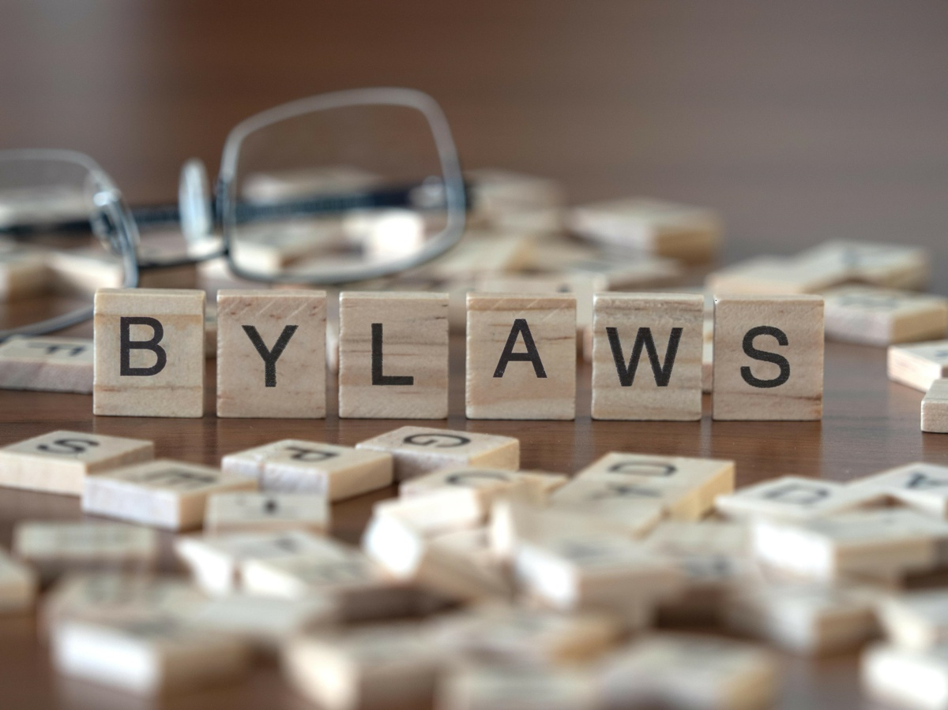
What Is In Your Bylaws?
- - - - - - - - - - - - - - - - - - - - - - - - - - - - - - - - - - - - - - - - - - - - - - - - - - - - - - - - - - - - - -
SAP & SICC
Notes:
Now that we have discussed the content of bylaws, we want to ask if anyone has anything not on these lists included in their bylaws. If you want to share, please raise your hand and we will call on you to unmute, or simply type something in the chat.

Slide 19
Bylaws Best Practice
Adhere to the Bylaws - if you make an exception, you set a precedent.
Establish a Bylaw subcommittee and review the Bylaws each year.
The nice thing about Bylaws is they can be changed as long as the changes do not violate IDEA or open meeting requirements.
Amendment process to revise Bylaws.
Notes:
Bylaws can only be effective if they are followed. Keep in mind, if you make an exception, you set precedent. Panels and ICCs may find it helpful to have a subcommittee that is tasked with reviewing the bylaws each year. Periodically, panels and ICCs may want to revise their bylaws and there should be an established amendment process to make those revisions. Changes can be made as long as they do not violate IDEA or open meeting requirements. One example of a change one panel made was to add student members to the membership of the panel. Students were not a named member in their state statute, but the panel felt it was critical to have the student voice represented so they added them in their bylaws. We are going to launch a quick poll:
Tanner, please LAUNCH POLL: If you are an Advisory Panel or ICC member, does your group have a Bylaw Committee to periodically review the bylaws?
Yes____ No_____.

Slide 20
Member Annual Orientation
Use the Advisory Panel/ICC Bylaws as part of the annual Panel/ICC orientation. Every new member should receive a copy of the Bylaws to read.
Notes:
Another best practice is to include the bylaws as part of the annual Panel/ICC orientation. Every new member should receive a copy of the bylaws to read. Here is another quick poll:
Tanner, please Launch Poll: Does your Advisory Panel or ICC provide training for new members to review and make them familiar with the bylaws?
Yes___ No____.
Read results of poll. Now I am going to turn it over to _____________, to talk about some of the best practices as they relate to the bylaws.

Slide 21
Best Practices Relating to the Bylaws and SAP/ICC Meetings
Notes:
Now we are going to shift gears over to best practices on conducting effective Panel and ICC meetings. As we discussed earlier, bylaws inform the procedures of meetings. This is a very abbreviated overview of best practices in conducting effective meetings. Today we are going to go over the ones that directly relate to bylaws, but there are many other issues to consider, such as public comment and the Family Educational Rights and Privacy Act (FERPA). We discuss these other topics in some of our previously recorded webinars that you can find on our website. We are going to drop that link in the chat right now.
Tanner, Please DROP LINK IN CHAT: https://osepideasthatwork.org/resources-grantees/sap-sicc/webinars

Slide 22
SAP/ICC Meeting Procedures
Follow the meeting procedures as stated in the bylaws and Open Meeting requirements.
Notes:
Panels and ICCs should be consistent in the way meetings are conducted, following the procedures outlined in the bylaws and their state’s open meeting requirements.

Slide 23
Effective Meeting Facilitation
Panels and ICC’s can:
Provide training for Executive Committee Members and Subcommittee Chairs
Provide mentoring for new members/chairperson
Build capacity of members
Set clear meeting agendas
Notes:
To do their best work, there are some things that Panels and ICCs can do proactively to ensure they run efficient and productive meetings, such as: providing training for the Executive committee members and Subcommittee chairs to understand their roles and responsibilities pertaining to their committees. Having a system for mentorship of new members by experienced members and the outgoing chairperson mentoring the new chairperson is another way to build the capacity of of members to be effective in meetings. Building capacity can be done with trainings within the group itself, or externally through webinars such as the one you are here for today.

Slide 24
How Does your Panel/ICC Prepare New Members?
Notes:
We want to hear from you again, this time on what does your panel or ICC do to prepare new members? You can either type something in the chat or raise your hand and we will call on you.

Slide 25
Effective Facilitators
Stick to the agenda
Keep the group on task and on time
Follow Robert’s Rules of Order
Understand protocols for interacting with public commenters
Know how to work towards consensus
Notes:
The chairperson plays a critical role in in the efficiency and productivity of the Panel or ICC meeting. They are responsible for leading the group through the agenda, ensuring that it stays on task and on time. A good facilitator is well-versed in Robert’s Rules of Order and understands the protocols for interacting with people who make public comments during meetings. They can facilitate the understanding of these protocols by both the public and the group by reviewing the protocol right before the public commenting portion of the meeting. Typically, this includes sharing the time limit and reminding that the Panel or ICC will listen to the public comments but cannot respond to them at this meeting. Most importantly, an effective facilitator knows how to move the group towards consensus.

Slide 26
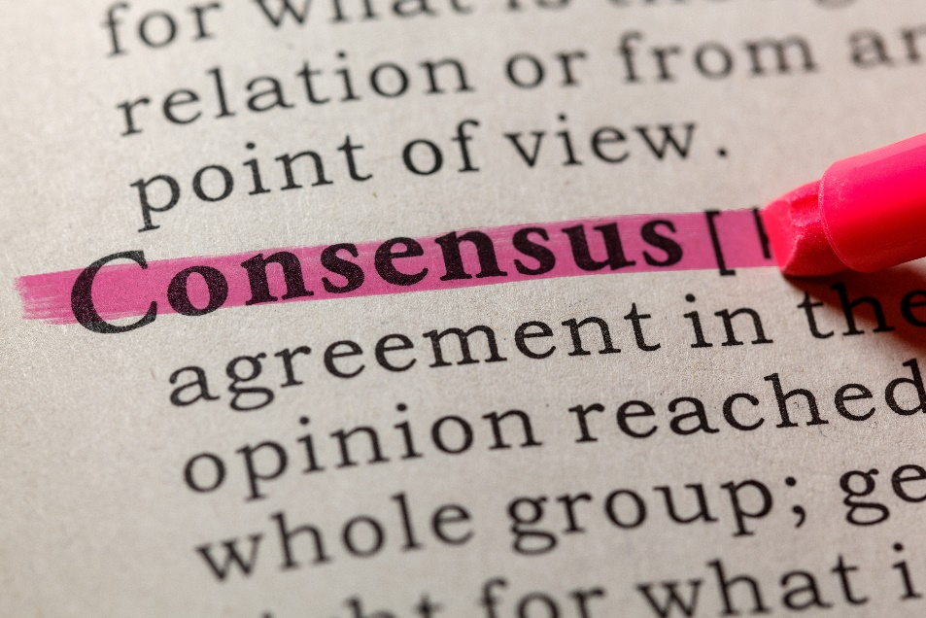
Consensus is not…
A unanimous vote
A majority vote
A vote of any kind
It is not 100% satisfaction
Notes:
There are many things that consensus is not, including a unanimous or majority vote, or 100% satisfaction for all members. Some refer to consensus as something that everyone can live with, even if they do not entirely agree.

Slide 27
Building Consensus at Panel/ICC Meetings
The Panel/ICC should move toward consensus when discussing and making recommendations.
Consensus is finding an acceptable proposal that all members can support.
Members might not get everything they want, but get enough to publicly support
Notes:
Panels and ICCs are diverse groups of stakeholders, coming from different backgrounds, with different experiences, ideas and perspectives. As such, it can be expected that the group will not always agree. When discussing recommendations to make, the chair can help move the group towards consensus, where members feel comfortable enough with the recommendation to publicly support it even if they do not completely agree.

Slide 28
Robert's Rules of Order
Henry Martyn Robert
To bring order out of chaos
Consistent rules of order
First edition in 1876
5.5 million copies in print
Use to approve decisions and pass motions.
Notes:
Most Panels and ICC’s use Robert’s Rules of Order as their parliamentary procedures. It has been around since 1876. Using parliamentary procedures like Robert’s Rules, helps meetings be fair, consistent, and orderly. Towards the end of these slides we will have links to some additional resources and information about Robert’s Rules. Now I am going to turn it over to Eliana to discuss another important factor to consider: accessibility.

Slide 29
SAP/ICC Meetings Food for Thought – Accessibility
Use a proper “heading” structure.
Write in plain language. Use short simple sentences.
Always write out the first in-text reference to an acronym, followed by the acronym itself written in capital letters with spaces among letters, and enclosed by parentheses.
Use a common, plain font and a text size no smaller than 12 point. Arial, Helvetica, and Verdana are the good options.
Notes:
Headings are important because they communicate the organization of the content on the page. HEADIGNS provide in-page navigation for Web browsers, plug-ins, and assistive technologies .
Write in plain language. Use short simple sentences. Writing in plain language should increase audience access to your work while not leaving out any of the substance. Anyone benefits from plain language but this is especially important for accessibility for people with with disabilities.
Acronyms can be very useful but they are only appropriate when the people you're addressing recognize and understand what the abbreviation stands for. To be sure they do, always precede it with its expanded name the first time it's used.
Font size and style. Use simple fonts without excessive special formatting. Avoid compressed, decorative, or cursive fonts. Font size is no smaller than 12 point. When possible use 14 point font. Large print materials should use between 16 and 18 point.

Slide 30
SAP/ICC Meetings Food for Thought – Accessibility
Organize information using numbers or bullets.
Provide alt-text for images and graphics.
Check the accessibility of documents. (In Word, Excel, and PowerPoint, select Review > Check Accessibility)
Provide in different languages and different formats, as possible.
Notes:
Bulleted lists and numbered lists can help readers see and understand the list items easily.
Alternative (Alt) Text is meant to convey the “why” of the image as it relates to the content of a document or webpage. It is read aloud to users by screen reader software, and it is indexed by search engines.
The Microsoft Accessibility Checker verifies your file against a set of rules that identify possible issues for people who have disabilities. Depending on how severe the issue is, the Accessibility Checker classifies each issue as an error, warning, or tip. It’s not enough but it’s a good beginning.
Having documents in different languages and formats responding to the needs of your community can increase your reach and help you ensure representation.

Slide 31
SAP/ICC Meetings Requirements for Places of Public Accommodation
The Americans with Disabilities Act (ADA) requires businesses and non-profit organizations that serve the public to remove architectural barriers when it is “readily achievable” to do so; in other words, when barrier removal is “easy, accomplishable and able to be carried out without much difficulty or expense.”
The ADA Checklist, available at ada-checklist.pdf, lists 4 Priorities for Accessibility
Accessible approach to entrance
Access to goods and services
Access to public toilet rooms
Access to other items such as water fountains and public telephones
Notes:
Please visit adachecklist.org to learn more about the ADA different requirements of public accommodations for businesses and non-profit organizations that provide goods to or serve the public.
Tanner, please share links in chat: https://adachecklist.org/ and https://www.adachecklist.org/doc/fullchecklist/ada-checklist.pdf

Slide 32
Questions and Comments

Slide 33
Resources
Robert’s Rules of Order
Robert’s Rules Cheat Sheet
Robert’s Rules of Order – the Basics
SAP-SICC Webinar Recordings
Notes:
Tanner, please post links:
https://robertsrules.com/
https://diphi.web.unc.edu/wp-content/uploads/sites/2645/2016/10/cheat-sheet.pdf
https://www.pta.org/docs/default-source/files/training/course-tools/president/english/roberts-rules-of-order-basics
https://osepideasthatwork.org/resources-grantees/sap-sicc/webinars

Slide 34
Supports for SAPs & SICCs
SAP & SICC Support
Contact SAP_SICC at:
info@sapandsicc.org
Website Content
Visit the SAP- SICC website:
https://osepideasthatwork.org/resources-grantees/sap-sicc
Website
Newsletter
Flyer
Webinar Series
Linkage to TA Center for Individualized Support
News
Calendar
Files: Archives
Contacts: States
FAQs
State Resources
- - - - - - - - - - - - - - - - - - - - - - - - - - - - - - - - - - - - - - - - - - - - - - - - - - - - - - - - - - - - - -
20
SAP & SICC
Notes:
We would like to remind you that there are a variety of supports available to state advisory panels and interagency coordinating councils through this national workgroup.
First, you may contact our group using the info@sapandsicc.org email with any questions or requests for information OR you may visit our SAP/SICC website located at: https://osepideasthatwork.org/resources-grantees/sap-sicc
THE LINK WILL BE PLACED IN THE CHAT BOX
https://osepideasthatwork.org/resources-grantees/sap-sicc

Slide 35
Evaluation
If you registered for this webinar, you will get an email with a link to the evaluation. Please help us to serve you better by completing the evaluation.
You can access the evaluation now, using the link in the chat box.
- - - - - - - - - - - - - - - - - - - - - - - - - - - - - - - - - - - - - - - - - - - - - - - - - - - - - - - - - - - - - -
21
SAP & SICC
Notes:
Please help us help you. We appreciate hearing from you through the evaluation or by email.
We appreciate you taking the time now using the link in the chat box for the evaluation. Just copy and paste it in your web browser. Thank you!
Tanner, please POST LINK in the CHAT: https://unc.az1.qualtrics.com/jfe/form/SV_bpTahcP8ioGXenA

Slide 36
Thank You!
Thank you for your active engagement and ongoing support!
- - - - - - - - - - - - - - - - - - - - - - - - - - - - - - - - - - - - - - - - - - - - - - - - - - - - - - - - - - - - - -
22
SAP & SICC

