Slide 1
From “Talking the Talk” to “Walking the Walk:” RI’s Engagement Story
Teri Marx, PhD, American Institutes for Research
J. David Sienko, Rhode Island Department of Education
Sue Donovan, Rhode Island Parent Information Network
July 22-24, 2019

Slide 2
OSEP Disclaimer
2019 OSEP Leadership Conference
DISCLAIMER:
The contents of this presentation were developed by the presenters for the 2019 OSEP Leadership Conference. However, these contents do not necessarily represent the policy of the Department of Education, and you should not assume endorsement by the Federal Government.
(Authority: 20 U.S.C. 1221e-3 and 3474)

Slide 3
Our Goal for this Session
Consider stakeholder engagement not as a compliance activity, but as an opportunity for meaningful collaboration that leads to shared outcomes.

Slide 4
Moving Beyond Compliance
Stakeholder Engagement under Results-Driven Accountability (RDA)

Slide 5
A Brief Rhode Island History
This Photo by Unknown Author is licensed under CC BY-SA
This Photo by Unknown Author is licensed under CC BY-SA

Slide 6
State Systemic Improvement Plan (SSIP)
Phase I
Stakeholder involvement in data analysis
Stakeholder involvement in identifying the State-identified Measurable Result (SiMR)

Slide 7
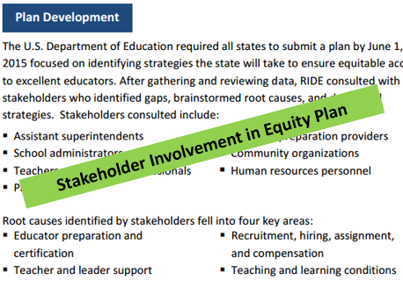
Parent Center’s Role
The SSIP Core Team sought feedback from multiple groups in RI, bringing data to each session and returning with new areas to examine based on group feedback.
Focus group with practitioners in the State who are implementing intensive interventions to prepare for scaling-up.
RIPIN hosted the focus group, and the Director of the PTIC @ RIPIN participated.
Interviews with special education leaders and their representatives in urban districts.

Slide 8
Phase II
Stakeholder involvement in SSIP development
Used the results from the initial focus group and interviews to identify specific ways to build capacity.
Sustainable practices to ensure intensive intervention would not lose traction.

Slide 9
Technical Assistance Recipients
Academics
&
Social-Behavior
Skilled at collecting data, not at analyzing data to inform instructional decisions.
Over- or under-reliance on curricula or intervention programs rather than on quality instruction.

Slide 10
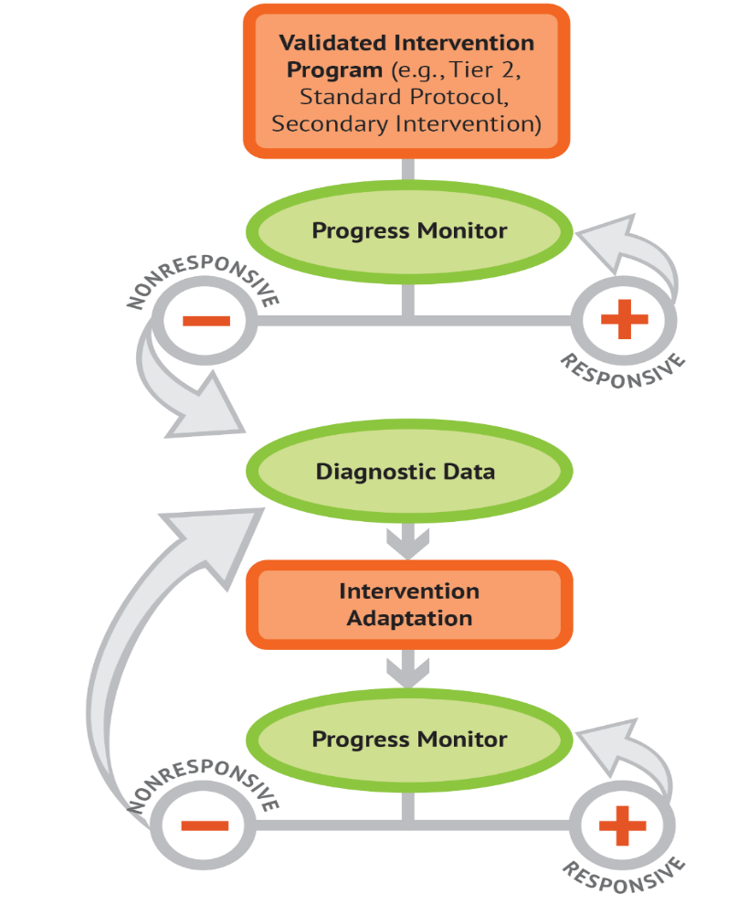
What is Data-Based Individualization (DBI)?
Is a process for delivering intensive intervention
Origins in experimental teaching
Is not a one-time fix
Integrates data-based decision making across academics and social behavior

Slide 11
SSIP Guiding Principles
Improved Student Results
State & District Data Analysis
Targeted Investments
Targeted Interventions
Changes in Adult Behavior & School Practices
Listen to your LEAs!

Slide 12
Phase III
Stakeholder involvement in SSIP implementation
Stakeholder involvement in SSIP evaluation

Slide 13
RI Intensive Math Intervention Project (SSIP)
Original Intent
Focus on improving Tier 2 and Tier 3 interventions for students who struggle in mathematics
Needs Analysis
Many schools lacked high quality Tier 1 mathematics instruction for students
Ineffective or non-existent MTSS structures/processes in mathematics
Current
Continuing the focus on improving Tier 1 instruction and using data-based decision making
Improving implementation at Tier 2 for further intensification at Tier 3

Slide 14
Discussion Prompt
How can we move beyond “compliance” to “actual” stakeholder engagement within RDA?

Slide 15
Differential Engagement of Stakeholders
Understanding Stakeholder Roles

Slide 16
Peripheral Stakeholders
“those who broadly have an interest in/awareness of Rhode Island’s SSIP but may not work closely with implementation or evaluation activities.”
Work with the Rhode Island Special Education Advisory Council
Collaborate with the Office of Curriculum and Instruction
Collaborate with other RIDE Initiatives
Work with the Math Advisory Board at the State Level

Slide 17
Primary Stakeholders
“Primary stakeholders include school staff and DBI core team members who are involved in the ongoing implementation efforts.”

Slide 18
Differential Engagement Strategies
Peripheral
Primary
Feedback/listening sessions to determine if the implementation/evaluation approaches are meaningful and relevant to broader State needs
Professional Learning Community with district leaders to foster cross-district collaboration and support capacity building
Determine course of TA activities
Co-develop site goals and plans
Provide feedback on training content or coaching resources prior to broader dissemination
Invite to present what they’ve learned at the RI Learning Forum
Create training/resources after attending professional conferences

Slide 19
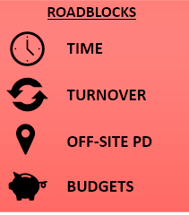
Continuous Improvement
Scaling
From initial team to school-wide implementation
Sustaining
Ability to easily train new staff and/or provide refreshers

Slide 20
Discussion Prompt
What strategies can be used to differentially engage different types of stakeholders in change efforts? To support continuous improvement?

Slide 21
Co-Constructing
Resources and Outcomes through Meaningful Partnerships

Slide 22
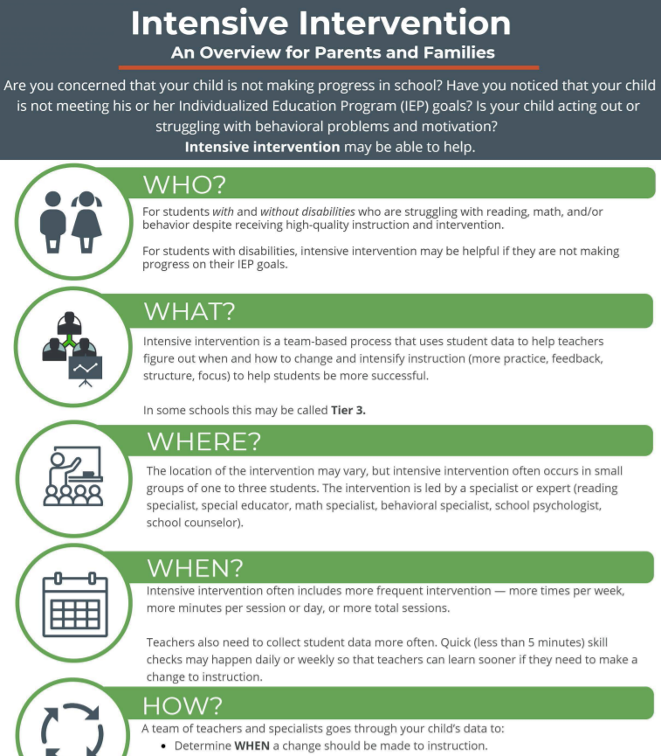
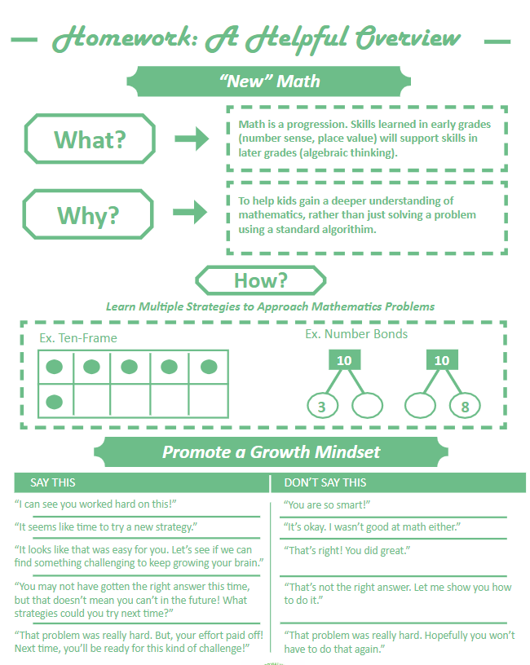
Parent and Family Engagement
A priority, not an afterthought!

Slide 23
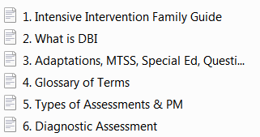
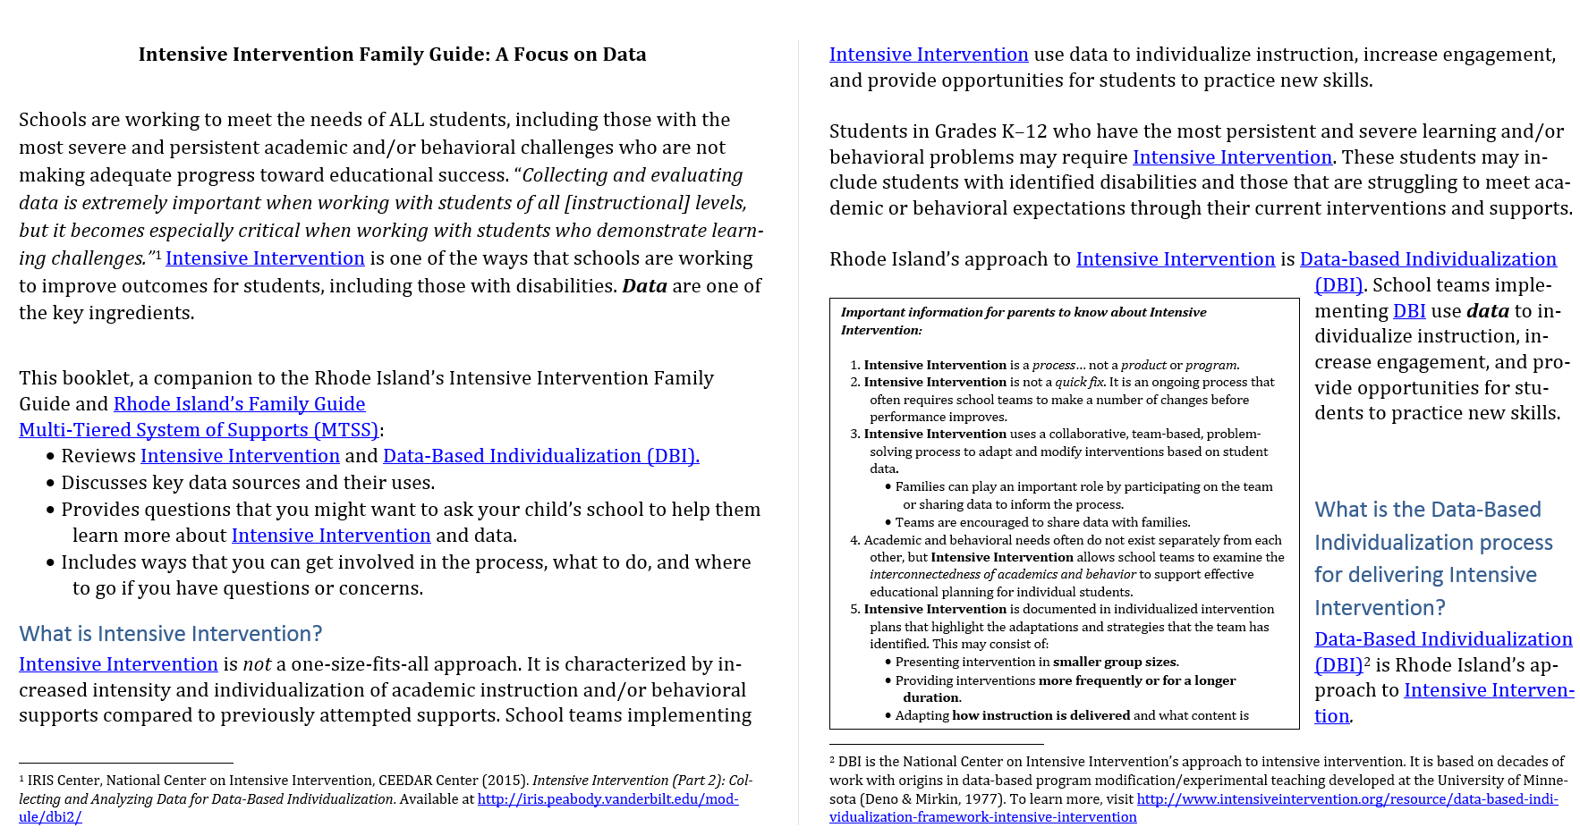
Our Best Laid Plans…
Original Intent
Develop Family Toolkit on Intensive Intervention that incorporates friendly language about what intensive intervention is, who it supports, and how schools make it happen.
Challenge: How to address everything at once.
Solution: Let’s break it up!

Slide 24
Feedback: Engage Other Stakeholders
Questions to Consider | Feedback
Is the language clear for the parents and families you work with? If not, Do you have suggested edits (note text level edits within the guide section provided)? Are there specific terms and sections that are unclear?
Is there additional content/clarification needed?
Recognizing that this hasn’t been put into final formatting, does the current structure/look make sense or do you have additional considerations?
Do you have additional thoughts and feedback?
WAY TOO MUCH INFORMATION TO PROCESS! NEED TO SIMPLIFY!

Slide 25
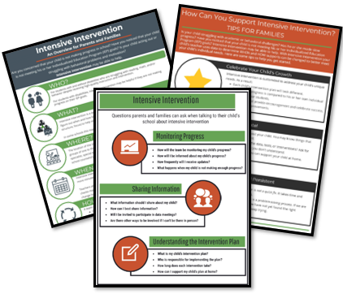
The End Result

Slide 26
…And Beyond!

Slide 27
Discussion Prompt
How can you improve your engagement story?

Slide 28
Closing Slide
Thank you!

Slide 29
NCII Disclaimer
This presentation was produced under the U.S. Department of Education, Office of Special Education Programs, Award No. H326Q160001. Celia Rosenquist serves as the project officer. The views expressed herein do not necessarily represent the positions or policies of the U.S. Department of Education. No official endorsement by the U.S. Department of Education of any product, commodity, service, or enterprise mentioned in this webinar is intended or should be inferred

Slide 30
OSEP Disclaimer
2019 OSEP Leadership Conference
DISCLAIMER:
The contents of this presentation were developed by the presenters for the 2019 OSEP Leadership Conference. However, these contents do not necessarily represent the policy of the Department of Education, and you should not assume endorsement by the Federal Government.
(Authority: 20 U.S.C. 1221e-3 and 3474)

