Slide 1
Systemic Transformation: Social Media & Technology Implementation
Presenters:
Debi Tucker- CEO, Parent to Parent of Georgia
Joe La Belle- Director of Programs Impact, FND
Eliana Tardio- Director of Digital Communications, FND

Slide 2
2019 OSEP Leadership Conference
DISCLAIMER:
The contents of this presentation were developed by the presenters for the 2019 OSEP Leadership Conference. However, these contents do not necessarily represent the policy of the Department of Education, and you should not assume endorsement by the Federal Government.
(Authority: 20 U.S.C. 1221e-3 and 3474)

Slide 3
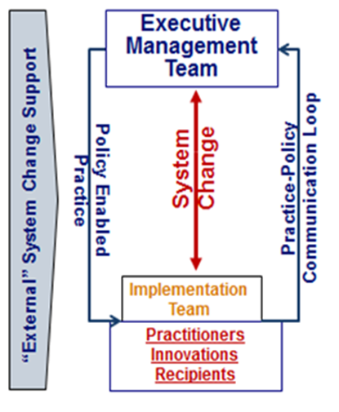
Where do we intersect?
Communication Loop
Two Critical Features in Successful Evidence-Based Program:
Practice to Policy Communication Loop (detect problems, identify leverage points) and the
Policy to Practice Supports (solve real problems in real time)
FNDUSA.ORG/OSEP2019
2019 OSEP LEADERSHIP CONFERENCE

Slide 4
FNDUSA.ORG/OSEP2019
Align Your Messaging and Data
Who is seeing this information and who are you missing? How are you cultivating the base whom you want to interact with your information?
What information do your programs currently send out? What expectation do you have for that information being used and/or understood?
2019 OSEP LEADERSHIP CONFERENCE

Slide 5
FNDUSA.ORG/OSEP2019
Let’s Talk!
10 Min Group Discussion
2019 OSEP LEADERSHIP CONFERENCE

Slide 6
––––
Partnering- A Way to Leverage Support and Resources
How can Parent Centers be part of Part B and Part C State Systems Communication Plans?
How do we strengthen the relationships between Part B and Part C State Programs with Parent Centers?
FNDUSA.ORG/OSEP2019
2019 OSEP LEADERSHIP CONFERENCE

Slide 7
FNDUSA.ORG/OSEP2019
Let’s Talk!
10 Min Group Discussion
2019 OSEP LEADERSHIP CONFERENCE

Slide 8
FNDUSA.ORG/OSEP2019
2019 OSEP LEADERSHIP CONFERENCE

Slide 9
Thank You. Now… Let’s Take a SELFIE!
FNDUSA.ORG/OSEP2019
2019 OSEP LEADERSHIP CONFERENCE

Slide 10
2019 OSEP Leadership Conference
DISCLAIMER:
The contents of this presentation were developed by the presenters for the 2019 OSEP Leadership Conference. However, these contents do not necessarily represent the policy of the Department of Education, and you should not assume endorsement by the Federal Government.
(Authority: 20 U.S.C. 1221e-3 and 3474)

