Slide 1
Mentoring and Induction for Educators/Personnel Supporting Students with Disabilities
OSEP Leadership Conference
Washington, DC
Lynn Holdheide, Director Meg Kamman, Co-Director Karen Wyler, Induction Specialists
Center on Great Teachers and Leaders CEEDAR Center Georgia Office of Teaching and Learning
American Institutes for Research University of Florida Georgia Department of Education

Slide 2
OSEP Disclaimer
2019 OSEP Leadership Conference
DISCLAIMER:
The contents of this presentation were developed by the presenters for the 2019 OSEP Leadership Conference. However, these contents do not necessarily represent the policy of the Department of Education, and you should not assume endorsement by the Federal Government.
(Authority: 20 U.S.C. 1221e-3 and 3474)

Slide 3
Objectives
Participants will:
Learn about evidence-based strategies, tools, and resources for strengthening mentoring and induction programs
Examine strategies to create collaborative partnerships between state education agencies, local education agencies, and educator preparation programs to strengthening mentoring and induction
Examine their role in strengthening mentoring and induction for teachers of students with disabilities.

Slide 4
Format
Engagement Activity
Center on Great Teachers and Leaders
Overview Mentoring and Induction for Educators of Students with Disabilities
Alignment Activity
CEEDAR Center
Special Educators Mentoring and Induction
Activity
Georgia Department of Education
Statewide Mentoring and Induction & High Leverage Practices
Facilitated Discussion

Slide 5
Discussion
Given your role, what do you perceive as the most critical element to ensure mentoring and induction programs are effective?

Slide 6
Mentoring and Induction Toolkit
The purpose of the GTL Center’s Mentoring and Induction Toolkit is to give state education agencies (SEAs) tools, resources, and support to facilitate meaningful conversations with local education agencies (LEAs) to design and implement effective, high-quality mentoring and induction programs.

Slide 7
Overview of the Toolkit
Module 1: Introduction to the GTL Mentoring and Induction Toolkit
Module 2: Mentor Recruitment, Selection, and Assignment
Module 3: Mentor Professional Learning, Development, and Assessment
Module 4: Beginning Teacher Professional Learning and Development
Module 5: The Role of the Principal in Mentoring and Induction
Module 6: Mentoring and Induction for Educators of Students with Disabilities
Module 7: Collecting Evidence of Induction Program Success

Slide 8
Module Components
Anchor Presentation: Summarizes research and best practices related to the topic.
Handouts: Provide information to supplement the anchor presentation.
Team Tools: Help teams plan, design, and implement the components of a comprehensive mentoring and induction program.
Anchor presentations, handouts, and team tools are available on the GTL Center website.
SEA personnel may request consultation from GTL experts to learn more about customizing the toolkit materials.

Slide 9
Module 6 Objectives
Strengthen collaboration and shared investment between SEAs, LEAs, and educator preparation programs (EPPs) in M&I programs that span across preservice and inservice.
Establish consistency in expectations of instructional practice that offer all students equitable access to the general education curriculum.
Promote evidence-based/high-leverage instructional practices and provide teacher candidates and novice teachers with practice-based opportunities to advance their practice.

Slide 10
The Context
Increasingly diverse classrooms—with a diverse set of backgrounds and learning needs.
Achievement gap persists between students with disabilities and their same-age peers; gap has existed for decades with little improvement (Vaughn & Wanzek, 2014).
Teacher shortages are prevalent; supply has dwindled over the years, and alternative certification routes have become more popular as a result (Papay et al., 2018).

Slide 11
Educator Perspective
Special educators
2.5 times more likely than general education teachers to leave teaching (Smith & Ingersoll, 2004).
Cite a lack of shared ownership of students with disabilities (SWDs) and role ambiguity as reasons for leaving the profession (Holdheide & DeMonte, 2016).
General educators
play a primary role in the education of SWDs, but often report feeling unprepared to take this role (Cameron & Cook, 2007).
On average, are offered only 1.5 courses that address SWDs, and only 23 states require general education teacher candidates to have clinical experiences involving SWDs (Goldrick, Sindelar, Zabala, & Hirsh, 2001).

Slide 12
How Do We Support Beginning Teachers to Become Effective Instructors?

Slide 13
The Opportunity
Mentoring and induction can be used to:
Facilitate partnerships among SEAs, LEAs, and EPPs
Establish consistent expectations of instructional practice from preservice to inservice
Provide multiple, practice-based opportunities to move teachers from novices to experts
Help low-performing schools exit targeted status

Slide 14
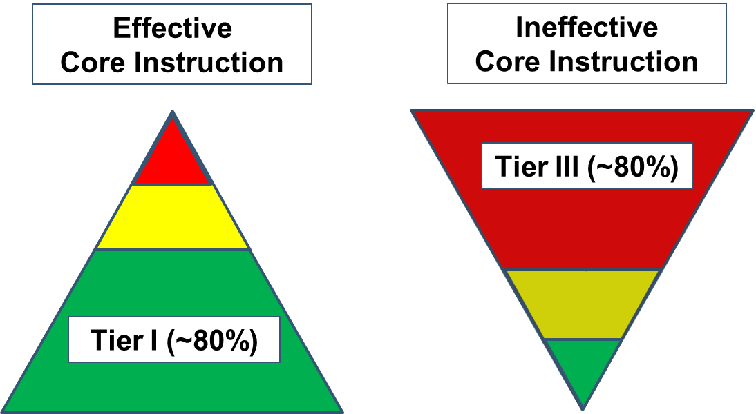
Equitable Access to Effective Instruction

Slide 15
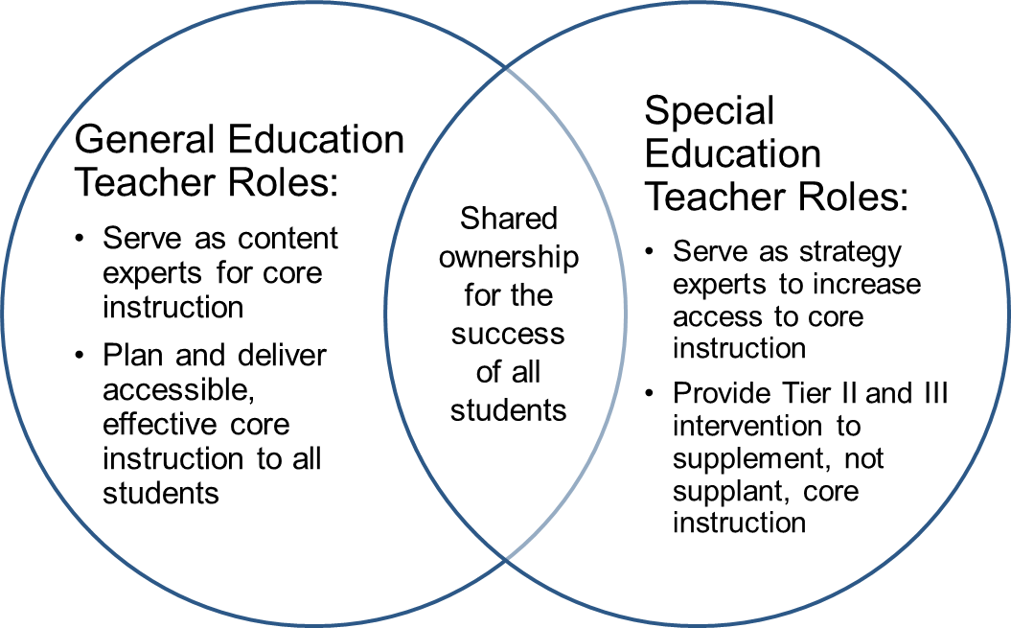
Effective Core Instruction Requires Shared Ownership

Slide 16
Mentoring & Induction is a Game-Changer
No preparation program can prepare a beginning teacher with all the skills necessary to be an expert on day 1.
A purposefully designed M&I program can bridge the preservice-to-inservice transition by reinforcing instructional practices that strengthen core instruction for all students.
High-quality core instruction means less likelihood of an “inverted triangle” that causes additional stress on school resources and teachers’ time.

Slide 17
Content of Mentoring and Induction

Slide 18
What Are High-Leverage Practices (HLPs)?
“A set of practices that are fundamental to support K–12 student learning, and that can be taught, learned, and implemented by those entering the profession.”
(Windschitl, Thompson, Braaten, & Stroupe, 2012, p. 880)

Slide 19
Features of HLPs
Focus directly on instructional practice
Occur with high frequency in teaching
Research based and known to foster student engagement and learning
Broadly applicable and usable in any content area or approach to teaching
Fundamental to effective teaching when skillfully executed
Source: Council for Exceptional Children and CEEDAR (2017)

Slide 20
HLP Frameworks
HLPs in Special Education
(examples)
Explicit instruction
Systematic instruction
Flexible grouping
Active student engagement
Positive and constructive feedback
Organized and respectful learning environments
Teaching Works HLPs
(examples)
Explaining and modeling content and practices
Coordinating and adjusting a lesson during instruction
Specifying and reinforcing productive student behavior
Building respectful relationships with students

Slide 21
Why Should We Focus on HLPs?
HLPs provide a set of consistent, clearly-defined expectations for the things all novice teachers should know and be able to do.
HLPs are the basis for the content of clinical experiences.
This can help create a seamless system of support for teachers throughout their career.

Slide 22
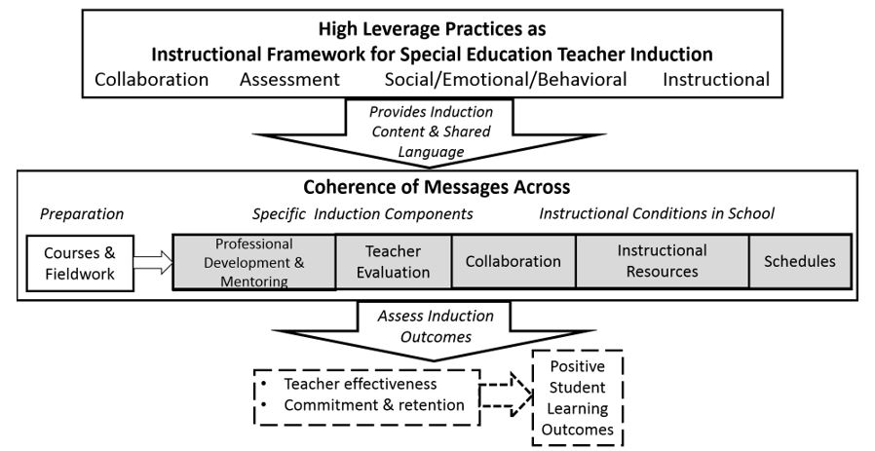
A Common Language for Core Instruction
Source: Billingsley, Bettini, & Jones (in press).

Slide 23
Discussion
How is the content of mentoring and induction defined in your context?
Are expectations for instructional practice consistent and clearly-defined in a way that is accessible to a beginning practitioner?

Slide 24
Structure of Mentoring and Induction

Slide 25
Practice-Based Opportunities
Experiences embedded within preparation that afford candidates opportunities to integrate both content and pedagogy acquired through coursework into instruction.
Focus: Emphasize critical content and pedagogy
Duration: Extend learning to develop mastery
Coherence: Reinforce common expectations of instructional practice
Source: Benedict et al. (2016)

Slide 26
Learning to Teach Resources
BRIEF: Learning to Teach: Practice-Based Preparation in Teacher Education
RUBRIC: Framework for Crafting High-Quality, Practice-Based Preparation (Word version)
PRACTICAL EXAMPLES:
Bug-in-ear coaching
Coursework-aligned, field-based practice opportunities
Structured tutoring
Virtual simulation
Lesson study
Laboratory experiences
Video analysis

Slide 27
Partnerships for Mentored Clinical Practice

Slide 28
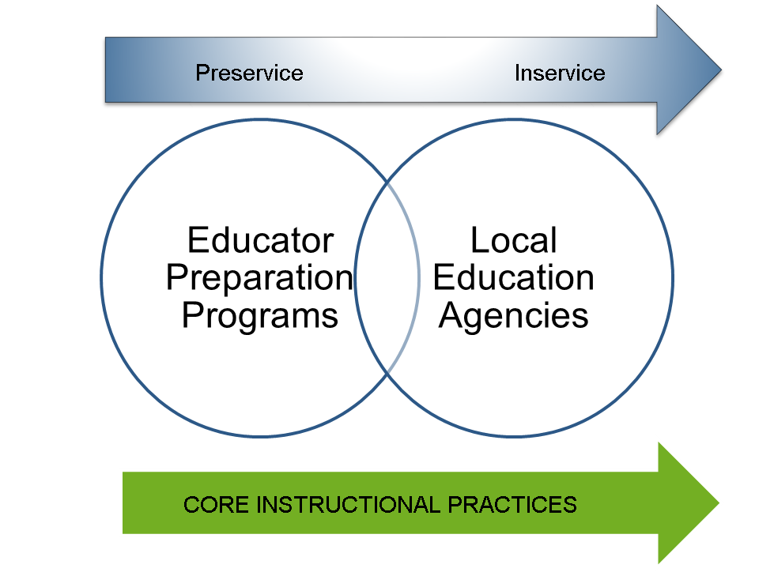
Partnerships Are Key

Slide 29
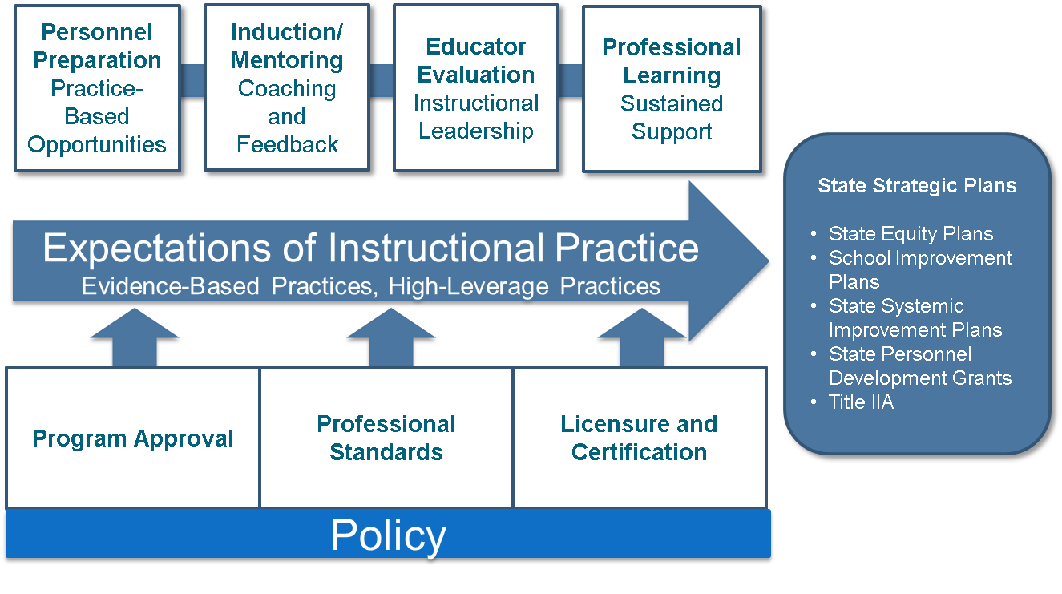
Consistency in Instructional Expectations

Slide 30
Mentoring and Induction for Beginning Special Education Teachers

Slide 31
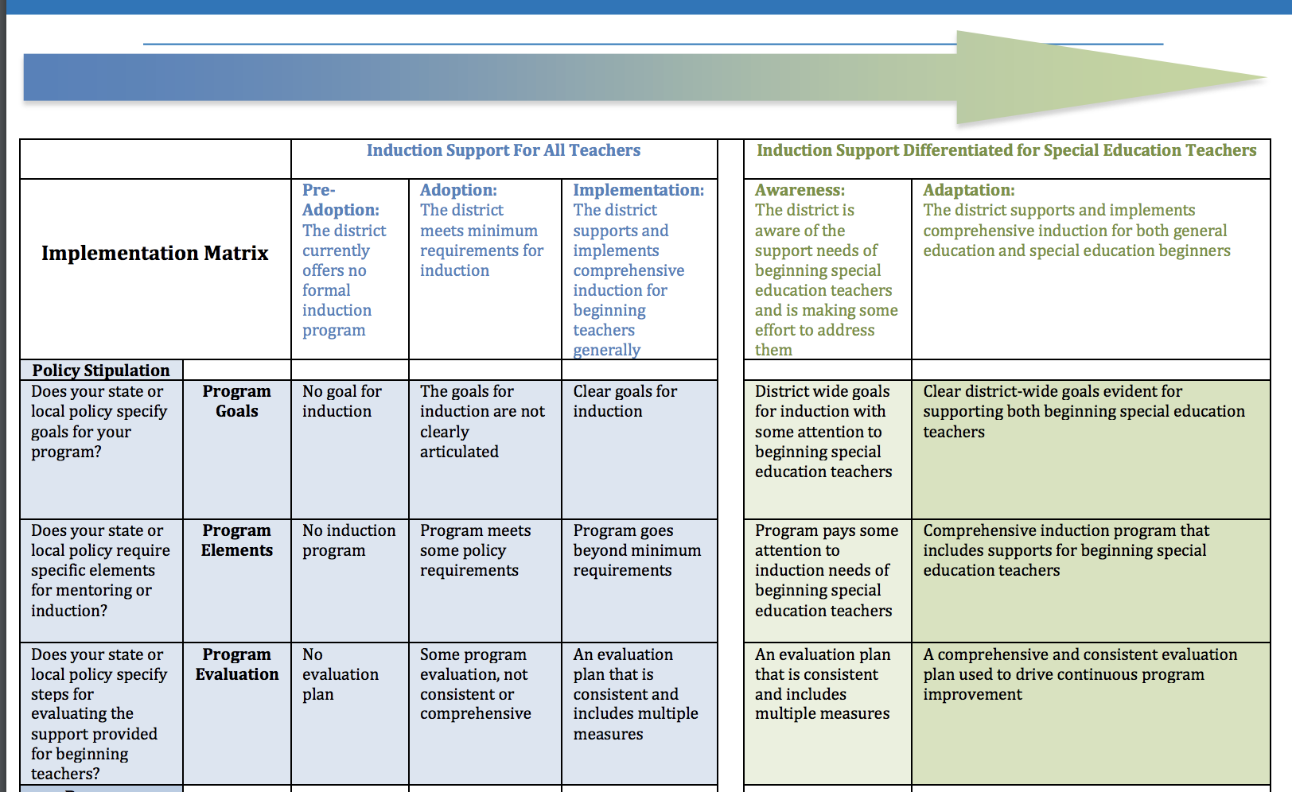
District Needs Assessment

Slide 32
Slide 32

Slide 33
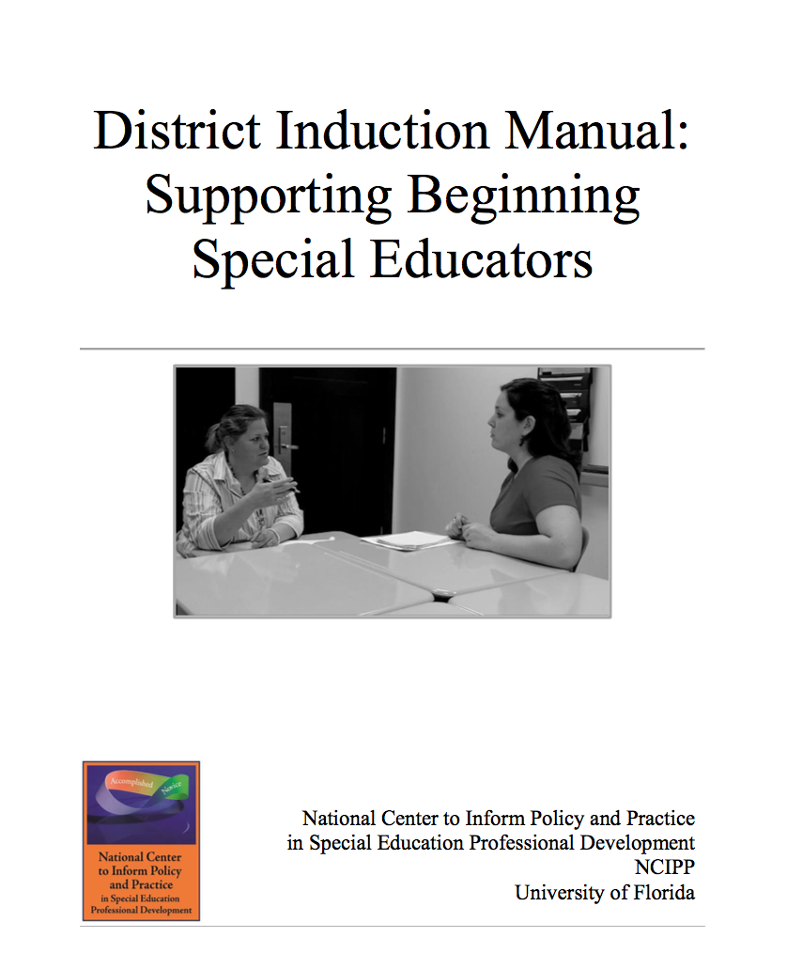
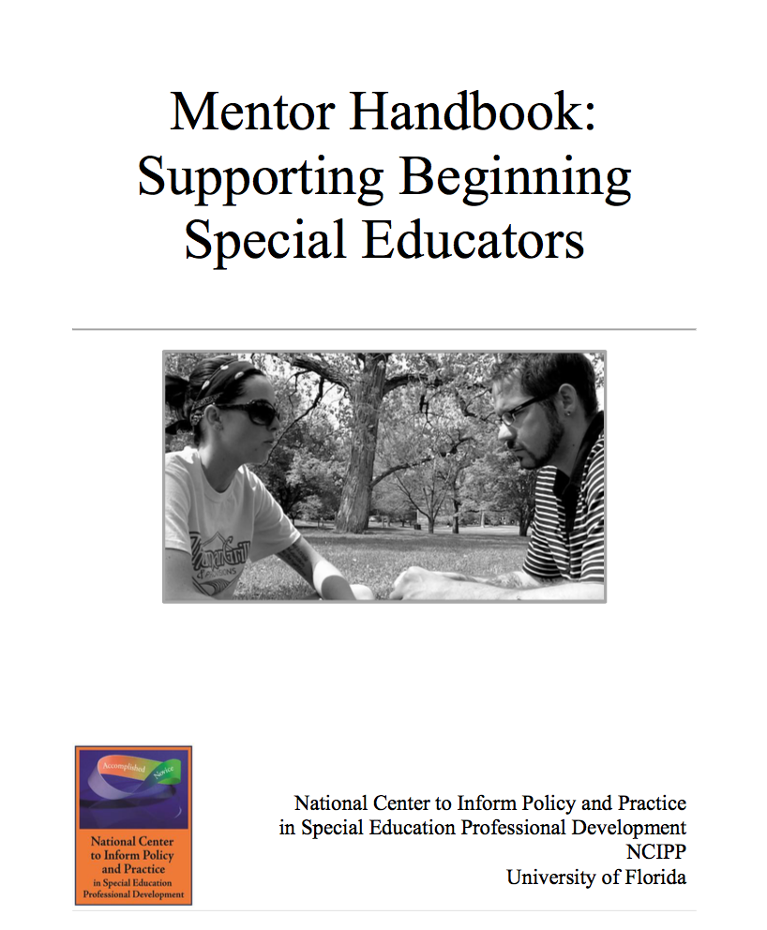
Slide 33

Slide 34
Support from the Start: P20 Partnerships Collaborating to Provide Effective Induction Support
Dr. Karen Wyler, TLSD

Slide 35
High Quality Induction Programs
Comprehensive - There is a structure to the
program, consisting of many components that
involves many people.
Coherent - The various components, activities,
and people are logically connected to each
other.
Sustained - The comprehensive and coherent
program continues for many years.

Slide 36
Georgia’s Educational Landscape
Teacher Keys and Leader Keys Effectiveness System
Tiered Certification
Induction is non-renewable*
Professional Learning Rule Change
PSC Program Providers – Rule 505.03-01
PPEM (Program Provider Effectiveness Measure)
Regional P-20 Collaboratives

Slide 37
GaDOE Induction Guidance
Purpose:
to provide Georgia districts and schools guidance for the creation, implementation, and sustainability of a quality induction program.
A program that supports retention and the induction phase educator’s growth, thereby increasing learning for all.

Slide 38
Guidance Domains
Roles and Responsibilities
Leadership and Organizational Structures
On-going Performance Assessment
Orientation
Mentoring
Professional Learning*
Program Evaluation
*Teacher Induction Guidance
**PL is embedded in all Leader Induction Domains

Slide 39
Slide 39
It’s about having the right people at the table…
“The development of the induction phase educator must be strengthened by the roles and responsibilities of the Georgia Department of Education, higher education, RESAs, district level personnel, administrators, mentors, and the induction phase teacher or leader.”
GaDOE Induction Guidance

Slide 40
Discussion
Does state or local policy specify or require collaboration among districts and educator preparation programs?
If you have a mentoring and induction program, does state or local policy define a set of instructional practices for beginning teachers?
How are you embedding and integrating high leverage practices into preservice coursework and in-service professional learning?
Are cooperating teachers or mentor teachers trained to observe and provide feedback on HLPs?

Slide 41
References
Benedict, A., Holdheide, L., Brownell, M., & Foley, A. M. (2016). Learning to teach: Practice-based preparation in teacher education. Washington, DC: Center on Great Teachers and Leaders. Retrieved from https://files.eric.ed.gov/fulltext/ED570144.pdf
Billingsley, B., Bettini, E., & Jones, N. (In press). Supporting special education teacher induction through high leverage practices. Remedial and Special Education.
Cameron, D. L., & Cook, B. G. (2007). Attitudes of preservice teachers enrolled in an infusion preparation program regarding planning and accommodations for included students with mental retardation. Education and Training in Developmental Disabilities, 42(3), 353.
Council for Exceptional Children and CEEDAR. (2017). High-leverage practices in special education (HLPs). Arlington, VA: Council for Exceptional Children & CEEDAR Center. Retrieved from http://ceedar.education.ufl.edu/wp-content/uploads/2017/11/HLP-flyer-list.pdf

Slide 42
References
Goldrick, L., Sindelar, P., Zabala, D., & Hirsch, E. (2014). The role of state policy in preparing educators to meet the learning needs of students with disabilities (Document No. PA-1). Retrieved from http://ceedar.education.ufl.edu/wp-content/uploads/2014/10/PA-1_FINAL_10-21-14.pdf
Holdheide, L., & Demonte, J. (2016). Critical shortages in special education teachers: Sound familiar? Washington, DC: American Institutes for Research. Retrieved from https://www.air.org/resource/critical-shortages-special-education-teachers-sound-familiar
Papay, J., Bacher-Hicks, A., Page, L., & Marinell, W. (2018, January 9). America’s teacher shortage can’t be solved by hiring more unqualified teachers. Washington Post. Retrieved from https://www.washingtonpost.com/news/posteverything/wp/2018/01/09/americas-teacher-shortage-cant-be-solved-by-hiring-more-unqualified-teachers/?noredirect=on&utm_term=.5e5ce9364afa

Slide 43
References
Smith, T. M., & Ingersoll, R. M. (2004). What are the effects of induction and mentoring on beginning teacher turnover? American Educational Research Journal, 41(3), 681-714.
Vaughn, S., & Wanzek, J. 2014. Intensive interventions in reading for students with reading disabilities: Meaningful impacts. Learning Disabilities Research and Practice, 29(2).
Windschitl, M., Thompson, J., Braaten, M., & Stroupe, D. (2012). Proposing a core set of instructional practices and tools for teachers of science. Science Education, 96(5), 878-903. doi:10.1002/sce.21027

Slide 44
OSEP Disclaimer
2019 OSEP Leadership Conference
DISCLAIMER:
The contents of this presentation were developed by the presenters for the 2019 OSEP Leadership Conference. However, these contents do not necessarily represent the policy of the Department of Education, and you should not assume endorsement by the Federal Government.
(Authority: 20 U.S.C. 1221e-3 and 3474)

