Slide 1



State District Partnerships:
Sustaining Implementation Capacity
Carolyn Cherry, Minnesota Department of Education
Rochelle Cox, Minneapolis Public Schools
Caryn Ward, SISEP Center

Slide 2
State Systemic Improvement Plan—Minnesota’s Approach
Examine the various ways in which linked implementation teams, informed by data, evolve and support the capacity of SEA, Regions, Districts and schools to manage implementation and move towards results.

Slide 3
Formula for Success: Implementing Check & Connect
Usable Innovations
(Check & Connect)
Effective Implementation methods
(Stages and Drivers)
Enabling Contexts
(Linking Teams & Improvement Cycles)
Educationally Significant Outcomes
(Improved graduation rates for MN American Indian and Black students with disabilities)

Slide 4
ACTIVE IMPLEMENTATION: Check & Connect
Letting it happen
  Recipients are accountable
Helping it happen
  Recipients are accountable
Making it happen
  Active support implementation and sustainability of practice
  Implementation Teams are accountable
  Based on Hall & Hord (1987); Greenhalgh, Robert, MacFarlane, Bate, & Kyriakidou (2004); Fixsen, Blase, Duda, Naoom, & Van Dyke (2010)

Slide 5
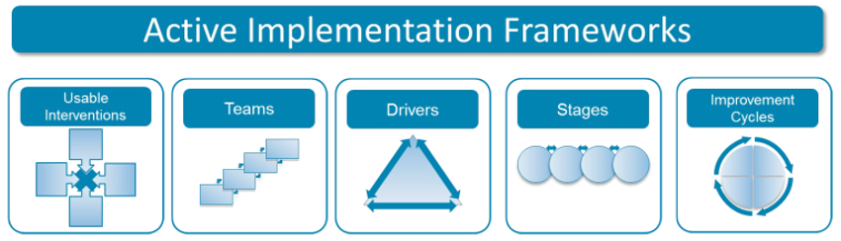

ACTIVE = use DATA to guide effective implementation
GOAL: Provide updates about MN Check & Connect implementation work
Illustrating AI Frameworks in practice, and
Emphasizing data use continually guiding our SSIP partnerships

Slide 6





SSIP Partner Districts
State Identified Measureable Result (SIMR)
6-year Graduation Rates for American Indian and Black students with disabilities.
Duluth
Osseo
Saint Paul
Minneapolis

Slide 7
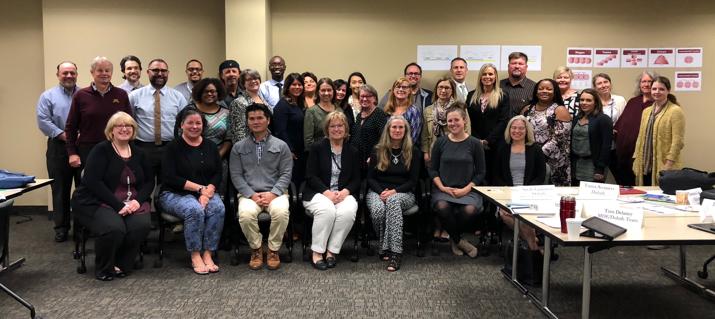
All District Gathering—September 2018

Slide 8
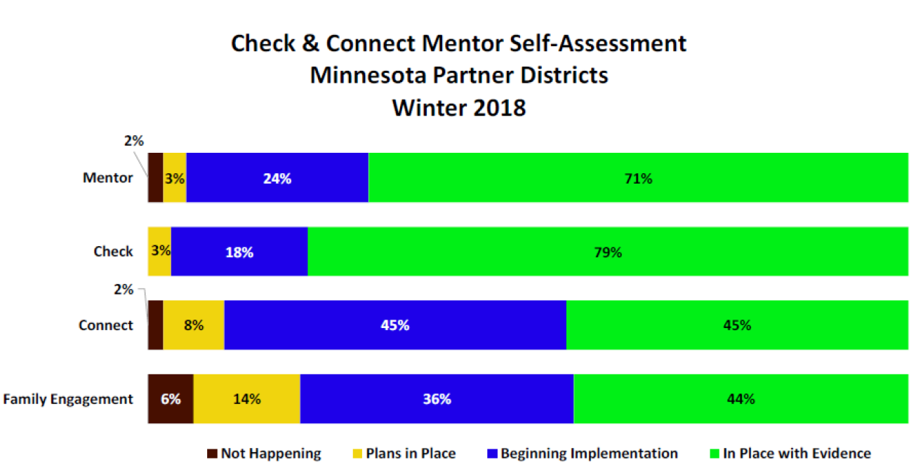
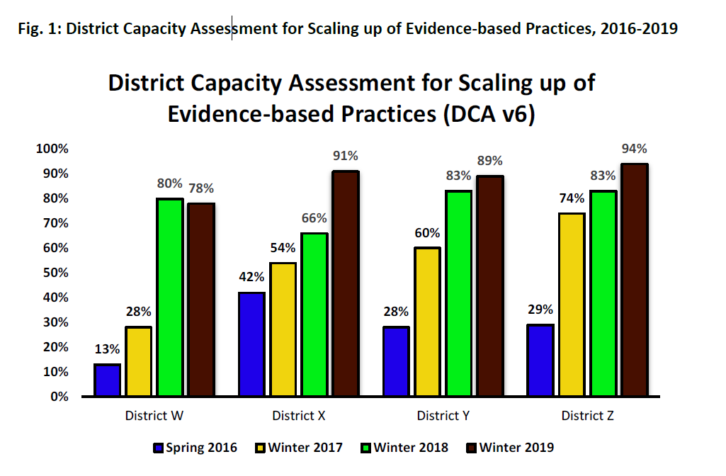
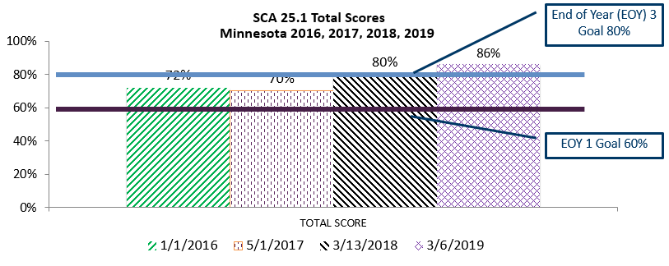
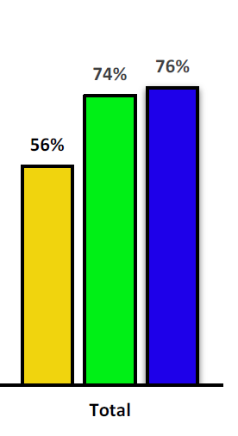
Linked Implementation Teams with Data
School-based
Implementation Teams
Teams are accountable for the work, not individuals.
District Implementation Teams
MDE ‘Regional’
Implementation Teams
Teams use implementation data to make decisions to support the use of the innovation.
State Core Management
Implementation Team
Notes:
8

Slide 9
What Types of Teams?
MDE Core Management Team: Supervisors/leads from each of the 4 district teams, Director
MDE District Teams: 4 Teams, ~4 MDE members each with background/skills in implementation science, data, evidence-based practice facilitation, and supervisor role.
MDE Transformation Zone Team: MDE members of the 4 district teams (~16 MDE staff)
MDE Implementation Workgroup: Implementation specialists from each of the MDE Teams (4 staff)
MDE Data Workgroup: Data-knowledgeable staff, at least one from each of the 4 teams (~6-8 staff)
MDE Facilitation Workgroup: Facilitation knowledgeable/interested staff, at least one from each of the 4 MDE teams
District Implementation Team: District teams with project facilitator, district leadership, EBP expert, along with MDE District Team
Building Implementation Team: School level team responsible for EBP implementation

Slide 10
What types of Data?
Effort data: document actions occurring such as time spent on a specific endeavor, number of training sessions attended, etc.
  How often? How much?
Fidelity data: measure the extent to which adults are using the critical features of a practice as they were designed. Independent checks for fidelity are more valid and reliable than self-report
  How well?
Outcome data: measures the extent to which the activities, initiatives, and improvement efforts are leading to a desired end
  What changed?

Slide 11


Entering into a Partnership with MDE
Health of the District and Department
Mutual Goal
Sustainability
Alignment with District Priorities
School Buy-in

Slide 12

Minneapolis Public Schools-Demographics
36,531 Students
17.3% Special Education
73 schools and programs
65.3% Students of color
Overall Graduation Rate of 66%
State Test Scores
  Math 42% Proficient
  Reading 45% Proficient
District Priorities:
Social Emotional Learning
Equity
Literacy
Multi-tiered Systems of Support

Slide 13

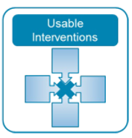
Strategy Selection: District Perspective
Check & Connect history in MPS
Understanding the Data
Navigating Relationships
Cross Departmental Work

Slide 14

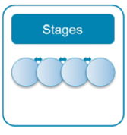
District Comprehensive Assessment Process
Year 1 to Year 3 Experiences
Information Sharing
Implementation Science in a World of Urgency
Fiscal Resource Sharing Improves Cross Departmental Work

Slide 15

SSIP Check & Connect in MPS
Two mentors
Four high schools
~50 American Indian and Black students with disabilities
Project Coordinator
Collaboration departments of
  College & Career Readiness
  Indian Education
  Office of Black Male Student Achievement (OBMSA)

Slide 16
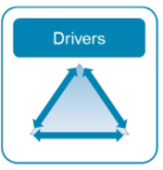
Check & Connect/Cultural Competency Training & Coaching
Training and Coaching and provided by:
College & Career Readiness
  Check & Connect Training & Coaching
Special Education Project Coordinator/Data Administrator
  Mentor coaching/training in special education basics, problem solving process, data collection/analysis, and intervention selection
Indian Education
  Counselors
  Student programming & services
OBMSA
  B.L.A.C.K. classes

Slide 17
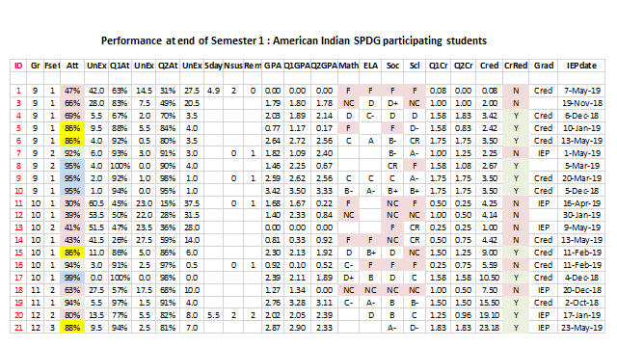
Reviewing Student Progress and Data-Based Decision-Making

Slide 18
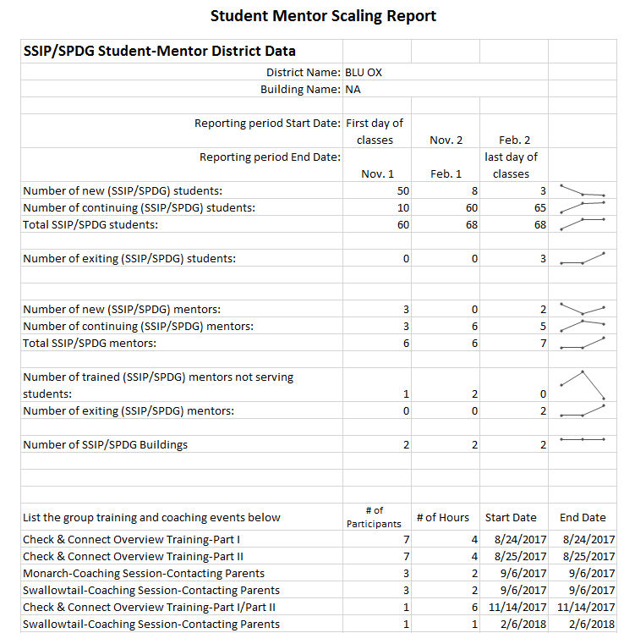
MDE in partnership with District Teams—
Student/Mentor Scaling Form
District level ‘dashboard’ to continually measure progress AND implementation data
  Number of students receiving C&C
  Number of mentors
  List Group Training & Coaching Events

Slide 19
SSIP Student/Mentor Scaling Form
District Data Summary 2018-2019
Reporting period End Date | Nov. 1 | Feb. 1
Number of new (SSIP/SPDG) students: | 122 | 30
Number of continuing (SSIP/SPDG) students: | 98 | 199
Number of re-entering (SSIP/SPDG) students: | 2 | 1
Total students: | 220 | 229
Number of exiting (SSIP/SPDG) students: | 179 | 131
Number of newly trained staff serving SSIP/SPDG students: | 20 | 7
Number of newly trained staff not serving SSIP/SPDG students: | 1 | 14
Number of continuing staff serving SSIP/SPDG students: | 57 | 21
Number of continuing trained staff not serving SSIP/SPDG students: | 18 | 21
Total trained staff: | 94 | 118
Number of exiting (SSIP/SPDG) mentors: | 6 | 0
Total schools: | 17 | 17

Slide 20
Results 2018-19 –Self Assessment

Slide 21
Results 2018-19—Fidelity Survey
  Across the four partner districts, 14% of mentors achieved 80% fidelity or above
  One district reported 21% of mentors at 80% fidelity
  Other three districts less than 10% of mentors were at 80% fidelity
  Overall mentors typically performed better in adhering to (monthly reporting) documenting student data, level of risk/case notes, and providing students’ feedback and struggled more with discussing staying in school and connecting with families

Slide 22
Results 2018-19—Practice Profile
    Statewide, 35% of mentors rated themselves proficient on 8 of 10 items
    Districts with mentors in place for more than one year showed rated themselves with higher levels of proficiency
    Districts with mentors new this year reported lower levels of proficiency
    Areas for growth include systematic monitoring, personalized data-based interventions, and connect/partner with families.

Slide 23
Results 2017-18—Student Engagement: Affective Domain

Slide 24
Results 2017-18—Student Engagement: Cognitive Domain

Slide 25
Results 2018-19—Student Focus Groups
Many students gave high praise for C&C and reported it is helping them (with school).
Students reported various ways their families are contacted or engage with their school.
When asked why American Indian and black students with disabilities don’t graduate at the same rate as others, students shared that there are times staff may not know how to help students who are ‘different’ and sometimes it just takes longer for students on IEPs to succeed.
Students indicated that districts need to hire the ‘right people’ who are passionate about their job, care about students, and are able to connect and understand from where a student is coming.

Slide 26
MPS Progress on Graduation Rates

Slide 27
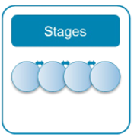
Measuring District Capacity to Implement:
Check and Connect

Slide 28
SSIP-DCA Highlights
All districts continue to increase capacity over prior years for implementing Check & Connect
Increases in Leadership and Competency Drivers
  Sustained administrative support for implementations
  Refining Check & Connect training and coaching across districts
Increases in Organizational Driver
  Decision Support Data Systems development and improvement

Slide 29
Successes and Opportunities for
Developing District Capacity...
Developing a Practical Balance between…
…“Doing” implementation work and “lifting up” implementation patterns with a common vocabulary across linked district and MDE teams (e.g., applied v. conceptual implementation focus)
…“Expectations and focus of work”-- supporting district teams to identify next right steps without over-stepping with unwanted or unneeded guidance AND grounding progress with data
Using an iterative process: Get started, Get better and MEASURE!

Slide 30
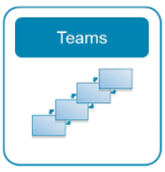
Measuring Regional Capacity to Support Implementation

Slide 31
SSIP-RCA Highlights
Slight decrease in RCA total score to support Check & Connect implementation; item interpretation and relevance continue to be challenges
Continuing evidence that the TZ Team has the capacity of to support multiple districts across implementation stages
Identified needs in the area of Leadership Drivers, particularly to develop more formal implementation plans and guidance for TZ team members across all districts

Slide 32
Successes for Developing State-Regional Capacity:
Linked Teams Accountability & Transparency
Developed Terms of Reference for Teams
  Core Management Team
  Transformation Zone Team
  Implementation Specialists Team
  Data Workgroup Team
RCA
  Data to inform MDE Management Team how to support ‘Transformation Zone’ Team to support districts to implement Check & Connect
  Prioritizing & action planning on Driver items…

Slide 33
Successes for Developing State-Regional Capacity:
Transforming Division Work
  Increasing Capacity for the use of Implementation Science
    Professional Development for Division staff beyond MIT members
    Coaching supports across teams
  Using Implementation Science in natural opportunities of our work
    Real world application to implement an evidence-based practice
    Cross-unit teams in partnership with selected districts
  Developing and using decision-making data systems to support the work

Slide 34
Opportunities for Developing State-Regional Capacity:
Using Data, Managing Roles
Get implementation data in front of teams ASAP and at regular intervals to make the next right step
  Right info at right level (closest to where decision can be made—avoid micromanagement)
  Right type of data at right time (e.g., by Implementation Stage, Improvement Cycles)
Coach teams through the shift—from viewing data generation an reporting as ‘grant compliance’ to teams valuing and expecting implementation data for progress feedback and team use through improvement cycles
When moving from Implementation to Scaling: Impact on teams
  Manage role clarity on team- multiple hats – researcher, practitioner, purveyor
  Anticipate shifting role of entire team

Slide 35
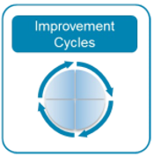
MDE in partnership with District Teams—
Student/Mentor Scaling Form
District level ‘dashboard’ to continually measure progress AND implementation data
  Number of students receiving C&C
  Number of mentors
  List Group Training & Coaching Events

Slide 36
SSIP Student/Mentor Scaling Form
District Data Summary 2018-2019
Reporting period End Date | Nov. 1 | Feb. 1
Number of new (SSIP/SPDG) students: | 122 | 30
Number of continuing (SSIP/SPDG) students: | 98 | 199
Number of re-entering (SSIP/SPDG) students: | 2 | 1
Total students: | 220 | 229
Number of exiting (SSIP/SPDG) students: | 179 | 131
Number of newly trained staff serving SSIP/SPDG students: | 20 | 7
Number of newly trained staff not serving SSIP/SPDG students: | 1 | 14
Number of continuing staff serving SSIP/SPDG students: | 57 | 21
Number of continuing trained staff not serving SSIP/SPDG students: | 18 | 21
Total trained staff: | 94 | 118
Number of exiting (SSIP/SPDG) mentors: | 6 | 0
Total schools: | 17 | 17

Slide 37
Stakeholder Involvement
Partner District Monthly Meetings
District Stakeholder Meetings
Partner District Evaluation Planning Meetings
Special Education Advisory Panel/Directors’ Forum
MDE Cross-division Meetings
Newsletters

Slide 38
Reasons to be excited about our progress…
Sustained district and MDE commitment to the partnership and work
Expending State Personnel Development Grant funds to support implementation work
Minnesota has exceeded our 2019 State Identified Measureable Result (SIMR) target for 6-year graduation rates for American Indian and Black students with disabilities of for the last two years (57%)
OSEP has been recognized Minnesota as a state leader in SSIP implementation

Slide 39

MPS Lessons Learned
Importance of Partnership -
Inside and Out
Rumbling is productive
Data tells a story - Be humble enough to listen
Persistence - a long road to changing systems

Slide 40
Getting to Results

Slide 41
Where we’re going….
Sustained fidelity of Check & Connect implementation…
Scaling to provide services to more students…
Deeper dive into student feedback about Check & Connect experiences…
Continuing to use effort, fidelity, and outcome data to inform team decision-making…
…to continue to improve graduation outcomes of American Indian and black students with disabilities.

Slide 42
AND…
As stage based implementation efforts continue…
  — Checking effort and fidelity of practices against outcome data guides next steps in strengthening the implementation effort
  — It is important to note that effort and fidelity data are only meaningful when connected to results-Outcomes

Slide 43
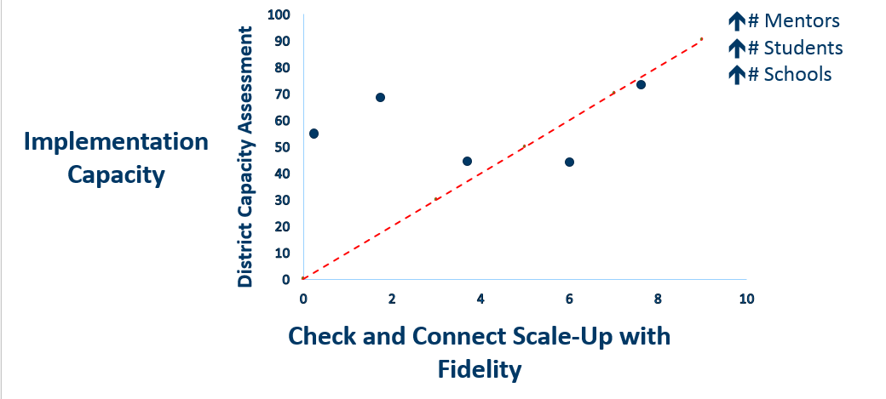
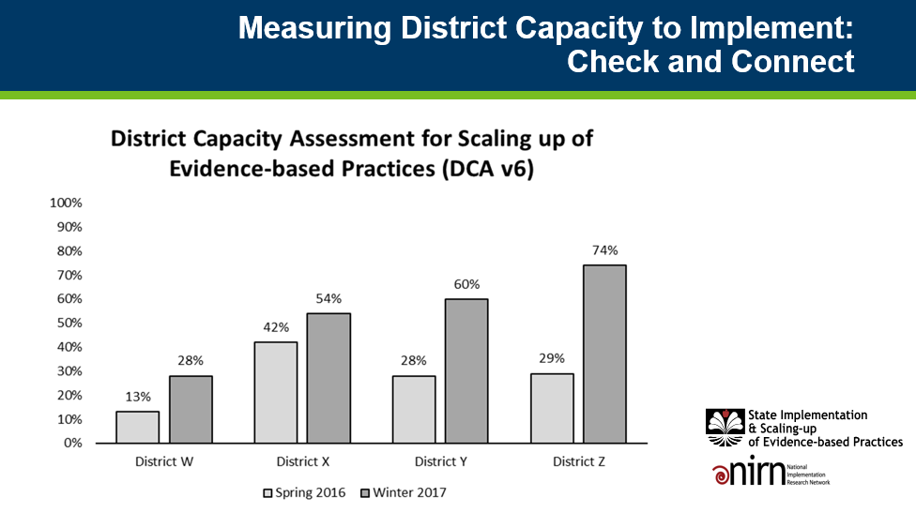
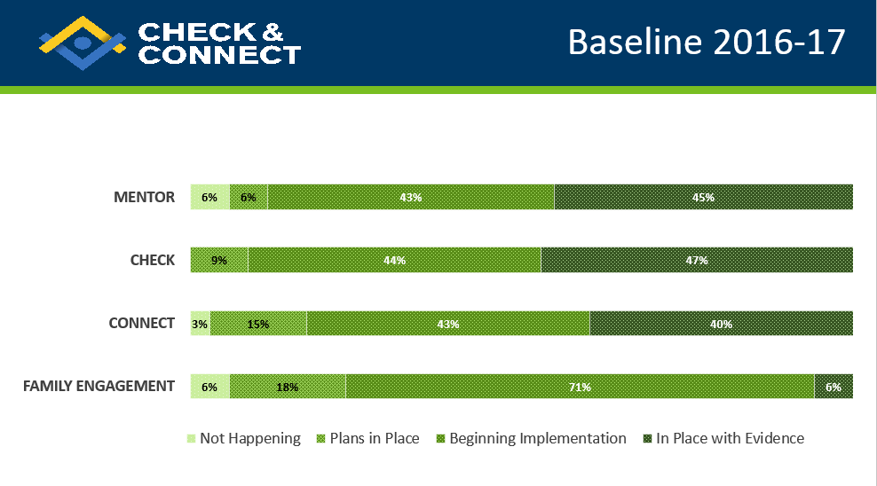
BIG PICTURE: Fidelity, Capacity and Scaling-up

Slide 44
Discussion Questions:
Areas for Collaboration and Support
  How have you used and sustained the Active Implementation Frameworks in your state systemic improvement work?
  What challenges and opportunities have you faced in building local capacity to sustain use of evidence-based practices?
  What challenges and opportunities have you faced in building internal SEA capacity to support the work of your SSIP?

Slide 45

OSEP Disclaimer
2019 OSEP Leadership Conference
DISCLAIMER:
The contents of this presentation were developed by the presenters for the 2019 OSEP Leadership Conference. However, these contents do not necessarily represent the policy of the Department of Education, and you should not assume endorsement by the Federal Government.
(Authority: 20 U.S.C. 1221e-3 and 3474)

