Slide 1
Identifying and Addressing Student Needs:
Meeting Local Needs with Evidence

Slide 2
OSEP Disclaimer
2019 OSEP Leadership Conference
DISCLAIMER:
The contents of this presentation were developed by the presenters for the 2019 OSEP Leadership Conference. However, these contents do not necessarily represent the policy of the Department of Education, and you should not assume endorsement by the Federal Government.
(Authority: 20 U.S.C. 1221e-3 and 3474)

Slide 3
Objectives
Review evidence definitions in use at ED
Consider how States can support schools to:
Identify student needs
Select interventions to address those needs
Engage in a continuous improvement cycle to refine interventions as necessary.
Discuss how ED’s resources relate to this work.
Learn about some immediate and longer term needs.

Slide 4
Agenda
Evidence at ED
ED resources to support teachers and schools
Policy and Program Studies Service (PPSS)
Institute of Education Sciences (IES)
Deep dive into a sample of U.S. Department of Education (ED) resources
Poll on State/district/school needs

Slide 5
Presenters U.S. Department of Education
Leticia Braga, PPSS
Research Analyst
Nikki Churchwell, PPSS
Program Specialist
Victoria Hammer, PPSS
Supervisory Research Analyst
Matthew Soldner, IES
Commissioner, National Center for Education Evaluation and Regional Assistance

Slide 6
Opportunities: Evidence in ESEA
Evidence-based interventions required in Titles I, II, IV, VI in both formula and discretionary grant programs (e.g., 1111(d)(1)(B)(ii), 1111(d)(2)(B)(ii))
ESEA § 8101(21)(A) defines “evidence-based” as having 4 levels
Strong evidence
Moderate evidence
Promising evidence
Evidence that demonstrates a rationale

Slide 7
Evidence in ESEA What is an “EVIDENCE-BASED” INTERVENTION?
“…the term ‘evidence-based,’ when used with respect to a State, local educational agency, or school activity, means an activity, strategy, or intervention that –
(i) demonstrates a statistically significant effect on improving student outcomes or other relevant outcomes based on –
(I) strong evidence from at least one well-designed and well-implemented experimental study;
(II) moderate evidence from at least one well-designed and well-implemented quasi experimental study; or
(III) promising evidence from at least one well-designed and well-implemented correlational study with statistical controls for selection bias; or
(ii) (I) demonstrates a rationale based on high-quality research findings or positive evaluation that such activity, strategy, or intervention is likely to improve student outcomes or other relevant outcomes; and
(II) includes ongoing efforts to examine the effects of such activity, strategy, or intervention.
Source: § 8101(21)(A) of the ESEA

Slide 8
EDGAR Evidence Standards

Slide 9
How does EDGAR define the evidence levels?
Strong evidence: evidence exists of the effectiveness of a key project component in improving a relevant outcome for a sample that overlaps with the populations and settings proposed to receive that component, based on a relevant finding from one of the following:
A practice guide prepared by the WWC using version 2.1 or 3.0 of the WWC Handbook reporting a “strong evidence base” for the corresponding practice guide recommendation;
An intervention report prepared by the WWC using version 2.1 or 3.0 of the WWC Handbook reporting a “positive effect” on a relevant outcome based on a “medium to large” extent of evidence, with no reporting of a “negative effect” or “potentially negative effect” on a relevant outcome; or
A single experimental study reviewed and reported by the WWC using version 2.1 or 3.0 of the WWC Handbook, or otherwise assessed by the Department using version 3.0 of the WWC Handbook, as appropriate, and that meets the four criteria in the EDGAR definition of strong evidence.
Moderate evidence: evidence of effectiveness of a key project component in improving a relevant outcome for a sample that overlaps with the populations or settings proposed to receive that component, based on a relevant finding from one of the following:
A practice guide prepared by the WWC using version 2.1 or 3.0 of the WWC Handbook reporting a “strong evidence base” or “moderate evidence base” for the corresponding practice guide recommendation;
An intervention report prepared by the WWC using version 2.1 or 3.0 of the WWC Handbook reporting a “positive effect” or “potentially positive effect” on a relevant outcome based on a “medium to large” extent of evidence, with no reporting of a “negative effect” or “potentially negative effect” on a relevant outcome; or
A single experimental study or quasi-experimental design study reviewed and reported by the WWC using version 2.1 or 3.0 of the WWC Handbook, or otherwise assessed by ED using version 3.0 of the WWC Handbook, as appropriate, and that meets the four criteria in the EDGAR definition of moderate evidence.

Slide 10
How does EDGAR define the evidence levels?
Promising evidence means that there is evidence of the effectiveness of a key project component in improving a relevant outcome, based on a relevant finding from one of the following:
a practice guide prepared by the WWC reporting a “strong evidence base” or “moderate evidence base” for the corresponding practice recommendation;
an intervention report prepared by the WWC reporting a “positive effect” or “potentially positive effect” on a relevant outcome with no reporting of a “negative effect” or “potentially negative effect” on a relevant outcome; or
a single study reviewed and reported by the WWC or assessed by ED, as appropriate, and that meets the two criteria for a single study in the EDGAR definition of promising evidence.
Demonstrates a rationale: a key project component included in the project’s logic model is informed by research or evaluation findings that suggest the project component is likely to improve relevant outcomes.

Slide 11
Evidence in ESEA Evidence Resources
Non-Regulatory Guidance: Using Evidence to Strengthen Education Investments (September, 2016)
Education Department General Administrative Regulations: Technical Revisions Fact Sheet (October, 2017)

Slide 12
Support and Resources From ED
Policy and Program Studies Service
Full reports and shorter, practitioner-focused briefs
https://www2.ed.gov/about/offices/list/opepd/ppss/index.html
Toolkits and data stories
https://tech.ed.gov/edtech-english-learner-toolkits/
Institute of Education Sciences
What Works Clearinghouse Regional Educational Laboratories

Slide 13
Support and Resources From ED
Office of Elementary and Secondary Education
Comprehensive Centers
State Support Network
Equity Assistance Centers
Office of Special Education Programs
Technical Assistance and Dissemination Centers
Model Demonstration Projects
Stepping-up Technology Implementation
Center to Improve Project and Program Performance

Slide 14
PPSS Support and Resources
PPSS staff work to understand program implementation and support data quality, transparency, and utility
PPSS collaborates with program offices across ED to learn about staff and grantee needs related to evidence and data
PPSS provides resources to support data and evidence-based decision making at the federal, state, and local levels

Slide 15
Identifying Students’ Needs: What Story Does the Data Tell?
WHY: Telling rich, accessible data narratives is challenging. This format allows us to turn raw data into actionable information.
WHAT: A webpage that leverages a reusable template to share integrative graphics and compelling data narratives that shine a light on pressing issues in education.
FOR WHOM: The data stories make our data accessible for data novices – those who don’t feel confident interpreting data on their own.

Slide 16
Identifying Students’ Needs: What Story Does the Data Tell?
THE RESULTS: We changed how we communicate about data, improving the ways in which we create and disseminate data visualizations. Our stories explore many topics:
A Leak in the STEM Pipeline: Taking Algebra Early
Chronic Absenteeism in the Nation’s Schools: A hidden educational crisis
Our Nation’s English Learners: What are their characteristics?

Slide 17
The What Works Clearinghouse
The What Works Clearinghouse

Slide 18
What is the Clearinghouse? “Consumer Reports” – and more – for educators
Reviews research to identify “what works” in education.
Intervention reports focus on specific curricula or programs.
Practice guides summarize evidence-based recommendations and offer suggestions on how to implement them.

Slide 19
What Topics Does the WWC Address? A Dozen Areas, and Growing!
whatworks.ed.gov

Slide 20
Intervention Reports

Slide 21
A Sample Intervention Report

Slide 22
A Sample Practice Guide One of 23 Currently Released

Slide 23
Regional Educational Laboratories
Regional Educational Laboratories

Slide 24
What are RELs? Helping You Put Research Into Action
A network of 10 providers that conduct applied research and training, with a mission of supporting a more evidence-based education system.
Offer dozens of events in each region every year, and across the network have hundreds of evidence-based resources that you can use.
Alongside their partners in Comprehensive Centers, can support technical assistance on using those resources in States and districts.

Slide 25
Where’s My REL?
https://ies.ed.gov/ncee/edlabs
(or just Google us!)

Slide 26
Webinars A Snapshot of What’s Happening Across the RELs

Slide 27
Reports, Videos, and Infographics
Locally-relevant research that may have broader applicability.

Slide 28
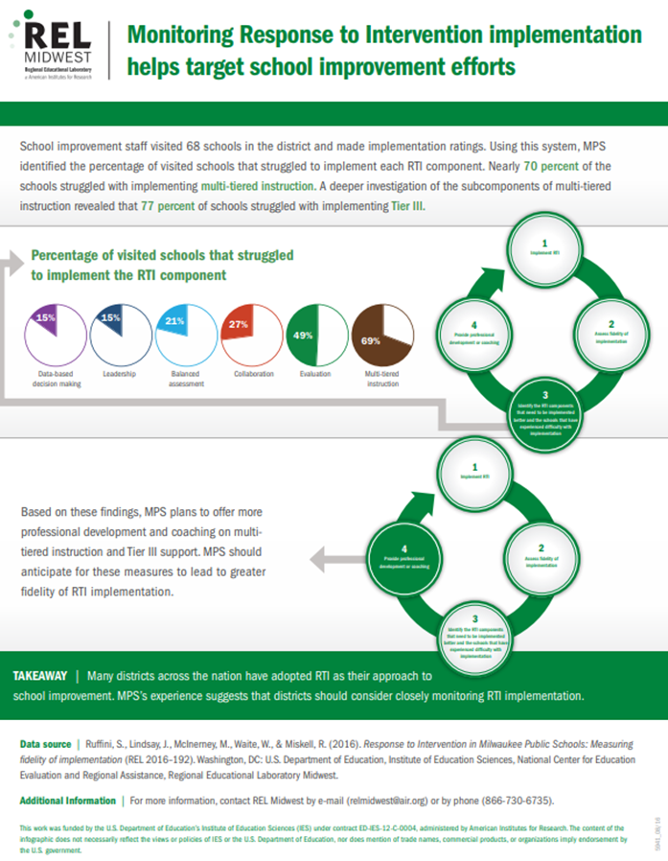
Reports, Videos, and Infographics

Slide 29
Questions?

Slide 30
Polling: Immediate and Longer-term Needs
Most pressing needs?
Longer-term needs?

Slide 31
OSEP Disclaimer
2019 OSEP Leadership Conference
DISCLAIMER:
The contents of this presentation were developed by the presenters for the 2019 OSEP Leadership Conference. However, these contents do not necessarily represent the policy of the Department of Education, and you should not assume endorsement by the Federal Government.
(Authority: 20 U.S.C. 1221e-3 and 3474)

