Slide 1
High Leverage Practices (HLPs) In Action
Resources & Examples for
Personnel Development
Meg Kamman, Erica McCray, Lynn Holdheide, Deb Ziegler

Slide 2
2019 OSEP Leadership Co2019 OSEP Leadership Conference
DISCLAIMER:
The contents of this presentation were developed by the presenters for the 2019 OSEP Leadership Conference. However, these contents do not necessarily represent the policy of the Department of Education, and you should not assume endorsement by the Federal Government.
(Authority: 20 U.S.C. 1221e-3 and 3474)

Slide 3
Session Objectives
Overview of HLPs
HLPs in action, across states
Currently available HLPs resources

Slide 4
Do you remember. . .
The first time you learned to drive, play an instrument, play a sport, or teach a strategy or curriculum?
What was your performance like?

Slide 5
When you were learning,
How many of you had a good teacher or coach who helped you learn?
What did that teacher or coach do to help you?

Slide 6
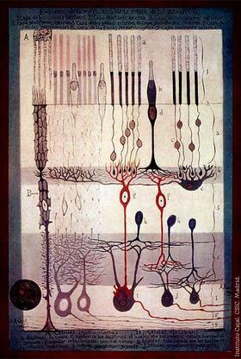
Why is practice important?
Allows for the development of fluent performance and situated knowledge

Slide 7
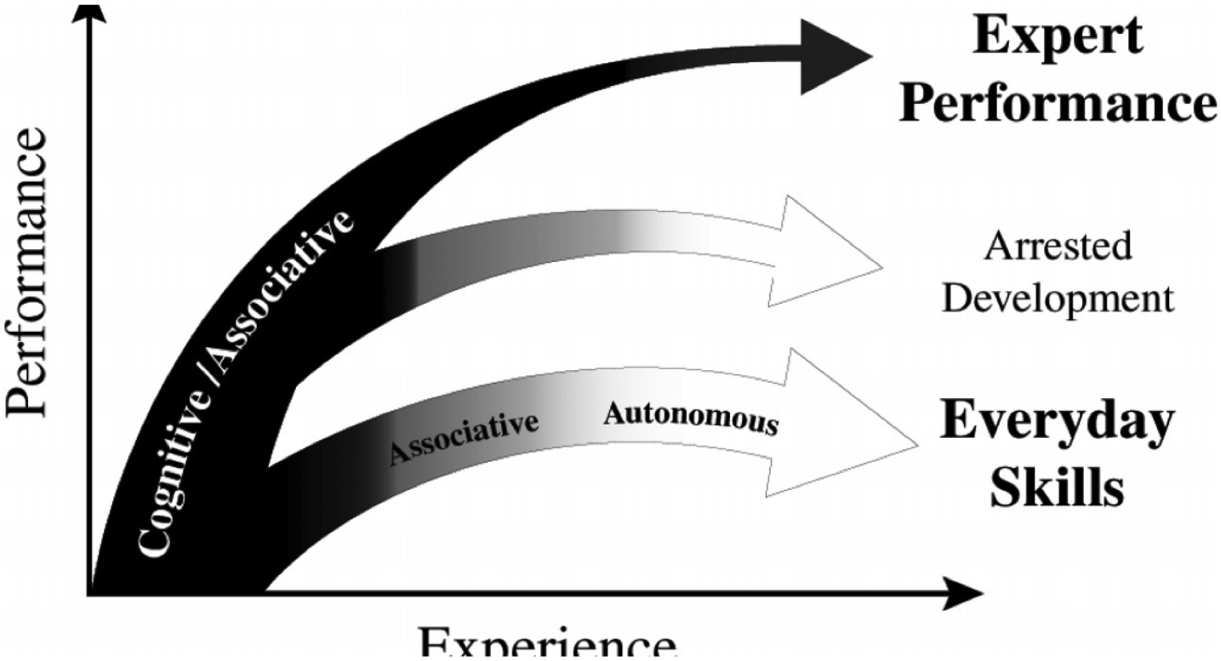
Contributes to Development of Expertise
Performance
Experience

Slide 8
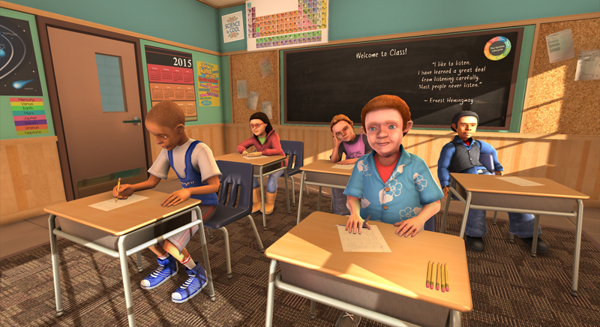
Deliberate Practice

Slide 9
What is Deliberate Practice?
Intense concentration on improving the most critical aspects of performance over time
Immediate feedback designed to improve analysis of performance

Slide 10
Deliberate Practice is:
Reasonable set of practices that:
are the essence of effective teaching, leading, etc.
can improve student outcomes
are fundamental to developing more complex practice

Slide 11
These practices should…
Cut across content areas
Apply to different types of learners
Apply to learners of different ages
AND, one should be able to break them down into smaller parts and teach them using deliberate practice

Slide 12
HLP Content
HLPs
Collaboration
(3)
Assessment
(4)
Social/Emotional/ Behavioral
(3)
Instruction
(12)
22 HLPs Across Four Domains

Slide 13
HLPs: Collaboration
Collaborate with professionals to increase student success.
Organize and facilitate effective meetings with professionals and families.
Collaborate with families to support student learning and secure needed services.

Slide 14
HLPs: Assessment
Use multiple sources of information to develop a comprehensive understanding of a student’s strengths and needs
Interpret and communicate assessment information with stakeholders to collaboratively design and implement educational programs.
Use student assessment data, analyze instructional practices, and make necessary adjustments that improve student outcomes.

Slide 15
HLPs: Social/Emotional/Behavioral
Establish a consistent, organized, and respectful learning environment.
Provide positive and constructive feedback to guide students’ learning and behavior.
Teach social behaviors.
Conduct functional behavioral assessments to develop individual student behavior support plans.

Slide 16
HLPs: Instruction
Identify and prioritize long- and short-term learning goals.
Systematically design instruction toward specific learning goals.
Adapt curriculum tasks and materials for specific learning goals.
Teach cognitive and metacognitive strategies to support learning and independence.

Slide 17
HLPs: Instruction (con’t)
Provide scaffolded supports.
Use explicit instruction.
Use flexible grouping.
Use strategies to promote active student engagement.
Use assistive and instructional technologies.

Slide 18
HLPs: Instruction
Provide intensive instruction
Teach students to maintain and generalize new learning across time and settings.
Provide positive and constructive feedback to guide students’ learning and behavior.

Slide 19
HLPs Creation: A Collaborative Process
Partnership between:
Collaboration for Effective Educator Development, Accountability and Reform (CEEDAR) Center
Council for Exceptional Children (CEC)
CEC’s Teacher Education Division (TED)

Slide 20
Why Use HLPs?
They become the core curriculum in teacher education, upon which cohesive deliberate practice opportunities can be built.

Slide 21
Does this mean we should forget about evidence based practice?
Not at All
Many HLPs are necessary for implementing evidence-based practices successfully (e.g., providing feedback).

Slide 22
Example
Using explicit instruction and feedback to teach summarization strategies or how to teach regrouping with base ten blocks

Slide 23
HLPs and EBPs: A Promising Pair
HLPs
Based on evidence and professional expertise
Used across different content and grade levels
Common core of professional knowledge and skill…taught to teacher candidates and practicing teachers across all types of programs and pathways
Provide infrastructure
EBPs
Instructional strategies backed by evidence and professional expertise
Often content focused
Appropriate for students at different developmental levels

Slide 24
HLP Stakeholders
Educator Preparation Providers (EPPs)
P-12 Teachers
Instructional/Academic Coaches and Teacher Leaders
School and District Leaders
State and National Policymakers

Slide 25
Educator Preparation Programs
Institutions of Higher Education (IHEs)
What is the process?
Prioritize
Collaborate
Implement
Collect evidence

Slide 26
P-12 Teachers
Opportunities for intensifying instruction
Versatile practices to implement across settings
Supports all phases of instruction

Slide 27
Instructional/Academic Coaches and Teacher Leaders
Framework for feedback
Ability to examine the strength and efficiency of the system
Impact on ALL learners in the system

Slide 28
School and District Leaders
Knowledge of HLPs in order to support implementation of these structures
Individualizing district, school, and classroom level decisions based on data

Slide 29
State and National Policymakers
Setting a common framework for supporting the learning needs of ALL students
Complying with requirements within ESSA and IDEA

Slide 30
How are we helping professionals learn to use the HLPs?

Slide 31
HLPs in Action: Tennessee
Purpose: Create Cohesive Opportunities to Practice HLPs
School district & university partner selected 6 HLPs
District provides professional development on HLPs to practicing teachers
University partner revises coursework to include HLPs

Slide 32
HLPs in Action: Georgia
Purpose: Align with initiatives across Stakeholders
Partnership with EPPs and SEA to provide professional development series within MTSS framework
Audience included EPP, SEA, LEA.

Slide 33
We Have Resources for You!
The Website
www.HighLeveragePractices.org

Slide 34
Books
Teaching Exceptional Children Special HLP Edition – “Putting HLPs into Practice” – March/April 2018
High Leverage Practices in Special Education
High Leverage Practices
for Inclusive Classrooms

Slide 35
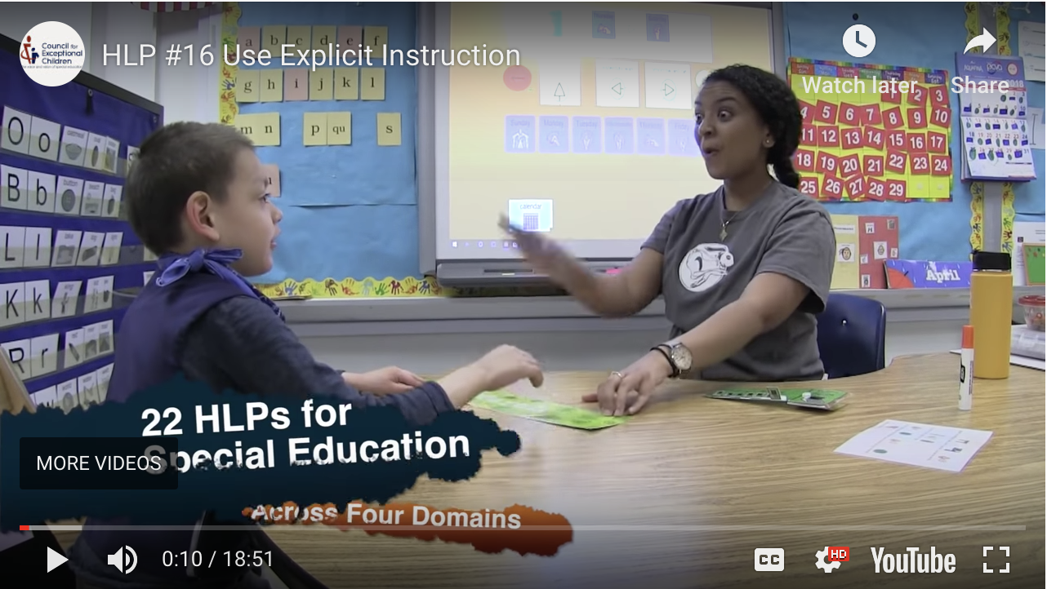
HLPs Resources: Videos
Video Library
Introduction Video
HLPs #8 and #22: Feedback
HLP #12: Systematically Design Instruction
HLP #16: Use Explicit Instruction
HLP #18: Student Engagement
HLP #7: Learning Environment
Let’s Take a Quick Look

Slide 36
HLPs Resources: Webinars
www.ceedar.org/archived-webinars/

Slide 37
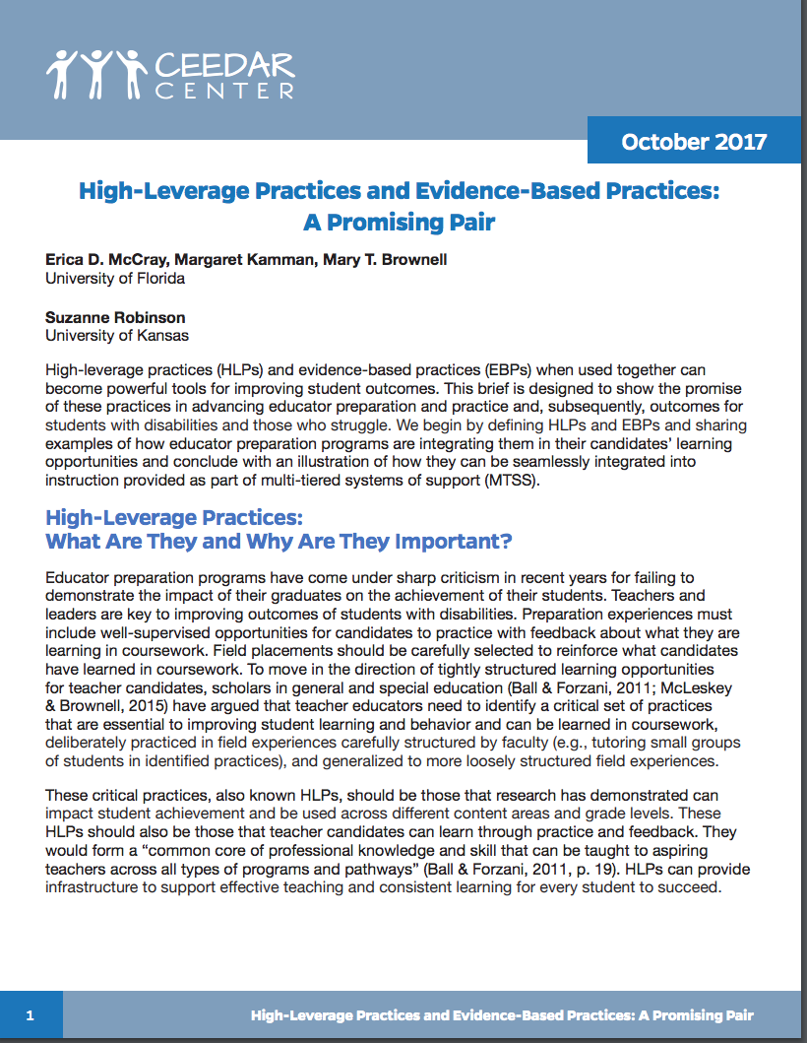
HLPs Resources: Brief
www.ceedar.org/reports/
“High-Leverage Practices and Evidence-Based Practices: A Promising Pair”

Slide 38
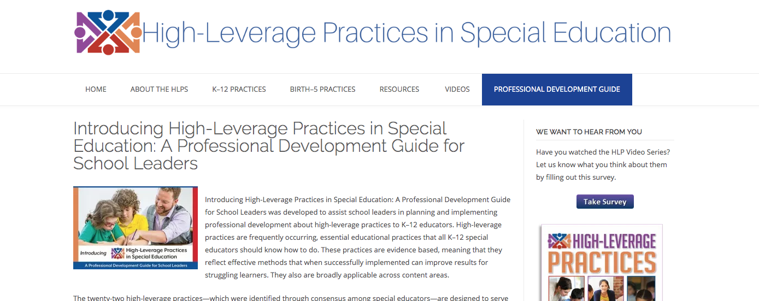
HLPs Resources: PD Guide
“HLPs in Special Education: A Professional Development Guide for School Leaders”

Slide 39
HLP Professional Development Guide for School Leaders
Developed for school leaders implementing K-12 professional development
Special Education Administrators, Principals, Mentors and Coaches
Web-Based Guide
Downloadable
Interactive, fillable forms
Free

Slide 40
Q&A

Slide 41
References
McLeskey, J., Barringer, M., Billingsley, B., Brownell, M., Jackson, D., Kennedy, M., Lewis, T., Maheady, L., Rodriguez, J., Scheeler, M., Winn, J., & Ziegler, D. (2017). High leverage practices in special education: The final report of the HLP Writing Team. Arlington, VA: CEC & CEEDAR Center.
McLeskey, J. & Brownell, M. (2015). High leverage practices and teacher preparation in special education (Document No. PR-1). Retrieved from http://ceedar.education.ufl.edu/wp-content/uploads/2016/05/High-Leverage-Practices-and-Teacher-Preparation-in-Special-Education.pdf

