Slide 1
Model Demonstration Projects to Improve Literacy Outcomes for English Learners with Disabilities in Grades 3-5

Slide 2
Overview of Model Demonstration Projects
Three model demonstration projects were funded by the Office of Special Education Programs, Department of Education in August 2016, to assess how the models can:
improve literacy outcomes for English Learners (ELs) and ELs with disabilities (ELSWDs) in grades three through six, within a multi-tiered system of support (MTSS) framework;
use culturally responsive principles; and
be implemented by educators and sustained in general and special education settings.

Slide 3
English Learner Institute for Teaching and Excellence: Project ELITE²
Sites: Three elementary schools located in a rural district adjacent to an urban area in central Texas.
Project Site Overview:
Of students served by the district, 35% are identified as ELs, with representation of ELs at the three participating campuses ranging from 44% to 59%.
Number of ELs increased 153% between 2004 – 2014.
Students served in a one-way (50/50) dual language model in which students transition to all-English instruction with Spanish support in Grade 3.

Slide 4
English Learner Literacy Intervention Programs and Strategies, Ensuring Success: Project ELLIPSES
Sites: Three elementary schools located in a South Texas district bordering Mexico.
Project Site Overview:
Situated in the Lower Rio Grande Valley along the Texas-Mexico border and serves about 50,000 students, mostly Hispanic (99%).
Up to 68% of students in elementary school in the district are ELs.
English learners served through an early exit bilingual education model.
English learners who are Spanish dominant are instructed in Spanish and English in grades K-2 and then transition to all-English instruction with Spanish support in Grade 3.

Slide 5
Project Lectura para Excelencia y Éxito: Project LEE
Sites: Three K-5 suburban elementary schools within the Pacific Northwest.
Project Site Overview:
Student population in the district is 12,678 representing 49 languages
21% to 44% of students identified as Ever English Learners
Two of the three partner schools are implementing a two-way dual language model in English and Spanish
School three focuses on English-only with ESL supports..

Slide 6
Core components of the projects' MTSS models
High-quality, evidence-based language and literacy instruction in all tiers
Culturally and linguistically responsive teaching practices and principles
Linguistically aligned assessment practices and regular review of student data
Appropriate identification of ELs with language and literacy learning disabilities
Job-embedded professional development and strategic coaching for teachers

Slide 7
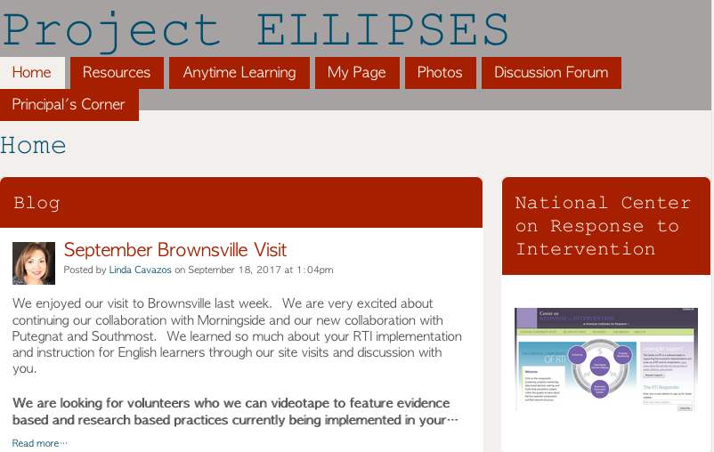
Slide 7
Project Websites
Project ELITE²
https://www.elitetexas.org/
Project LEE
http://projectlee.org/
Project Ellipses
https://mtssclrt.ning.com/

Slide 8
Slide 8
Cohort Website
https://www.mtss4els.org/
Watch for
updates

