Slide 1
Value-added Models and Test Scores from Students with Disabilities
Heather M. Buzick
Educational Testing Service
2013 OSEP Project Directors’ Conference
Washington, DC
July 15th, 2013

Slide 2
Value-added modeling
Value-added modeling is a statistical approach that attempts to isolate the contribution of particular teachers to student performance
Controls for factors beyond the teacher’s control
Attempts to control for sorting of teachers and students into schools
Many different models can be specified as value-added
Pros: Objective and quantifiable; comparable across schools and districts
Cons: General technical limitations may diminish support for valid inferences about teacher effectiveness

Slide 3
Research and Policy Questions
Should scores from students with disabilities be included?
Face and consequential validity
Technical challenges and solutions
How should scores from students with disabilities be included?

Slide 4
Technical challenges
Inconsistent accommodation use across years is related to measured growth (read aloud and extra time)
Average performance is low, the scale is imprecise
The number of tested students for special education teachers is often too low
Time spent with the teacher (general ed. and special ed.)
Alternate assessment scores cannot be used in most cases

Slide 5
Research Example

Slide 7
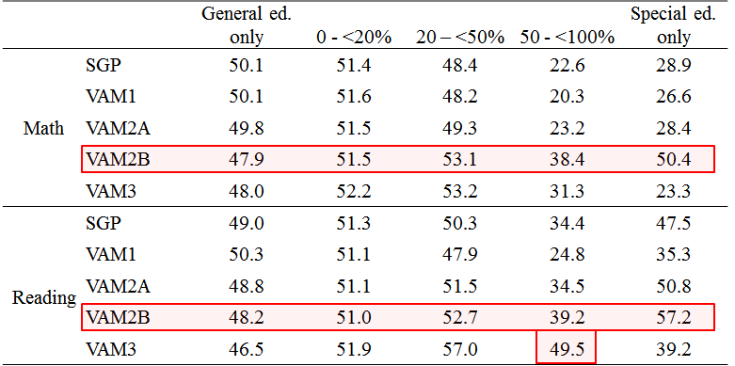
Average percentile ranking of teachers

Slide 8
Value-added and teacher preparation programs
Limited research with special education teachers and students with disabilities
Some challenges may be mitigated in the aggregate
Likely contributes to more within-program variation
The model matters

