Slide 1
Retaining Effective Personnel to Serve Children with Disabilities

Slide 2
Slide 4

Slide 3

Slide 3

Slide 4
Slide 4
The contents of this presentation were developed by the presenters. Those contents do not necessarily represent the policy of the Department of Education, and you should not assume endorsement by the Federal Government. (Authority: 20 U.S.C. 1221e-3 and 3474)

Slide 5
Retaining Special Educators:
Creating and Supporting Meaningful Roles
Elizabeth Bettini, PhD
Boston University

Slide 6
Supporting Meaningful Roles for Special Educators
Special educators motivated to teach students with disabilities
Review of Research: Special Educators’ Attrition
  Major findings: Special educators whose job demands exceed their capacity to meet those demands are more likely to plan to leave
    Capacity in terms of:
      Preparation for Knowledge and Skills
      Working Conditions
        Demands – Paperwork, Caseloads, Instructional Responsibilities
        Logistical Supports
          Material resources
          Time – Planning Time, Collaborative time, Instructional Time
        Social support – Collaboration, Collegial Support, Admin Support, School Culture
Albrecht et al., 2009; Berry, 2012; Bettini et al., in revision; Billingsley & Bettini, accepted; Cancio et al., 2013; Conley & You, 2017; Connelly & Graham, 2009; DeMik, 2008; Jones et al., 2013 ; Ronfeldt & McQueen, 2017; Ronfeldt et al., 2014

Slide 7
Supporting Meaningful Roles for Special Educators
Do Special Educators Experience….
Adapted from Bettini et al., in review; Billingsley, Bettini, & Jones, in press

Slide 8
Supporting Meaningful Roles for Special Educators
Do Special Educators Experience…. |  | Opportunities to Learn Effective Practices (e.g., through Preparation, PD)?
Adapted from Bettini et al., in review; Billingsley, Bettini, & Jones, in press

Slide 9
Supporting Meaningful Roles for Special Educators
Do Special Educators Experience…. |  | Opportunities to Learn Effective Practices (e.g., through Preparation, PD)?
Working Conditions that Support Use of Effective Practices?
Adapted from Bettini et al., in review; Billingsley, Bettini, & Jones, in press

Slide 10
Supporting Meaningful Roles for Special Educators
Do Special Educators Experience…. |  | Opportunities to Learn Effective Practices (e.g., through Preparation, PD)?
Working Conditions that Support Use of Effective Practices? |  | Yes | No
 | Yes
 | No
Adapted from Bettini et al., in review; Billingsley, Bettini, & Jones, in press

Slide 11
Supporting Meaningful Roles for Special Educators
Do Special Educators Experience…. |  | Opportunities to Learn Effective Practices (e.g., through Preparation, PD)?
Working Conditions that Support Use of Effective Practices? |  | Yes | No
 | Yes | YY
 | No
Adapted from Bettini et al., in review; Billingsley, Bettini, & Jones, in press

Slide 12
Supporting Meaningful Roles for Special Educators
Do Special Educators Experience…. |  | Opportunities to Learn Effective Practices (e.g., through Preparation, PD)?
Working Conditions that Support Use of Effective Practices? |  | Yes | No
 | Yes | YY | YN
 | No | NY
Adapted from Bettini et al., in review; Billingsley, Bettini, & Jones, in press

Slide 13
Supporting Meaningful Roles for Special Educators
Do Special Educators Experience…. |  | Opportunities to Learn Effective Practices (e.g., through Preparation, PD)?
Working Conditions that Support Use of Effective Practices? |  | Yes | No
 | Yes | YY | YN
 | No | NY | NN
Adapted from Bettini et al., in review; Billingsley, Bettini, & Jones, in press

Slide 14
Supporting Meaningful Roles for Special Educators
What Working Conditions Support Special Educators in Effectively Serving Students with Disabilities?
Resources
Social:
Admin, Collegial Support
School Culture
Logistical:
Time, Material Resources
Demands
Instructional Grouping
Extra Responsibilities
Paperwork
Caseload
Affective Outcomes (e.g., Stress, Burnout)
&
Intent to Continue Teaching
Graphic adapted from A. Gilmour; Bettini et al., 2016; Bettini, Cumming et al., in revision; Bettini, Gilmour et al., in revision; Billingsley & Bettini, accepted; Billingsley & Bettini, 2018; Conley & You, 2017; Gersten et al., 2001; Jones et al., 2013

Slide 15
Supporting Meaningful Roles for Special Educators
Admin. Support
Intent to Stay in School
Reasonable Instructional Group
Access to Curricula
Emotional Exhaustion
Adequacy of Plan Time
Manageable Workload
Stress
Hours Spent Planning Outside School
Number of Para-Professionals Supervised
Bettini, Cumming et al., in revision

Slide 16
Supporting Meaningful Roles for Special Educators
Does a Special Educator Experience Working Conditions that Support Use of Effective Practices?
Resources
Social:
Admin, Collegial Support
School Culture
Logistical:
Time, Material Resources
Do their colleagues & admin understand & support their role?
Is their planning time commensurate w/ instruction & caseload responsibilities?
Do they have materials (e.g., curricula, incentives) for all subjects/grades they teach?
Do they have sufficient protected time with students to promote gains?
Are their instructional groups reasonable?
Do extra responsibilities distract from service delivery?
Demands
Instructional Grouping
Extra Responsibilities
Paperwork
Caseload
Affective Outcomes (e.g., Stress, Burnout)
&
Intent to Continue Teaching
Graphic adapted from A. Gilmour
Bettini et al., 2016; Bettini et al., in revision; Bettini, Gilmour et al., in revision; Billingsley & Bettini, accepted; Billingsley & Bettini, 2018

Slide 17
Supporting Meaningful Roles for Special Educators
Do Special Educators Experience…. |  | Opportunities to Learn Effective Practices (e.g., through Preparation, PD)?
Working Conditions that Support Use of Effective Practices and Retention? |  | Yes | No
 | Yes | YY | YN
 | No | NY | NN
What leverage do you & your colleagues have?
Adapted from Bettini et al., in review; Billingsley, Bettini, & Jones, in press

Slide 18
Provider Shortages in Part C
Allan Phillips, Part C Coordinator for District of Columbia and Board Member, Infant Toddler Coordinator Association

Slide 19
Is Your State Experiencing Provider Shortages (N=49) ITCA Tipping Points Survey 2018

Slide 20
2018 Personnel Shortages

Slide 21
Leadership Thoughts on Hiring and Retention:
Develop a clear vision, mission, and purpose for the program
Provide strong professional development
Have manageable workloads and expectations
Provide opportunities and supports to staff – coaching, reflection
Develop a culture of learning

Slide 22



Maryland's Pyramid Model & Workforce Development
Margo Candelaria, Ph.D.
UMB SSW
The Institute for Innovation and Implementation
Parent, Infant, Early Childhood Team
OSEP Symposium
Wednesday, May 15, 2019

Slide 23
Within State Department of Ed, Two Drivers of PM
Division of Early Childhood
Leadership Committee
Ongoing trainings and TOTs
Division of Early Intervention Special Education Services
SSIP counties (4) training and coaching +
Practice-based programmatic coaching for EI team leads
2017 Cadre
OMS data collection system
TA and Training from NPC
Data collection
Incorporation of coaching

Slide 24


Cadre Training
Trainings for Cadre Members: PBC, TPOT, TPITOS, new TOT Slides
Monthly webinar TA topics: coaching fidelity, and invited speakers
1:1 Consultation with Cadre Members

Slide 25
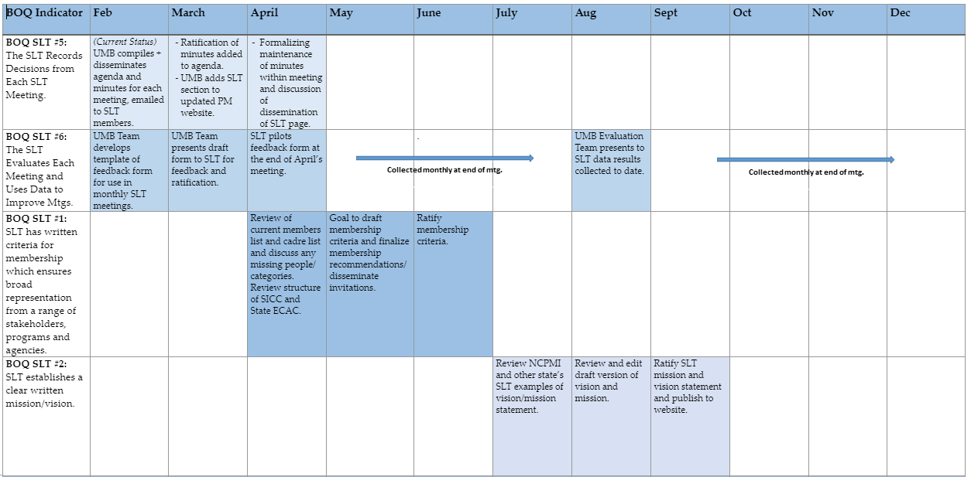

State Leadership Team Action Plan 2019

Slide 26

Supporting PM Within Part C
Substance Exposed Newborns, Caregiver Mental Health, Anxiety in Children and Parents, Considerations for Trauma.
Data driven assessments for Social Emotional Development
Pyramid Model
Routines Based Interview
Family Coaching
Practice Based Coaching

Slide 27
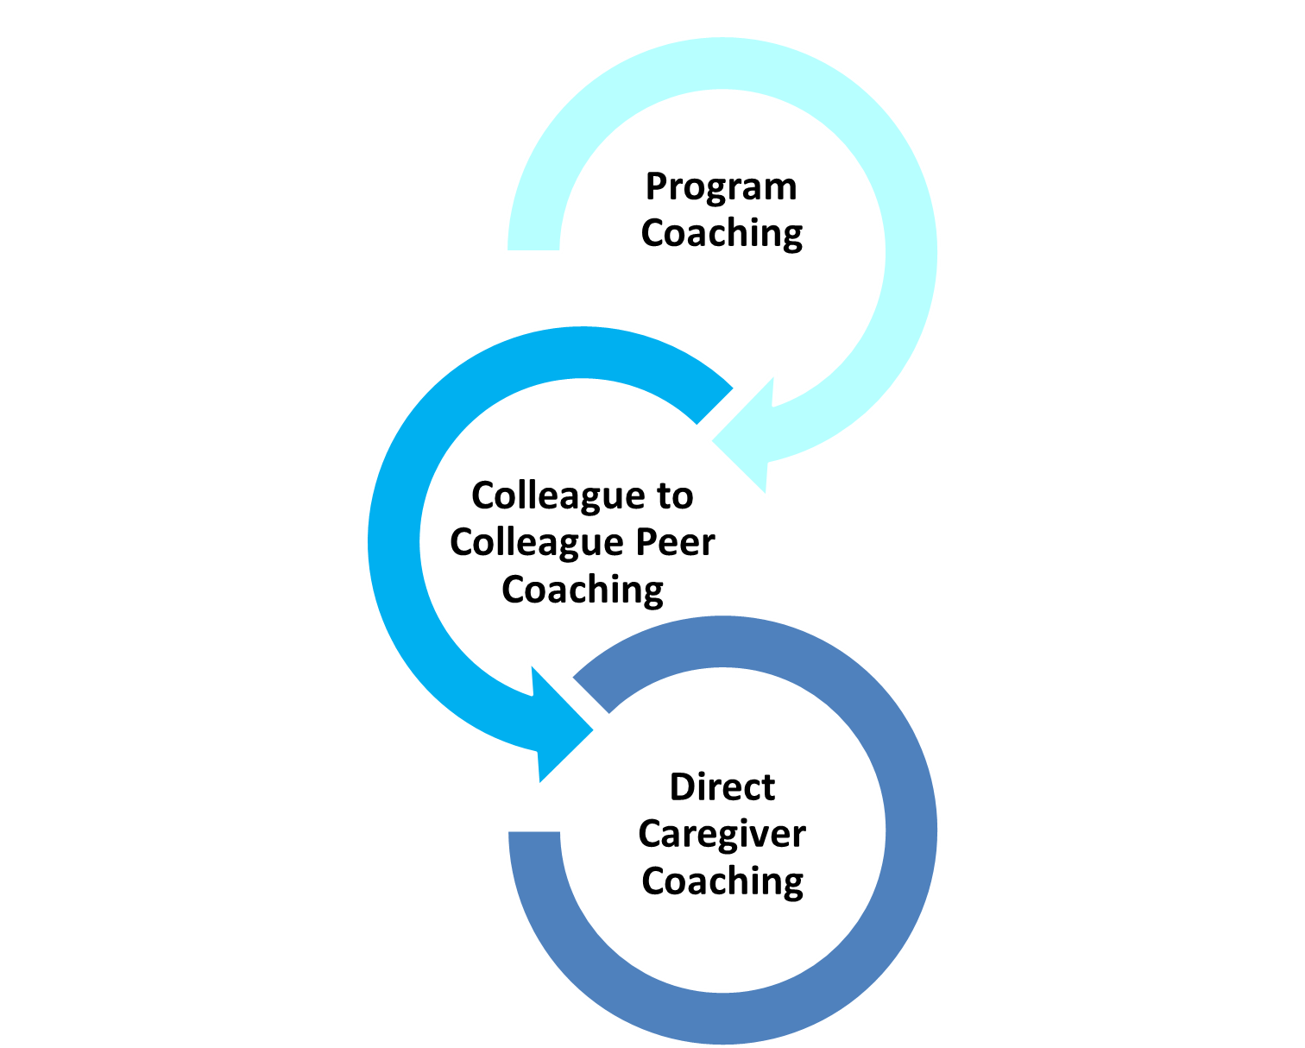
Coach Model
Coaching Model
Intentionally facilitated a parallel process of coaching lead coaches
Supports practice-based coaching implementation for Part C providers
Applies to both peer coaching and family coaching
Supports the social and emotional needs of children engaged in care on their caseloads

Slide 28
BOQ
BOQ

Slide 29

OMS Data Tracking –
Program/
Classroom Level
How many trainers?
What trainings?
How many classrooms?
How many coaches?
Compilation of coaching activities
  Logs
  Fidelity
  Review of goals and strategies
  TPOT
  TIPITOS

Slide 30
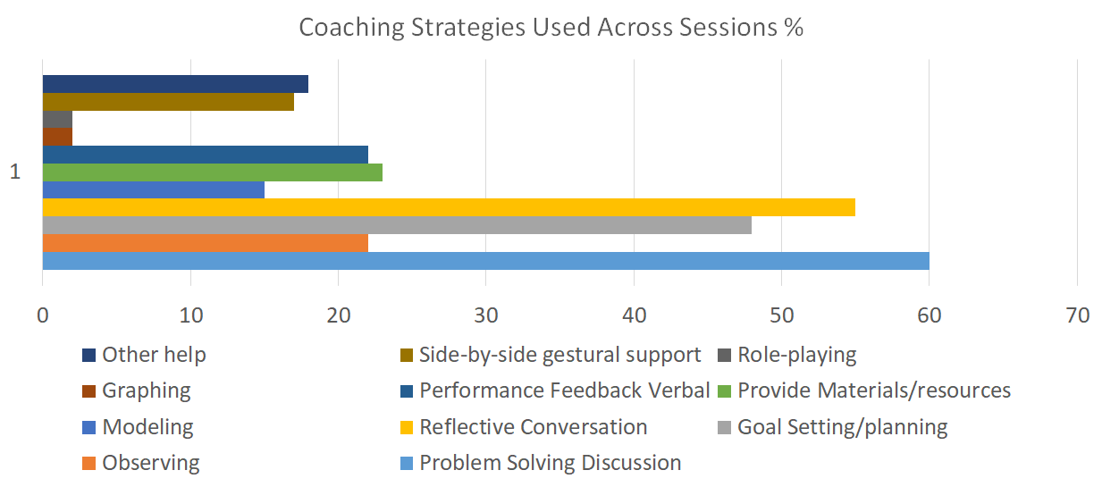
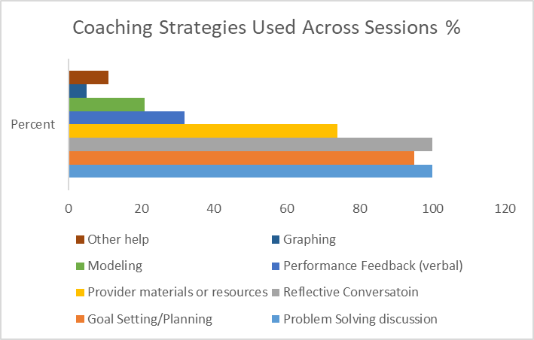
Fidelity to inform Coaching Practices

Slide 31
Slide
MSDE Division of Early Childhood
Leadership Committee
MSDE – Division of Early Intervention
SSIP counties (4) training and coaching
Counties – Special Ed 3-5
Preschool Training
Coaching of embedded internal coaches
Counties –
Pre-k/K
Preschool Training
Coaching of embedded internal coaches
Ongoing trainings and TOTs
2017 Cadre
TA and Training from NPC
OMS system
Practice-based programmatic coaching for EI team leads
Data collection
Spread to other counties
Inclusion of IECMH consultants in the work
Data Collection
Data Collection
NCPMI TA

Slide 32
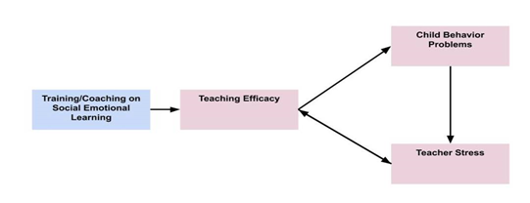
Planned study to address Teacher Efficacy and Stress
One county Training & Coaching
One County Training Only

Slide 33


Next Steps
Deepening PM SSIP work with Part C teams
  Fidelity & Screening Efforts
Expanding linkages with Part B
Systems coaching in county school systems (Pre K and K expansion)
  Embedding capacity of internal systems coaches
Increased systematic data tracking

Slide 34
Retaining Effective Personnel:
The Role of High-Leverage Practices

Slide 35


Slide 35
Michael J. Kennedy, Ph.D.
@MJK_PhD
mjk3p@virginia.edu

Slide 36



Slide 36

Slide 37

Slide 37
To what extent can HLPs and associated resources help reduce the revolving door of teachers leaving the field???
Picture credit: LA Johnson, NPR

Slide 38
Focusing
HLPs are:
A set of practices that can be considered to be the essence of effective teaching
Associated with positive student outcomes
The backbone of more complex practice (including several evidence-based practices)

Slide 39
Focusing
HLPs :
Cut across grade levels and content areas
Apply to students with various disabilities or other learning challenges
Can be broken into component parts to help guide practice

Slide 40


High Leverage Practices in Special Education
22 HLPs spread across four domains:
  Collaboration
  Assessment
  Social/emotional and behavioral
  Instruction

Slide 41
Focusing
Examples of HLPs :
Use explicit instruction
Collaborate with families
Teach social skills
Evaluate and make ongoing adjustments to instruction using data
Provide intensive instruction

Slide 42

Slide 42
HLPs are not a replacement for evidence-based practices

Slide 43
Slide 43
HLPs are not a replacement for evidence-based practices
In some instances HLPs are EBPs, but most are not

Slide 44
Slide 44
HLPs are not a replacement for evidence-based practices
In some instances HLPs are EBPs, but most are not
Effective teaching is more complex than learning and implementing the HLPs

Slide 45

Slide 45
As researchers, faculty, and other stakeholders, we have a responsibility to provide our teacher candidates and those in the field with a strong repertoire of practices known to be effective for students under a range of scenarios.

Slide 46

Slide 46
You’re a licensed special educator, congrats!!!

Slide 47

Slide 47
Resources related to the HLPs for special education that can be leveraged to support retention of our colleagues in the field

Slide 48

Slide 48
Teachers need strong knowledge of effective practices, including EBPs and HLPs to succeed when teaching students with disabilities.

Slide 49
Slide 49
These books provide a solid introduction to the HLPs, and the empirical evidence backing them

Slide 50

Slide 50
www.highleveragepractices.org

Slide 51
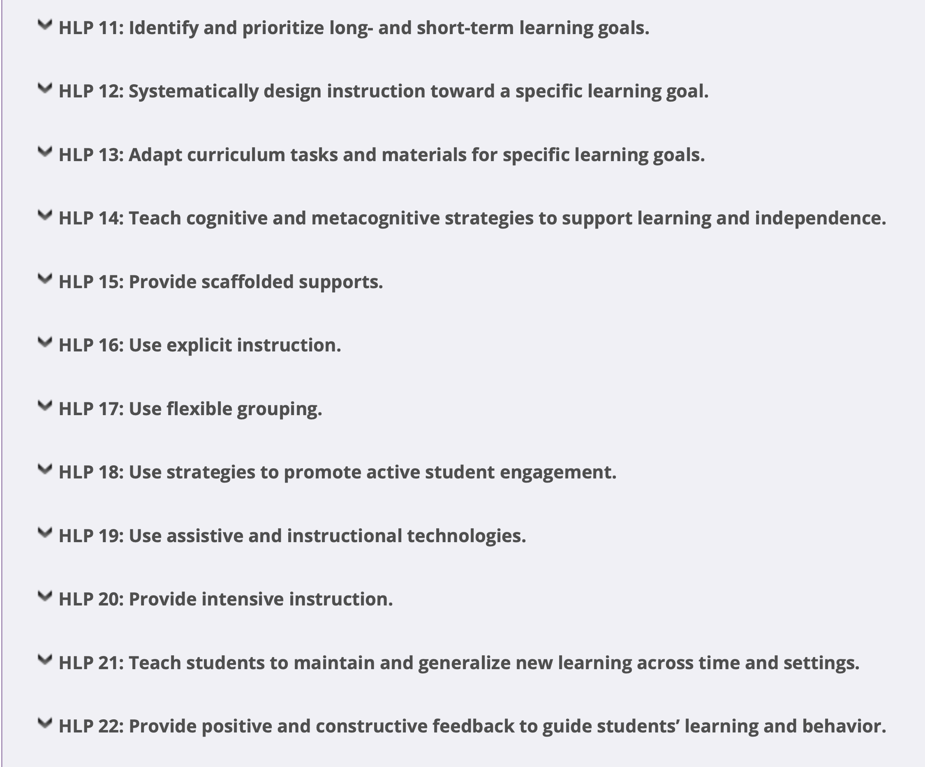
Slide 51

Slide 52
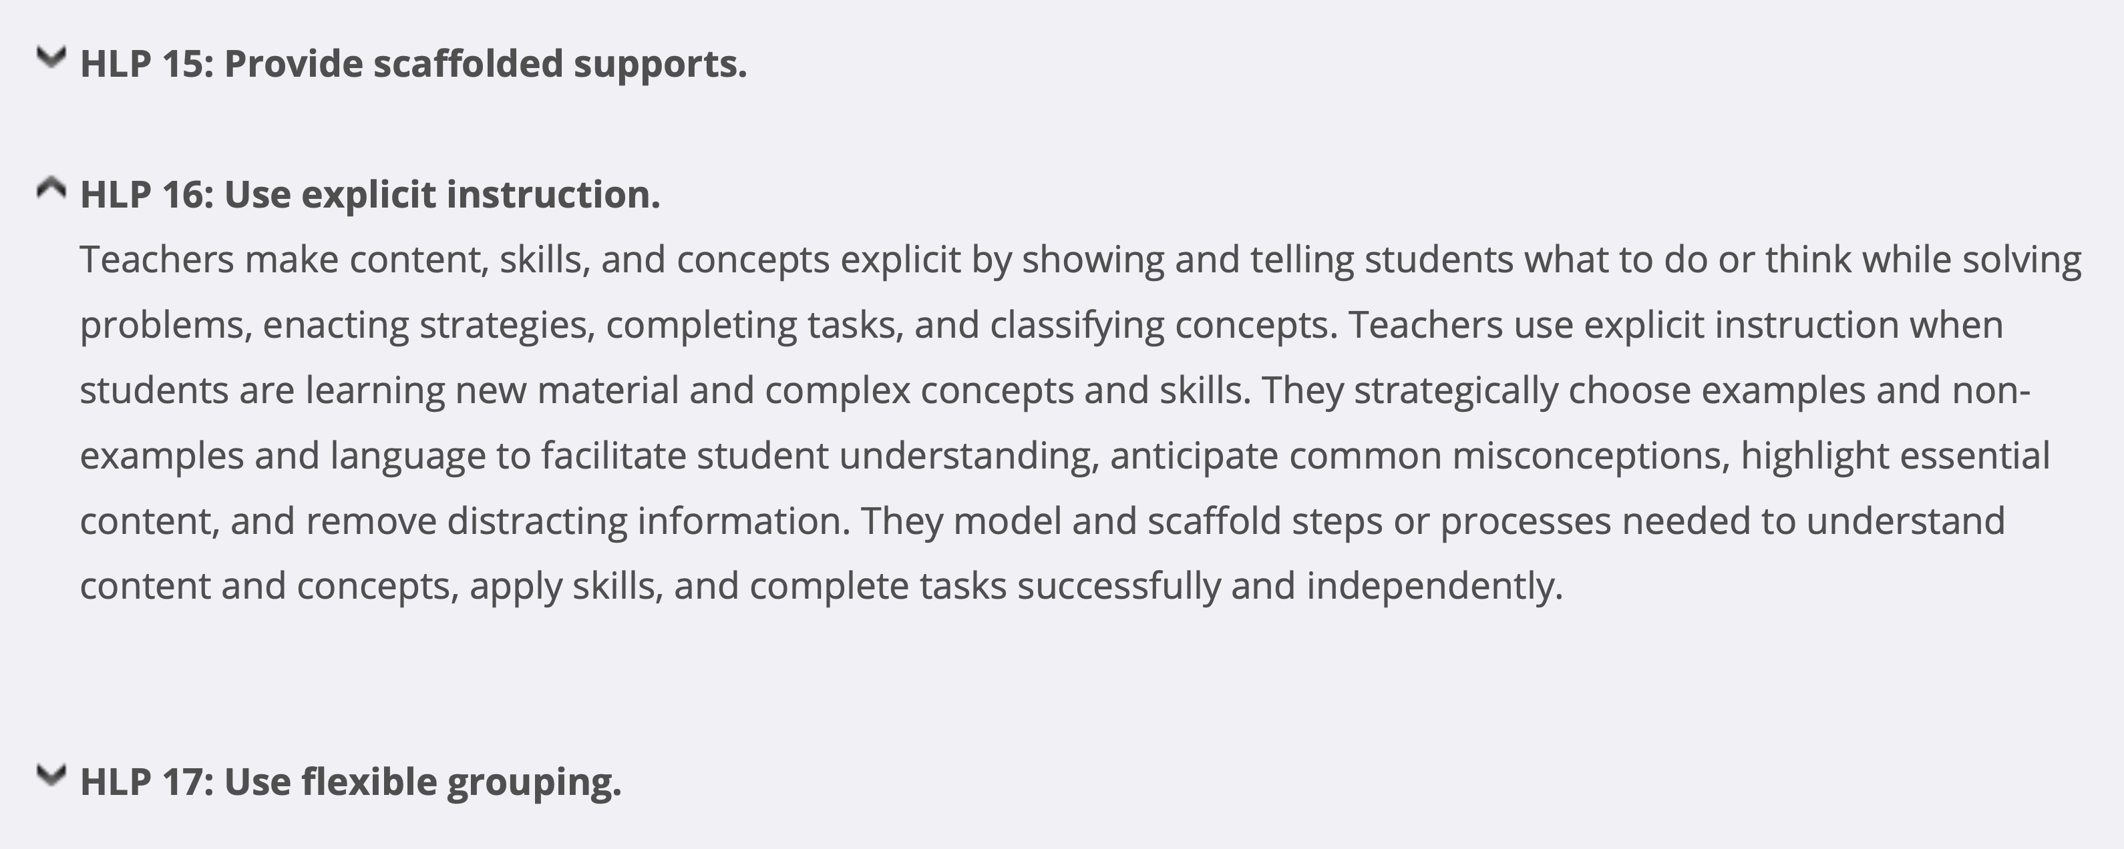
Slide 52

Slide 53

Slide 53
Teachers need strong and specific supports that are well connected to their practice and ongoing in order to make a meaningful change in practice

Slide 54

Slide 54

Slide 55

Slide 55

Slide 56
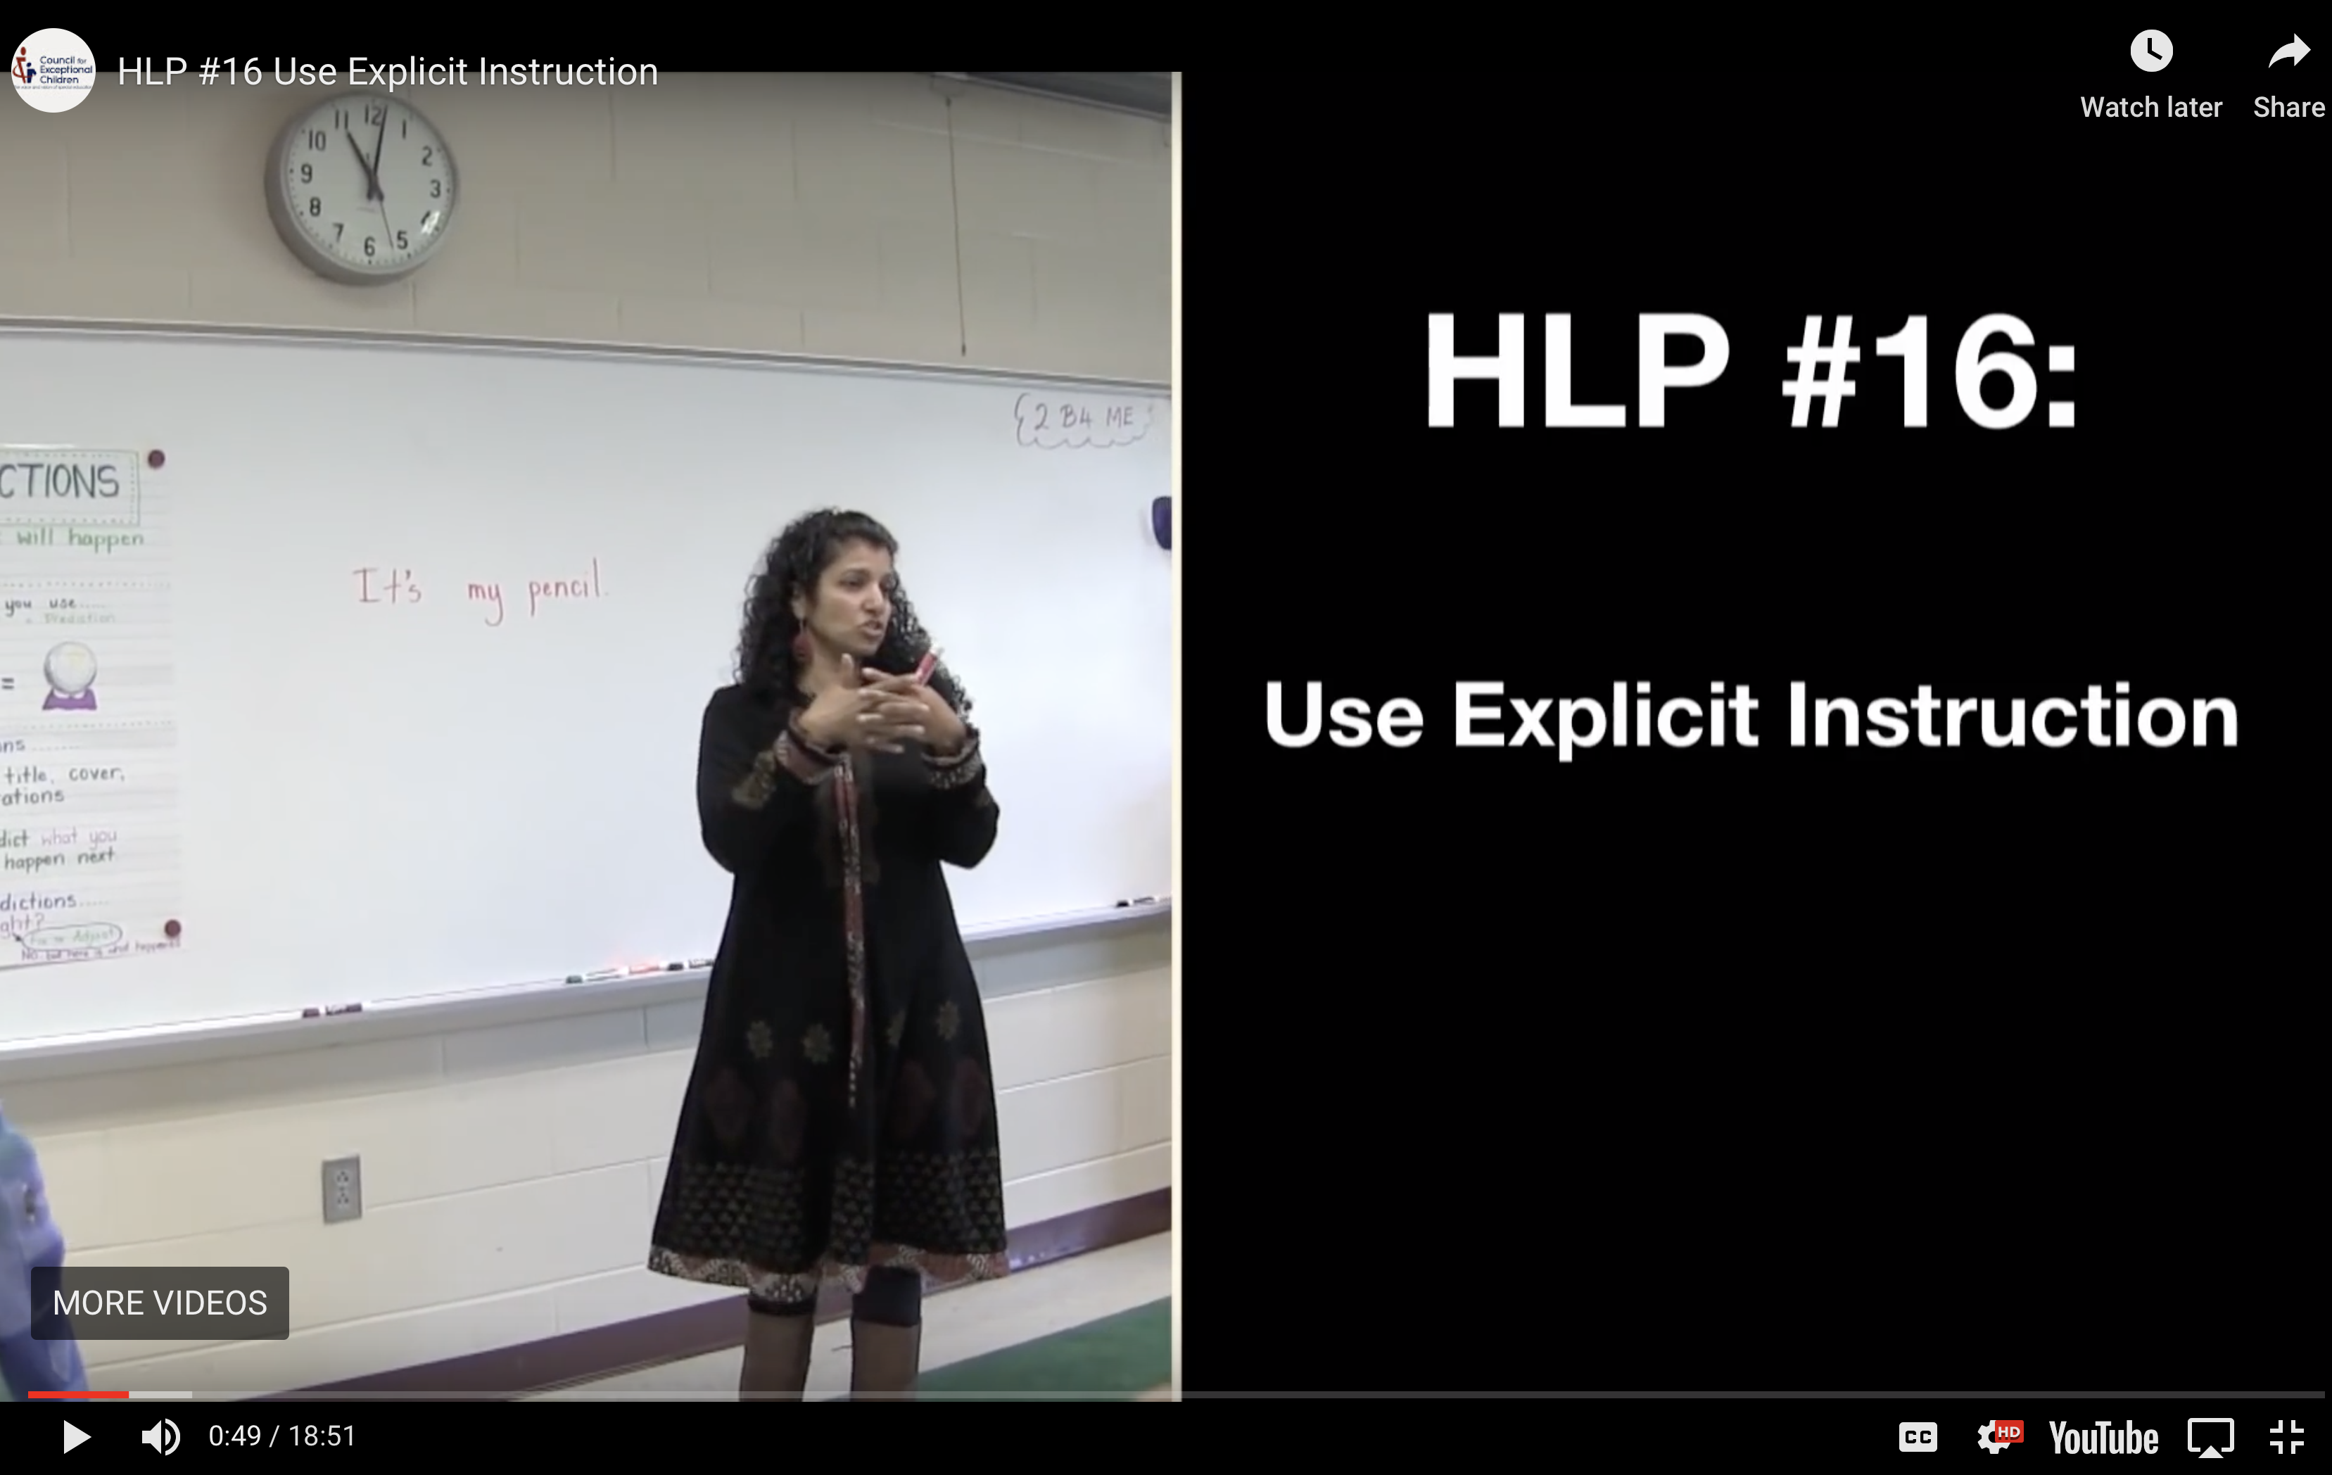
Slide 56

Slide 57
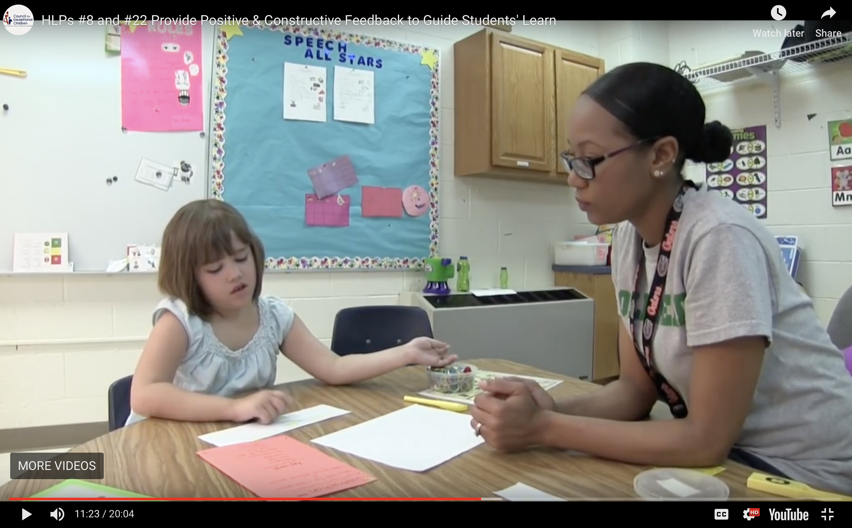
Slide 57

Slide 58
Slide 58
1. Use a logical
sequence within
lessons
2. Provide clear
models and
explanations of content
3. Provide multiple
opportunities to
respond & appropriate
feedback
4. Provide a range of
examples and non-
examples to highlight
content being taught

Slide 59

Slide 59
Teachers benefit from coaching provided by a peer, instructional coach, self–study, or an administrator

Slide 60


Slide 60
When implementing practices as broad and complex as HLPs, there is a challenge for the observer to capture the nuance of instruction and provide meaningful feedback.

Slide 61

Slide 61
Did the teacher use explicit instruction?

Slide 62
Slide 62
Did the teacher use explicit instruction?
Provide feedback?

Slide 63
Slide 63
Did the teacher use explicit instruction?
Provide feedback?
Systematically design instruction toward learning goals?

Slide 64
Slide 64
Simply answering yes or no for any HLP the teacher attempted is an OK starting place, but is very limited in terms of determining if the practice was implemented with fidelity/quality needed to support student needs.

Slide 65

Slide 65
An important first step in evaluating implementation of any HLP is identifying the component parts.

Slide 66
Slide 66
In other words, each HLP was written to be intentionally broad, so as to apply to the range of grade levels, content areas, most disability categories, and other criteria…

Slide 67
Slide 67
That said, the HLPs were identified and written using the best available research. Therefore, under each broad HLP should lay smaller components of the practice that can be identified during a lesson or other relevant setting.

Slide 68
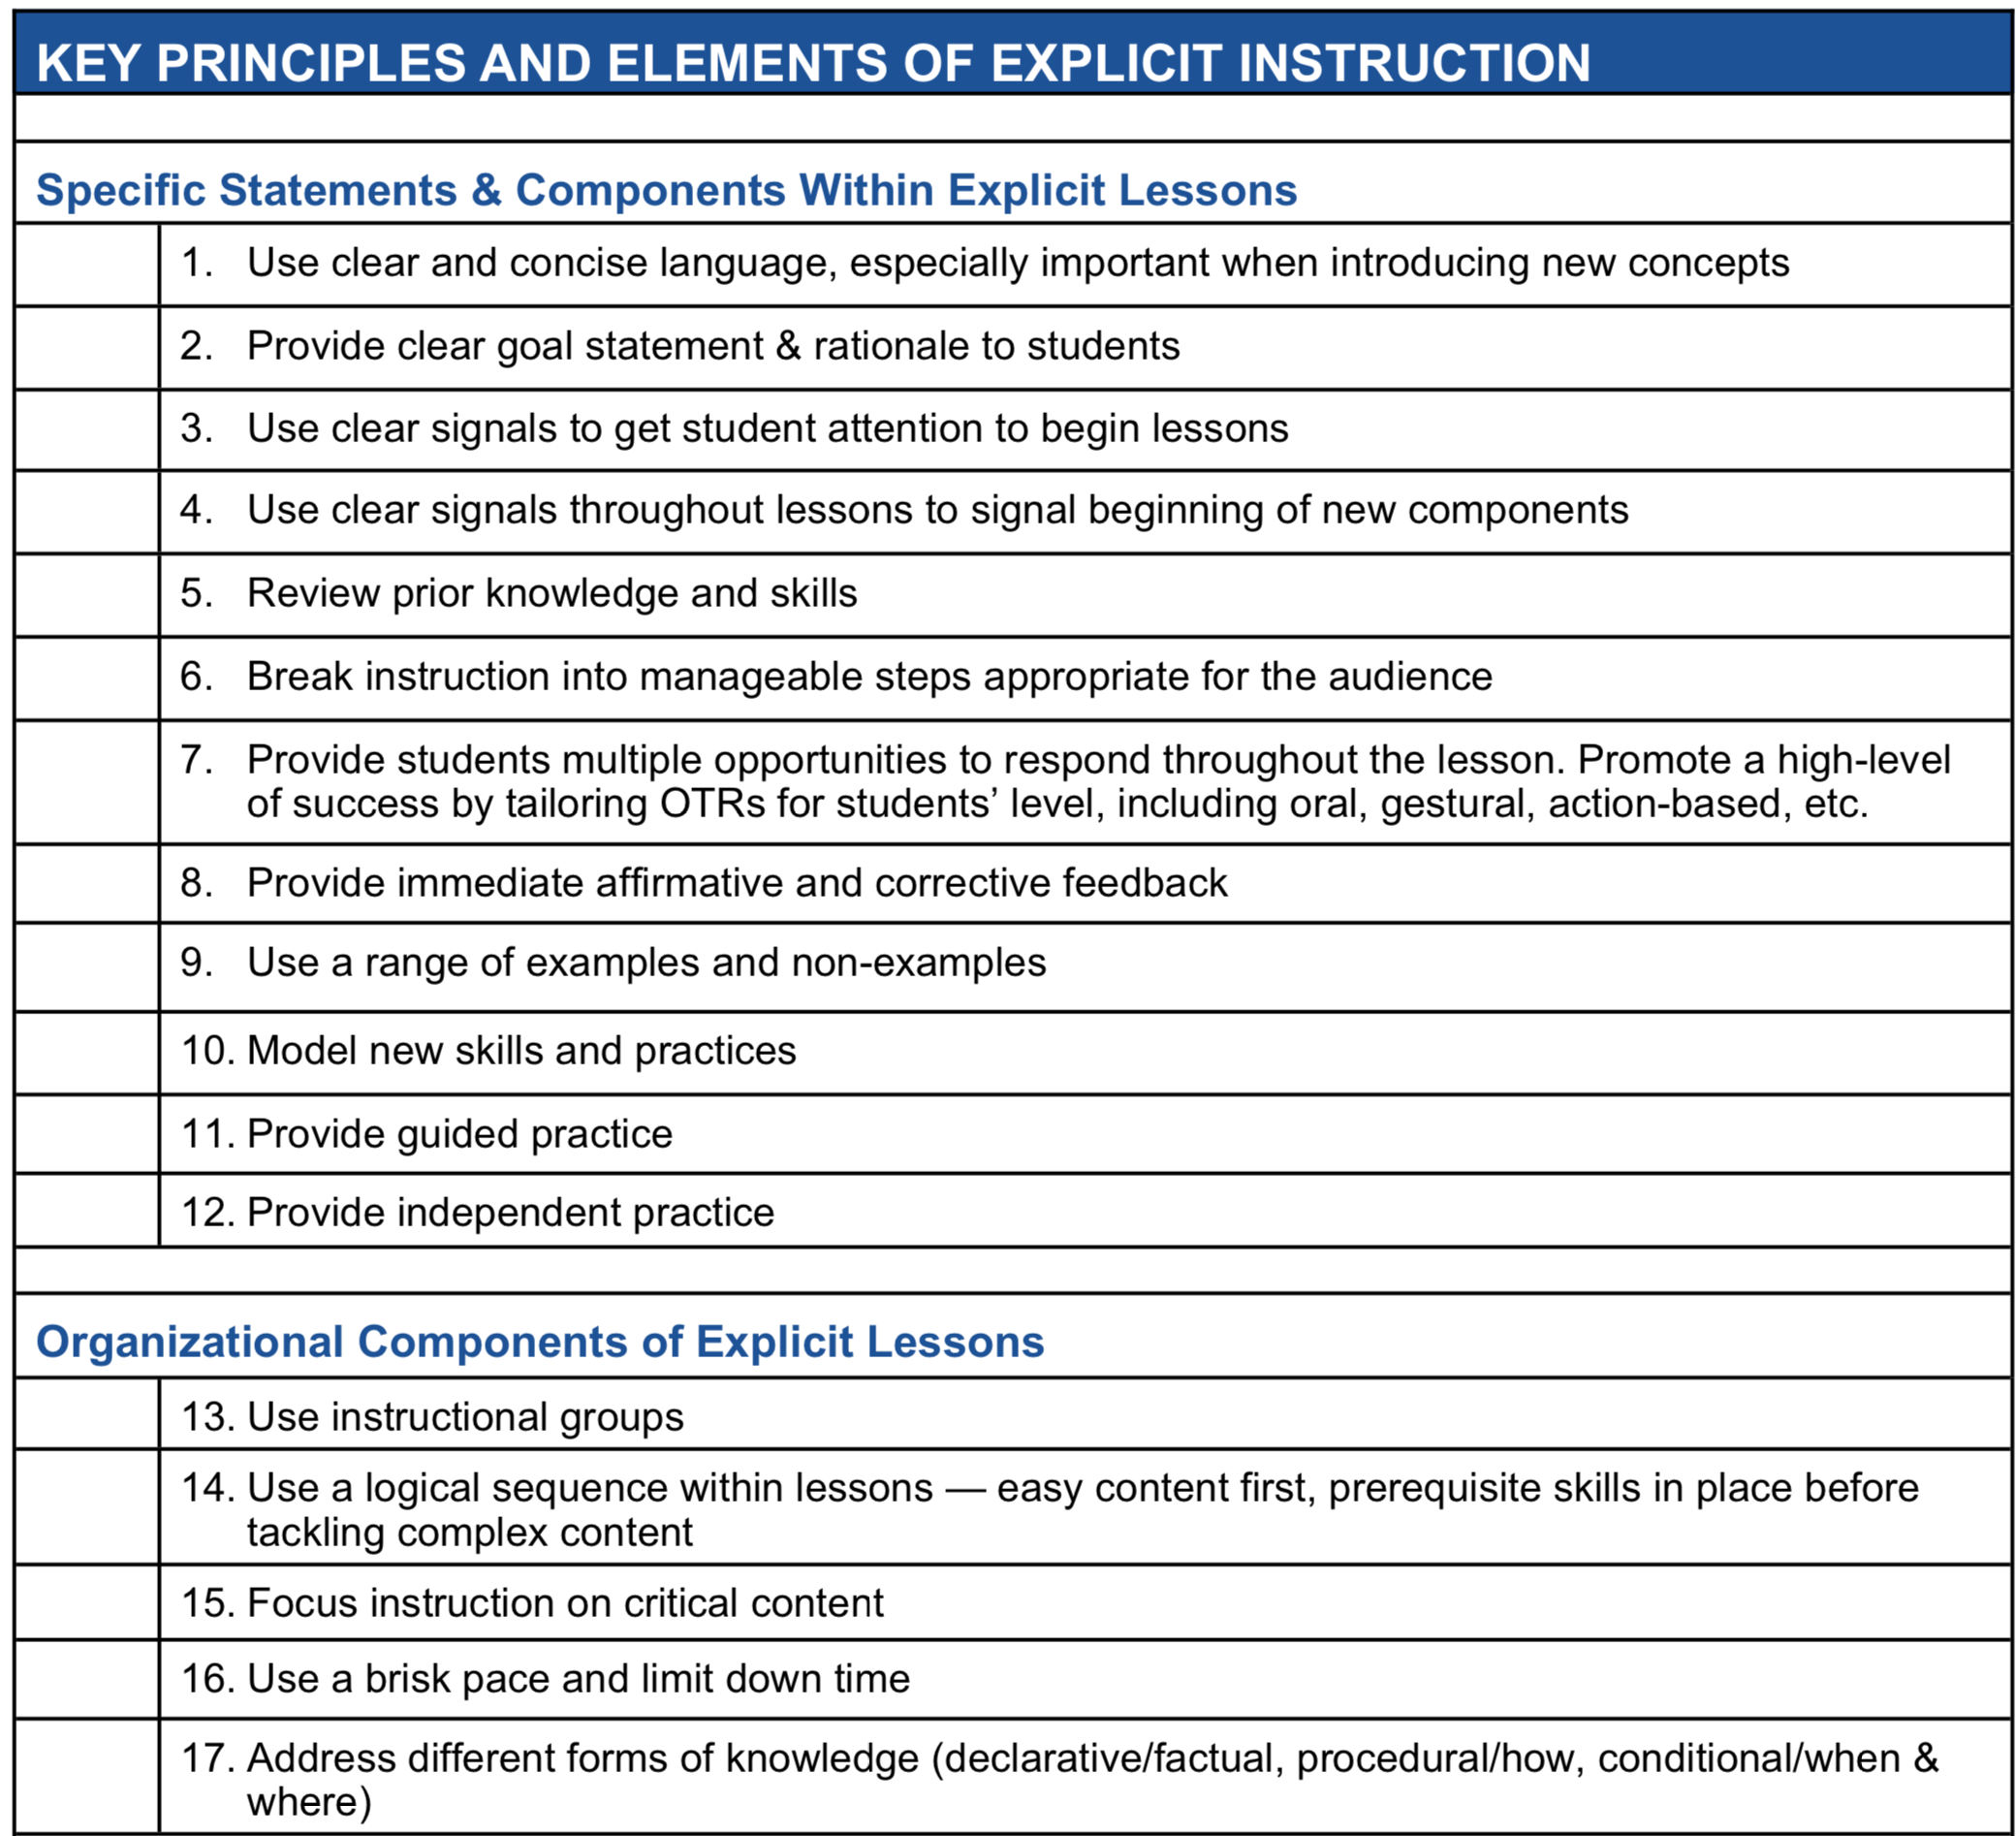
Slide 68
HLPs were written intentionally broad – We need to think about the nuance of each practice (guided by the literature, when possible) to identify the key principles and elements of each. This provides PD developers and leaders the language to use when communicating with teachers about implementation

Slide 69
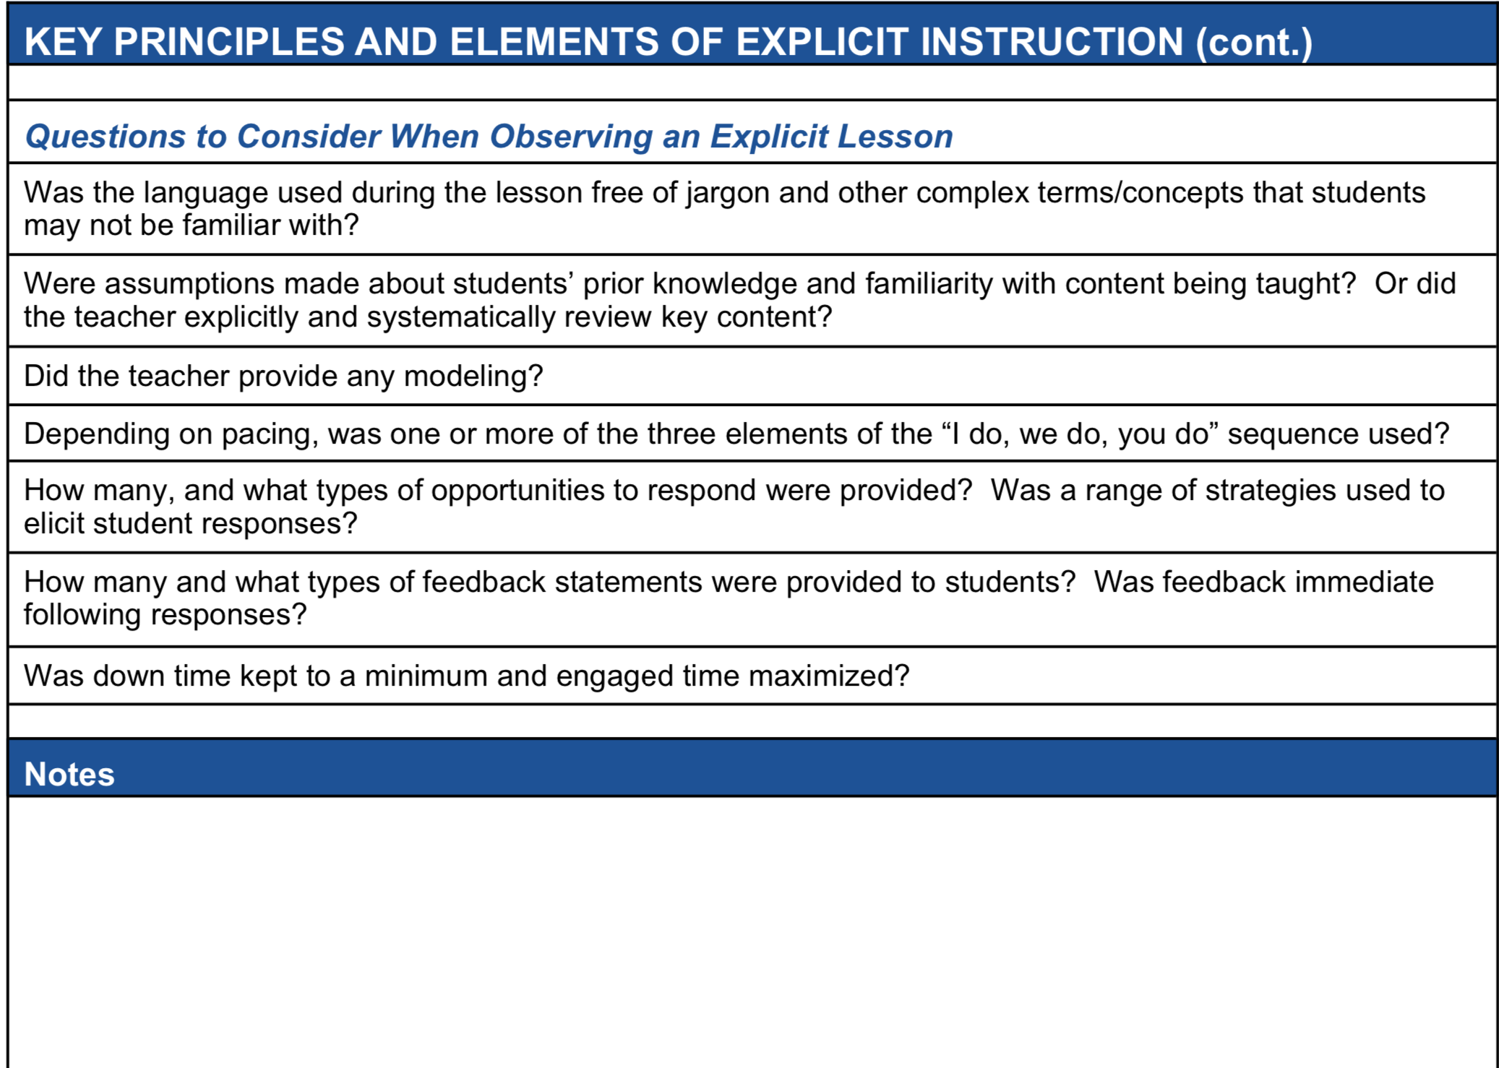
Slide 69
Coaches and
other leaders can also benefit from guiding questions, checklists, and other observation tools that can help guide a systematic observation

Slide 70
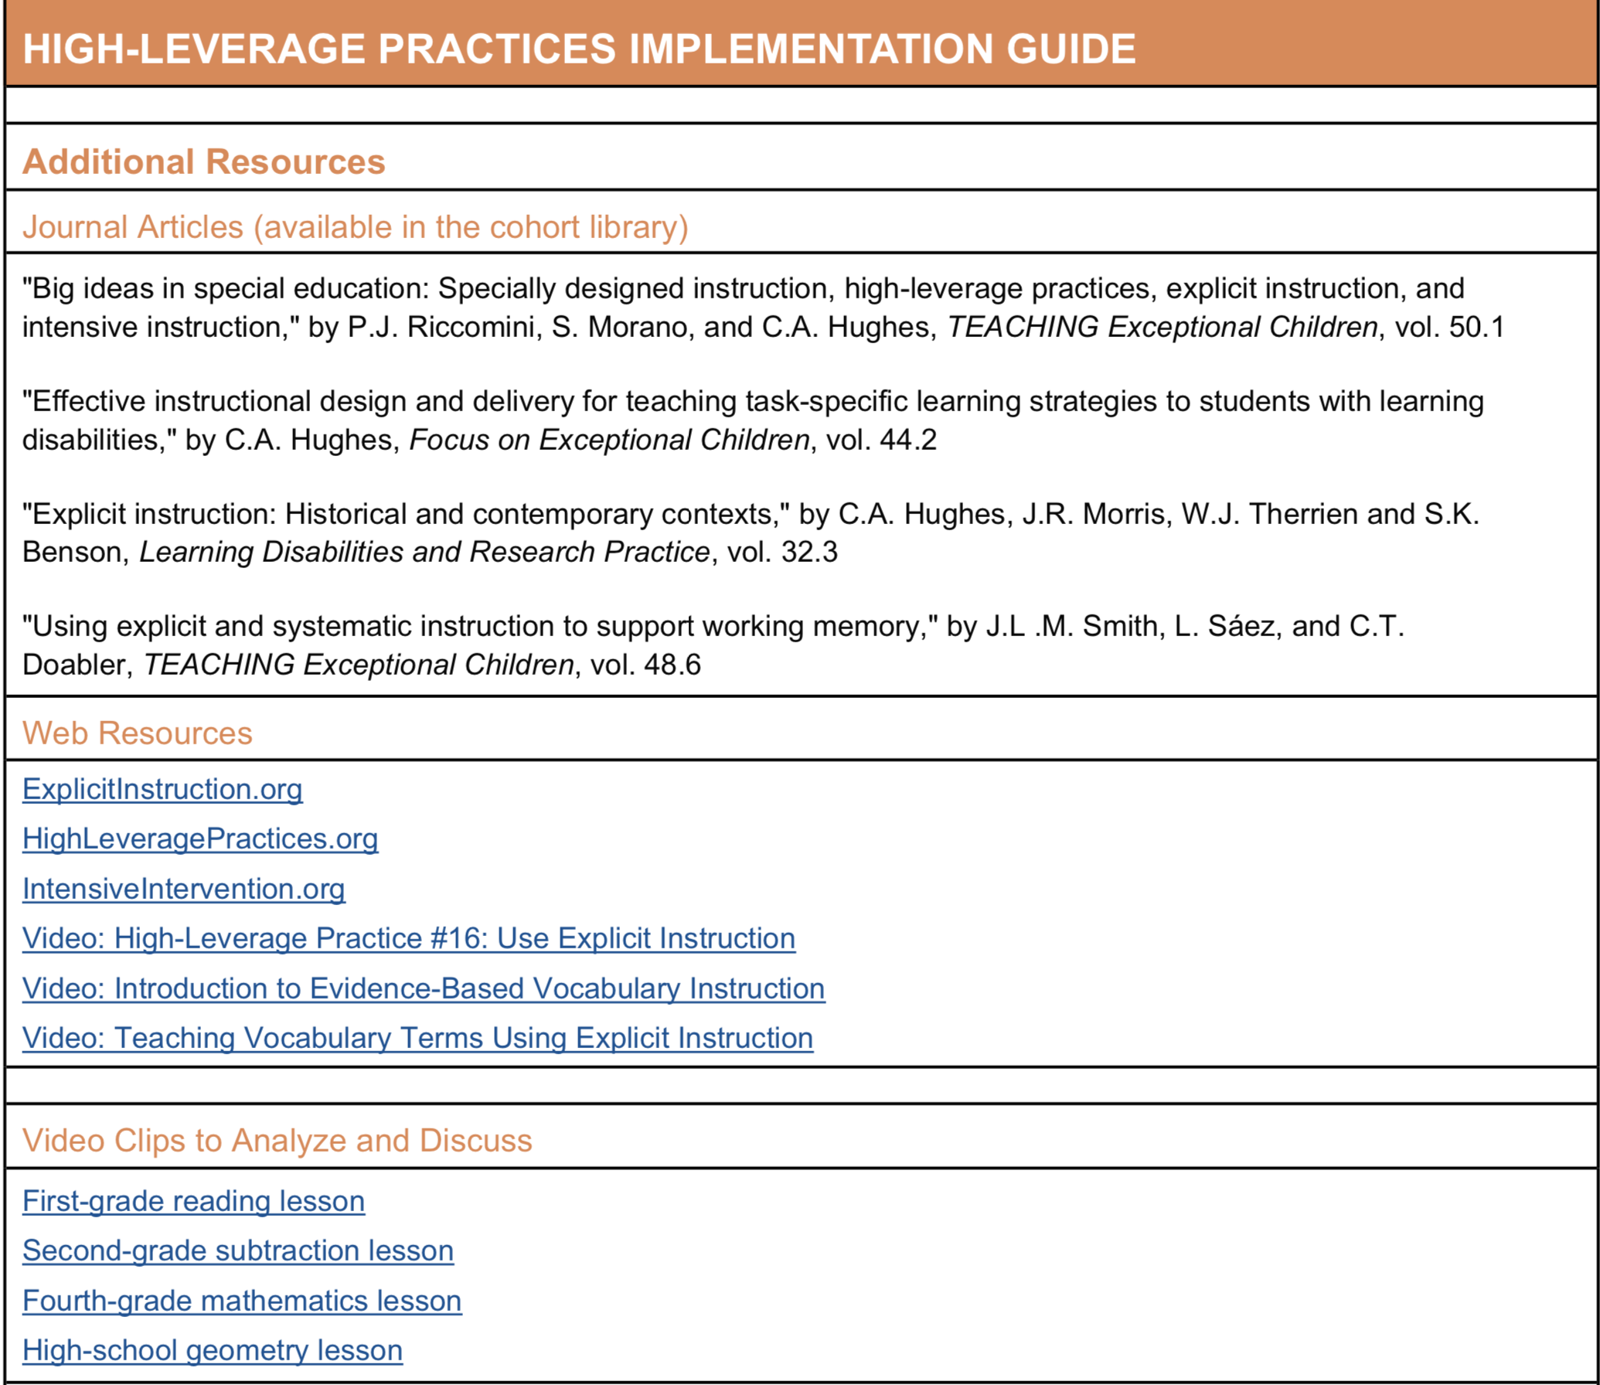
Slide 70
It is important for PD developers and other leaders to give teachers high-quality materials like practitioner-friendly articles, websites, videos, and other models of quality implementation.

Slide 71

Slide 71
Michael Kennedy
U.Va
@MJK_PhD
mjk3p@virginia.edu

Slide 72
Developing Expertise to Support Students who Require Intensive Intervention
Rebecca Zumeta Edmonds, Ph.D.
Co-Director, National Center on Intensive Intervention

Slide 73


Why Do We Need Intensive Intervention?
More Help
Validated programs are not universally effective programs; 3 to 5 percent of students need something more.
More Practice
Students with intensive needs often require 10–30 times more practice than peers to learn new information.

Slide 74
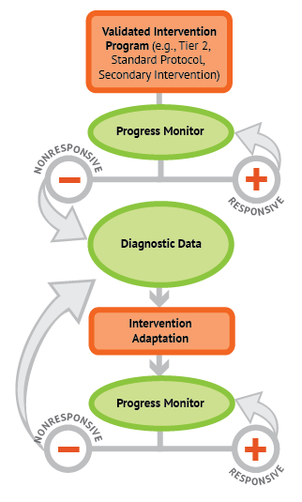
Intensive Intervention through Data-Based Individualization
Intensive Intervention through Data-Based Individualization
www.intensiveintervention.org

Slide 75
Slide
Students with severe and persistent learning and behavior needs require ongoing intensive, data-driven instruction designed to address their individual strengths and challenges…
Educators require ongoing support to develop this expertise.

Slide 76
Who delivers intensive intervention?
Special educators
Intervention specialists
School psychologists
Social workers
Related service personnel
*Although they may play a supportive role, in most cases it is not realistic for classroom teachers or paraeductaors to lead the implementation of an intensive intervention.*

Slide 77
What should supports emphasize?
What should supports emphasize?

Slide 78
#1: Learn to collect and interpret data
Screening | Progress Monitoring | Diagnostic Data
Determine who needs additional support Individual & group trends Subgroup analysis | Determine when changes are needed Evaluate response to instruction/ intervention | Determine why the current program isn’t working Identify strengths and weaknesses
Identify tools at: https://intensiveintervention.org/about-charts-resources https://intensiveintervention.org/intensive-intervention/diagnostic-data/example-diagnostic-tools

Slide 79
#2: Develop Expertise in Explicit Instruction
Explicit Instruction
Identify important objectives
Specify learning outcomes
Design structured instructional experiences
Explain concepts directly
Model new skills and concepts
Provide multiple opportunities for practice with feedback
https://intensiveintervention.org/intensive-intervention-features-explicit-instruction

Slide 80

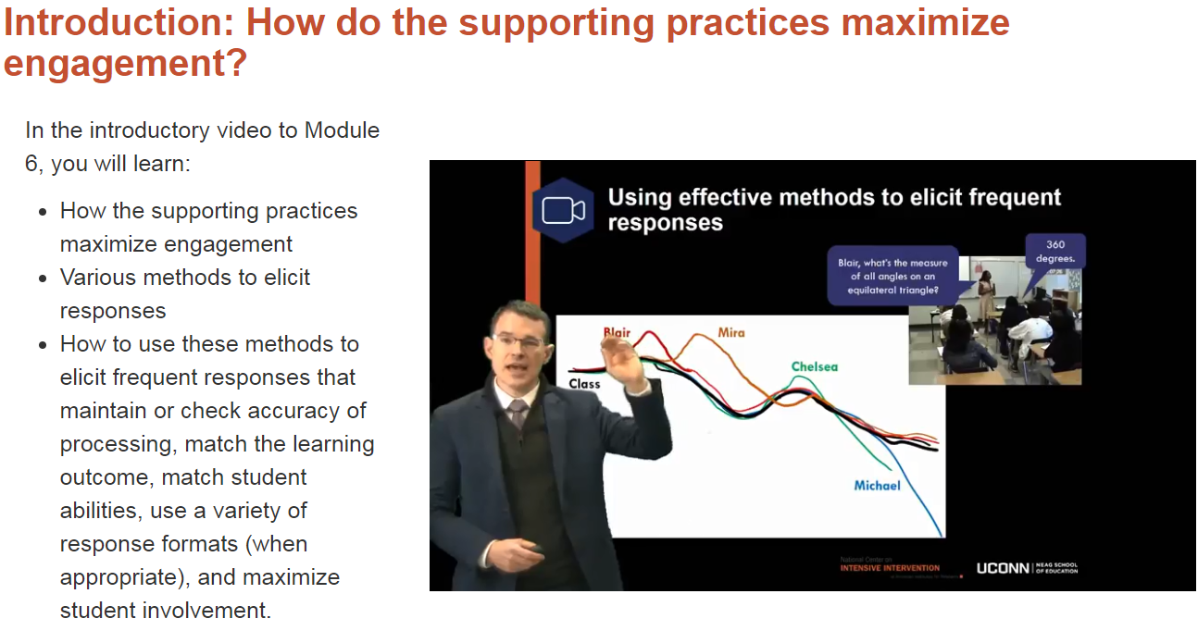



Explicit Instruction Course Content and Resources
Explicit Instruction
Course Content and Resources
Content Overview:
Modeling and Practicing to Help Students Reach Academic Goals
Using Effective Methods to Elicit Frequent Responses
Providing Immediate and Specific Feedback and Maintaining a Brisk Pace
Evaluating Use of Explicit Instruction to Support Students’ Academic Needs
Coming Soon!
Math, Reading, and Classroom Management courses
Pre-recorded lecture content
Adaptable PowerPoint slides
Video examples / non-examples of classroom instruction
Activities, Discussion Prompts, Quiz Questions, Coaching Guide

Slide 81
#3: Develop Skills to Support Students with Challenging Behavior
Screening & Progress Monitoring for Behavior | Functional Assessment | Classroom Management and Intervention Supports
Tools charts: https://charts.intensiveintervention.org/chart/behavior-screening https://charts.intensiveintervention.org/chart/behavioral-progress-monitoring-tools Professional Learning Module: https://intensiveintervention.org/resource/monitoring-student-progress-behavioral-interventions-dbi-training-series-module-3 | Professional Learning Module: https://intensiveintervention.org/resource/using-fba-diagnostic-assessment-behavior-dbi-training-series-module-6 | Function-Based Behavior Strategies: https://intensiveintervention.org/intervention-resources/behavior-strategies-support-intensifying-interventions Professional Learning Module: https://intensiveintervention.org/resource/what-do-i-do-now-individualizing-behavior-interventions-when-standard-approaches-dont-work Coming Soon: Online course

Slide 82
#4: Learn Strategies for Intensifying Interventions

Slide 83
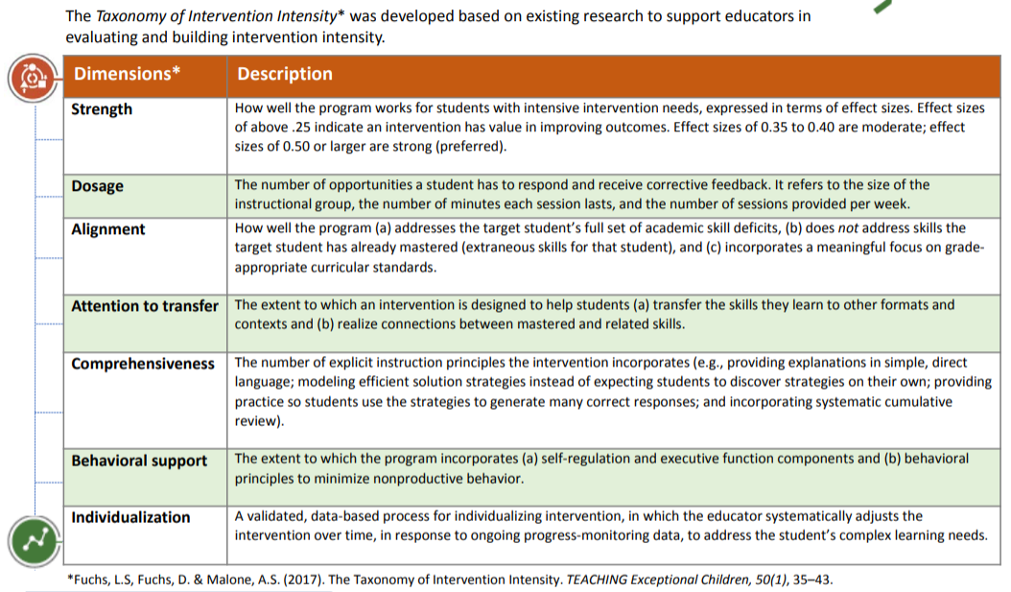
Taxonomy of Intervention Intensity
Taxonomy of Intervention Intensity
https://intensiveintervention.org/taxonomy-intervention-intensity

Slide 84
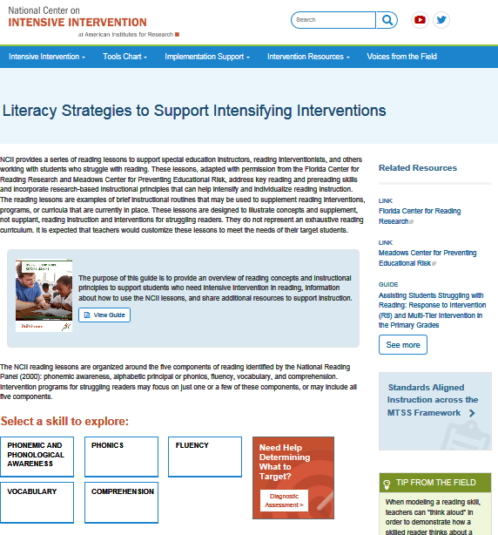
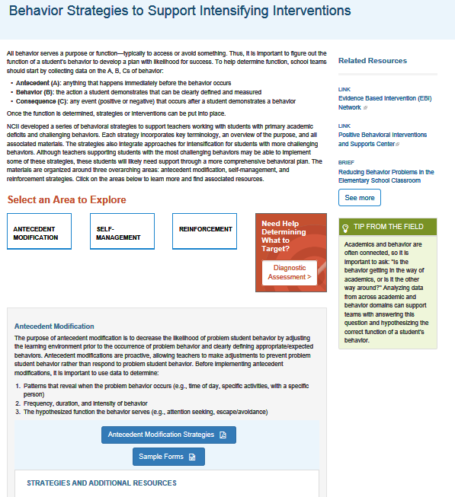



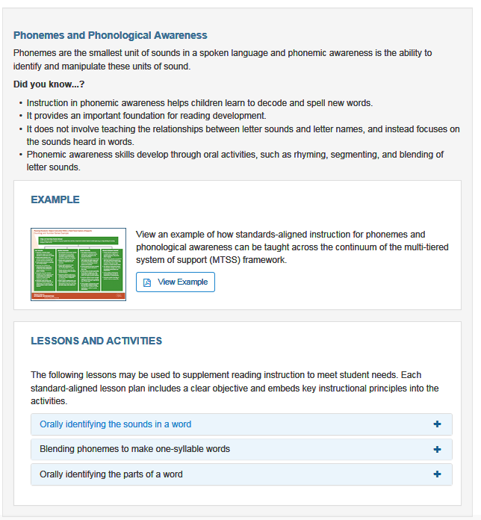

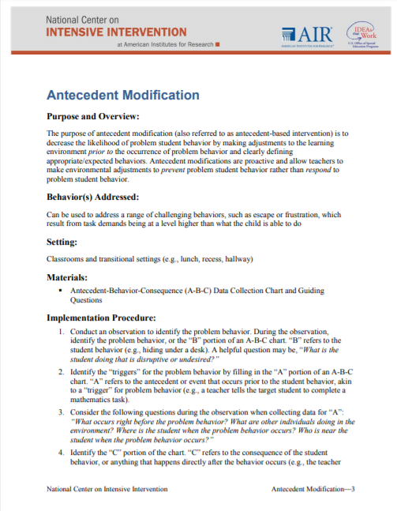

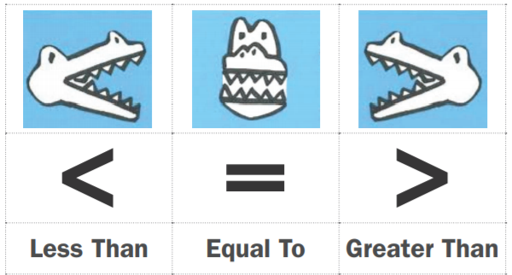
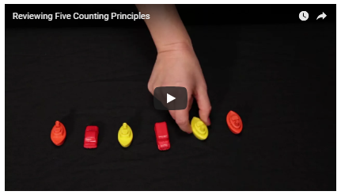
Content-Specific Intensification Resources
Literacy
Math
Behavior

Slide 85

#5: Plan for the whole child
Academic and behavior needs do not exist in isolation

Slide 86

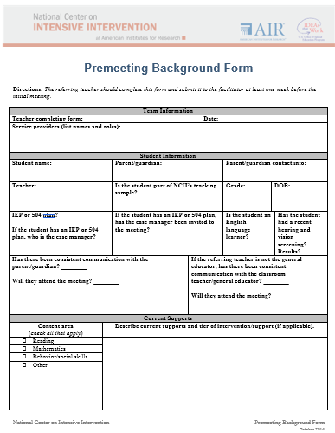
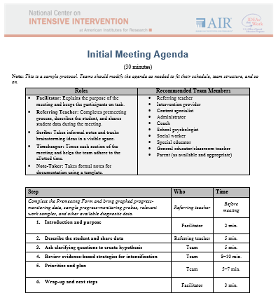
Essentials of Intensive intervention
https://intensiveintervention.org/implementation-support/tools-support-intensive-intervention-data-meetings

Slide 87
NCII Disclaimer
This presentation was produced under the U.S. Department of Education, Office of Special Education Programs, Award No. H326Q160001. Celia Rosenquist serves as the project officer. The views expressed herein do not necessarily represent the positions or policies of the U.S. Department of Education. No official endorsement by the U.S. Department of Education of any product, commodity, service, or enterprise mentioned in this webinar is intended or should be inferred

Slide 88
Classroom Management Through the Lens of Effective Instruction:
What Teachers Can Do
Terry Scott, Ph.D., Professor and Distinguished University Scholar, University of Louisville and Director, Center for Instructional and Behavioral Research in Schools

Slide 89
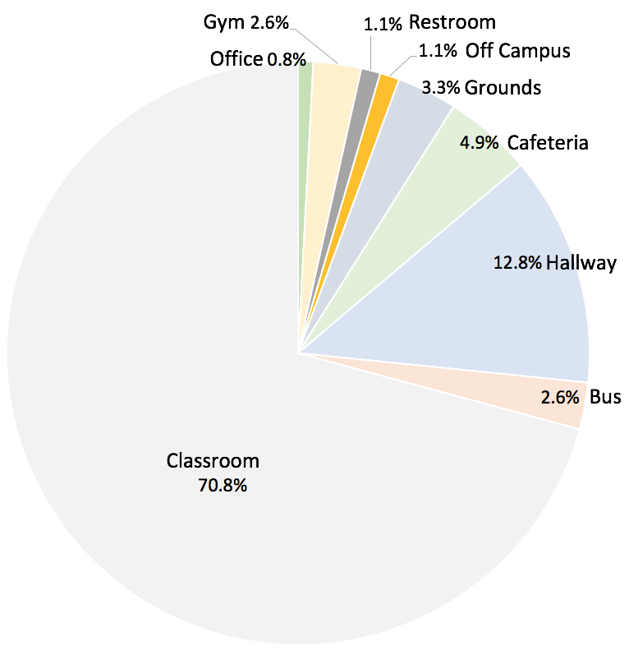
Suspensions by Location and Ethnicity
The classroom is by far the most likely location of a suspension offense – and that is the same across ethnicities

Slide 90
Instructional Practices and Student Success
Consider the degree to which teachers provide—
  Focus on students (focus on curriculum and students)
  Opportunities to respond (OTR)
  Positive feedback (verbal or other affirmation)
Latent-class analysis reveals 3 clusters of teachers in terms of using these practices
Teachers in the lowest cluster have students that are
  27% more likely to be off task
  67% more likely to be disruptive

Slide 91
Instruction and Classroom Management
Effective Instruction
High Rates of
Student Success
Classroom Management
The purpose of classroom management is to facilitate a safe learning environment to maximize student success with instruction

Slide 92
Managing Classroom Learning Environments
The Highest Probabilities for success:
Teach Rules
  Be explicit, real examples, engagement, practice, reminders
Establish Routines
  Be consistent, use routines to build habits, avoid problems
Thoughtful Arrangement of the Physical Environment
  Actively supervise, assign seats, teacher proximity, furniture arrangement
Relationships
  Take an interest in students, build momentum for respectful interactions

Slide 93
Changing Teacher Behavior in the Classroom
Efficient coaching delivery via video-based modules
  Teacher focus groups provide authentic scenarios for video and discussion (keep it real)
  Shorter in length with less talking heads (fast moving)
  Opportunities for facilitated engagement (discussion)
    people talking about application to their own classroom is necessary for buy-in
  Use PLCs and other structures (build it into school)
    people need coaching and feedback

Slide 94

Video-Based Facilitated Group Learning
Describe problem, show problem, define solution, show solution, engage adults

Slide 95
Play Video 1 Here: Video-Based Facilitated Group Learning

Slide 96
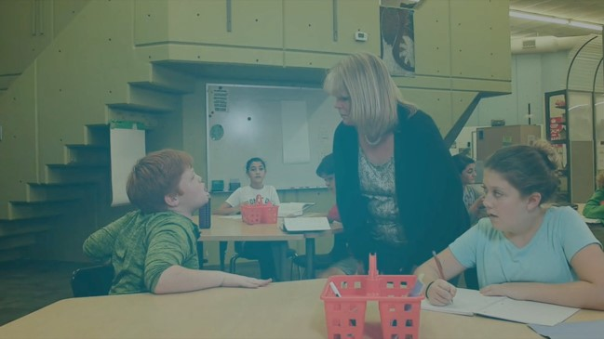
Range of Topics for Teachers to Discuss
Show a full range of classroom-based problems and effective strategies

Slide 97
Play Video 2 Here: Range of Topics for Teachers to Discuss

Slide 98
Regular School Monitoring and Feedback

Slide 99
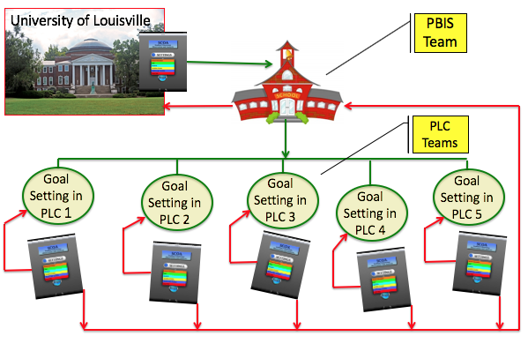
Sustainability = Coaching and Feedback

Slide 100
A Teacher’s Perspective: The Importance of Effective Preparation
Daniel Sherlock, District of Columbia Public Schools

Slide 101
Video 3 here: Alabama SPDG

Slide 102
Questions & Answers

Slide 103
Slide 4
The contents of this presentation were developed by the presenters. Those contents do not necessarily represent the policy of the Department of Education, and you should not assume endorsement by the Federal Government. (Authority: 20 U.S.C. 1221e-3 and 3474)

