Slide 1
OSEP Project Director’s Meeting: Establishing, Sustaining and Scaling Effective Practices
Rob Horner
University of Oregon
OSEP TA Center on PBIS
www.pbis.org

Slide 2
Goal
Provide lessons learned from implementation of School-wide PBIS about scaling and sustaining effective practices.

Slide 3
Implementation Science
Start with effective practices
Define key “Implementation Drivers” that combine to achieve:
High fidelity implementation with functional outcomes
Sustained implementation
Scaling up to levels of social importance
Define Stages of Implementation and Criteria for Each Stage
Define the Cascading Process of Implementation Impact

Slide 4
What is “School-wide Positive Behavior Interventions and Support?”
School-wide PBIS is:
A framework for establishing the social culture and behavioral supports needed for a school to be an effective learning environment for all students.
Evidence-based features of SWPBIS
Prevention
Define and teach positive social expectations
Acknowledge positive behavior
Arrange consistent consequences for problem behavior
On-going collection and use of data for decision-making
Continuum of intensive, individual intervention supports.
Implementation of the systems that support effective practices

Slide 5
School-wide Positive Behavioral Interventions and Supports (SWPBIS)
The social culture of a school matters.
A continuum of supports that begins with the whole school and extends to intensive, wraparound support for individual students and their families.
Effective practices with the systems needed for high fidelity and sustainability
Multiple tiers of intensity

Slide 6
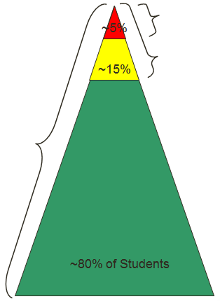
SCHOOL-WIDE
POSITIVE BEHAVIOR
SUPPORT
Tertiary Prevention:
Specialized
Individualized
Systems for Students with High-Risk Behavior
Secondary Prevention:
Specialized Group
Systems for Students with At-Risk Behavior
Primary Prevention:
School-/Classroom-
Wide Systems for
All Students,
Staff, & Settings
Main Ideas:
Invest in prevention first
Multiple tiers of support intensity
Early/rapid access t o support
From Hill Walker

Slide 7
Experimental Research on SWPBIS
SWPBIS Experimentally Related to:
Reduction in problem behavior
Increased academic performance
Increased attendance
Improved perception of safety
Reduction in bullying behaviors
Improved organizational efficiency
Reduction in staff turnover
Increased perception of teacher efficacy
Improved Social Emotional competence

Slide 8
Number of Schools Implementing SWPBIS since 2000
As of February 2013
19,054

Slide 9
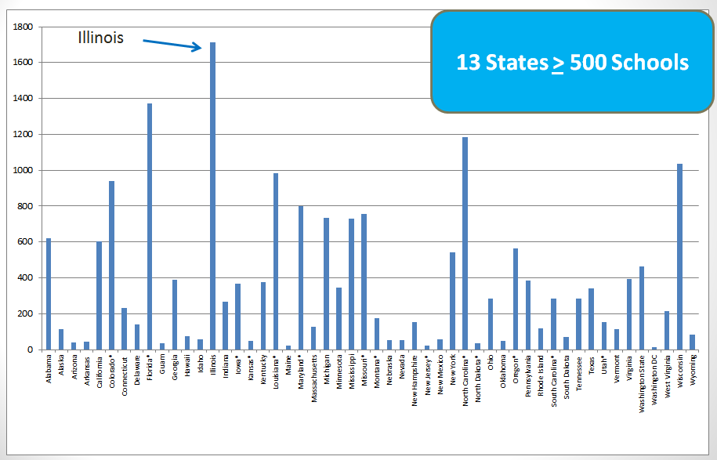
Count of School Implementing SWPBIS by State
February, 2013

Slide 10
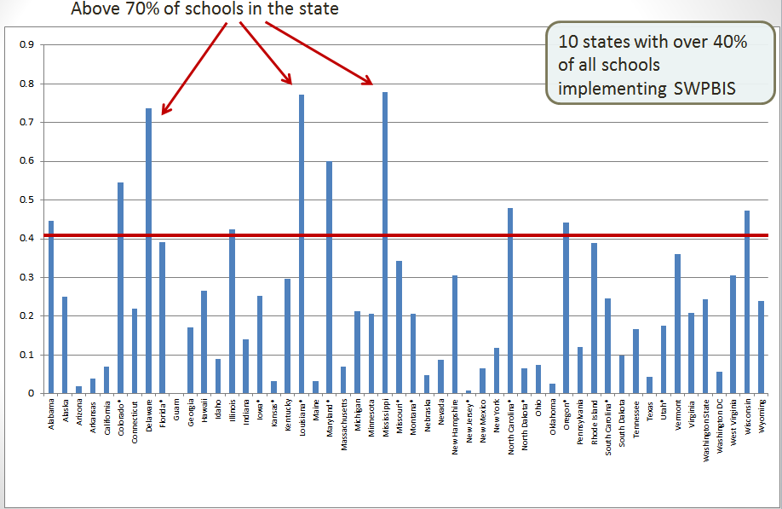
Proportion of Schools Implementing SWPBIS by State
February, 2013

Slide 11
Count of School Implementing SWPBIS by State
February, 2013

Slide 12
Schools Implementing SWPBIS by State
Green = Total Schools Implementing SWPBIS
Red = The Number of Schools Reporting Fidelity Data on www.pbisassessment
Blue = The number of schools reporting Fidelity Data at criterion (Tier I).
Schools using SWPBIS
Schools using SWPBIS and reporting Fidelity Data

Slide 13
Schools Implementing SWPBIS by State
Green = Total Schools Implementing SWPBIS
Red = The Number of Schools Reporting Fidelity Data on www.pbisassessment
Blue = The number of schools reporting Fidelity Data at criterion (Tier I).
Schools using SWPBIS
Schools using SWPBIS and reporting Fidelity Data
Schools using SWPBIS
At Fidelity Criterion

Slide 14
Scaling and Sustaining SWPBIS
Priority
We need to focus on outcomes that are of high value
Effectiveness
Evidence-base
What is done, for whom, by whom, where, toward what outcome?
Efficiency
The most under-rated variable
Practice must be more efficient than alternatives
Implementation process must become more efficient with scaling.
Data Use
Use of both fidelity and impact data for validation, continuous improvement and regeneration.

Slide 15
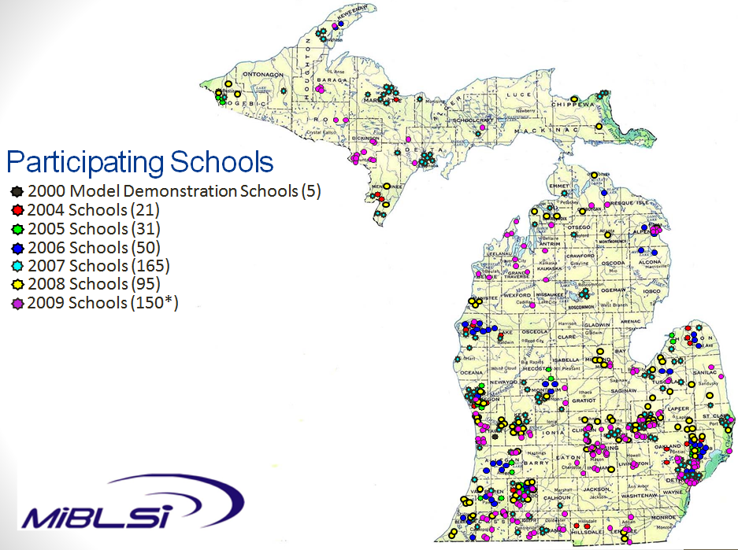
The strategies and organization for initial implementation need to change to meet the needs of larger scale implementation.
Total of 512 schools in collaboration with 45 of 57 ISDs (79%)

Slide 16
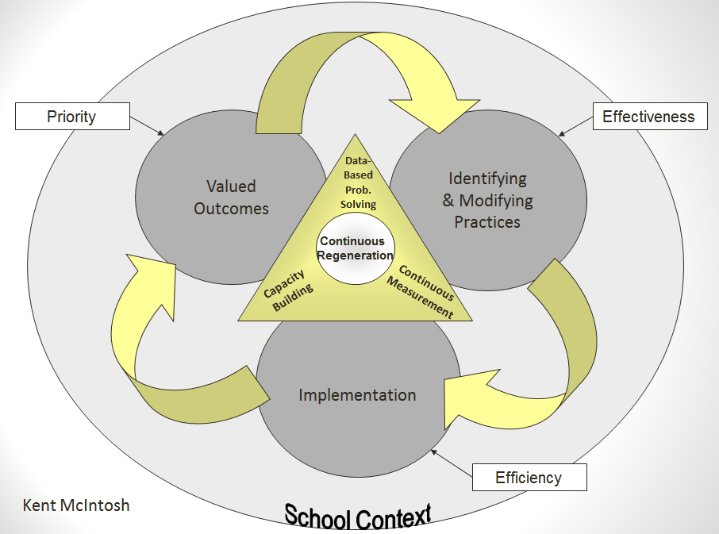

Slide 17
Scaling and Sustaining
Systems Change
District

Slide 18
Organizing Technical Assistance for Scaling and Sustaining Effective Practices
Student is the unit of analysis
School is the unit of intervention
District is the unit of implementation
State is the unit of coordination

Slide 19
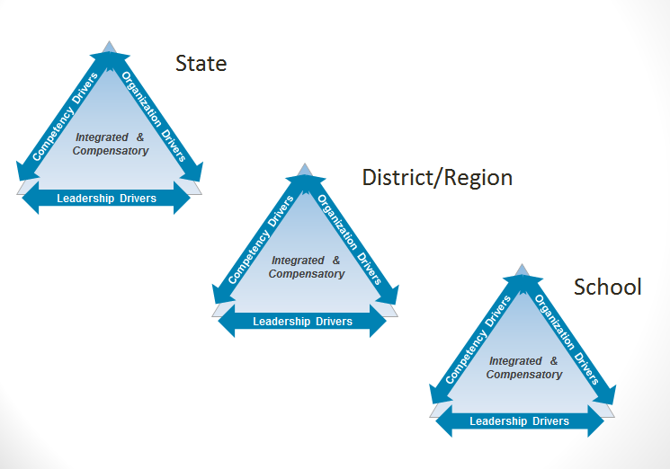
Implementation Drivers
An Active Implementation Framework

Slide 20
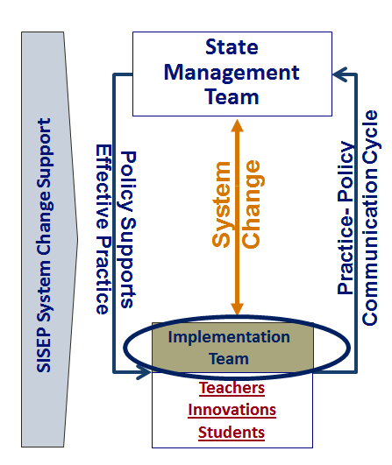
System Reinvention
Adaptive Challenges
Duplication
Fragmentation
Hiring criteria
Salaries
Credentialing
Licensing
Time/ scheduling
Union contracts
RFP methods
Federal/ State laws
Notes:
(c) Dean Fixsen, Karen Blase, Robert Horner, George Sugai, 2008
20
(c) Dean Fixsen and Karen Blase, 2004
20

Slide 21
Summary
Innovation X Implementation = outcome
Select effective practices
Implementation occurs in stages, with emerging development of core “drivers”
Data use is essential but occurs differently across the stages.
Data systems need to build continuous improvement cycles within and across levels of the system.

Slide 22
