Slide 1
Systems Change: Maximizing High-Quality Opportunities for Young Children with Disabilities
Panelists:
Phillip S. Strain, Ph.D., University of Denver
Ruth E. Gallucci, 619 Coordinator, RI
Amy Bunnell, Part C Coordinator, NE
Facilitator: Julia Martin Eile, OSEP

Slide 2
OSEP Disclaimer
2019 OSEP Leadership Conference
DISCLAIMER:
The contents of this presentation were developed by the presenters for the 2019 OSEP Leadership Conference. However, these contents do not necessarily represent the policy of the Department of Education, and you should not assume endorsement by the Federal Government.
(Authority: 20 U.S.C. 1221e-3 and 3474)

Slide 3
Agenda
Overview of 40 Years of Inclusion Research
State Experiences:
Nebraska Early Development Network
Rhode Island’s Itinerant ECSE Service-Delivery Model

Slide 4
A Brief Overview of 40 Years of Inclusion Research
Phillip S. Strain, Ph.D.
Kennedy Endowed Chair in Education
University of Denver

Slide 5
Some Bottom-Line Considerations Regarding Early Childhood Inclusion

Slide 6
Bottom Line Considerations…
High quality inclusive settings are the only environments with data consistently supporting children’s superior learning AND non-inclusive environments have been shown to negatively impact children’s learning.
Fully inclusive options beat the alternative at a ratio of about 15 studies to 1.

Slide 7
Bottom Line Considerations…
Fully inclusive options have been shown to work for children across disability groups and levels of severity (children with developmental delays, mild to severe; children with ASD; children with multiple disabilities; children with significant social and emotional needs; children with hearing impairment; children with limited mobility).

Slide 8
Bottom Line Considerations…
Fully inclusive options tend to be of higher quality in general
Greatest magnitude of effect is social (but also significant differences in communicative, cognitive skills, and challenging behavior)

Slide 9
So What’s the Big Deal About Social Outcomes?

Slide 10
What Having A Friend Means For Later In Life Success
Better academic skills
Higher high school graduation rates
Fewer special education services
Better adult employment status
Greater chance of independent living
Better adult mental health
Less drug/alcohol use in teen years

Slide 11
And What About Typically Developing Children?
Equal or greater cognitive and language skills
Fewer challenging behaviors
More advanced social skills
More accepting attitudes toward individuals who are different

Slide 12
What Do the Better Inclusion Settings Look Like and Operate Like?

Slide 13
More Typically Developing Peers
Ilene Schwartz – DATA Project
Gail McGee – Walden/Early Emory Autism Program
Phil Strain – LEAP Preschool
All began with 50:50 ratio and abandoned that for 2 or 3:1 ratio
Enhances generalization opportunities in social domain
Minimizes behavioral contagion effects around challenging behavior and “autistic-like” behaviors
Minimizes “Buddy Burn-Out”

Slide 14
Everyday, all day long!
No special education in the corner of classes
Not just on Tuesday and Thursday
Not just when related services personnel drive by

Slide 15
Transdisciplinary Service Model
Maximizes instructional generalization opportunities
IEP & IFSP goals get addressed everyday all day
Maximizes consistency of adult-child interactions

Slide 16
Full Utilization Of Peer Influence
Initiate social interactions
Invite others to activities
Take their hand and lead them there
Respond to social bids
Pass-out & Pick-up materials, props
Model desired actions
Praise, compliment peers
Give play directions
Help others complete a task/activity (give assistance)

Slide 17
Predictable, Comprehensible Routines
Daily Schedule
Opening Circle
Calendar
Arrival
Table Time
Opening Circle
Centers
Story Circle
Snack
Outside
Small Groups
Closing Circle
Greeting Song
Calendar
Child Choice Song
Social Skill Lesson
Choosing Centers
Clap the Month
Days of the Week Song
Add Today
Motor Cube
Pattern
Review

Slide 18
Wide Range Of Evidence-based Practices Used And Their Efficacy Assessed Frequently

Slide 19
Data-Based Decision Making
Modification of curricula, materials, activities
Swiftly going to plan B
Communicating progress to families

Slide 20
Practice-Based Coaching
Reaching and maintaining fidelity
Arranging time to coach and plan
Planning for scale-up

Slide 21
Function-Based Approach to Serious and Persistent Challenging Behavior

Slide 22
Nebraska Early Development Network
Nebraska’s IDEA Part C/Early Intervention Program

Slide 23
Nebraska’s Early Intervention System
Co-Lead Administration:
Nebraska Department of Education (NDE),
Office of Special Education
Nebraska Department of Health and Human Services (DHHS), Division of Medicaid and Long-term Care
Birth Mandate State – most EI services provided by school districts
Dedicated EI Services Coordination model – contracted by DHHS

Slide 24
Supporting Inclusion for infants & toddlers in Nebraska

Slide 25
Focus on QRIS
QRIS in Nebraska: Collaboration between DHHS and NDE
Surveyed QRIS coaches re: perceptions and needs in supporting infants/toddlers with disabilities within early care/education settings.
Prioritized emerging trends from survey:
1. How to talk with parents/make a referral if concern with child’s development or behavior
2. Managing challenging behaviors
3. Recognition of and alternatives to suspension/expulsion
4. Training and education on Inclusive Practices

Slide 26
Focus on QRIS
Training/Resources provided to child care and other early care/education settings in partnership with DHHS and other private agencies:
Pyramid training and coaching
Cara’s Kit training
Cradle to Prison Pipeline: Addressing suspensions/expulsions in early care/education
Early Intervention and preschool special education supports and services
DEC Recommended Practices http://www.dec-sped.org/dec-recommended-practices

Slide 27
Focus on Preschool Development Grant Fund/Activities (B-5)
Utilizing State Indicators of High Quality Inclusion through leverage of Nebraska’s PDGF:
Indicator 1: Cross-sector Leadership – DHHS, NDE, Head Start, University/Higher Ed System, Child Care, Private Agencies, Families
Revised State Early Learning Standards/Guidelines (Indicator 6)
Revise QRIS steps to embed Inclusive Practices and related trainings and use of the Quality Inclusive Practices Checklist as a self-assessment tool (Indicator 8 & 9)
Development of PA strategies/trainings promoting inclusion (Indicator 12)
Indicator 8: Allocation of Resources to Support Personnel
Indicator 9: Coordination of Professional Development Resources
via Nebraska’s Early Childhood Training Center; collaboration with Higher Ed, multiple state and private agencies

Slide 28
High Quality Inclusion Supported by Nebraska Part C
Indicator 10: EC Personnel Standards, Certification & Licensing
Indicator 11: Preservice Education and Personnel Preparation
Collaboration with University of Nebraska in development of curriculum to support inclusionary practices for infants/toddlers with disabilities
Provision of tuition assistance to early care/education professionals in accessing coursework

Slide 29
Rhode Island’s Itinerant Early Childhood Special Education Service-Delivery Model (RI-ECSE)

Slide 30
IECSE Service Delivery
Research based service delivery model for providing special education services within the general EC environment
Alternative to pulling children out of the classroom to separate spaces, classes, programs or schools
Allows the IECSE teacher to provide direct service embedded into the typical classroom routines and activities
Through planned and routine collaboration, allows EC teachers to embed instruction throughout the week
Allows services/supports to be provided seamlessly within the child’s natural environment (no unnecessary transitions for children)
Can benefit children with all types and severity of disability

Slide 31
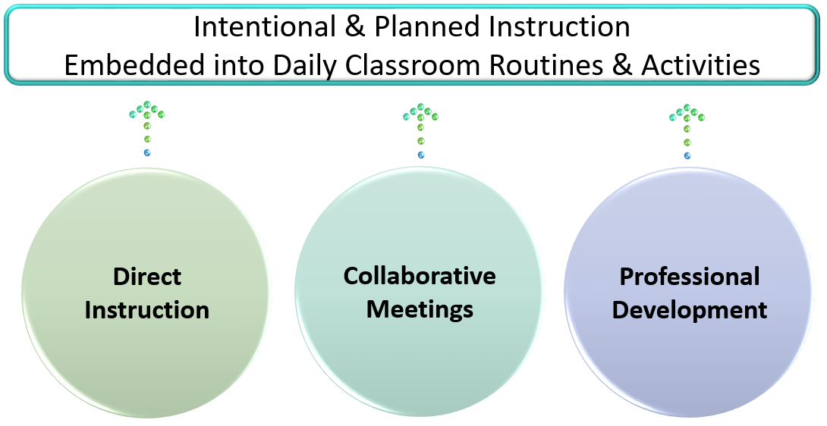
RI-IECSE Anchors of practice

Slide 32
RI-IECSE Anchors of Practice

Slide 33
What’s it all about? WHAT’s it all about?
Embedded Instruction
All special education services are designed to increase access to
learning opportunities, which are distributed and embedded into the general early childhood classroom activities and routines.

Slide 34
Not a “resource” model
The IECSE service delivery model is not the same as the resource model. It is built upon collaboration and embedding instruction throughout the week.
It is not just for children with the most mild delays; children with moderate & severe disabilities also benefit from the IECSE service delivery model.

Slide 35
RI-IECSE Implementation Fidelity Checklist
Draft
Informed by the DEC Recommended Practices http://www.dec-sped.org/dec-recommended-practices)
Purpose:
Increase the understanding of the IECSE provider’s role & to allow for reflection relative to implementation fidelity.
As a self-assessment tool to rate use of IECSE practices, across all students and classrooms.
Clear expectations
See handout

Slide 36
RI-IECSE System of Support
RI-IECSE P.D.

Slide 37
RI-IECSE System of Support

Slide 38
Q&A

Slide 39
Discussion Questions

