Slide 1
Personnel Development Program:
Program Area Check-In 2020
(CFDA 84.325)
Welcome!
Office of Special Education Programs
U.S. Department of Education
July 20, 2020
Notes:
[Post during logon before we begin]

Slide 2
Opening Remarks
Welcome!
Logistics
Today’s Agenda
84.325 (PDP) Investments & OSEP Priorities
Providing Practice Opportunities & Delivering Services Remotely
OSEP Updates &Cross-Project Collaboration Opportunities
What challenges did you face with your PDP project when COVID-19 struck?
… providing practice opportunities for scholars?
…delivering services remotely?
Type your answers
in the Questions box

Slide 3
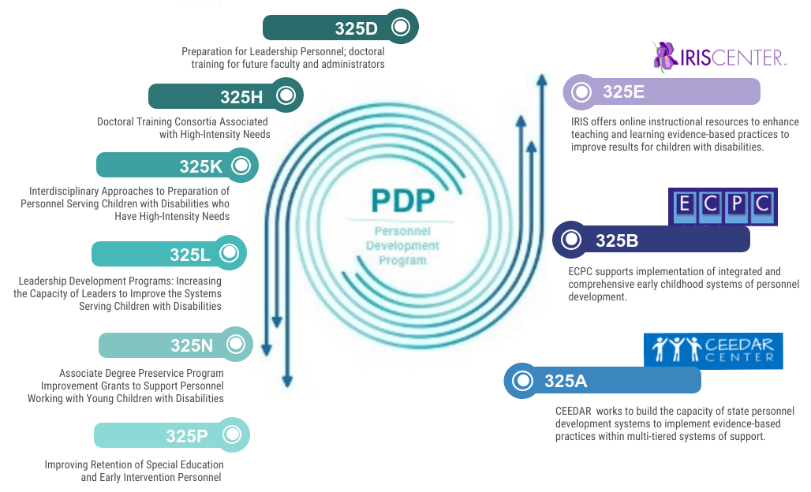
DRAFT
See what you think!
Personnel Development Program

Slide 4

OSEP Expectations for Family Engagement
OSEP Priority: Family Engagement
What expectations
for family engagement
do we have for PDP grants?
… scholars? … personnel?
… child outcomes?
Please type your responses
In the Questions box
Things to Do
Addressed in application
Considered in hiring
Solicited input from advisors
Build capacity of personnel
Enhance systems
Other?
Notes:
[Add “OSEP Expectations for Family Engagement” to Chat box]

Slide 5

OSEP Priority: COVID-19
OSEP Priority: COVID-19
OSEP Resources
Supporting Continuity of Learning
Looking
for
resources
to support
PDP
projects?
Notes:
[Add links to Chat box]
View Department Guidance on IDEA Dispute Resolution in COVID-19 Q-and-A at
https://sites.ed.gov/idea/department-releases-idea-dispute-resolution-covid-19-q-documents/
Additional resources are available at
OSEP IDEAS That Work
https://osepideasthatwork.org/continuity-learning-during-covid-19
ECTA
https://ectacenter.org/
NCSI
https://ncsi.wested.org/
U.S. Department of Education
https://www.ed.gov/coronavirus?src=feature

Slide 6
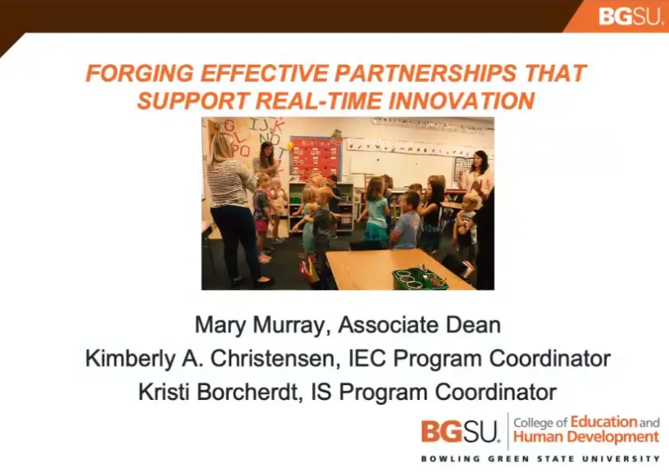
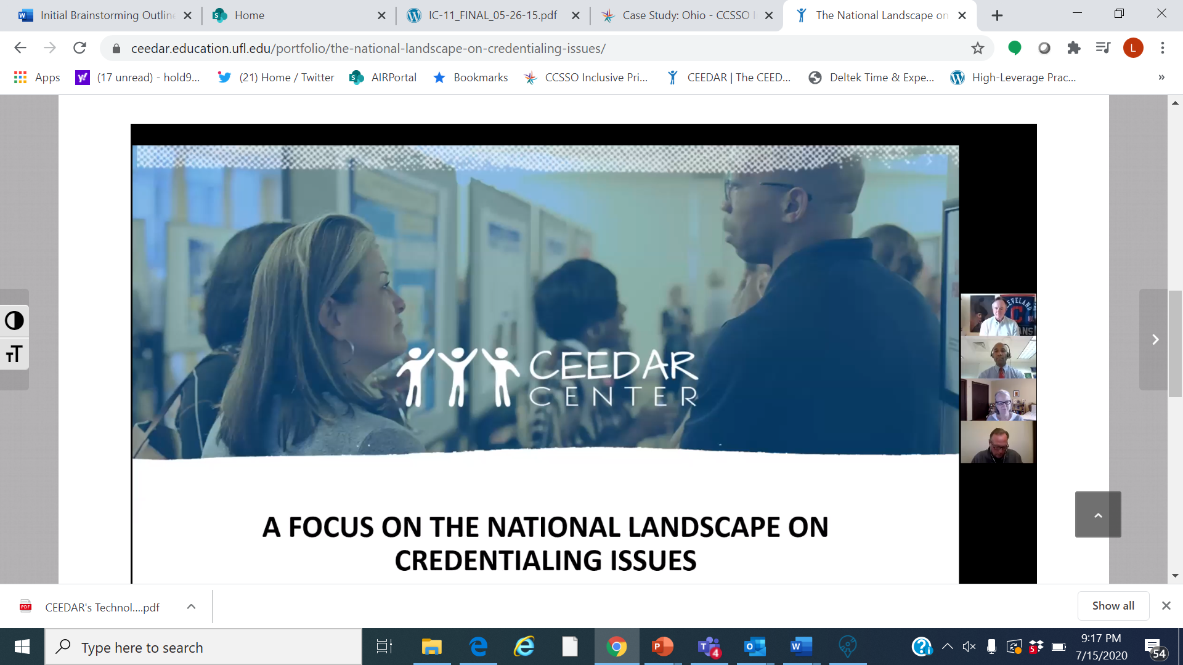
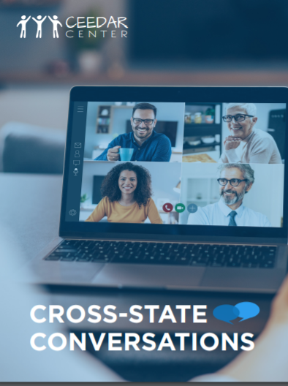
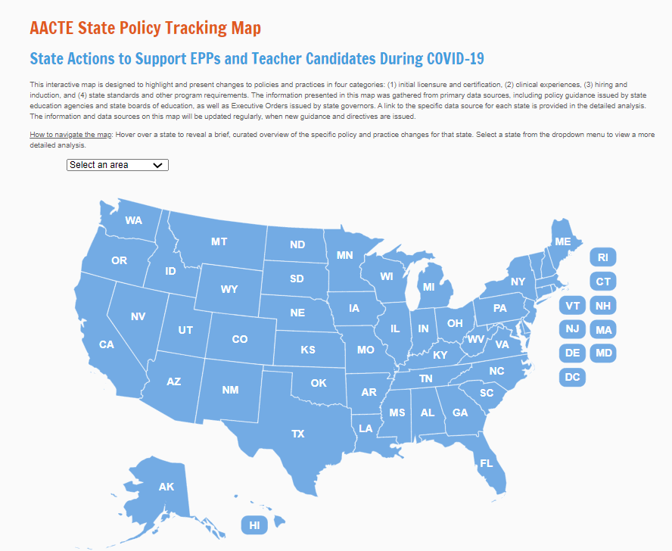
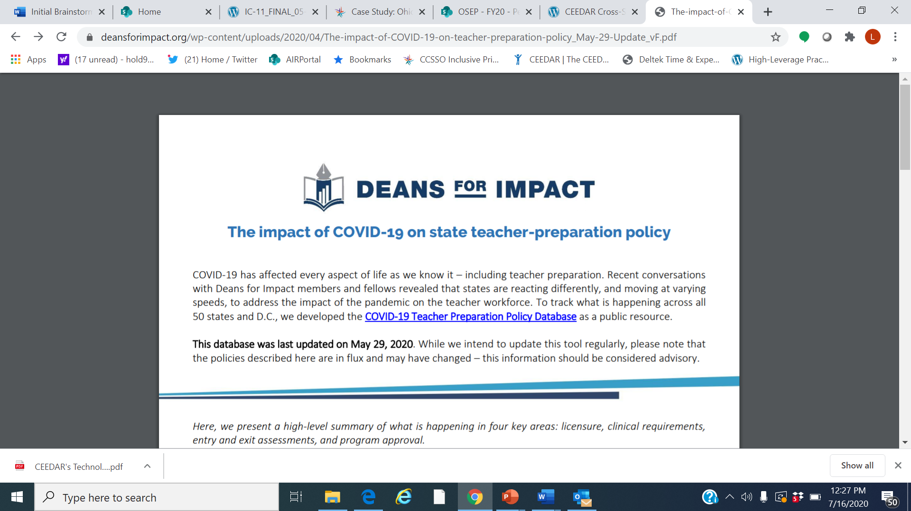
Educator Preparation
Discussions
What challenges did you and do you anticipate in providing practice opportunities for “scholars” due to COVID 19?
  COVID Implications
    Certification and Licensure
    Assessment
    Clinical Practice Requirements
Databases
Notes:
[Lynn: Please ask participants to type their questions in the “Questions” box.]

Slide 7


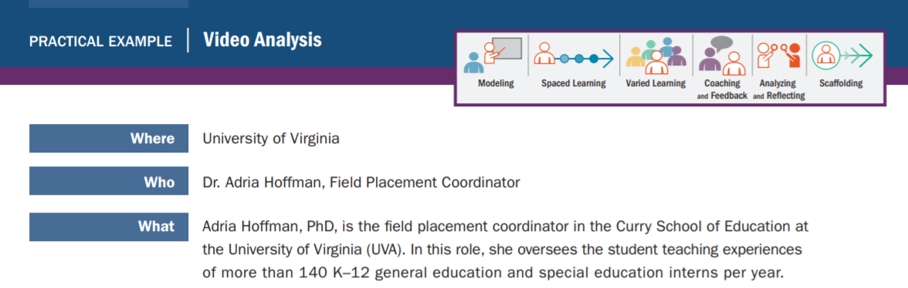
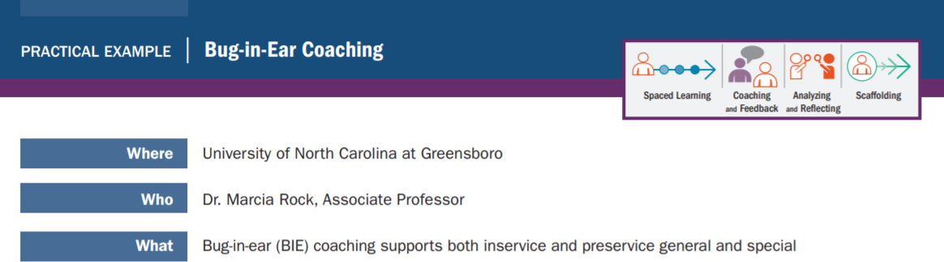
Turning Trying Times into Opportunity
  Establishing and Retaining the Educator Workforce

Slide 8
Preparing Doctoral Students to Become Special Education Leaders: Research, Personnel Preparation, and Policy
Preparation of Special Education, Early Intervention, and Related Services Leadership Personnel
CFDA: 84.325D
Project Family IMPACT I (H325D150036)
Project STePS (H325D180023)
Project Family IMPACT II (H325D190020)
Project Co-LEAD (H325D190043) (University of Oregon & Purdue University)
Hedda Meadan, Ph.D., BCBA-D
meadan@Illinois.edu

Slide 9

Partnering with Families
DEC Family Practices
Family-centered practices
Family capacity-building practices
Family and professional collaboration
www.dec-sped.org/recommendedpractices

Slide 10
Building Relationships With Families
  Connecting with parents/caregivers based on parents’ priorities, interests, needs, goals, and experiences.
  Asking about the parents/caregiver vision for their child and their family.
  Building rapport with families.
  Establishing cultural reciprocity

Slide 11

Adult Learning Theory
Introduce
Mastery
Illustrate
Reflect
Practice
Evaluate

Slide 12





Adult Learning
“I see and
I forget.
I hear and
I remember.
I do and
I understand.”
-Confucius
Adult Learning
After 2 weeks we tend to remember…
+
+
Adapted from Edgar Dale (1969)

Slide 13

Cascading Model
Training and Coaching Professionals to Work with Families
Caregiver
Child
Professional
Caregiver
Child
Researcher/Scholar
Professional
Caregiver
Child
Professional
Caregiver
Child
Caregiver
Child

Slide 14
Cascading Model
Training and Coaching Professionals to Work with Families
Caregiver
Child
Professional
Caregiver
Child
Researcher/Scholar
Professional
Caregiver
Child
Professional
Caregiver
Child
Caregiver
Child

Slide 15
Cascading Model
Training and Coaching Professionals to Work with Families
Caregiver
Child
Professional
Caregiver
Child
Researcher/Scholar
Professional
Caregiver
Child
Professional
Caregiver
Child
Caregiver
Child

Slide 16
Cascading Model
Training and Coaching Professionals to Work with Families
Caregiver
Child
Professional
Caregiver
Child
Researcher/Scholar
Professional
Caregiver
Child
Professional
Caregiver
Child
Caregiver
Child

Slide 17
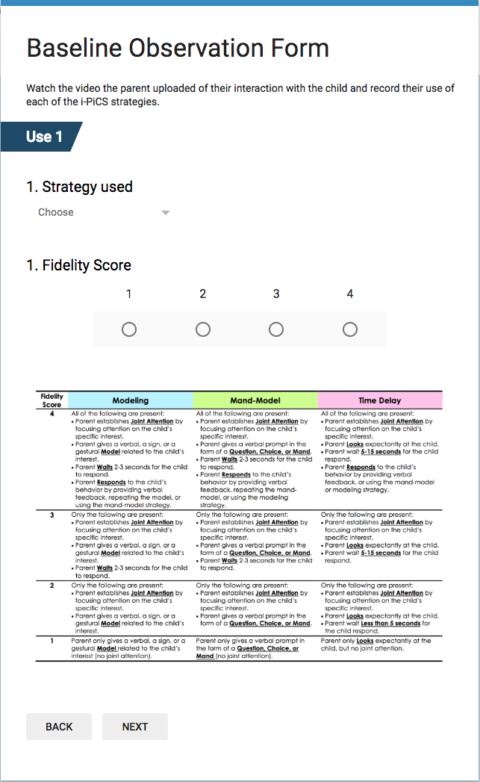
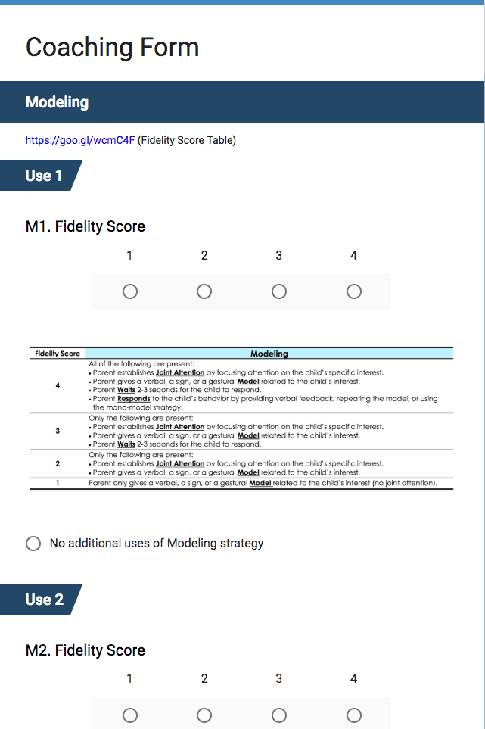
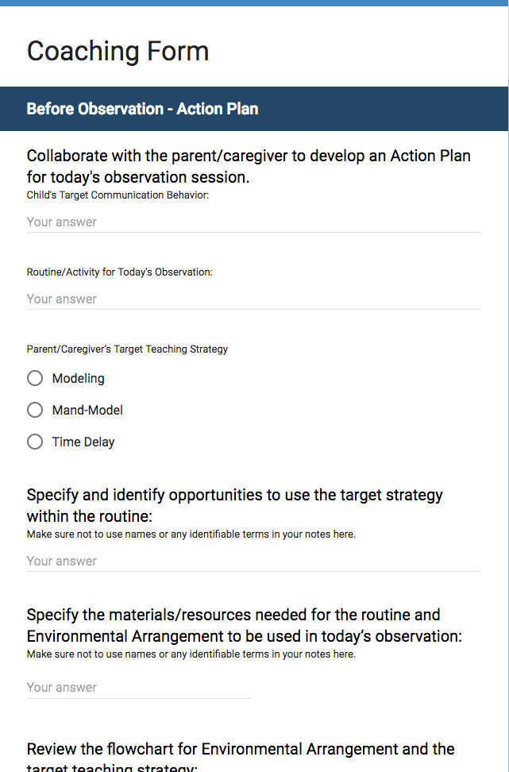
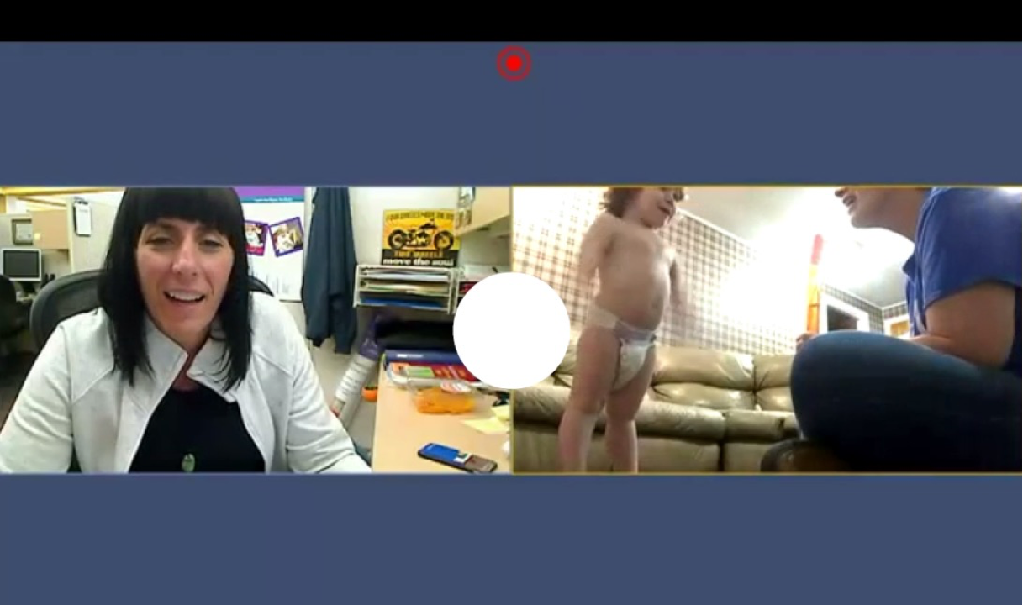




Technology
Technology
Supporting Practice Opportunities and Field Experience
Developing Knowledge:
Readings, case studies, video examples, coding videos, role playing
Developing Skills:
Observing scholars and providing supportive and corrective feedback, working in teams, self-observations

Slide 18
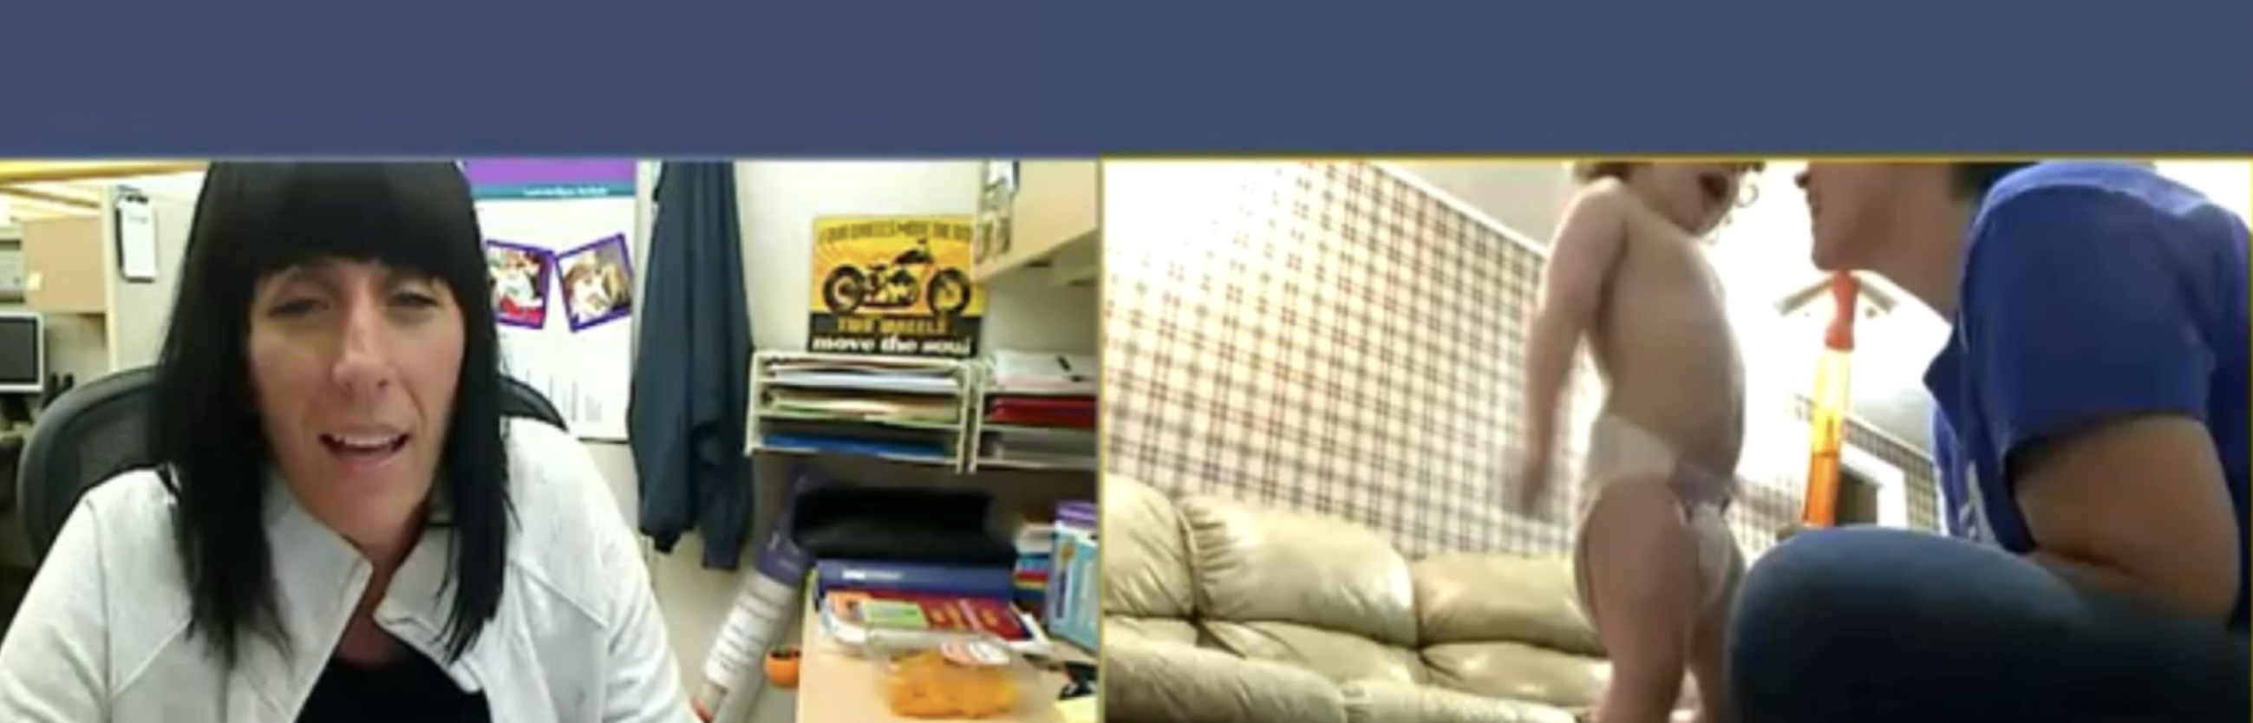
Video
VIDEO

Slide 19

Channon K. Horn, Ph.D.
University of Kentucky
Traditional, 4-year, special education with dual licensure program
21 Candidates fulfilling Student Teaching Requirements
18 Candidates completing an advanced practicum experience
channon.horn@uky.edu

Slide 20

Embedded Opportunities
Student Teaching
8 weeks High Incidence Disabilities
8 weeks Low Incidence Disabilities
One elementary setting
One middle or high school setting
70 day minimum
Advanced Practicum
Semester Long
8 hour minimum per week
Low incidence setting
Assigned tasks

Slide 21
The Swift Shift
Candidates in low incidence settings met individually or with smaller groups of students.
  Varied depending on the needs of the student
  Guardian availability (not all instruction occurred between the hours of 7:45 and 3:00)
Materials were developed and disseminated in the preferred modality.
  Hard copies were available for those without access to technology
  PPTs of adapted books with voice over were created with questions and feedback embedded throughout

Slide 22
The Swift Shift
Zoom, Google Voice, Flip Grid, and video models were frequently utilized
  Zoom candidates had previous familiarity with and utilized with ease
  Google Voice allowed candidates to maintain professional boundaries
  Flip Grid was introduced, and candidates utilized to record instruction but also as a tool to access student acquisition
  Video Models were essential for secondary students and math content
IRIS Center Modules were available when virtual instruction was not possible

Slide 23
Mutually Beneficial
Parents benefited from observing and being taught how to implement instructional strategies.
  Use of Constant Time Delay
  Behavior Specific Praise
  Corrective Feedback
Cooperating teachers benefited from having materials and lessons created and implemented by candidates.
  Materials were shared across settings
  Candidates were able to assist multiple educators when time allowed
Rural school districts requested the services of our candidates in developing and implementing instruction.

Slide 24
Lessons Learned
Increased contact with candidates is paramount.
  High touch philosophy was utilized.
  Encouragement is essential.
  Mental Health mindfulness is key.
Flexibility is essential but expectations must remain consistent
  Clear expectations for the number of hours students must spend actively engaged with students or materials.
  Google Doc was utilized to monitor hours spent daily.

Slide 25
Lesson Learned
Collaboration was enhanced between candidates and their cooperating teachers.
  Shared materials.
  Shared ideas
  Shared previous knowledge of learners.
Feedback indicates it was effective but not preferred.
  “I love seeing their sweet faces, but I miss being with them in the classroom.”
  ”I know for sure I can adapt, modify, and develop materials for my students.”
  All candidates seeking a teaching position have obtained one.
Notes:
Collaboration was enhanced between candidates and their cooperating teachers.
Shared materials
Shared previous knowledge of learners
Feedback indicates it was effective but not preferred.

Slide 26
Questions or Comments?
 | Type Questions or Comments in the Questions box
Notes:
[Mary & Lynn]

Slide 27
DaShaunda Patterson, Ph.D.
DaShaunda Patterson, Ph.D.
Clinical Associate Professor
Georgia State University
Work was developed and refined
through State Leadership Teamwork with CEEDAR
Serve currently as a co-lead for the CEEDAR
High Leverage Practices/Clinical Practice Topical Action Group

Slide 28
Description
Title of Practice Based Opportunity: Structured Video Analysis of HLP (Patterson, D., Driver, M.K., Zimmer, K., & Wetherington, P., 2019)
Description: In this PLO, we provide an example of how structured video analysis is used to develop knowledge about and successful implementation of HLP #16: Explicit Instruction.
Target: Traditional and Alternative Preparation Candidates
Context: Methods Class and Level 1 Practica/Field Experience

Slide 29
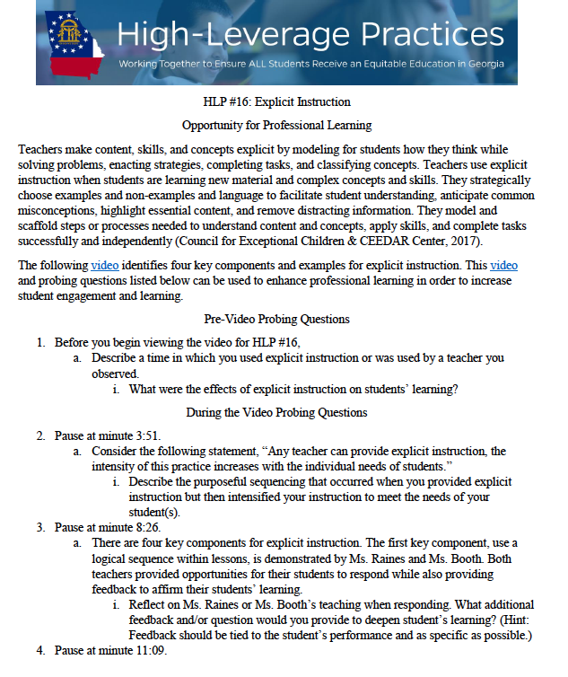
Example of PLO

Slide 30
Preparation of Candidates for PLO
Develop proficiency in prerequisite knowledge of explicit instruction components
Develop proficiency in identifying and modeling relevant HLPs
Model components through demonstrations within coursework
Practice observing instruction for target skills prior to PLO

Slide 31
Implementation Considerations
Timing of coursework in relation to field experiences
Candidate autonomy in planning and implementing instruction
Setting for reflection and/or debrief of the analysis

Slide 32
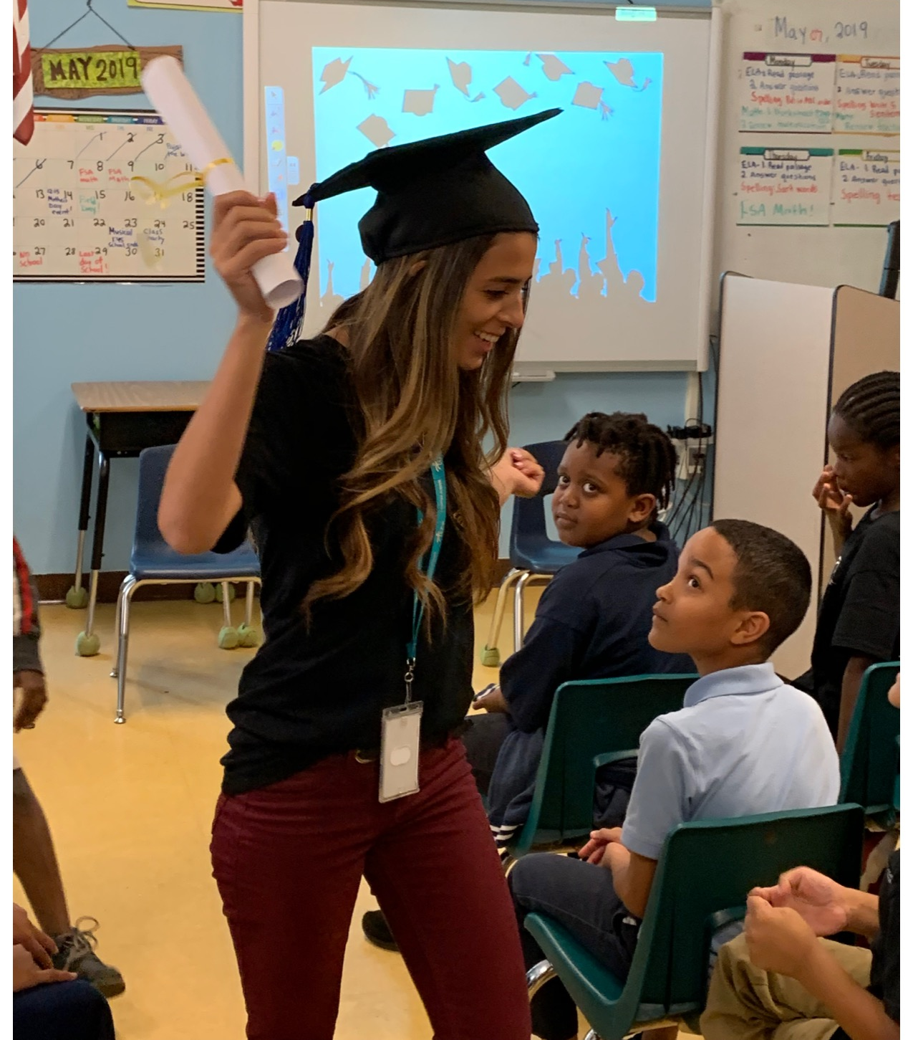
Moving Community-Embedded Teacher Preparation Online
Moving
Community-
Embedded
Teacher
Preparation
ONLINE
Rebecca A. Hines
University of Central Florida
Rebecca.Hines@ucf.edu
84.325D Preparing Scholars to Lead Inclusion and Transition (LEADIT)

Slide 33
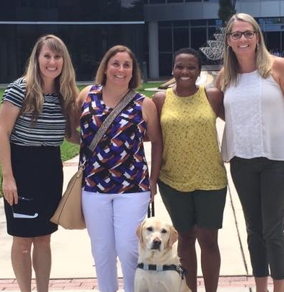



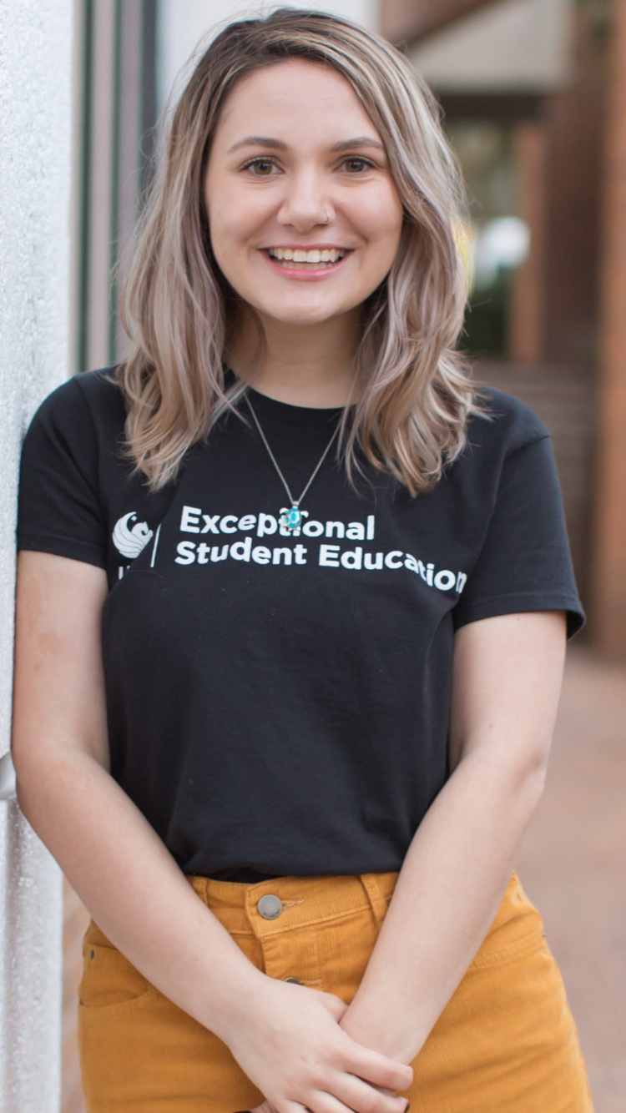
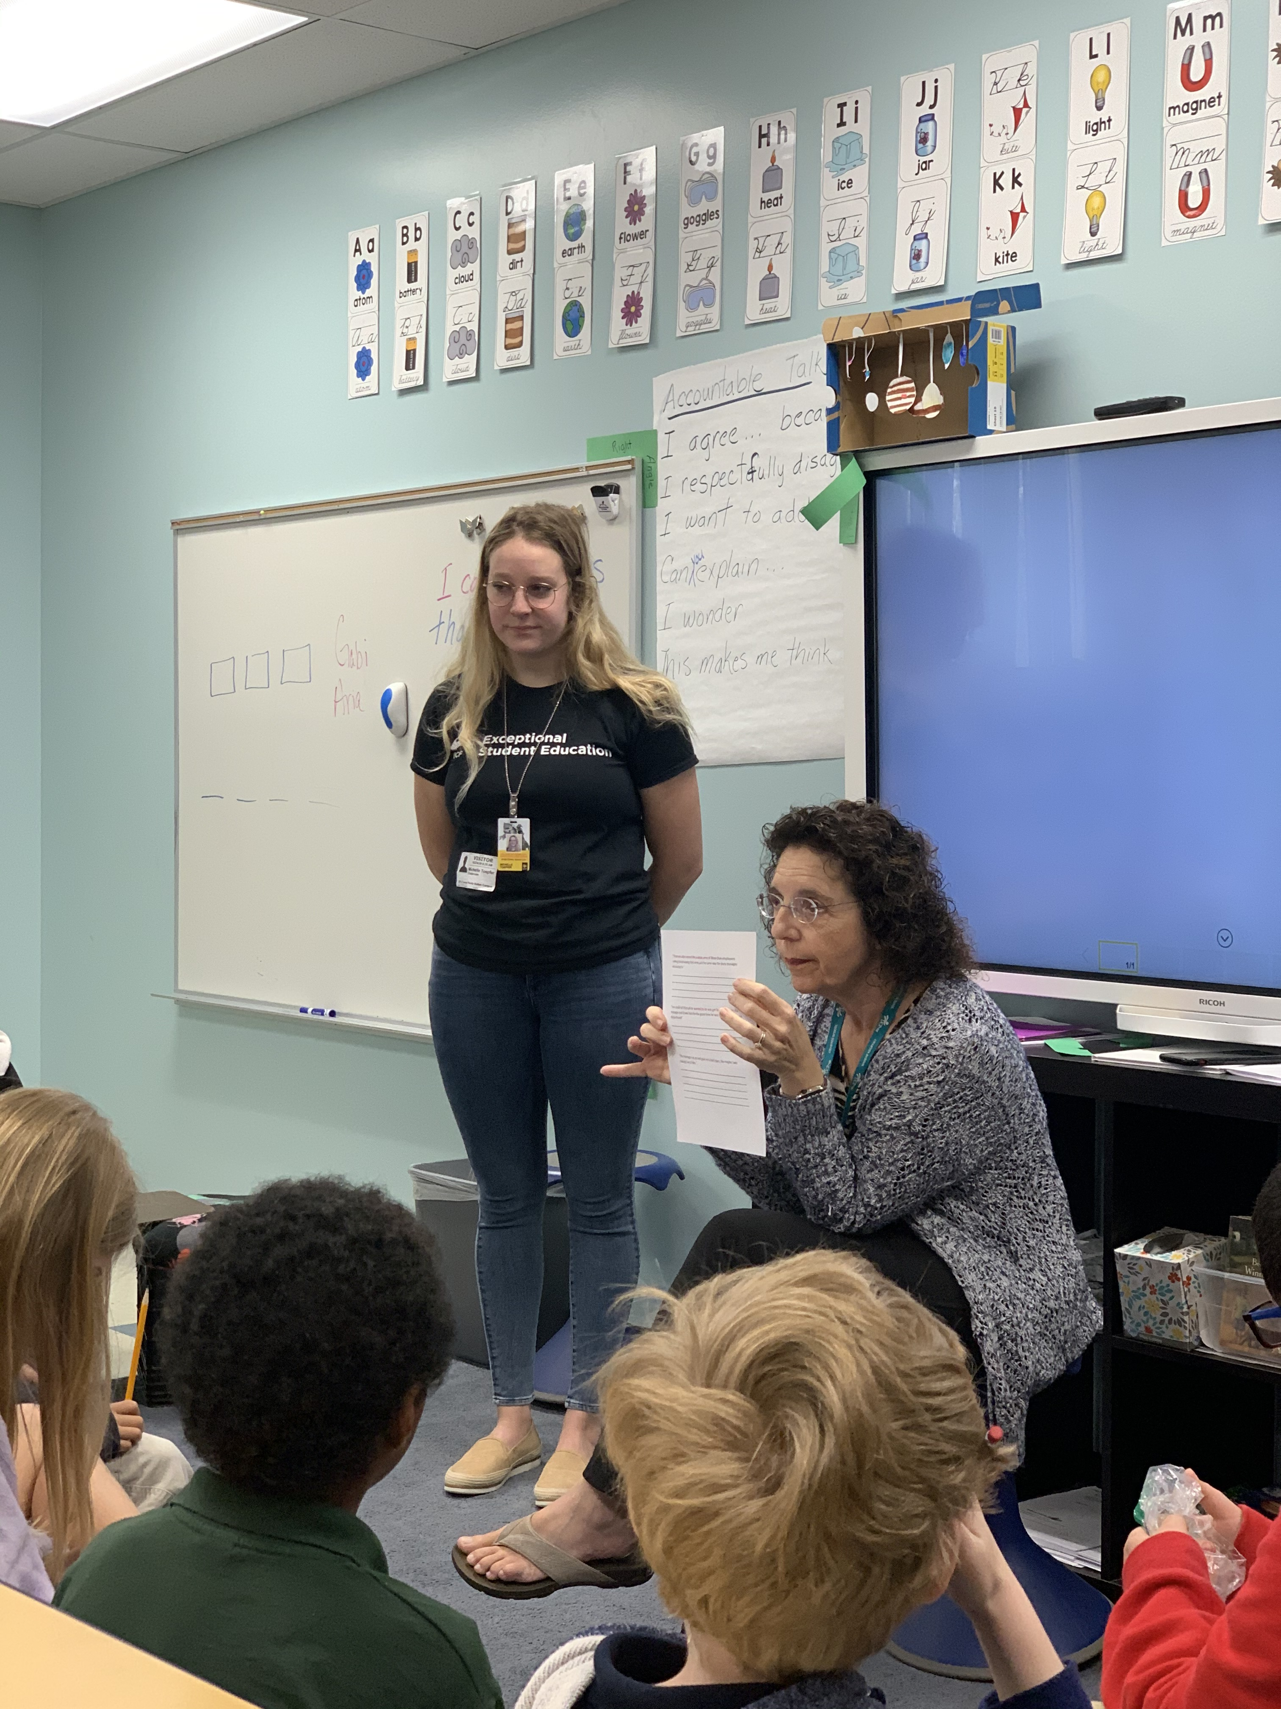


UCF School of Teacher Education
Notes:
Kotter – establish a coalition of stakeholders
Partner School established - a formal MOU was established with UCP of Central Florida, who pledged to provide mentor teachers, and allow our preservice teachers to be embedded in their schools for authentic, immersive experiences in inclusive classrooms.
Additionally, an MOU was revised with OCPS to allow preservice teachers to be working as full-time paraprofessionals in classrooms while completing fieldwork, internship, and/or practicum

Slide 34

Our goal is to make a visible
IMPACT in local schools every semester

Slide 35
Meeting Needs During Closures
Partner Schools
Preservice Teachers
Doctoral Scholars
Need for immediate innovation, training, and support
Trained in distance delivery, innovative thinking
Engrained in school culture through residencies
Need for research opportunities
Need for continued practice opportunities

Slide 36
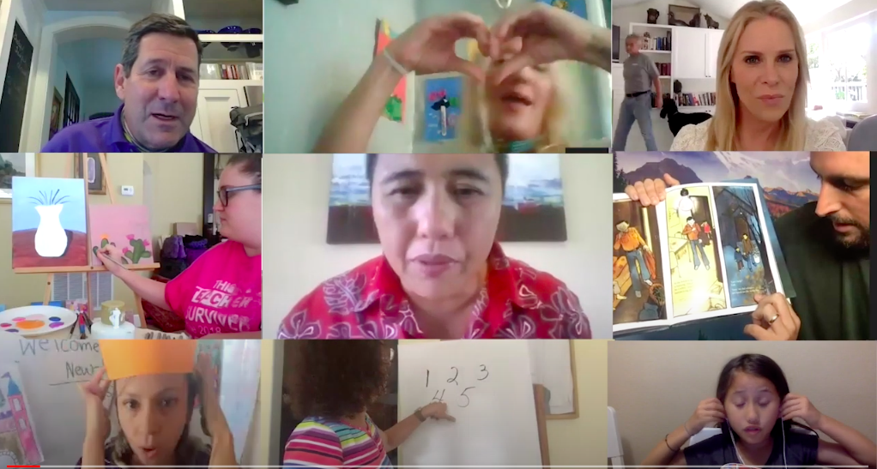
Working as a Community
Working as a Community

Slide 37

Leveraging Talent and Teamwork
Leveraging Talent & Teamwork
Notes:
https://www.youtube.com/watch?v=zDr3LOXDWHA&feature=youtu.be

Slide 38

UCP Online
Focus on Accessibility?

Slide 39
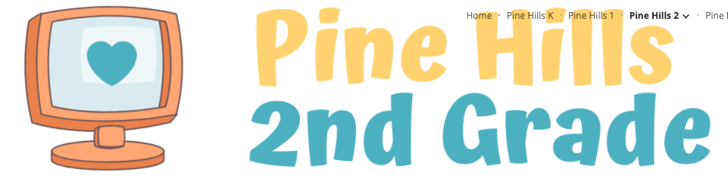
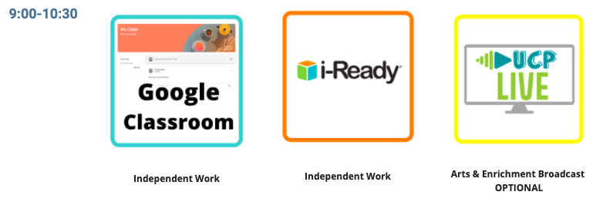
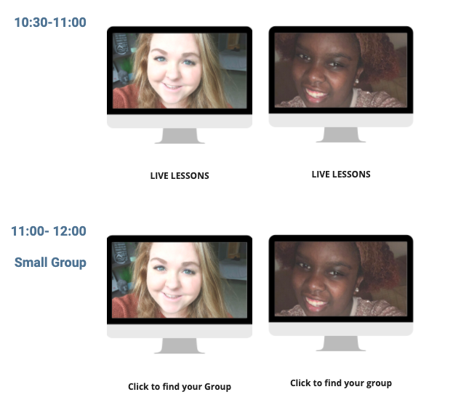
Pine Hills 2nd Grade Daily Schedule

Slide 40
Practice-based Opportunities
Undergraduates
Doctoral Scholars
Recorded job fair lessons
Led online groups for students of all levels
Designed UCP LIVE full-day streaming
Participated with in-service teachers to provide daily stream to students of all abilities
Consulted with undergraduates

Slide 41
Considerations for preparing students for this type of work in the future

Slide 42

Considerations
Have a clear Mission across program levels so doctoral scholars can support underclassmen and community partners know what we collectively “bring to the table”

Slide 43

Reinforce “sand-box” approach to technology rather than teaching specific tools/tech

Slide 44
5 Stages of Service Learning
Focus on Service Learning
rather than volunteering

Slide 45

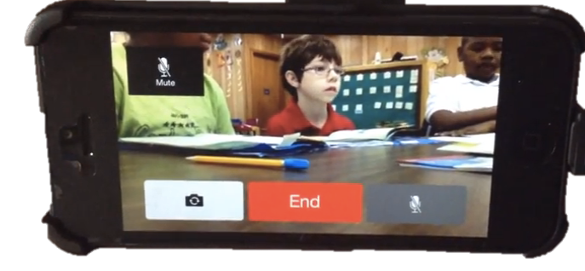
Embed Remote Audio Coach and Other Tools in Coursework
Embed Remote Audio Coaching
and other tools in coursework
Scheduling Observations
Use this site to schedule observations for the following:
___________________________________________________________________________________________
EEX 3241- Schedule the 4 Coaching Sessions that correspond to specific course modules as noted in Webcourses. You will implement a specific strategy as assigned in the course. Be prepared by completing the module and readings prior to the coaching session. Have your bluetooth receiver ready and accept the call at the scheduled time. Inform your coach which assignment you are completing.
________________________________________________________________________________
Internship 1- Schedule a time for your Midpoint Evaluation and your Final Evaluation as noted in the schedule. Midpoint evaluations are the second week in October; Final evaluations are the last week of November. You should have arranged two observations by your supervising teacher before each observation. Submit a lesson plan in Webcourses prior to the evaluation observations.
______________________________________________________________________________________
Practicum/IND Study- Schedule a time for a Midpoint Evaluation and your Final Evaluation as noted in the schedule. Midpoint evaluations are the second week in October; Final evaluations are the last week of November. You should have arranged two observations by your supervising teacher before each observation. Submit a lesson plan in Webcourses prior to the evaluation observations. Instructions for conducting remote observations will be posted on the course website.

Slide 46
Questions or Comments?
 | Type Questions or Comments in the Questions box
Notes:
[Mary & Lynn]

Slide 47
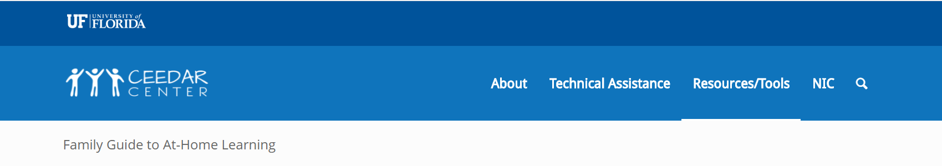

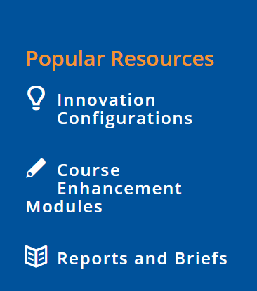
CEEDAR
Notes:
[Add link to Chat box]
https://ceedar.education.ufl.edu/wp-content/uploads/2020/05/CEEDAR-Family-Guide.pdf

Slide 48


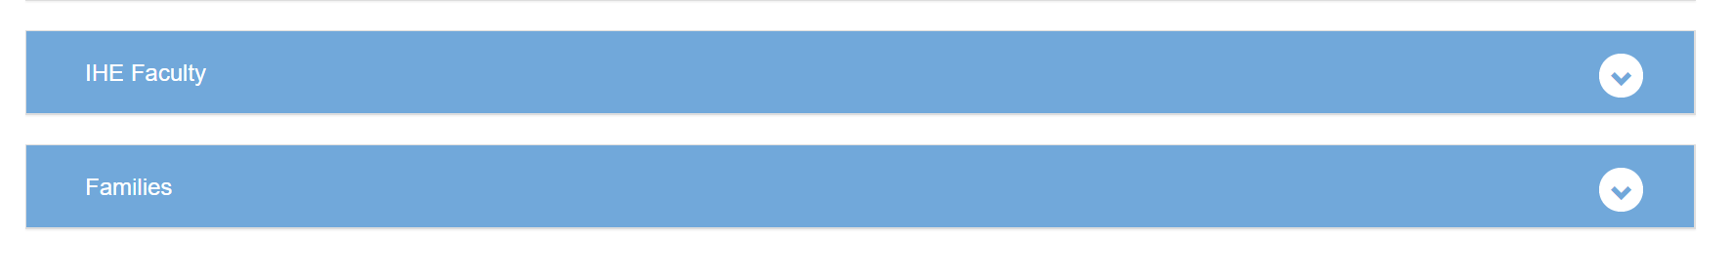
ECPC

Slide 49

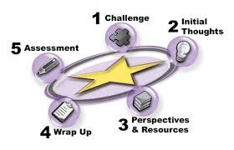
IRIS
New IRIS Module
Coming Soon!
For Faculty: Online/Hybrid Course Design
Developed to help faculty re-design their face-to-face courses for hybrid, Hyflex, or online formats, this module provides a step-by-step approach to help users:
Determine learning goals
Identify, design, and implement synchronous and asynchronous
  assessments
  course assignments
  learning activities
Structure a course in ways that
  promote belonging
  foster student engagement
  ensure equity and access
Learn about digital tools to support course implementation
Notes:
This new IRIS Module features content from the Online Course Design Institute offered by Vanderbilt University’s Center for Teaching (https://cft.vanderbilt.edu/ocdi/) and is based on the Understanding by Design framework by Wiggins and McTighe.

Slide 50
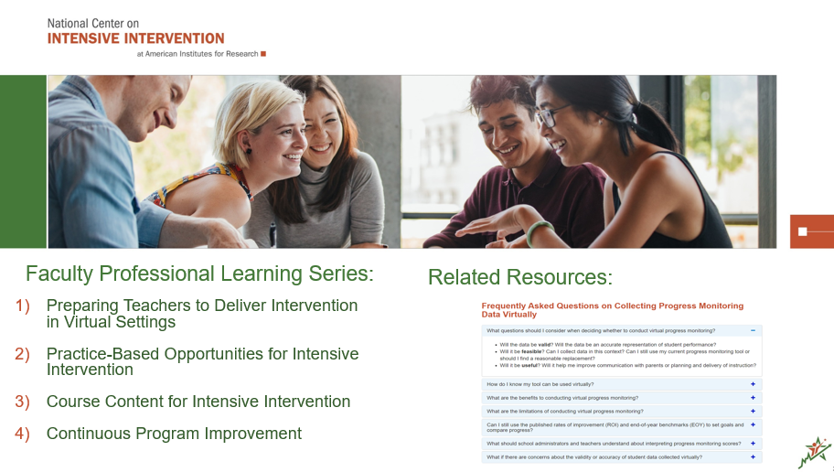
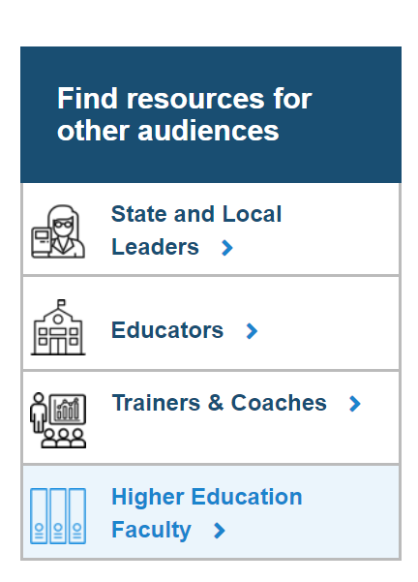
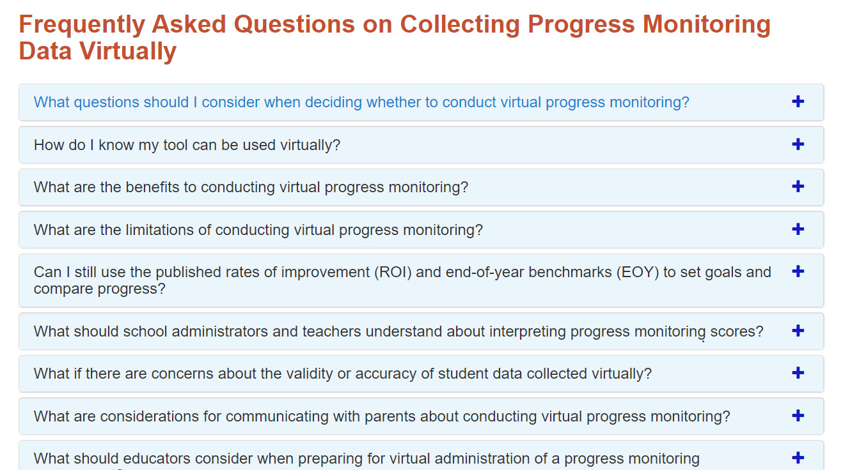
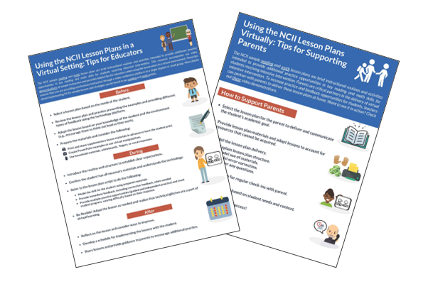
NCII
Resources for Supporting Continuity of Learning
Notes:
https://ncii

Slide 51


PBIS
Resources for Supporting Continuity of Learning
Returning to School During and After Crisis: A Guide to Supporting States, Districts, Schools, Educators, and Students through a Multi-Tiered Systems of Support Framework during the 2020-2021 School
Notes:
https://pbis.org

Slide 52
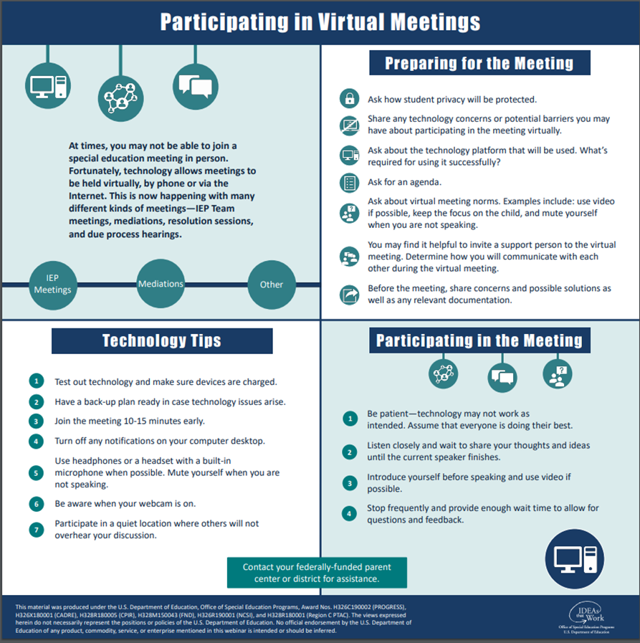
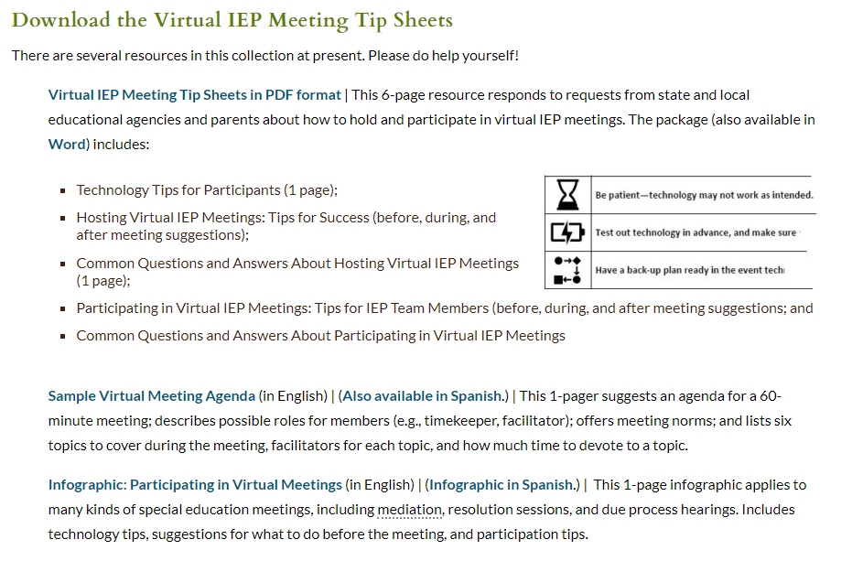
Virtual IEP Meeting Tip Sheets
Resources for Supporting Continuity of Learning
ParentCenterHub.org
Notes:
[Add link to Chat box]
https://parentcenterhub.org/virtual-iep-meeting-tip-sheets/

Slide 53
Resources to Share?
 | What do you have to share? What are you looking to find? Type in the Questions box

Slide 54
PDP Cross-Project Collaboration: The Logic
OSEP and the grantees across PDP Grant Programs learn from and with each other to inform policy and influence practice
OSEP provides support to attract, prepare and retain personnel through PDP
PDP Grant Programs address common and unique challenges
Notes:
[Joanne]

Slide 55
PDP Cross-Project Collaboration: The Value
Share approaches to
technical challenges
Systems
Policies
Processes
Content
Implementation
Competencies
Assessment
Quantitative Data
Evaluation
Learn together about
adaptive challenges
Beliefs
Biases
Culture
Competences
Practices
Understanding
Collaboration
Qualitative Data
Evaluation

Slide 56
PDP Cross-Project Collaboration: The Vision
PDP Cross-Project Collaboration: The Vision
Build an active community of grantees, scholars, and OSEP staff
Interact regularly
Identify topics of importance
Share their own leaning
Build shared meaning
Turn to each other with challenges and opportunities
Draw on the work of other OSEP investments
Co-create shared messages and tools

Slide 57
PDP Cross-Project Collaboration: The Plan
Updates to
OSEP IDEAS That Work coming soon!
Join PDP Listserv
  Get updates and opportunities
  Learn about PDP events
  Share announcements
Revisiting OSEP Webinars from PDP Perspective: Three-Part Series on Supporting Learning During COVID-19
PDP Cross-Project Collaboration Series: Project directors and co-project directors with a focus on current and emerging issues
PDP Scholar Series: Scholars focus on their roles in translating research to practice, policy, teaching, and more…

Slide 58
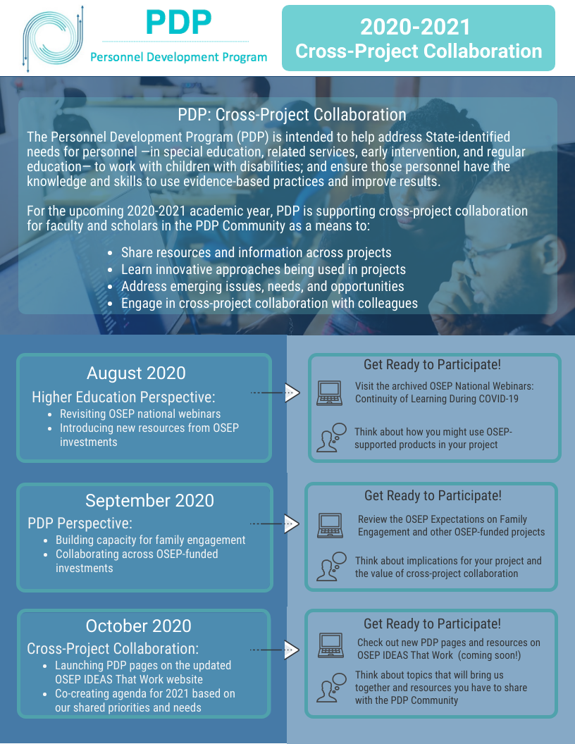

PDP: Cross-Project Collaboration
PDP: Cross-Project Collaboration
  Who
  What?
  When?
  Where?
  Why?
Type your ideas
in the Questions box

Slide 59
OSEP Updates & Announcements
Notices Inviting Applications
84.325P - Improving Retention of Special Education Teachers and Early Intervention Personnel
84.327F - National Center to Improve Faculty Capacity to Use Educational Technology in Special Education, Early Intervention, and Related Services Personnel Preparation and Leadership Personnel Preparation Programs
Notes:
[Add links to Chat box]
325P: https://www2.ed.gov/programs/osepprep/applicant.html
327F: https://www2.ed.gov/programs/oseptms/applicant.html#84327f

Slide 60

Questions I Comments

Slide 61
Thank You!
Thank You!

