Slide 1
OSEP Disclaimer
2018 OSEP Project Directors’ Conference
DISCLAIMER:
The contents of this presentation were developed by the presenters for the 2018 Project Directors’ Conference. However, these contents do not necessarily represent the policy of the Department of Education, and you should not assume endorsement by the Federal Government.
(Authority: 20 U.S.C. 1221e-3 and 3474)

Slide 2
Slide 1
Office of Special Ed Programs
U.S. Department of Education
Arlington, VA July 23, 2018
Using Data and
Analytics to Eliminate
Achievement Gaps
Timothy M. Renick, Ph.D.
Sr. Vice President for Student Success
twitter: @tim_renick

Slide 3
The Challenge in Front of Us
82.4%
Top Income Quartile
40.2%
36.1%
Third Income Quartile
14.9%
16.5%
Second Income Quartile
10.9%
Bottom Income Quartile
6.2%
8.3%
Source: New York Times, “The Reproduction of Privilege,” March 12, 2012

Slide 4
Percent of Low-Income Students in Public Schools
United States 51%
Mississippi 71% Tennessee 58%
N. Mexico 68% Alabama 58%
Louisiana 65% California 55%
Arkansas 61% N. Carolina 53%
Oklahoma 61% W. Virginia 52%
Texas 60% Delaware 51%
Georgia 60% Nevada 51%
Utah 59% Arizona 51%
Florida 59% Hawaii 51%
S. Carolina 58% Illinois 50%
Source: Southern Education Fund

Slide 5
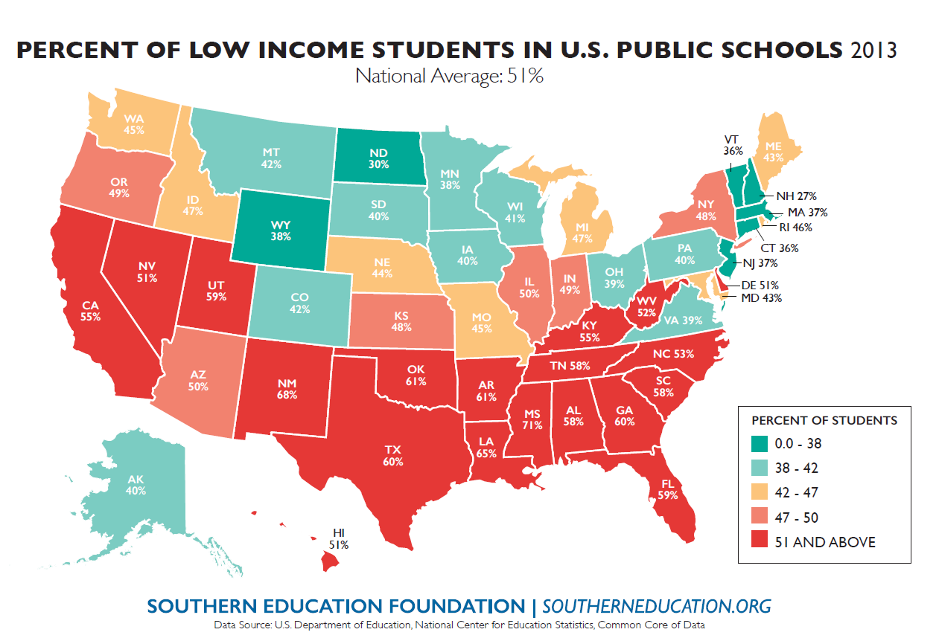
Changing Demographics
No FLC
FLC
No FLC
FLC

Slide 6
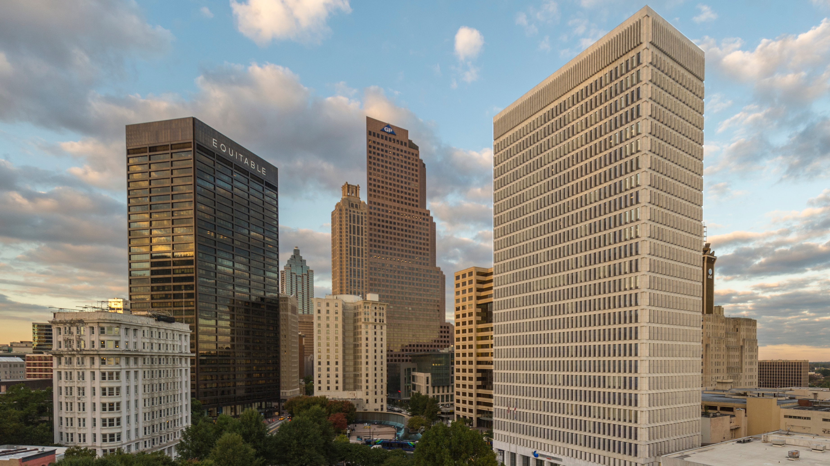
Slide 5
32,500 Students on the Atlanta campus
Research University status achieved in 1995
50,000+ Students as of 2016 with Perimeter College Consolidation

Slide 7
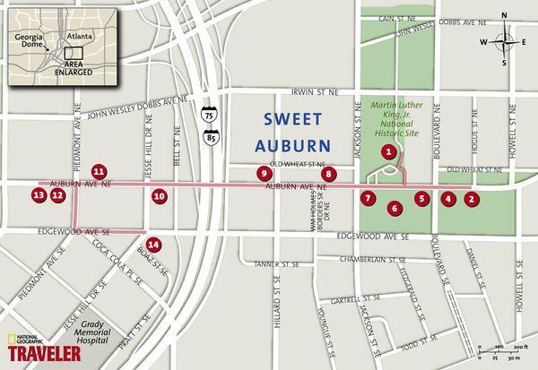
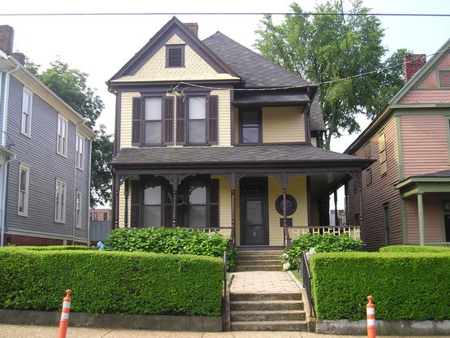
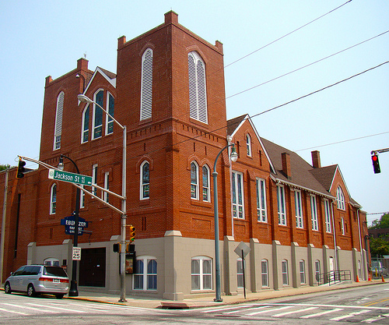
Slide 6

Slide 8
Graduation Rates by Race & Ethnicity
Where we were: 2003
WHITE
AFRICAN
AMERICAN
HISPANIC
No FLC
FLC
No FLC
FLC

Slide 9
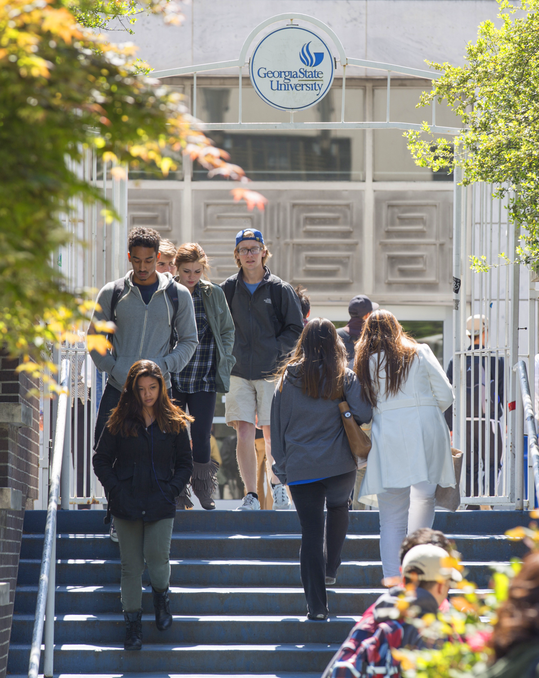
Changing Demographics: Race & Ethnicity

Slide 10
Low-Income Students

Slide 11
Slide 10
SAT SCORES
-33 points

Slide 12
Slide 11
Appropriations Cuts
-$40 million

Slide 13
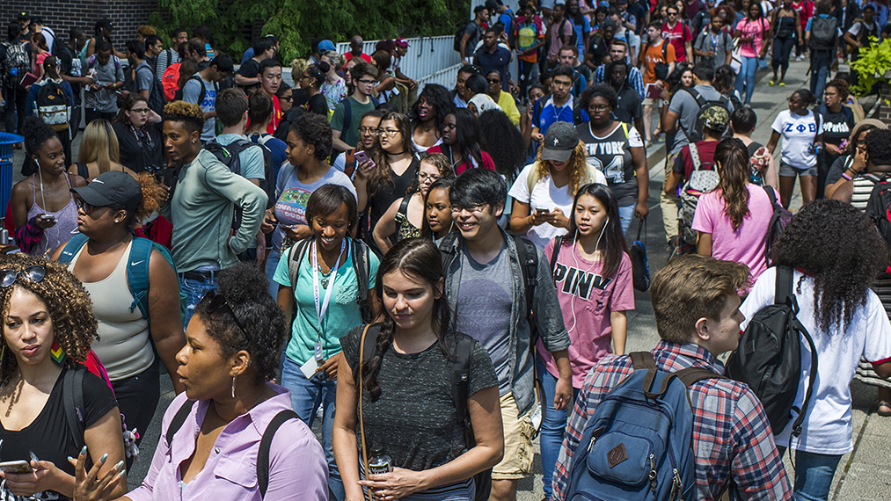
Slide 12
Are We the Problem?

Slide 14
Slide 13
Challenge:
Summer Melt

Slide 15
Summer Melt
Fall 2015
Confirmed GSU Freshman Who
Never Attended Any College: 278
Non-white 76%
First Generation 45%
Low Income 71%
Avg. High School GPA 3.34

Slide 16
The Hidden Obstacles to Enrollment
Federal Financial
Aid Application
Verification Request
State of Georgia
Immunization Proof
Taking Placement
Exams
Registering for Classes

Slide 17
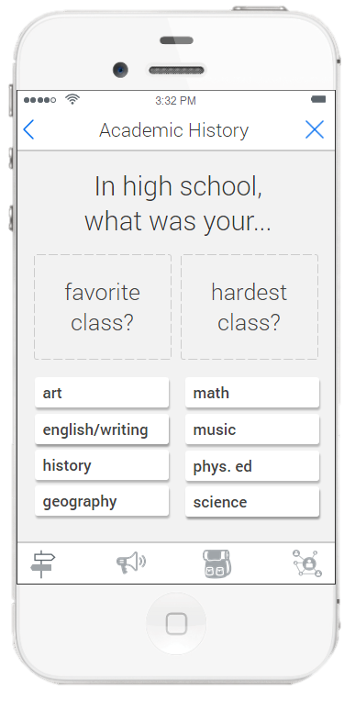
Personalized Interactions Before Enrollment Source: EAB

Slide 18
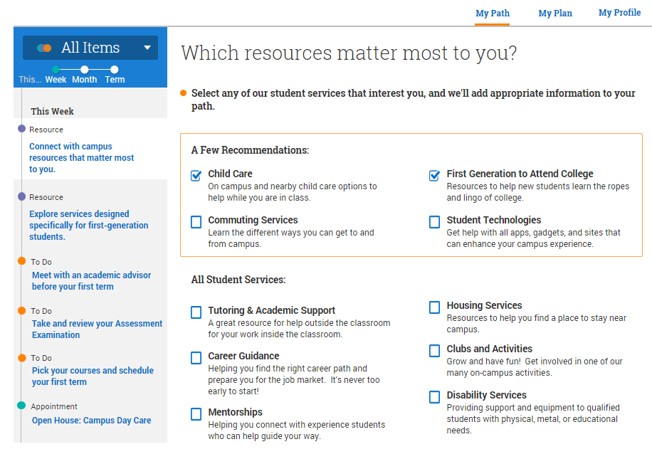
Slide 17
Portal to Guide Students Through Next Steps

Slide 19
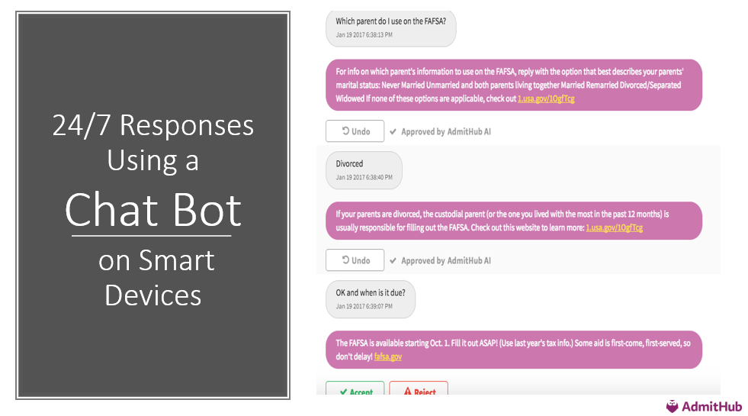
Slide 18

Slide 20
Slide 19
201,000

Slide 21
Slide 20
One-Year Drop in Summer Melt: 22%
+324
Students

Slide 22
Slide 21
Challenge:
Choosing A Major

Slide 23
Overwhelming Choices

Slide 24
Academic Guides with Live Job Data

Slide 25
Freshman Learning Communities & Meta Majors

Slide 26
Slide 25
Choice Architecture: Meta Majors
Business
Education
Exploratory
STEM
Humanities & Arts Health Professions
Policy/Social Science
26

Slide 27
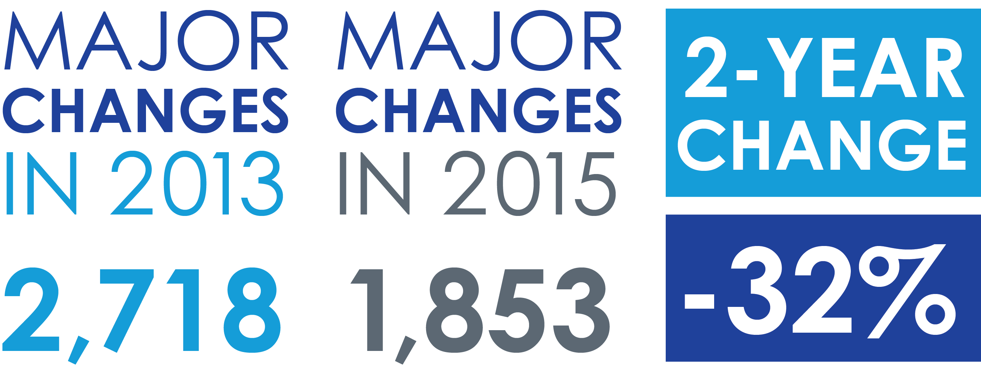
Meta Majors

Slide 28
Slide 27
Challenge:
Gateway Courses

Slide 29
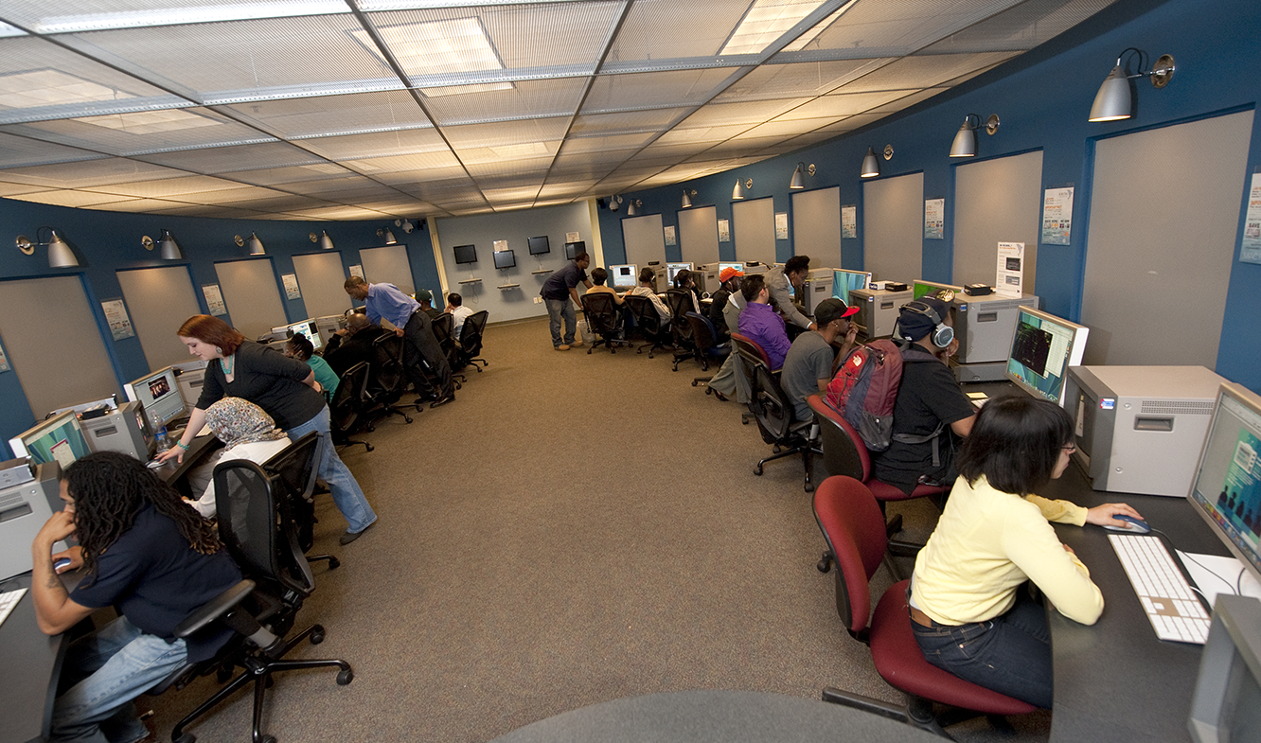
Strengthening Math Pathways
Pre-Calculus, College Algebra, Intro to Statistics
DFW Prior to Change: 43% DFW Today: 28% (35% drop)
Number of Students enrolled in courses taught through the MILE, 2016-17: 8,500
+1,275 Students Passing

Slide 30
Adaptive Learning at Scale
 |  | STUDENTS | SECTIONS | DFW
POLS 1101 | American Government | 4694 | 55 | 16.3%
MATH 1070 | Elementary Statistics | 2701 | 76 | 25.2%
ECON 2105 | Principle of Macroeconomics | 2340 | 38 | 19.2%
PSYC 1101 | Introduction to General Psychology | 2252 | 26 | 21.8%
POLS 2401 | Global Issues | 2250 | 35 | 18.9%
FILM 2700 | History of the Motion Picture | 2226 | 59 | 15.2%
ECON 2106 | Principles of Microeconomics | 2122 | 31 | 24.7%
MATH 1101 | Introduction to Mathematical Modeling | 2019 | 56 | 26.5%
MATH 1111 | College Algebra | 1540 | 45 | 20.2%
SOCI 1101 | Introductory Sociology | 1432 | 29 | 20.2%
MATH 1113 | Pre-calculus | 1289 | 34 | 27.5%
CHEM 1211 | Principles of Chemistry I | 1096 | 37 | 17.2%
BIOL 1103 | Introductory Biology I | 1051 | 48 | 24.8%

Slide 31
Eliminating Bottlenecks: Peer Tutors
Supplemental Instruction (SI)
BIOL
POLS
PHIL
CHEM
ACCT
PHYS
CRJU
Course GPA
No SI: 2.41
SI: 2.91
One-Year Retention
No SI: 83.5%
SI: 91.2%
Students: 9,700
No SI
SI
No SI
SI
No SI
SI
No SI
SI
No SI
SI
No SI
SI
No SI
SI

Slide 32
Slide 31
Challenge:
Stop Outs

Slide 33
Slide 32
< 30%
Likelihood that a college student who stops out for financial reasons will ever complete degree at the institution

Slide 34
Panther Retention Grants
Seniors Graduated: 78%
Grant Recipients
Graduated 2016-17: 1,321

Slide 35
Slide 34
r
Panther Retention Grants
11,027
Grants awarded since 2011
35

Slide 36
Slide 35
Challenge:
Staying On Track

Slide 37
Advisement: GPS Advising
Predictive Analytics Project with EAB

Slide 38
Academic Program Maps: B.S. in Chemistry
SEMESTER 1 | SEMESTER 2
Complete 1 of ENGL 1101, ENGL 1102 or ENGL 1103 (C or Better) Complete MATH 1113 or Higher (B- or Better) Complete CHEM 1211K (B- or Better) | Complete ENGL 1102 or 1103 (C or Better) Complete MATH 2211 or Higher (B- or Better) Complete CHEM 1212K (B- or Better) Maintain a cumulative GPA of 2.25 or Better
SEMESTER 3 | SEMESTER 4
Complete CHEM 2400 (B- or Better) Complete MATH 2212 (C or better) Complete PHY 2211k (C or better) | Complete CHEM 3410 (C or better) PHY 2212k ( B- or Better) (C or better) Maintain a cumulative GPA of 2.25 or Better
SEMESTER 5 | SEMESTER 6
Complete CHEM 4000 with a C or Better Complete CHEM 4110 with a C or Better | Complete CHEM 4010 with a C or Better Complete CHEM 4120 with a C or Better
SEMESTER 7 | SEMESTER 8
Complete CHEM 4160 with a B- or better | Complete CHEM 4190 with a C or Better

Slide 39
Alerts Based on Historical RPG Data
Graduation Rate in Major by Introductory Course Grade

Slide 40
Slide 39
51,545
54,364

Slide 41
Results: Increased Retention
Increased Average First Term Retention
Fall to Spring Retention

Slide 42
Results: Decline in Time to Degree

Slide 43
Slide 42
r
ROI for Students
$15 million
Savings to the Class of 2017 in tuition
and fees when compared to the
Class of 2013
43

Slide 44
Confounding Expectations
STEM Degrees Conferred
Since 2011 (enrollment change)
Black +69% (12%)
Black Male +111% (15%)
Hispanic +226% (22%)

Slide 45
Slide 44
Impacts

Slide 46
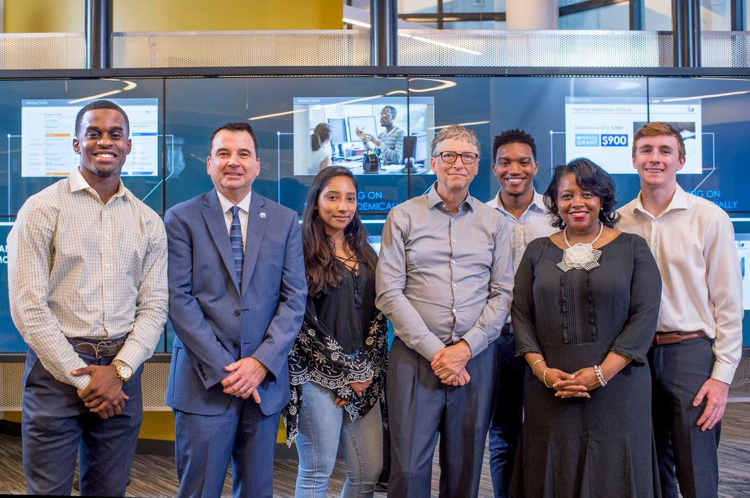
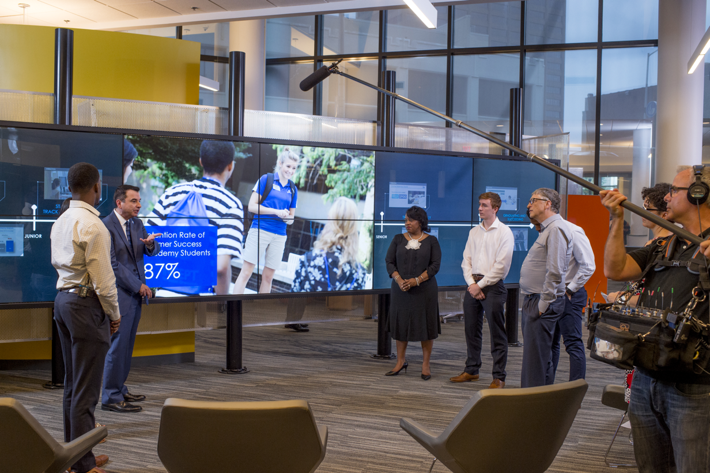
Overwhelming Choices

Slide 47
Growing Recognition

Slide 48
The Cost of Inaction
The Calculus of Student Success: ROI
1-point increase in retention = 325 students
Average student tuition & fees annually/student = $9,800
ROI for each 1-point increase = $3.18 million/year

Slide 49
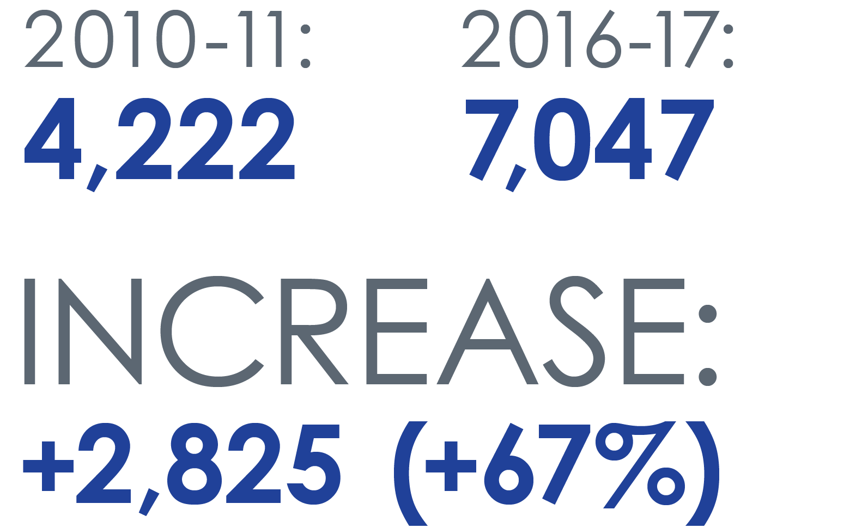
Georgia State Undergraduate Degrees Awarded

Slide 50
Bachelor’s Degrees Awarded Annually
 | 2009-10 | 2016 - 17 | 6-Year Change | % Change
African American | 1,001 | 2,040 | +1,039 | +103%
Pell | 1,298 | 2,957 | +1,659 | +128%
Hispanic | 196 | 509 | +313 | +160%

Slide 51
Graduation Rates by Race & Ethnicity
No FLC
FLC
No FLC
FLC

Slide 52
#1 in Degrees Conferred to African Americans
Top 100 Degree Producers: Non-Profit Universities
2016 African-American Bachelor's - All Disciplines Combined
 |  |  |  | Total | %Grads | %Chg
 |  | Institutions | State
1 |  | Georgia State University | GA | 1805 | 38% | 8%
2 |  | FAMU | FL | 1584 | 95% | 6%
3 |  | University of Maryland-University College | MD | 1409 | 26% | 19%
4 |  | University of Central Florida | FL | 1316 | 10% | 1%
5 |  | North Carolina A & T State University | NC | 1196 | 80% | 7%
6 |  | Howard University | D.C. | 1160 | 90% | -6%
7 |  | Florida Atlantic University | FL | 1087 | 19% | 7%
8 |  | Florida International University | FL | 1020 | 11% | 11%
9 |  | University of Memphis | TN | 1011 | 33% | 3%
10 |  | The University of Texas at Arlington | TX | 992 | 13% | -7%
Source: Diverse Issues in Higher Education

Slide 53
2017 Brookings Institution Social Mobility Ranking
#1 University in Georgia
#25 University in the United States
Student Income Growth from College Entry to Mid Career

Slide 54
Overwhelming Choices

Slide 55
Overwhelming Choices

Slide 56
Overwhelming Choices

Slide 57
Slide 56
http://success.gsu.edu
twitter: @tim_renick

Slide 58
OSEP Disclaimer
2018 OSEP Project Directors’ Conference
DISCLAIMER:
The contents of this presentation were developed by the presenters for the 2018 Project Directors’ Conference. However, these contents do not necessarily represent the policy of the Department of Education, and you should not assume endorsement by the Federal Government.
(Authority: 20 U.S.C. 1221e-3 and 3474)

