Slide 1
Increasing Capacity for Developing High-Quality IEPs/IFSPs

Slide 2

Slide 3

Slide 3
Slide 4

Slide 4
Impact of Endrew F. on IEP/IFSP Meetings and Development

Slide 5
Endrew F. v. Douglas County School District (2017): Implications for IEP Teams
David F. Bateman Ph.D.
dfbate@ship.edu
Shippensburg University

Slide 6
The Primary Requirement of the IDEA is to provide a special education that confers a free appropriate public education (FAPE)

Slide 7
Supreme Court Ruling: March 22, 2017
“To meet its substantive obligation under the IDEA, a school must offer an IEP reasonably calculated to enable a child to make progress appropriate in light of the child’s circumstances.” (Endrew, 2017, p. 16)

Slide 8
Endrew - Important Point #1
The Supreme Court rejected the “de minimis” or “trivial” educational benefit standard

Slide 9
Slide 9
“A student offered an education program providing ‘merely more than de minimis progress from year to year can hardly be said to have been offered an education at all” (Endrew, 2017, p. 14)

Slide 10
Endrew Important Point #2
The Endrew F. decision did not replace or overturn the Rowley decision; rather, it clarified its FAPE standard

Slide 11
Endrew - Important Point #3
The Supreme Court’s decision emphasizes “progress”

Slide 12
FAPE Analysis Under Rowley/Endrew
In the development of an IEP, has the IEP Team complied with the procedures set forth in the IDEA?
2. Is the IEP reasonably calculated to enable the child to make progress that is appropriate in light of his or her circumstances?

Slide 13
Endrew Important Point #4
The Endrew decision provides guidance to administrators, educators, & IEP Team members in developing IEPs that meet the Endrew standard.

Slide 14
Slide 14
A focus on the particular child is at the core of the IDEA. The instruction offered must be “specially designed” to meet a child’s “unique needs” through an “individualized education program.” An IEP is constructed only after careful consideration of the child’s present levels of achievement, disability, and potential for growth

Slide 15
Lessons from Endrew

Slide 16
Slide 16
“An IEP must be drafted in compliance with a detailed set of procedures" that “emphasize collaboration among parents and educators" (Endrew, 2017, p 2).

Slide 17
Slide 17
Point #1
"The nature of the IEP process, from the initial consultation through the state administrative proceedings, ensures that parents and school representatives will fully air their respective opinions on the degree of progress the IEP should pursue.” (Endrew, 2017, p 16).

Slide 18
Point #2
Ensure meaningful parent involvement in IEP meetings and that their concerns are considered in establishing their child’s educational/behavioral goals.

Slide 19
Slide 19
“The IEP is not a form document. It is constructed only after careful consideration of the child’s present levels of achievement, disability, and potential for growth” (Endrew, 2017, p 12).

Slide 20
Point #3
When developing the content of a student’s IEP and subsequently reviewing and revising it, be sure that the present levels of academic achievement and functional (PLAAFP) statements are based upon evaluations and other relevant data that are current.

Slide 21
Point #4
Ensure annual IEP goals are challenging, appropriately ambitious, and measurable.

Slide 22
“An IEP must be reasonably calculated to enable a child to make progress appropriate in light of his circumstances. ” (Endrew, 2017, p. 16)

Slide 23
Point #5
Continuously monitor and measure a child’s progress on annual goals (and objectives/benchmarks, if applicable) and maintain specific data to demonstrate that progress has been made.

Slide 24
Point #6
When progress reports and other data do not reflect an annual goal will be met, reconvene the IEP team to determine why, make needed instructional changes, and continue to collect data.

Slide 25
U.S. Department of Education
Question & Answer document on the Endrew F. decision on December 7, 2017
“The Endrew F. decision is important because it informs our efforts to improve academic outcomes for children with disabilities” (Q & A, 2017, p. 1)
Comments to Q & A: EndrewF@ed.gov

Slide 26
Georgia’s State Personnel Development Grant

Slide 27
ASPIRE
Active Student Participation
Inspires Real Engagement
Laura Brown
GA’s State Personnel Development Grant

Slide 28
What is ASPIRE?
ASPIRE is a student-led IEP initiative designed to develop self-determination skills in the following areas:
  Problem-solving
  Self-evaluation
  Choice-making
  Decision-making

Slide 29
ASPIRE Competencies
IEP Awareness
IEP Participation
IEP Content
Knowledge of Strengths and Challenges
Communication Skills
Competencies are addressed in the context
of classroom instructional activities.

Slide 30
Increasing Student Voice
Defining strengths and challenges
Expressing interests, likes, and dislikes
Practicing communication and negotiation skills
Engaging in goal setting, evaluating progress, and expressing how to adjust activities accordingly

Slide 31
Training
ASPIRE provides training and follow-up activities to enable students to actively participate in the development and implementation of their IEP.
Training includes:
  Overview and expectations
  Self-determination and self-advocacy
  Participating in the student-led IEP process
  Administrator, Educator, and Parent sessions

Slide 32

ASPIRE Promotes
Educator Engagement
Parent Engagement
Student Engagement
Post School Outcomes
Secondary Transition

Slide 33
Slide 7
ASPIRE PARTICIPATION | March 2018
Participating Schools | 594
Districts | 112
Teachers | 2698
Students | 38,419

Slide 34



ASPIRE Resources http://www.gaspdg.org/aspire
A Collaborative Initiative between
The Georgia Department of Education,
Division for Special Education and Student Services and
The Georgia Council on Developmental Disabilities

Slide 35
Critical Role of the School Principal

Slide 36
IFSP Considerations

Slide 37
Developing High-Quality,
Individualized Family Service Plans
Toby Long, PhD, PT, FAPTA
Center for Child and Human Development
Director, GU Certificate in Early Intervention

Slide 38
Thank you
This presentation is an adaptation of the
Developing High-Quality, Functional IFSP Outcomes and IEP Goals Training Package
Developed by Anne Lucas, Kathi Gillaspy, and Mary Peters of the Early Childhood Technical Assistance Center (ectacenter.org) and can be found at:
http://ectacenter.org/knowledgepath/ifspoutcomes-iepgoals/ifspoutcomes-iepgoals.asp

Slide 39

Early Intervention: High Expectations
Integrated program of services and supports
  Embedded into naturally occurring learning opportunities
  Intergenerational: child + parent
  Individualized
To help children
  Participate in activities they would like to or are expected to participate in
  Interact with peers, family members, & others

Slide 40
High Quality IFSP
Reflects family and caregivers
Concerns
Priorities
Resources

Slide 41
Relationship of Outcomes to Services
First…
develop IFSP outcomes based on authentic assessment information
Then…
determine services and supports based on what is necessary to meet the outcomes

Slide 42
Requirements for IFSP Outcomes
IFSP must include:
The measurable outcomes expected to be achieved for the child and family
The criteria, procedures, and timelines used to determine progress toward achieving the outcomes
If progress not being made are modifications or revision to the outcomes or services needed
34 CFR §303.344 (c)

Slide 43
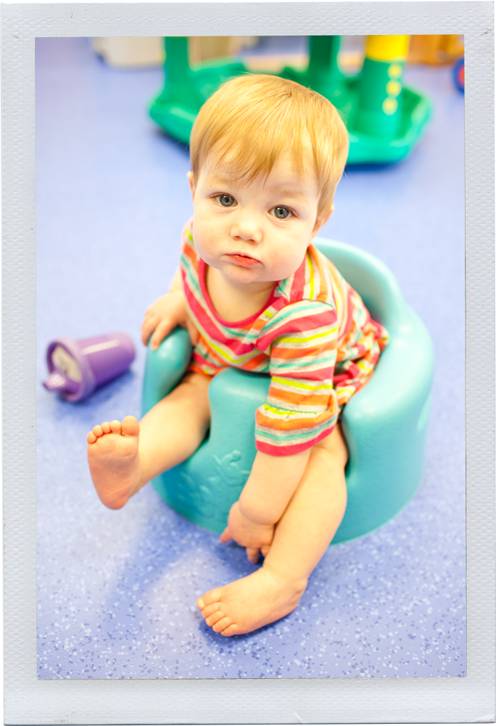
IFSP Outcomes
Start by asking:
  “What would your family like to see happen for your child/family?”
Two types of outcomes
  Child Outcomes
  Family Outcomes

Slide 44
IFSP Child Outcomes
Two types of child outcomes:
Participation-based
Routine/activity-based
Child outcomes should:
Enhance learning through functional participation in everyday activities (child is learner/actor)
Be important and meaningful to the family/caregiver (priorities)
Expand activity settings so child can be competent
Be based on child’s interests

Slide 45
IFSP Family Outcomes
Two types of family outcomes:
Participation-based
Resource-based
Family outcomes should:
Enhance capacity of the family (family is learner/actor)
Support accessing community resources and supports (service coordinator supported)
Be important and meaningful to the family/caregiver (priorities)
Be based on family’s interests

Slide 46
Developing IFSP Outcome Statements
Step 1: Determine the functional area(s) | Eating
Step 2: What routine(s) does this affect? | Meal time with the family
Step 3: Child will participate in [routines in question] | “Kim will eat with her Family at mealtime…”
Step 4: “by ________ing” (address specific behaviors) | “…eating the foods they eat.”
McWilliam, R.A. (2006). Steps to build a functional outcome. Retrieved from http://www.siskin.org/downloads/Steps_to_Build_a_Functional_Child_Outcome.pdf

Slide 47
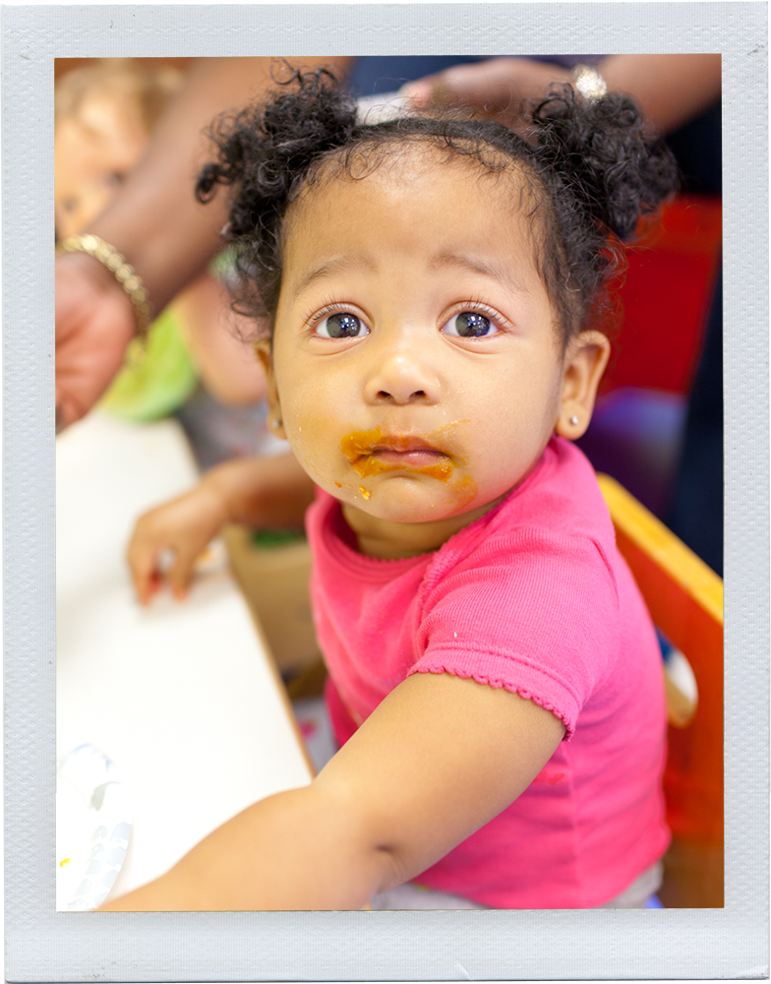
Third Word Rule
The third word of IFSP child outcome statement should be a contextualized action that is functional.
Example: “Kim will eat with her family at mealtime eating the foods they eat.”
Shelden, M. L., & Rush, D. D. (2009). Tips and Techniques for Developing Participation-Based IFSP Outcome Statements. Briefcase, 2(1). Retrieved from http://www.fipp.org/Collateral/briefcase/briefcase_vol2_no1.pdf

Slide 48
High-Quality IFSP Outcomes
Functional for child’s and family’s life
Reflect real-life
Jargon-free, clear and simple
Emphasize the positive, not the negative
Uses active words rather than passive words

Slide 49
Developing Child Outcomes
What parent states:
“I wish he could sit without as much
support when he eats and plays – it is
hard work holding him all the time.”

Slide 50
Child Outcome: Example
This
Not This
“Romeo will eat meals with his family, sitting upright in his high chair.”
“Romeo will improve muscle tone for sitting.”

Slide 51
Developing Family Outcomes
What parent states:
“We want to be able
to take Romeo with us in the car;
we need a travel car seat.”

Slide 52
Family Outcome: Example
This
Not This
“Karen and Mark will explore options for financial assistance for car seats and secure one.”
“Staff will explore options for financial assistance for travel chairs.”

Slide 53


Creating High Quality IFSP Outcomes
Training Activities
http://www.ectacenter.org/~pdfs/pubs/rating-ifsp.pdf
http://www.ectacenter.org/~pdfs/pubs/rating-iep.pdf

Slide 54
Resources on IFSPs
Agreed Upon Practices For Providing Early Intervention Services In Natural Environments http://www.ectacenter.org/~pdfs/topics/families/AgreedUponPractices_FinalDraft2_01_08.pdf
Rush and Shelden. Tips and Techniques for Developing Participation-Based IFSP Outcomes Statements, BriefCASE, Vol 2, No. 1 http://www.fippcase.org/briefcase/briefcase_vol2_no1.pdf
ECTA Center website http://www.ectacenter.org/topics/families/famresources.asp

Slide 55
Thank You
longt@Georgetown.edu

Slide 56
Behavior Considerations

Slide 57
Addressing Behavioral Needs of Children with Disabilities
Renee Bradley
U.S. Office of Special Education Programs

Slide 58
Supporting Behavior of Students with Disabilities
IDEA requires individualized education program (IEP) Teams to consider the use of positive behavioral interventions and supports for children with disabilities whose behavior interferes with their learning or the learning of others.

Slide 59
Slide 3
When a child displays inappropriate behavior, such as violating a code of student conduct or disrupting the classroom, this may indicate that behavioral supports should be included in the child’s IEP; this is especially true when the child displays inappropriate behavior on a regular basis

Slide 60
Slide 4
If a child displays inappropriate behavior despite having an IEP that includes behavioral supports, this may indicate that the behavioral supports in the IEP are not being appropriately implemented, or the behavioral supports in the IEP are not appropriate for the child.

Slide 61
Slide 5
IDEA requires that behavioral supports, determined appropriate by the IEP team, be based on peer-reviewed research to the extent practicable and individualized to the child’s needs

Slide 62
Slide 6
LEAs may also consider capacity needs of staff and what supports are needed for teachers and leaders in addition to what the student needs.

Slide 63
Supporting School Success

Slide 64

Slide 1
Building High Quality IEPs
June 18, 2018

Slide 65
Our mission is…
To improve the lives of the
1 in 5 children and adults
who struggle with learning and attention issues.

Slide 66
Building a Better IEP

Slide 67
Tip #1: Make the IEP Standards-based
A standards-based IEP compares a student’s present level of performance to grade-level expectations.
This type of IEP creates instructional goals that are designed to close the achievement gap.

Slide 68
Tip #2: Use SMART Goals
What is it? | Example of a Non-SMART IEP Goal | Example of a SMART IEP Goal
Specific Measurable Attainable Results-oriented Time-bound | Adam will be a better reader. | By May 15, Adam will be able to read a passage orally in a grade-level book at 110–130 words per minute with random errors. Progress will be measured through a monthly language assessment

Slide 69

Tip #3: Encourage and Support Self-Advocacy
Self-advocacy is the ability to speak up for what you need.
Being a good self-advocate can help a child academically and socially.
Schools can help children develop the skill of self-advocacy at any age, but it’s good to start early.

Slide 70
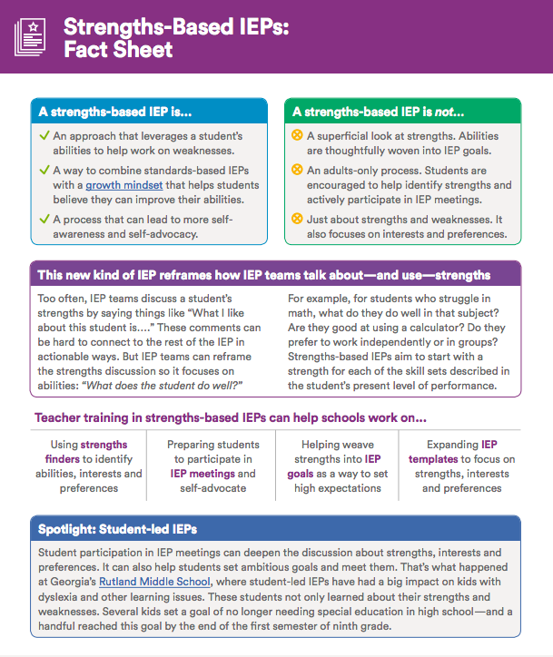
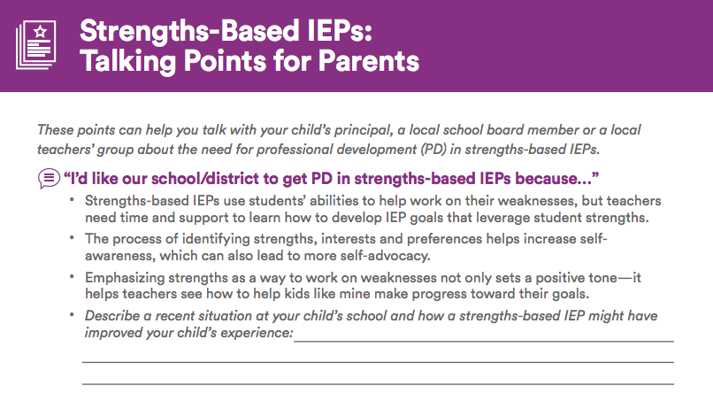
Tip #4: Incorporate Strengths in the IEP

Slide 71
Realizing the Promise of Endrew F.

Slide 72
Resources
Endrew F. Toolkit: u.org/endrewtoolkit
Professional Development Toolkit: u.org/schoolwide
Self-Advocacy Resources: ncld.org/selfadvocacy
Melissa Turner: mturner@ncld.org

Slide 73
Parent and Young Adult Videos

Slide 74
Questions & Answers

