Slide 1
2020 OSEP Project Directors' Virtual Meeting: Technical Assistance and Dissemination Program (84.326)
7-21-20
11:00 am – 12:30 pm ET

Slide 2
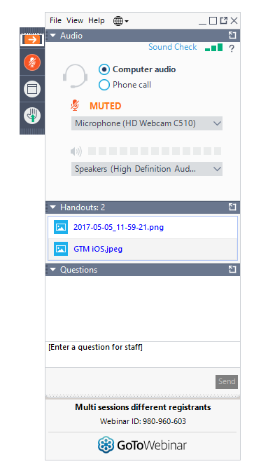
Logistics
All attendees will be muted for the majority of this webinar.
At times, you may be prompted to “raise your hand” if you would like to ask a question. You will be unmuted and re-muted by an organizer.
A link to Captioning is available in the chat and a tip sheet for accessing captioning can be found under the “Handouts” tab on your GoToWebinar control panel.
To submit questions for speakers, enter your question in the “Questions” dropdown in your control panel.
We will also have a poll using menti.com (you will need to open a new browser window)

Slide 3
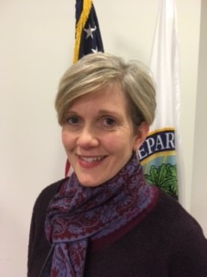
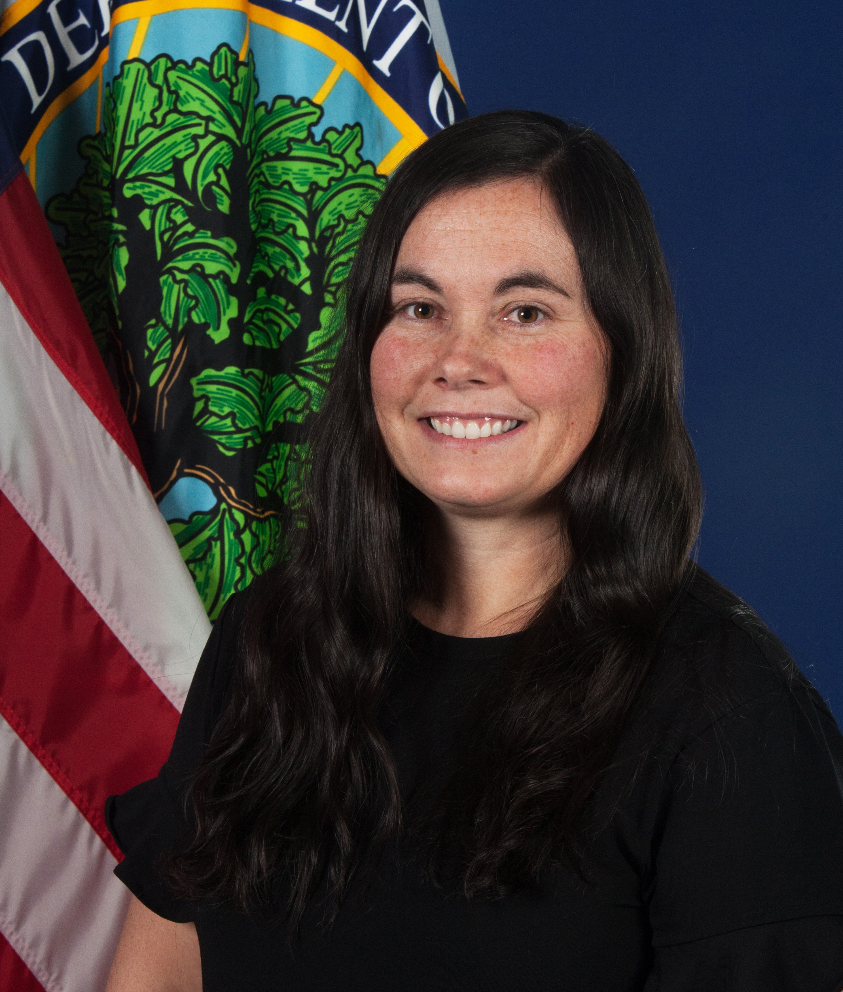
OSEP Staff:
Julia Martin Eile
Research to Practice (RTP) Division of the Office of Special Education Programs
Leslie Fox
Monitoring and State Improvement Planning (MSIP) Division of the Office of Special Education Programs
Amy Bae
Research to Practice (RTP) Division of the Office of Special Education Programs

Slide 4
TA&D Network
Notes:
Welcome newly funded TA Centers in October 2019
Promoting Rigorous Outcomes and Growth by Redesigning Educational Services for Students with Disabilities (PROGRESS Center). The PROGRESS Center will help private, public, and charter schools improve their capacity to design and implement high-quality, evidence-based educational programs to meet the standards of the Endrew F. decision. The expected outcomes are an increase in knowledge, awareness, and use of resources to improve quality and implementation, and ultimately an ecosystem of educators who can design and implement quality special education programs. The PROGRESS Center was awarded to American Institutes for Research and its website will launch soon.
National Center for Systemic Improvement (NCSI). NCSI will provide differentiated support to states through universal, targeted, and intensive technical assistance to help states best use their general supervision and professional development systems to establish and meet high expectations for each child with a disability. NCSI was awarded to WestEd.
National Center on Accessible Educational Materials (AEM 2.0). AEM 2.0 will continue improving systems that provide accessible educational materials and technologies for individuals with disabilities in early learning, K-12, higher education, and workforce settings. AEM 2.0 was awarded to CAST.
The Center for IDEA Early Childhood Data Systems (DaSy Center). The DaSy Center will provide technical assistance to (1) improve states’ capacity to collect, report, analyze and use high-quality IDEA Part C data required under IDEA sections 618 and 616 and IDEA Part B preschool data for those indicators that are not solely based on IDEA section 618 data (e.g., Indicators B7 and B12); and (2) enhance, streamline, and integrate statewide child-level early childhood data systems to address critical policy questions that will facilitate program improvement, improve compliance accountability, and improve outcomes for children served under Part C and Part B preschool special education programs. The DaSy Center was awarded to SRI International.
IDEA Data Center (IDC). IDC provides technical assistance to build state capacity for collecting, reporting, analyzing, and using IDEA Part B data, including preschool data. IDC also provides technical assistance to local education agencies (LEA), in partnership with states, to improve LEA data quality. IDC was awarded to Westat.
Results Driven Accountability: What's Due and What's New
OSEP's Monitoring and State Improvement Planning division conducts many state-focused activities under the umbrella of Results Driven Accountability (RDA). You can read more about this innovative initiative to focus on educational results for children and youth with disabilities and their families here. Additionally, OSEP is examining RDA as a part of the Office of Special Education and Rehabilitative Services RETHINK framework.

Slide 5
TA&D Network

Slide 6
Thank You!
NCSI and ECTA
Gathered great resources from all the TA Centers
Both centers report a significant jump in website review of resources
NCSI, NCII, Parent Center Hub, IRIS, CADRE, PBIS, TIES, NTACT, NDBP, etc.
VIDEO - Resources to support continuity of learning and back to school
All Centers
Participation in OSEP webinars
Collaboration with other centers to develop high quality resources
Sending resources to our EC and OSEP Newsletters

Slide 7
Agenda:
ED/OSEP websites on Guidance and Resources in relation to COVID-19, distance learning and returning to school
Quarterly calls
Polling and Q&A
TA Center Shares
Next Steps

Slide 8
ED/OSEP Guidance and Resources
Department of Education - https://www.ed.gov/coronavirus
Office of Elementary and Secondary Education (OESE) –
https://oese.ed.gov/resources/

Slide 9
ED/OSEP Guidance and Resources
Office of Special Education (OSEP)
https://www2.ed.gov/about/offices/list/osers/osep/index.html
OSEP Ideas That Work website – Continuity of Learning during COVID https://osepideasthatwork.org/continuity-learning-during-covid-19
OSEP Newsletter – https://sites.ed.gov/idea/newsletters/
Early Learning Newsletter - https://www2.ed.gov/about/inits/ed/earlylearning/newsletter.html

Slide 10
MSIP Updates
Proposed revisions to the approved information collection for the next Part B and Part C SPP/APR cycle are posted and available for public comment until August 10, 2020. The revisions, once finalized, will be in effect for the FFY 2020 SPP/APR due to OSEP in February 2022.
MSIP has established a new implementation team to oversee the development and implementation of OSEP’s next iteration of Differentiated Monitoring and Support (DMS). We anticipate sharing more information with States and technical assistance providers later this summer and early fall before initiating the new process in October.

Slide 11
MSIP Updates
SSIP feedback calls have started and will continue through September. We highly encourage TA providers to participate in these discussions. We plan to update our SSIP FAQ document and welcome suggestions from the TA providers of questions to be included and addressed.
OSEP continues to receive questions from states regarding the impact of the COVID-19 pandemic and school/EI program closures for next year’s SPP/APR reporting. We anticipate addressing these issues over the next several months.

Slide 12
MSIP Updates
We recognize that States may have concerns about the 618 and SPP/APR data collections and have questions about data reporting requirements for upcoming submissions. OSEP is having ongoing discussions about the impact of the COVID-19 pandemic on IDEA data reporting requirements. We welcome your input as we consider the implications and make decisions about the how to support States leading up to February 1, 2021. More guidance will be provided in the near future.

Slide 13
COVID-19 and changes in TA
Like all of you, OSEP has changed the way we interact and how we work together.
We understand how difficult it is to change your TA approaches when there is limited interaction
We also have been impressed with the many resources developed so quickly during the pandemic

Slide 14
Questions from the field:
Logistical Questions include:
How should TA be provided during the pandemic and beyond?
How do I shift TA plans and budgets due to the pandemic?
How do I best support my staff, the states and local programs?
Systems Questions include:
How can we support states and local programs to ensure equitable services for all children with disabilities?
How can we best support families?
How can we develop effective distance learning resources?

Slide 15
OSEP’s Vision for TA&D Network Calls
Communicate and provide updates through quarterly calls (or more frequently) and a listserv.
Q&A and polling for content for calls, call for speakers, etc.
Facilitated discussions on topics of interest.
Additional support, coordination and collaboration during this unprecedented time

Slide 16
OSEP’s Vision for TA&D Network Calls
Examples of Quarterly Call Topics:
Adaptive Leadership (supporting leaders in systems change)
Continuity of Learning and Return to School
Equity
Family Engagement
Social Emotional & Behavioral Support
TA Center Collaboration and/or work with States
Technology

Slide 17
Polling – prioritize interest in topics
Polling questions – prioritize interest in topics:
Adaptive Leadership (supporting leaders in systems change)
Continuity of Learning and Return to School
Equity
Family Engagement
Social Emotional & Behavioral Support
TA Center Collaboration and/or work with States
Technology

Slide 18
Polling Question #1
Of the 7 topic areas, please pick your top 3 topics for content for our next calls

Slide 19
Question #1
Of your top 3 topics, are there subtopics that you would like to have more of a discussion about?
(for example: If your topic priority is Technology, what are some of the subtopics? Technology and virtual coaching or delivery of services, etc.)
Please put your subtopics in the Q&A box

Slide 20
Question #2
Are there topics that we didn’t include that you would like to discuss more with the TA&D Network?
Please provide the topic you would be interested in discussing in the question box

Slide 21
Question #3
What other types of support would be helpful to you as you develop resources and implement changes to your TA? (ie: OSEP Calls, Project Officer support, etc.)
Please type ideas into the question box

Slide 22
Highlighted TA&D Grantees
Terri Vandercook
Project TIES
Sam Morgan and Jane Herder
Deaf Blind Project
Sarah Arden
National Center on Intensive Interventions (NCII)

Slide 23
How Covid-19 has changed the way we provide TA
Shared by Terri Vandercook on behalf of the TIES Center

Slide 24
Three changes in our Technical Assistance:
Created an entirely new universal TA series called the Distance Learning Series
Intensive TA work with states has all shifted to remote work, at the state, district, and focus school level
Targeted TA content focus pivoted to include content related to distance learning

Slide 25
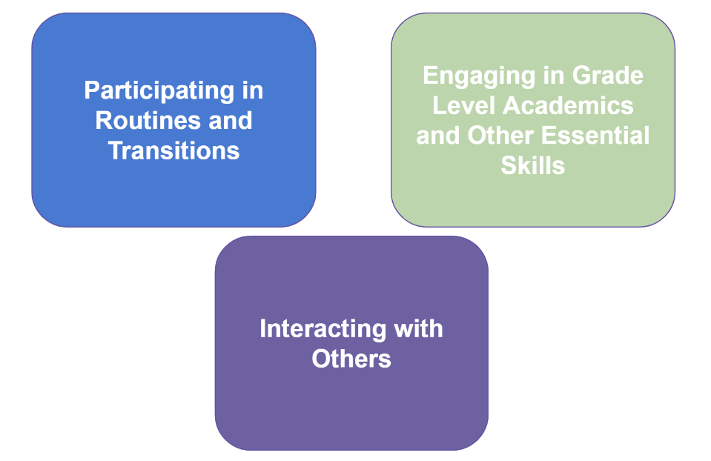
Distance Learning (DL) Organizing Framework

Slide 26
Series Topics …
Distance Learning Engagement: An Organizing Framework
DL #1: Morning Meetings
DL #2: A Collaborative Start to Behavioral Supports
DL #3: Effective Specially Designed Instruction (SDI) Within the Distance Learning Environment: What in the world does that look like?
DL #4: Dealing with Uncertainty: A Plea for Thoughtful Plans and Patient Collaboration
DL #5 Reflections About Individualizing Supports for Children and Families: Olivia’s Story
DL #6: Getting "Unstuck:" Tips to help your child if they get stuck with their remote learning
DL #7: Self-determined Schedule Making

Slide 27
Series Topics, continued…
DL #8: Time Management During Distance Learning
DL #9: Start Now to Plan for Students Transitioning Back to School
DL #10: Distance Learning and Communication Systems
DL #11: Embedding Instruction at Home
DL #12: Promoting Engagement for Students with Significant Cognitive Disabilities on Group Learning Platforms
DL #13: Distance Learning is Emotional Work: Tips for Parents and Caregivers
DL #14: Teachers: Understand and Communicate about Emotions to Support Deep Learning
The entire Distance Learning Series is available online

Slide 28
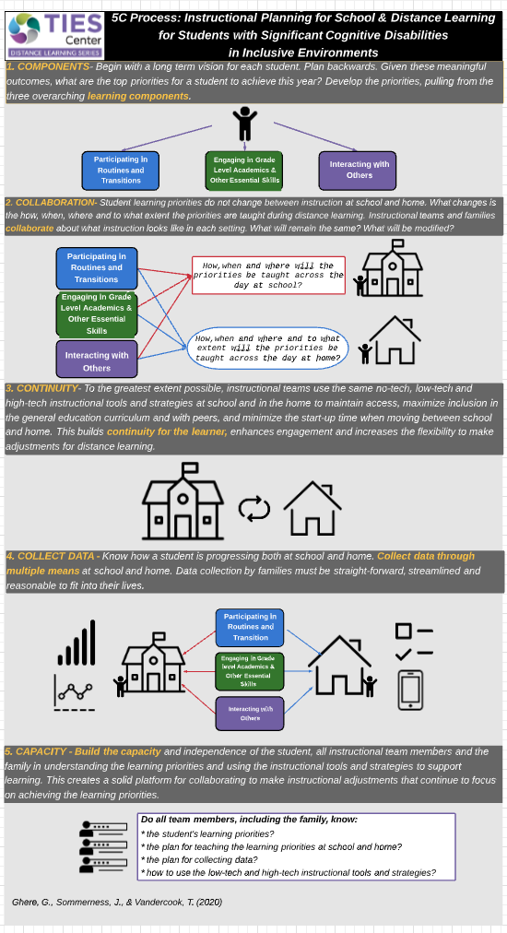
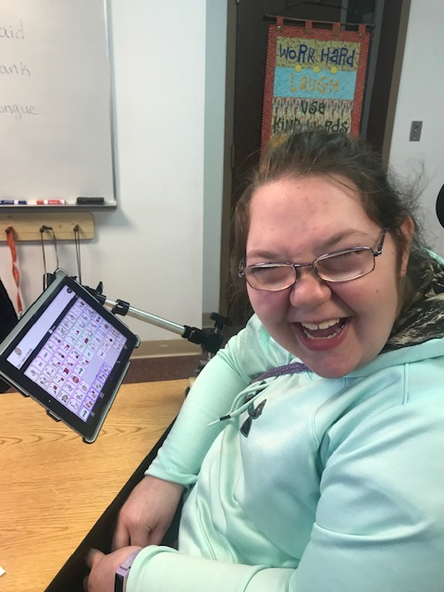
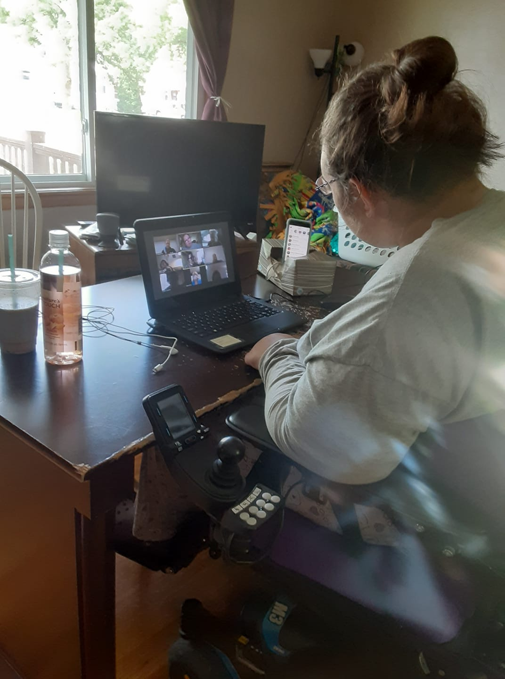
Begin with the end in mind
Begin with the end in mind

Slide 29
Video Series for Parents: Helping My Child with:
Routines at Home
Communication at Home
Academics at Home
Foundations of Reading at Home
Reading at Home
Foundations of Math While at Home
Math While at Home
Foundations of Writing While at Home
Writing While at Home
By Checking Progress in Knowledge and Behavior at Home

Slide 30
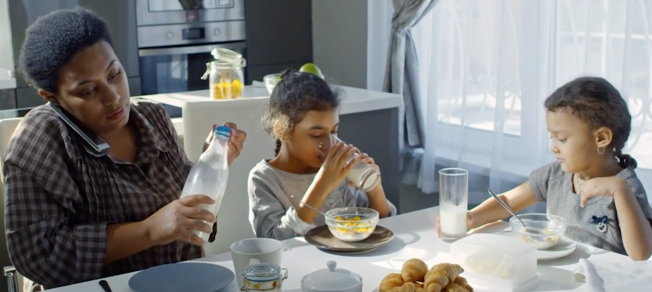
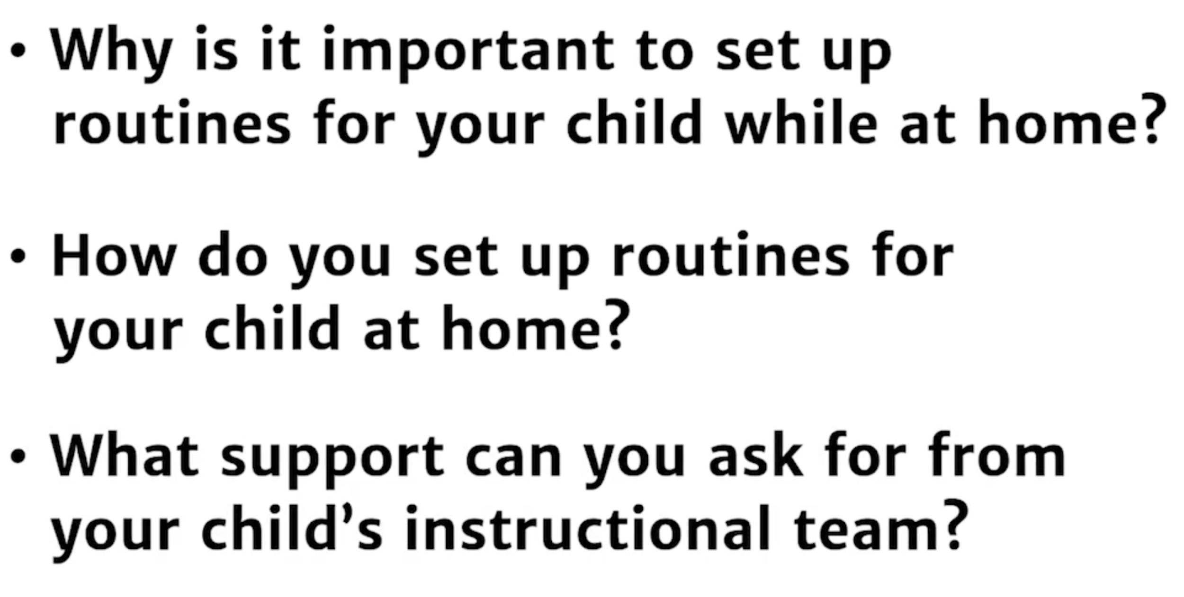
Video 1: Helping Your Child with Routines at Home

Slide 31
Intensive TA: Examples of Remote Work
State Level: Joined the Washington State Special Education Reopening Workgroup to create their Special Education Guidance Document
District Level: Created qualtrics version of an LRE Self-assessment and supported data analysis and discussion to identify action priorities and create improvement plans
Focus School Level: Support connection between district priorities and school improvement plans and agree upon a plan for professional development and coaching

Slide 32
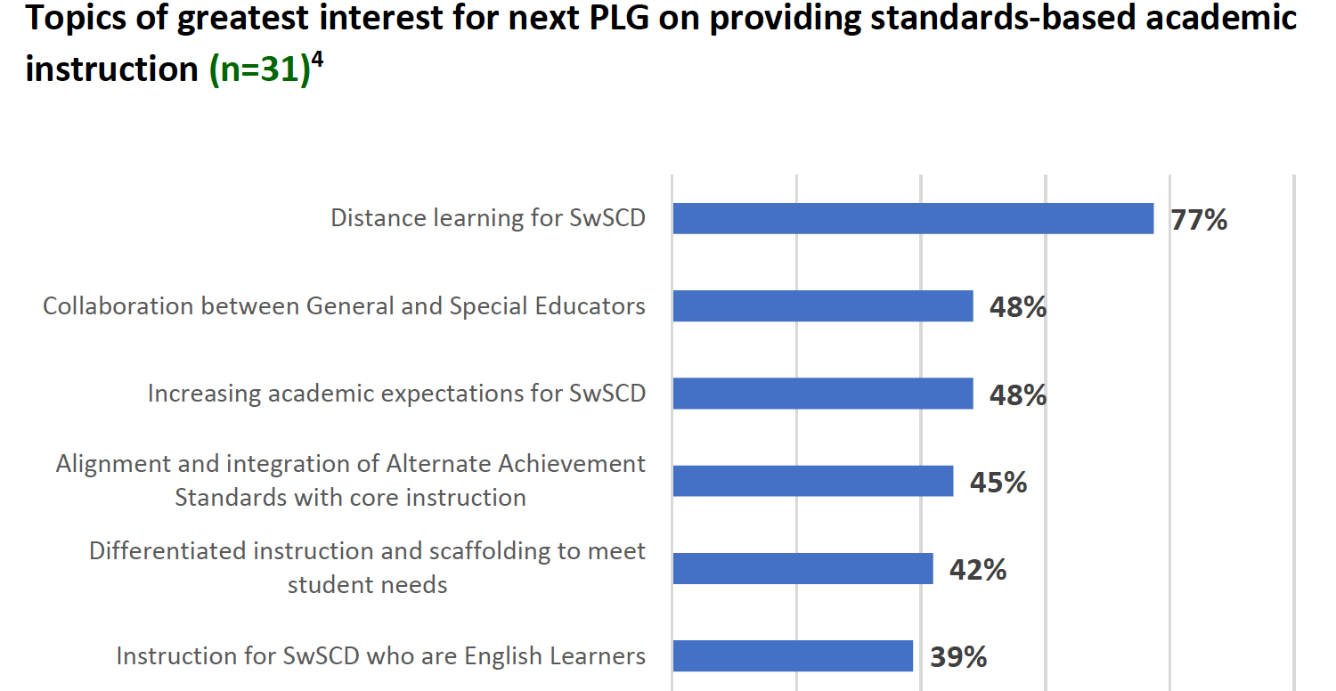
Targeted TA
3 SEA Prof Learning Groups (2020)
Online / 5-6 sessions per PLG
12 to 19 states per PLG session
Topics:
1. Systems Change
2. Communicative Competence
3. Standards-based Academics
Shift: PLG #3--planning for a much larger emphasis on Distance Learning

Slide 33
Let’s Chat…
What questions, comments, or advice do you have for furthering our work?
How has your universal, targeted, and intensive TA changed?
Similar to what we have done?
Different from our strategies?

Slide 34
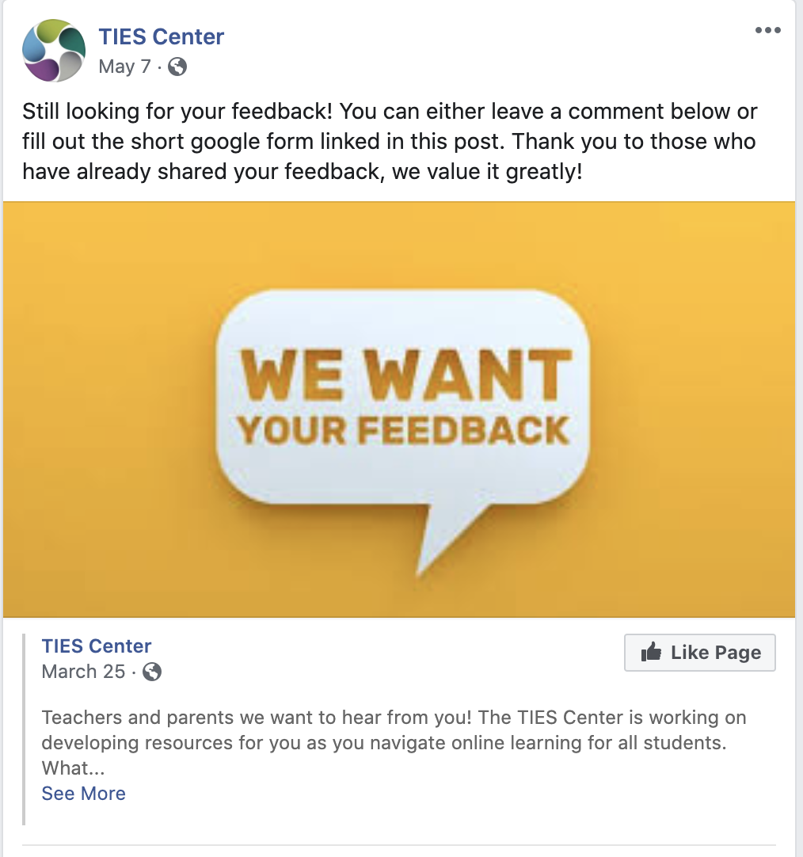
Thank you and a call to further action in support of learning for ALL!
Please share the TIES Center website and resources with colleagues and families. Check out our Facebook page!
Interested in contributing to the inclusive Distance Learning Series for students with significant cognitive disabilities? Please contact: vande002@umn.edu or ghere002@umn.edu

Slide 35
TITLE
TIES Center is supported through a Cooperative Agreement (#H326Y170004) with the Research to Practice Division, Office of Special Education Programs, U.S. Department of Education. Project Officer: Susan Weigert. Opinions expressed herein do not necessarily reflect the position or policy of the U.S. Department of Education.
The National Center on Educational Outcomes (NCEO) leads the TIES Center partnership. There are six additional collaborating partners: Arizona Department of Education, CAST, University of Cincinnati, University of Kentucky, University of North-Carolina–Charlotte, and University of North Carolina–Greensboro.

Slide 36
Emerging Work in Communication for Children Who are Deaf-Blind
Sam Morgan, NCDB
Jane Herder, MoDBTAP

Slide 37
An Early Communication Learning Map for Students Who are Deaf-Blind
ATLAS Center at KU and NCDB are collaborating on the development of a learning map for early communication development
Learning map models are large, fine-grained, and highly interconnected representations of learning in this case for early communication
Represent multiple pathways of learning
Assume that people learn differently

Slide 38
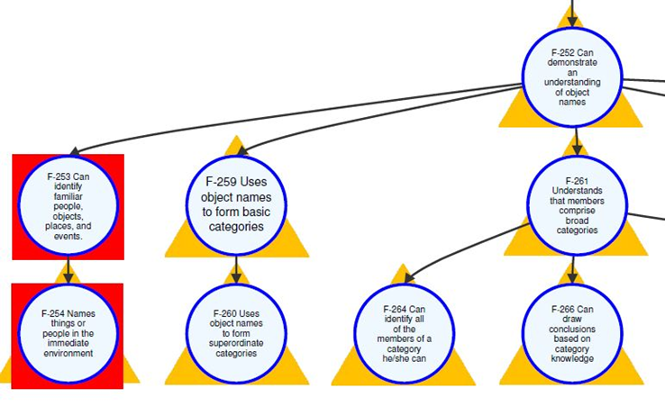
An Example - Early Communication Skills from the Foundational Map
Notes:
Cirdles are nodes which contain knowledge skills and understanding
Connections(arrows) indicate order of acquisition.

Slide 39
Goal, Process, Etc.
Goal - To support teaching, learning, and assessment of communication for deaf-blind students in general education contexts.
Development Process - Literature review, initial map development, expert review panel, map revision, product development
Products - Learning map of early communication, research report, professional development modules and materials to support use
Timelines - Proposed completion September 2022

Slide 40
MoDBTAP’s Usage of Universal Core
Project Core - an intervention designed to build communication in students within a classroom context who do not exhibit any expressive communication
Transient population such as large, urban school district
Transitional students from Missouri School for the Blind to their home schools
In addition to tactile sign during O&M

Slide 41
MoDBTAP
Luke - Using Tactile Connections (APH) tiles and symbols on clipboard
Velcro tiles near classroom door
3D symbols on clipboard
65% 3D symbols on AAC
collaborated with SLP/teacher/O&M
Milo- Velcro box with 3D symbols on top, able to have available at desk, carry to next classroom

Slide 42
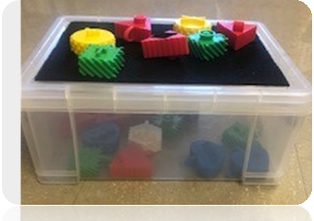
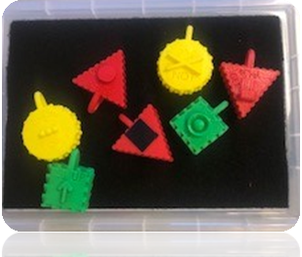
Tactile Symbol Adaptations

Slide 43
Links
APH Tactile Graphic Image Library
Request that 3D files be included
Project Core
The contents of this presentation were developed under a grant from the U.S. Department of Education, #H326T180026. However, those contents do not necessarily represent the policy of the U.S. Department of Education, and you should not assume endorsement by the Federal Government. Project Officer, Susan Weigert.

Slide 44
Supporting Delivery of Intensive Intervention Virtually

Slide 45
Educator Perspective of Virtual Intervention Delivery
Take 1 minute and reflect on these quotes. What stands out to you? Did you hear similar or different reflections?
“I'm enjoying the more one-on-one time with the students because I find you can really tailor every lesson for that specific child rather than a group of three or four because they're still going to be wide ranges within that group. So when you're getting on that Zoom or video chat for 30 minutes, I mean you're hitting that child exactly where they are for 30 minutes and then the next student might be the same topic, but you can expand on it or you can bring it down to a different level. So that's been one of the pluses to this.”
​“I’m reaching out to the families and finding out from them what works, what doesn't work because I think that's really important for us as an EC [Exceptional Children] community; and even finding out from each other. We are a large district, and what works well for people, and let's not recreate things if we can share and collaborate. It is that collaboration and that working together.”
Notes:
Perspectives of special educators from Charlotte-Mecklenburg School District

Slide 46
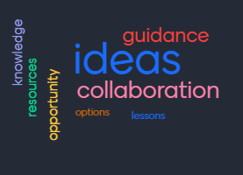
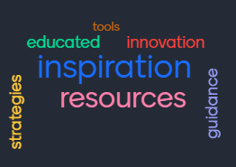
Learning from Educators Doing the Work: Virtual Community of Practice Vision
To inspire educators through collaboration that leads to new and innovative ideas and resources.

Slide 47
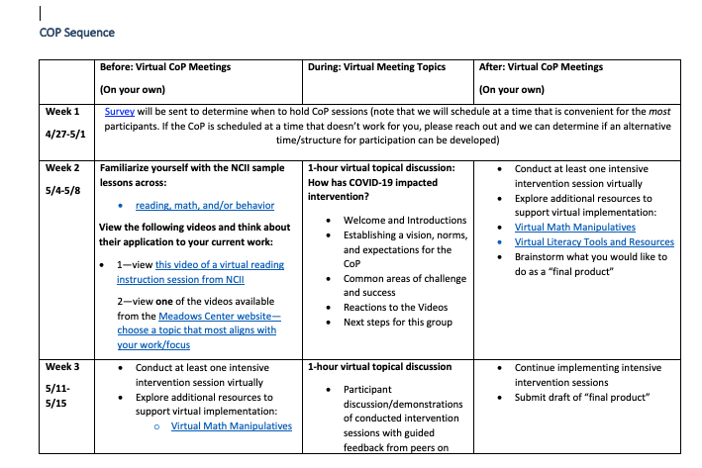
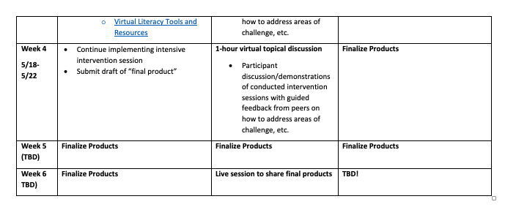
Structure and Objectives
Learn from NCII experts about available tools and resources with application for distance/virtual learning.
Pilot the use of tools and resources.
Share lessons learned with other educators.
Refine implementation.
Support NCII with developing products focused on delivering distance/virtual intensive intervention.

Slide 48
Participants
What did we learn from participants?
General and special educators, district administrators, school administrators, and intervention staff (e.g., dyslexia therapists, speech language pathologists) from intensive technical assistance states including Texas, Rhode Island, Colorado, and Oregon.
In addition, NCII hosted an additional Texas specific CoP with TEA due to high interest from the state.

Slide 49
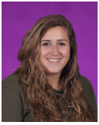
Jackie Perry
Segue Institute for Learning
Central Falls, RI
Highlights of Distance Learning
Importance of relationships with students
Knowing the academic, cultural and home background of students
Realizing that less was more; impossible to keep the same pace as in the classroom
Thinking deeply about standards and skills needed for the next grade; co-teaching model this year helped me see that in a more focused lens
Sticking to a routine was helpful for myself and students (platforms used, missing work doc, live classes, etc.)
Using platforms with data helped me plan for next steps
4 years at Segue as a classroom teacher and a numeracy coach
Taught 6th Grade Math this past year
Masters in ESL and Education (ASTL Program at RIC)

Slide 50
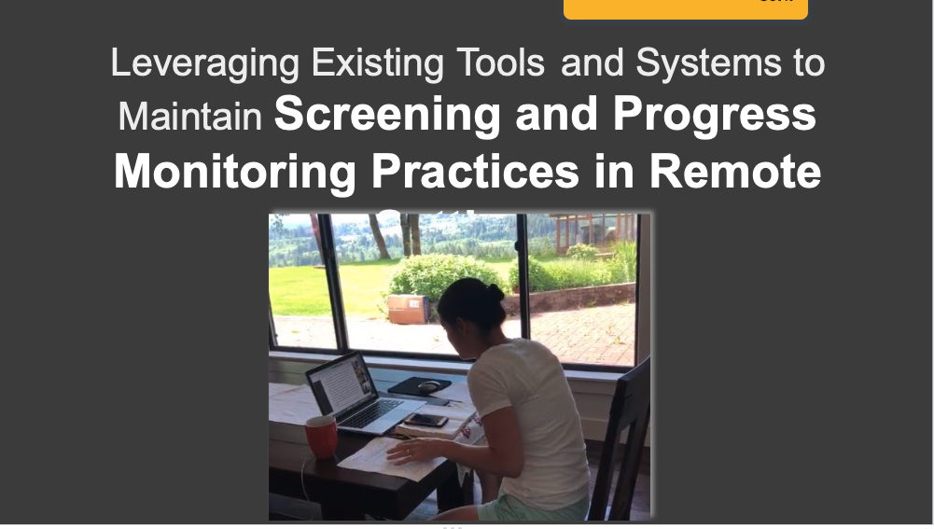
CoP Final (Draft!) Product Examples
Virtual Screening and Progress Monitoring Delivery:

Slide 51
CoP Final (Draft!) Product Examples
Using mathematics manipulatives virtually:

Slide 52
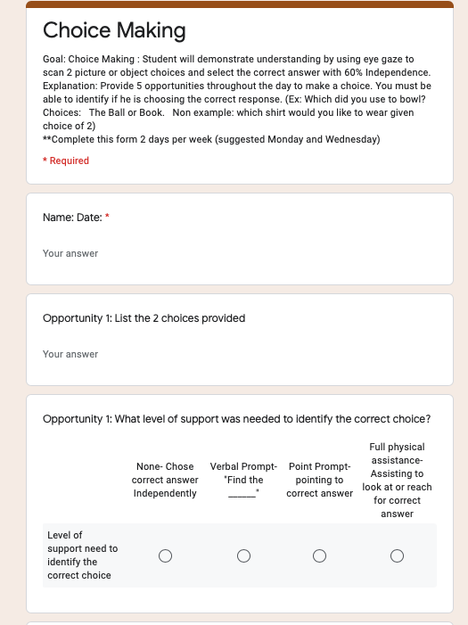
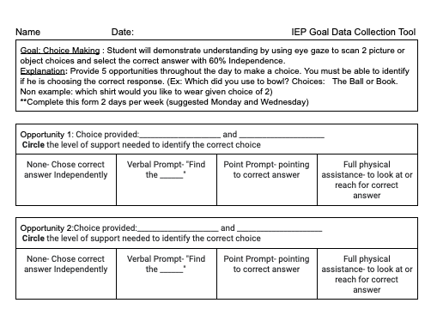
CoP Final (Draft!) Product Examples
Supporting parents with collecting data on IEP goals:

Slide 53
Lessons Learned and Take-Aways
The shift to virtual education was swift and required educators to completely overhaul their approach to intervention delivery with limited planning opportunities.
Creating opportunities for teams to meet virtually and discuss student outcomes were critical
Educators had to move beyond attempts to replicate brick-and-mortar school, which meant giving up some long-standing approaches to instructional delivery and working creatively to reach students.
Some educators indicated that virtual intervention worked better for their students. It is worth looking into this, especially considering what the 2020-2021 school year might entail.
Educators took their creative solutions to virtual instruction and began to plan for fall.
Could video lessons be used on sub days?
Can screening and progress monitoring occur virtually even while students are in the building?
Can virtual collaboration across schools better support students and provide more equitable services?

Slide 54
Next Steps
Finalize teacher developed products for formal release on the NCII website
Develop forum for educators to share their products and lessons learned (e.g., webinar or unconference)
Collaborate with intensive states to replicate community of practice model
Continue to elevate educator stories through the voices from the field pieces

Slide 55
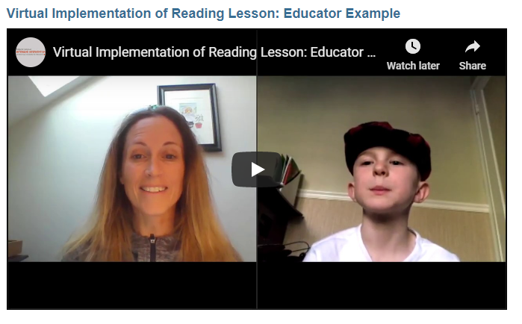
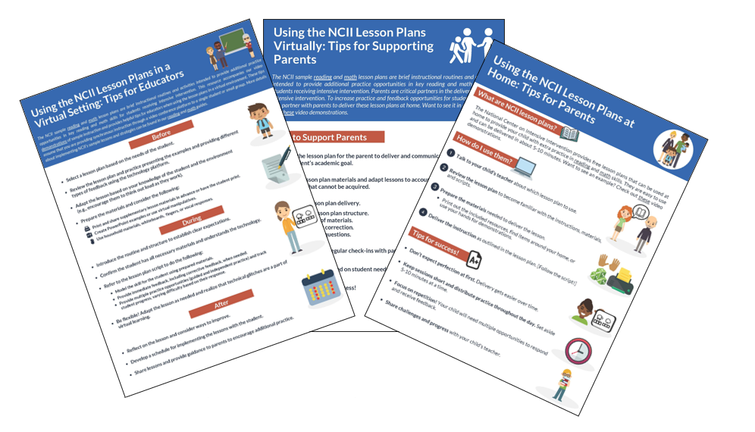
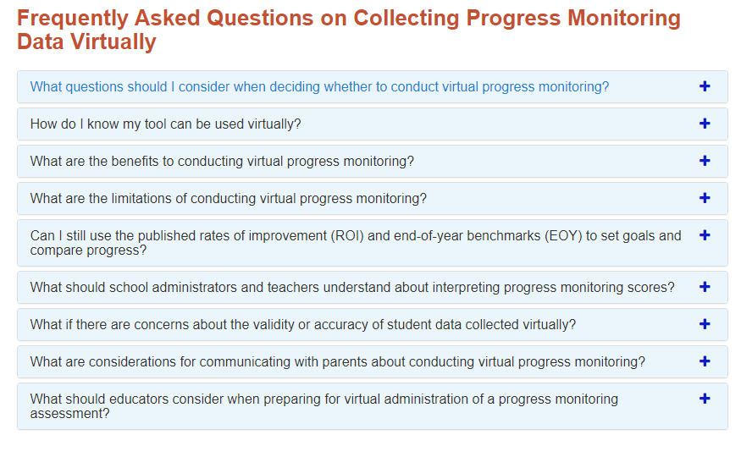
NCII Tools to Support Virtual Intensive Intervention

Slide 56
Questions or COmments

Slide 57
NCII Disclaimer
This presentation was produced under the U.S. Department of Education, Office of Special Education Programs, Award No. H326Q160001. Celia Rosenquist serves as the project officer. The views expressed herein do not necessarily represent the positions or policies of the U.S. Department of Education. No official endorsement by the U.S. Department of Education of any product, commodity, service, or enterprise mentioned in this presentation is intended or should be inferred

Slide 58
Challenges and Strategies
Tell us more about your approach to changes in your TA?
What challenges have you experienced in designing or delivering TA?
What strategies are you using to address these challenges?

Slide 59
Question #4:
In the Q&A Box, please tell us:
What did you like about the format of the meeting?
What could be different for our next call?

Slide 60
Next Steps
Compile the information from polling and Q&A and set agenda for our next call.
Next call with be scheduled for October 2020.
More information will be provided on the development of a TA&D Network Listserv.

Slide 61
Thank you!
Just a reminder how stressful this time is and to remember to provide a lot of self-care.
Remember to contact your Project Officer with any questions
Take some time off – it’s summer!
Stay healthy
Hope that we soon can be together in person…

