Slide 1

Slide 1
Updates from the Office of Elementary and Secondary Education
July 23, 2019

Slide 2

Office of Elementary and Secondary Education
Vision
Excellence and equity for all students
Organizational Statement
To empower States, districts and other organizations to meet the diverse needs of every student by providing leadership, technical assistance and finical support
Core Values
Collaboration, Accountability, Diversity, Integrity and Excellence

Slide 3
Approach
The new OESE, which includes a combined OESE and OII, is focused on providing transparent, timely, high-quality, and differentiated support that recognizes the individual needs of each grantee.
Administer grants in an accurate, timely, thorough manner;
Build mutually beneficial, resilient and trusting relationships with grantees;
Improve efficiency, effectiveness and collaboration for internal operations and external stakeholders; and
Improve dissemination and build capacity related to evidence-based practices.

Slide 4
OESE Organizational Chart
Office of the Assistant Secretary
DAS for Office of Administration
DAS for Office of Discretionary Grants
and Support Services
DAS for Office of Formula Grants
DAS for Office of Evidence-Based Practices and State & Grantee Relations
Migrant Education
Indian Education
Executive
Office
Management Support Office
Safe and Supportive Schools
Impact Aid Program
Rural, Insular, and Native Achievement Programs
Migrant Education
Group 1
Migrant Education
Group 2
Indian Education
Group 1
Indian Education
Group 2
School Support and Accountability
Innovation and Early Learning Programs
Well Rounded Education Programs
Charter School Programs
School Choice and Improvement Programs
Effective Educator Development Programs
Program and Grantee Support Services
Expanding Student Choice & High Quality Schools
High Quality Assessments and Accountability Systems
State and Grantee Relations
Effective Teaching and Social Emotional Learning

Slide 5
Slide 5
Office of Formula Grants
Deputy Assistant Secretary: Ruth Ryder
School Support and Accountability
Director: Patrick Rooney
Safe and Supportive Schools
Director: Paul Kesner
Impact Aid Program
Director: Marilyn Hall
Rural, Insular, and Native Achievement Programs
Director: Jim Butler
Grants to LEAs - Title I-A (84.010A)
State Agency Neglected or Delinquent - Title I-D, Subpart 1 (84.013A)
McKinney-Vento Education of Homeless Children and Youth (84.196A)
21st Century Community Learning Centers - Title IV-B (84.287C)
English Language Acquisition - Title III-A (84.365A)
Supporting Effective Instruction - Title II-A (84.367A)
Competitive Grants for State Assessments - Title I-B competitive (84.368A)
State Assessment Formula Grants - Title I-B (84.369A)
School Climate Transformation SEA (84.184F)
School Climate Transformation LEA (84.184G)
Project Prevent (84.184M)
Grants to States for Emergency Management (84.184Q)
SERV (84.184S)
Title IVA (84.424A)
Social Emotional Learning TA Center (84.424B)
Payments for Federal Property (84.041A)
Payments for Federally Connected Children (84.041B)
Discretionary school construction payments (84.041C)
Consolidated Grant for Insular Areas (84.403A)
Territories and Freely Associated States Education Grant (84.256A)
Republic of Palau Grant (84.256B)
Small Rural School Achievement (84.358A)
Rural and Low Income School (84.358B)
RLIS-SQA (84.358C)
Native Hawaiian (84.362A)
Alaska Native (84.356A)

Slide 6
Slide 6
Office of Migrant Education
Director: Lisa Gillette
Office of Indian Education
Director: Angeline Boulley
Title I, Part C: Migrant Education Program (MEP) (84.011A)
High School Equivalency Program (84.141A)
CIG (84.144F)
College Assistance Migrant Program (84.149A)
Indian Education Formula Grant (84.060A)
Indian Education Demonstration Grant (84.299A)
Indian Education Professional Development (84.299B)
State Tribal Education Partnership Program (84.415A)
Native American Language Grant (84.415B)

Slide 7
Office of Discretionary Grants
Deputy assistant secretary annie hsiao
The Office of Discretionary Grants supports and administers the discretionary grants under the ESEA.
The team will focus on providing subject-matter expertise, monitoring, technical assistance and general administration of the discretionary grants in the ESEA.

Slide 8
State and Grantee Relations and
Evidence-based Practices
Deputy assistant secretary chris rinkus
Among the benefits for grantees is the creation of a new State and Grantee Relations Team dedicated to servicing the relationship between grantees and OESE. This team will provide a consistent point of contact for States and grantees that will help us better understand your context and goals in order to improve our support for your work.
OESE will also add an Evidence-Based Practices Team, with the intention of better integrating the use of evidence into policy, planning, and technical assistance. The Evidence-Based Practices Team will also look to highlight evidence-based practices currently taking place among grantees in the field.

Slide 9
Overview-Disaster Recovery Unit
Purpose
Programs
Emergency Impact Aid for Displaced Students
Support all education stakeholders affected by natural disasters.
Coordinate interagency work to support natural disaster recovery.
Conduct all aspects of grant administration for the existing and future disaster recovery programs for K-12 Schools.
Immediate Aid to Restart School Operations
Assistance for Homeless Children and Youth
Project School Emergency Response to Violence (related to disaster-recovery)
Spearhead disaster recovery work across the Department.
People
Meredith Miller, Director
Molly Budman, Team Leader
Lindsay Booth, Education Program Specialist
Mi Mi Saunders, Education Program Specialist
Christopher Tate, Education Program Specialist
Contact Meredith Miller, DRU Director at meredith.miller@ed.gov for further information.

Slide 10
Comprehensive Center Program Purpose
The Comprehensive Centers program supports the establishment of not less than 20 Comprehensive Centers to provide capacity-building services to State educational agencies (SEAs), regional educational agencies (REAs), local educational agencies (LEAs), and schools that improve educational outcomes for all students, close achievement gaps, and improve the quality of instruction.
Authority: Section 203 of the Educational Technical Assistance Act of 2002 (ETAA) (20 U.S.C. 9601 et seq.).

Slide 11
FY19 Comp Center Competition Overview
Number of Awards: 20
  One National Center and 19 regional centers
Estimated Available Funds for FY19: $52 million; $1,000,000-$6,000,000
General Areas of Assistance:
  ESEA Consolidated State Plan implementation
  Evidence-based programs, practices, and interventions addressing unique educational obstacles faced by rural populations
  Corrective actions or results from audit findings and monitoring that are programmatic in nature
  Best practices and trends identification
Clientele: SEA, LEA, REA, or school staff as designated by the SEA

Slide 12
1% Cap Waiver Update
For SY 2017-18 school year, ED approved 23 state waivers in R/LA and Math and 16 state waivers in Science
  More than half of the states saw a decrease in their participation rate in the AA-AAAS
14 States without waivers received letters about exceeding the 1% threshold on their alternate assessments in the 2017-18 school year. (https://www2.ed.gov/policy/elsec/guid/stateletters/index.html)
  The 1% participation rates are based on EDFacts data submitted to ED by States.

Slide 13
1% Cap Waiver for SY 2018-19
19 States requested waivers for SY 2018-19
  3 of those states were new waiver requests
States that saw the largest decrease in AA-AAAS participation used at least one of these following approaches:
  Identify the target
  Identify the root cause
  Address the root cause

Slide 14
Assessment Peer Review Update
2016: 38 States 2017: 11 States 2018: 42 States
2019: 48 State ELP assessments (April-June); 3 State academic assessments (February); plan for 9 State academic assessments (August)
Four possible outcome categories
  Met Requirements, Substantially Meets Requirements, Partially Meets Requirements, or Does Not Meet Requirements
All outcomes posted at https://www2.ed.gov/admins/lead/account/nclbfinalassess/index.html
Large number of States (25-30) participating in reviews in winter 2020

Slide 15
Assessment Peer Review Status Update- Alternate ELP (AELP) Review
48 states participated in AELP peer review
  32 states submitted evidence of having AELP
  Three states have received feedback but only one is administering the AELP
More work to do in many states around the AELP

Slide 16
Safe and Supportive School Grant Programs
Recompeting Grants
School Climate Transformation Grants-LEA – Applications were due July 22nd (Est. $40 mil; 80 awards)
Project Prevent-LEAs – Applications were due July 15th (Est. $10 mil; 20 awards)
New Grants
Mental Health Demo- Applications due August 5th (Est. $15 mil; 50 awards)
  Program is for LEAs working with IHE or professional organization to increase the pipeline of mental health providers into the schools
Trauma Recovery Demo Program – Applications due August 14th ( Est. $5 mil; 4-10 awards)
  SEA program to support students from low-income families who have experienced trauma that impacts their educational experiences

Slide 17
And …...
  21st Century Community Learning Centers – Presentation on rights of SWD at conference last week
  Migrant – Presentation to HEP and CAMP grantees
  Homeless
  Neglected and Delinquent
  Statewide Family Engagement Centers (12 serving 13 States, many are in PTIs)
  New director of Innovation and Early Learning connected to OSEP
  Safe and Supportive Schools – Looped into implementation of School Safety Report recommendations
  Connecting the DRU to OSERS

Slide 18
Slide 18

Slide 19
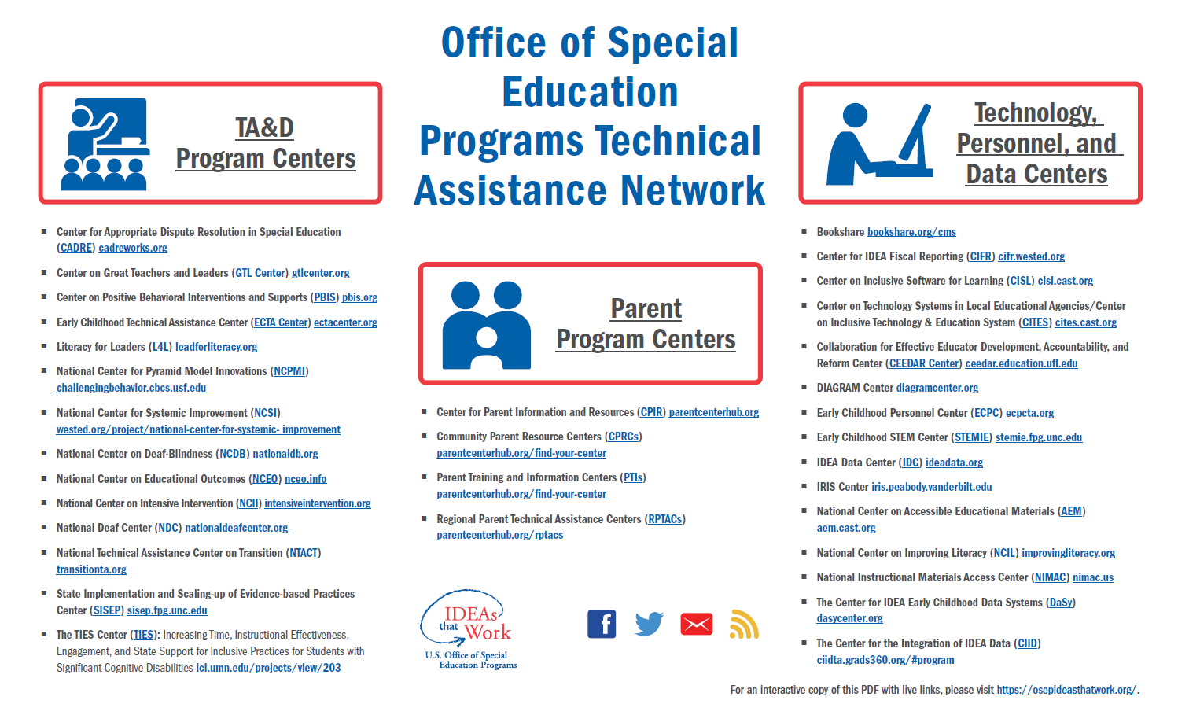
Slide 1
To Download this Infographic: https://osepideasthatwork.org/node/156

Slide 20
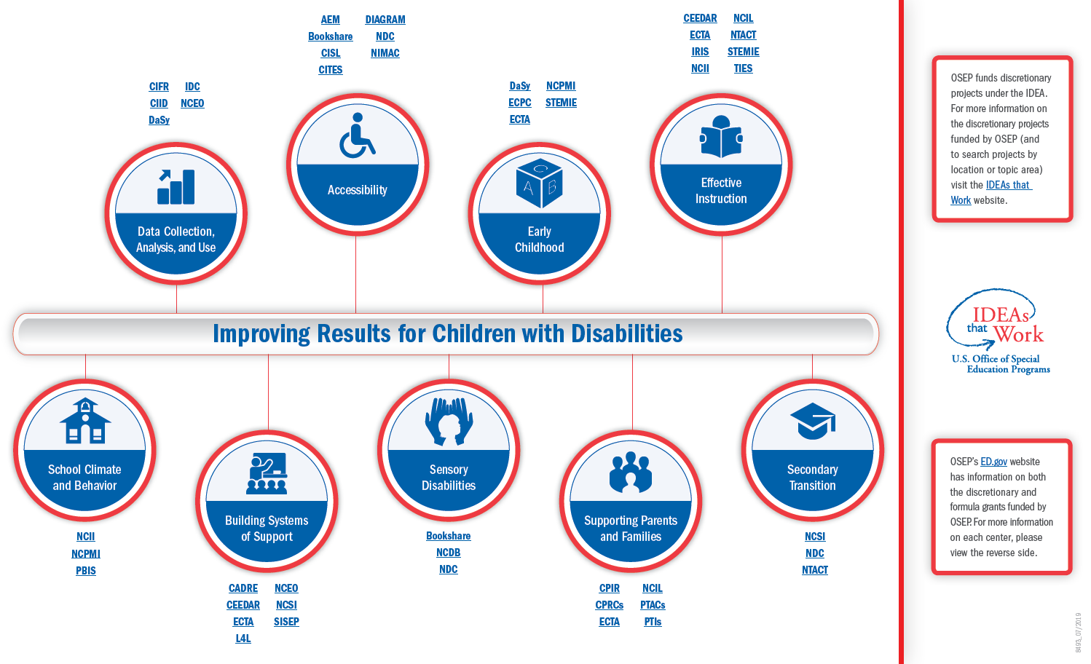
Slide 2
To Download this Infographic: https://osepideasthatwork.org/node/156

Slide 21
Slide 21

Slide 22
Moving Forward
Priorities, Big Ideas, and the Work Ahead

Slide 23
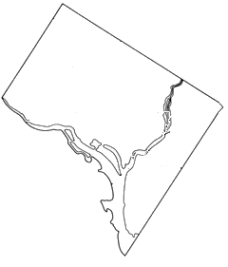

My Journey to OSEP
Parent
Teacher
Administrator
Advocate

Slide 24

Slide 24

Slide 25
Attract, Prepare and Retain
OSEPs emphasis is on amplifying and expanding efforts to Attract, Prepare and Retain effective personnel for ALL
OSEP has a strong history of support for both preservice and in-service preparation and support of teachers, leaders and providers--over 87 million dollars invested in 2019
Symposium Series- 3 part
Literature review and information gathering
Partnering with a variety of stakeholders and organizations
Capitalizing on the great work of our current investments

Slide 26
Attract, Prepare and Retain
Focus Groups
  Early Childhood
  States
  Principal Associations
  Parents
  Organization partners
  And More
Summit 2020

Slide 27

What OSEP is Doing to Reach You
Newsletters
  OSEP Update
  Early Learning
OSERS Blog, Twitter
OSEP Symposia
OSEP Websites
  https://osepideasthatwork.org/
  https://sites.ed.gov/idea/

Slide 28
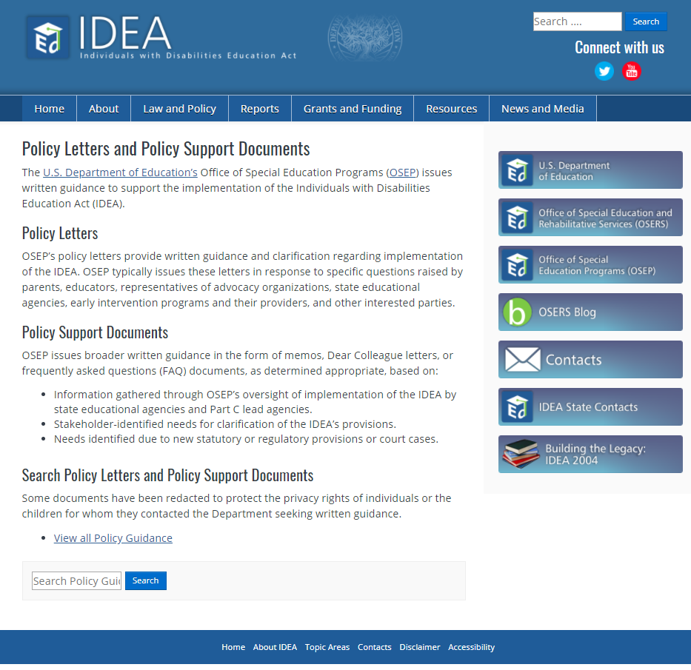
IDEA Website: Search Letters and Documents

Slide 29

Slide 29

Slide 30

OSEP IDEAs That Work

Slide 31

GRADS 360

Slide 32
What Our Centers are Doing to Reach You
Partnerships
  With OSEP and Department of Education-funded Centers
  With Associations (e.g., CEC, CCSSO, NASDSE)
Social media platforms
  Twitter
  Facebook

Slide 33






Centers Working Together to Serve You
Partnerships with other
OSEP Investments
http://www.parentcenterhub.org/

Slide 34


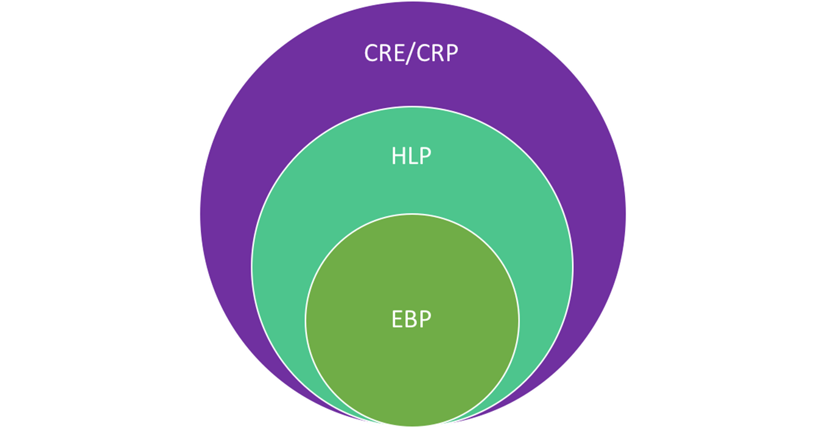


Slide 34
Assessment
Collaboration
Instruction
Social / Emotional / Behavioral

Slide 35
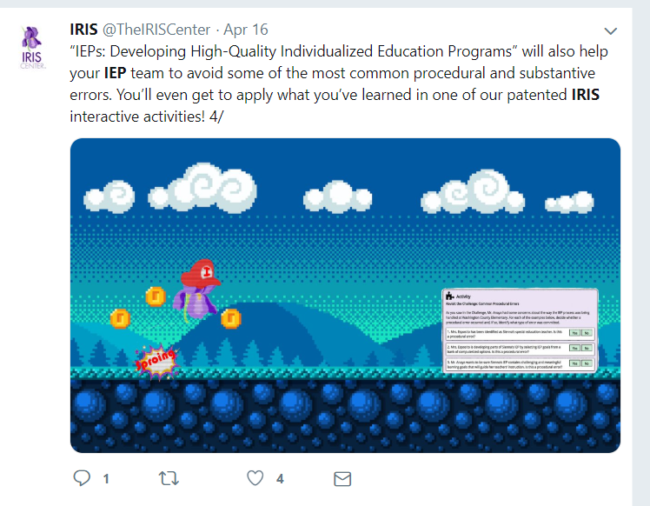
OSEP Center Twitter

Slide 36

OSEP Center Facebook Page

Slide 37
How you can help us…
Provide your feedback about how we can better reach you and the people you serve. You can email Tosha.Edwards@ed.gov with suggestions.
Passing on information/resources, such as HLPs, IRIS modules to LEAS, State Associations, personnel in your State.
    How can we help you pass our resources and messages along?

Slide 38

Slide 38

Slide 39
OSEP
Supports to States and Districts to Improve Results for ALL Students

Slide 40


It’s time to rethink how we’re serving students with disabilities and their families

Slide 41
Framework Circle – PARTNERSHIP Expanded
OSERS
Office of Special Education and Rehabilitative Services U.S. Department of Education
To improve early childhood, educational, and employment outcomes and raise expectations for all people with disabilities, their families, their communities, and the nation.
SUPPORT
OSERS will support
states in their work to raise expectations and improve outcomes for individuals with disabilities
Demonstrate commitment to high expectations for each individual with a disability
Provide differentiated support to states based on their particular needs
Commit to continuous improvement of our systems
to support states
PARTNERSHIP
FLEXIBILITY
RETHINK
OSERS will provide
states flexibility, within the constructs of the law, in implementing their programs
to raise expectations and improve outcomes for individuals
with disabilities
OSERS will partner
with parents and families, and diverse
stakeholders to raise expectations and
improve outcomes for individuals
with disabilities
Value the unique and diverse perspectives and expertise of parents and other stakeholders
Engage with parents and other stakeholders through meaningful and effective collaboration
Learn from individuals with disabilities and those closest to the individual as we
rethink how to best serve them
Acknowledge that states are in the best position to determine implementation
of their programs
Empower states to implement allowable flexibilities and to pursue innovation
Attend to our appropriate federal
role and avoid overreach

Slide 42
Determinations
OSEP is responsive to the feedback that we received during the Rethink listening sessions regarding Determinations. Some comments that we heard from you:
  Changes to the Process: Changes must be thoughtful, and the States should be given adequate time to implement the changes
  Reporting tool: Provide a strict template for reporting to reduce burden
  Data Quality: Must figure out a way to focus on compliance as well as data quality (e.g. concerned about inconsistencies between CSPR data and the data that are imported into GRADS) and improved outcomes.
  Assessment: Concerns with using NAEP data and national comparisons

Slide 43
Determinations
State Team Time and Parent Center listening sessions
Provide input on the proposed changes to how data are used in making the Department’s 2020 Annual Performance Report (APR) Determinations
Areas discusses
  Family Outcomes
  Part B Preschool Outcomes
  SSIP
  Assessment
  Next Steps!

Slide 44
Provide Additional Comments
Please provide additional thoughts and innovative ideas on how OSEP might consider using data in the 2020 Determinations.
Provide feedback by email us at-
OSEPdeterminations@ed.gov

Slide 45
Differentiated Monitoring and Supports (DMS)
OSEP develops a comprehensive plan, individualized for each State, based on a risk assessment rubric that includes:
  Evaluation of the SSIP
  Review of SPP/APR indicators
  Review of State’s fiscal policies, procedures and practices
Next Steps

Slide 46
SPP/APR Renewal
Current SPP/APR expires on August 31, 2020
SPP/APR information collection out for public comment late fall/winter 2019
Approval by August 2020
First submission due February 2022 (FY 2020, SY 2020-21 data)
Extend current SPP by one year to meet stakeholder participation requirements

Slide 47

Slide 47

